Slide 1
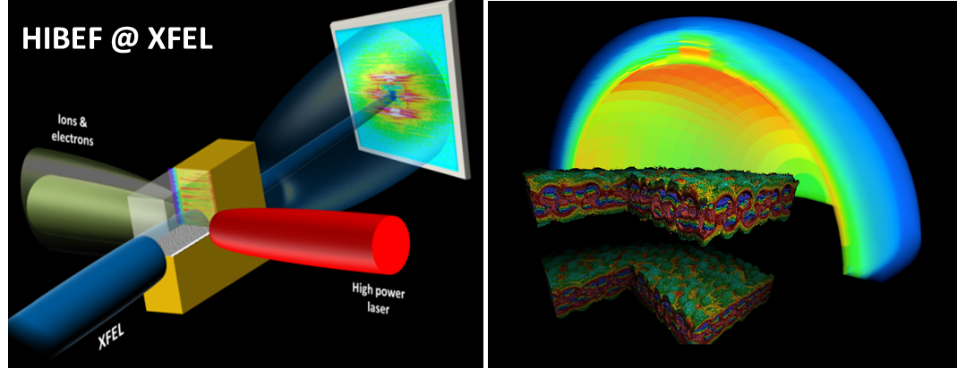





HZDR Laser-Plasma Research Program
T. E. Cowan
¹Helmholtz-Zentrum Dresden-Rossendorf, ²Technische Universität Dresden
and on behalf of the HIBEF User Consortium,
Helmholtz International Beamline for Extreme Fields at the European XFEL
HIBEF TheSiS
SATIF Workshop
HZDR, Dresden, Germany
10.October 2016
Notes:
1

Slide 2
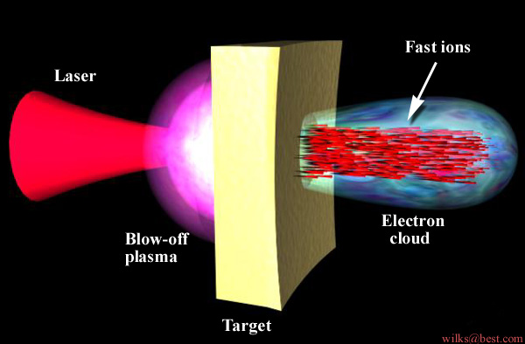
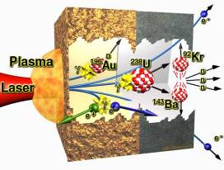
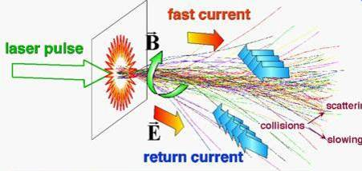
Extreme Conditions driven by Ultra-intense & High-energy Lasers
Extreme particle beams
Extreme pressures
Strong Fields
Extreme currents
Extreme radiations

Slide 3
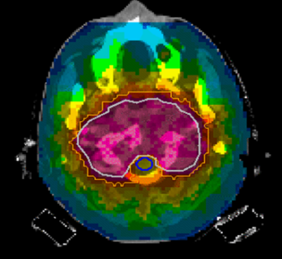
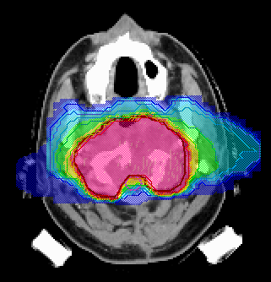
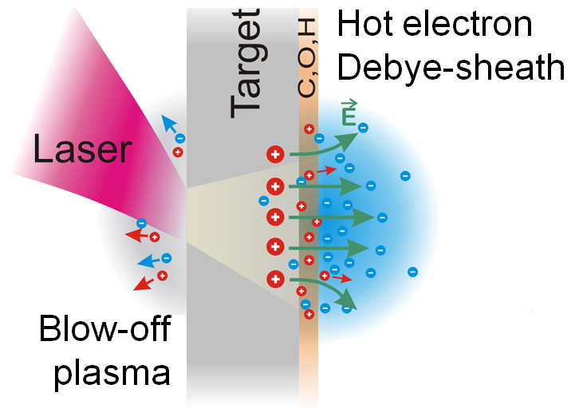
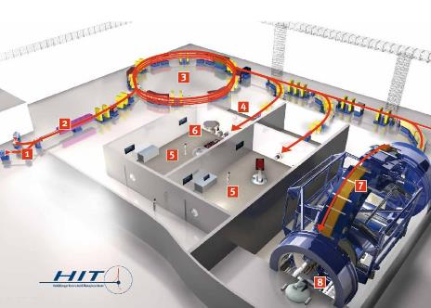
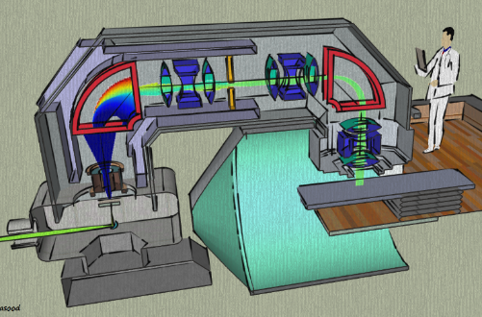
Making proton/ion beam radiation therapy of cancer compact
8 X-Ray Beams
2 Ion Beams
Effective Dose (%)
0 20 40 60 80 100
Notes:
3

Slide 4
contents
HZDR overview
Laser ion acceleration
Radiation Oncology
Helmholtz International Beamline for Extreme Fields (HIBEF) at European XFEL

Slide 5

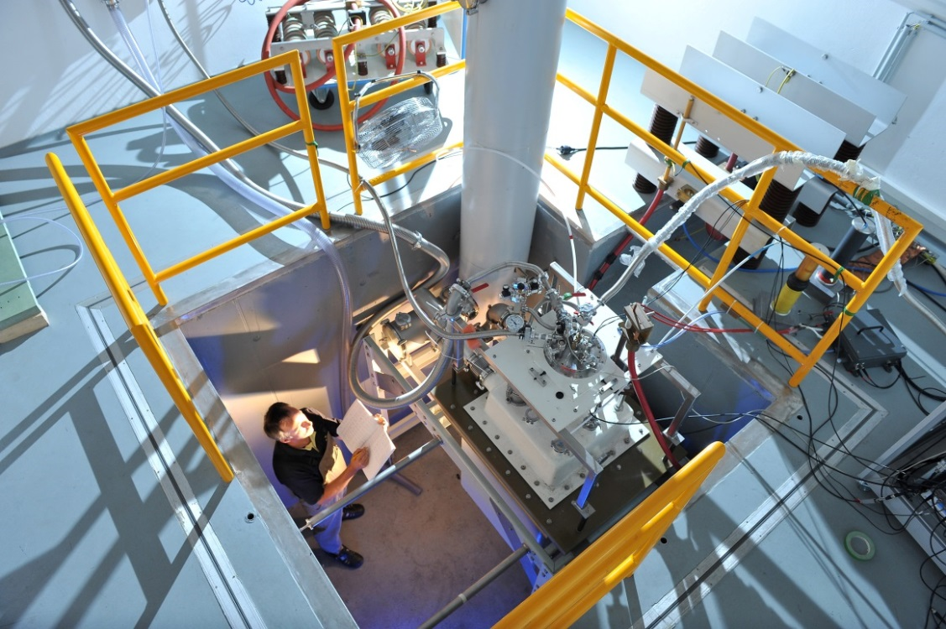


Helmholtz-Zentrum Dresden-Rossendorf
Research for the World of Tomorrow
ENERGY
HEALTH
MATTER

Slide 6

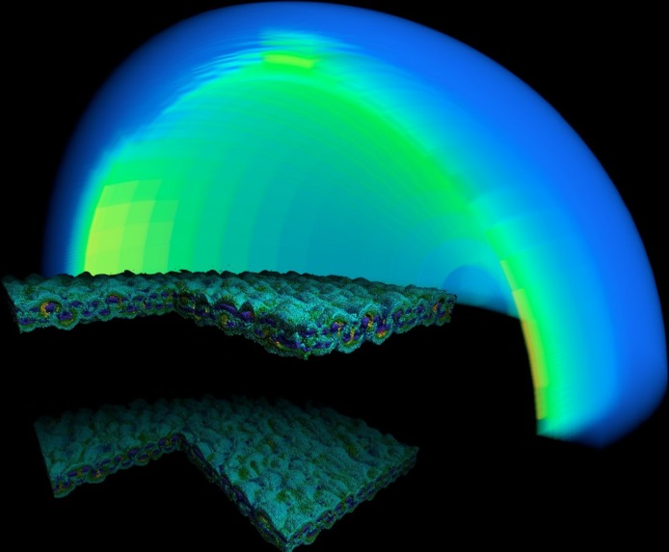
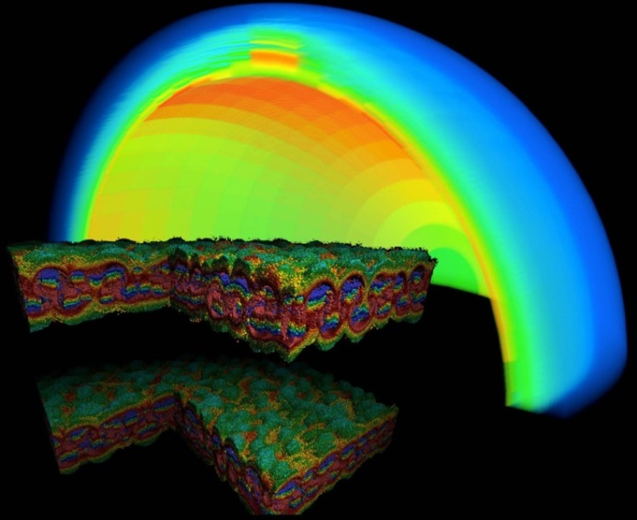

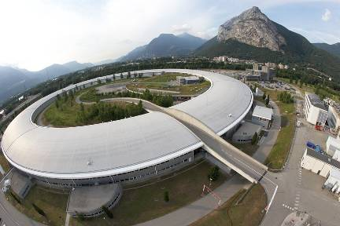
HZDR ProfilE
Member of Helmholtz Association 2011
DRESDEN
Grenoble, Freiberg, Leipzig
Base Budget 99,6 Mio. €/y
8 Institutes
8 Young Investigator Groups
Established 1992

Slide 7
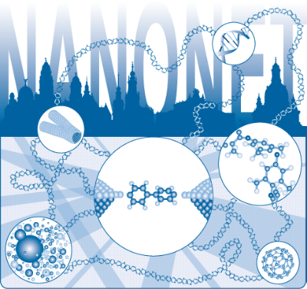
HZDR STAFF
Employees ~ 1,100
Scientists 300
Postdocs 89
Professors 25
Joint appointments 19
Scientific Guests from more than 50 countries
PhD Students 140
Engineers, Technicians 200
International Helmholtz Research School NanoNet

Slide 8
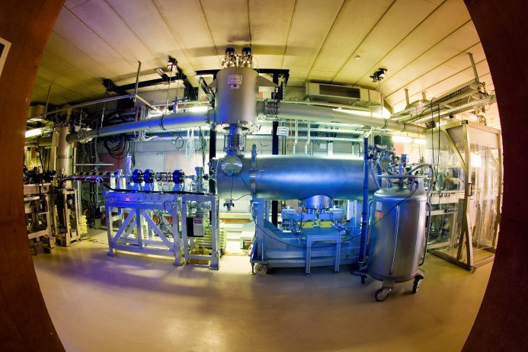
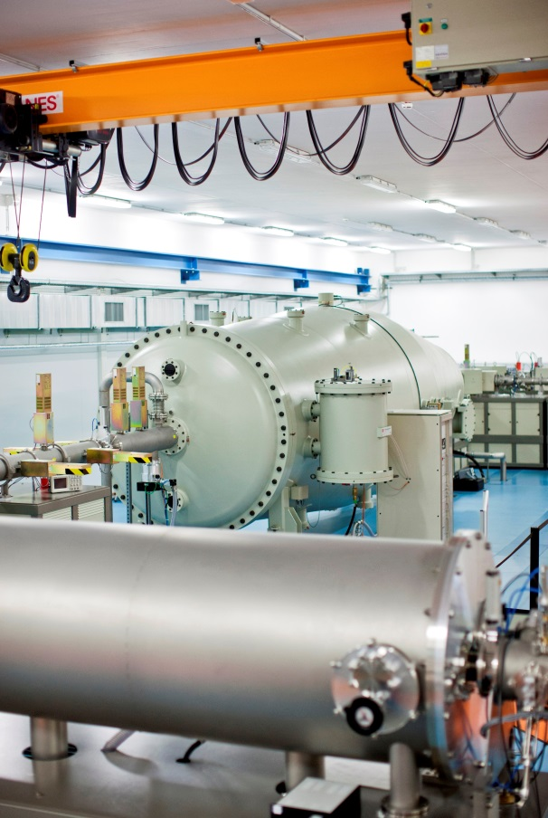


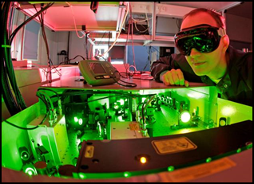
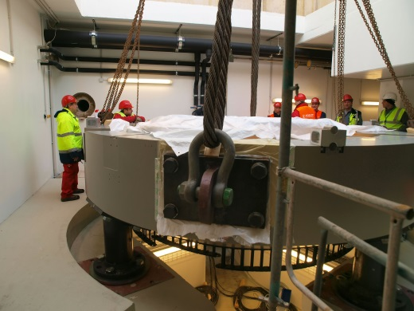



HZDR FACILITIES
DRACO & PENELOPE
and
PET Center
User Facilities

Slide 9
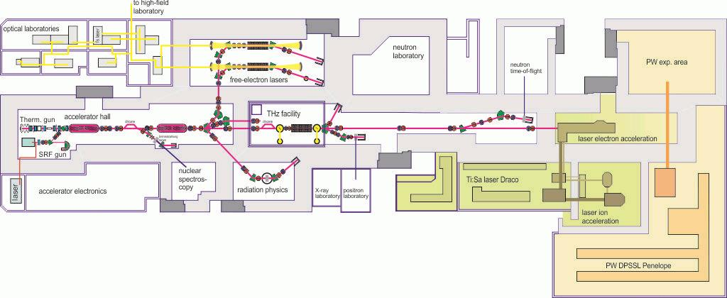
HZDR High Intensity Lasers
DRACO: Ti:Sapphire Laser
Dual beam performance:
150 TW, 4.5 J in 30 fs, high contrast, 10 Hz
1 PW, 30 J in 30 fs, 1Hz
DRACO & PENELOPE
PENELOPE: Diode pumped PW Laser about 150 J in 150 fs, 1 Hz

Slide 10
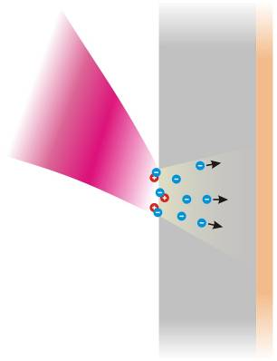
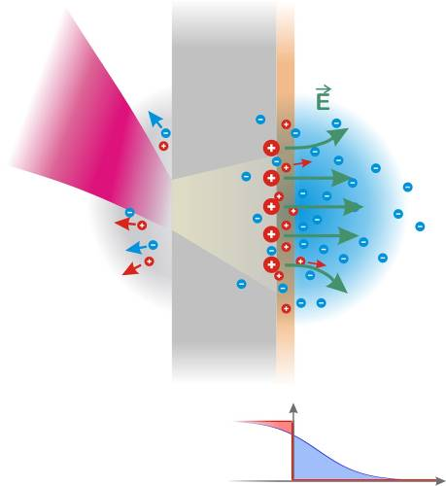
Ion acceleration – TNSA regime
electron acceleration
foil
laser
hot (MeV) electrons
penetrate the (µm) foil
quasi-static field forms
normal to target surface
source size > laser spot
N_{e,hot}

Slide 11
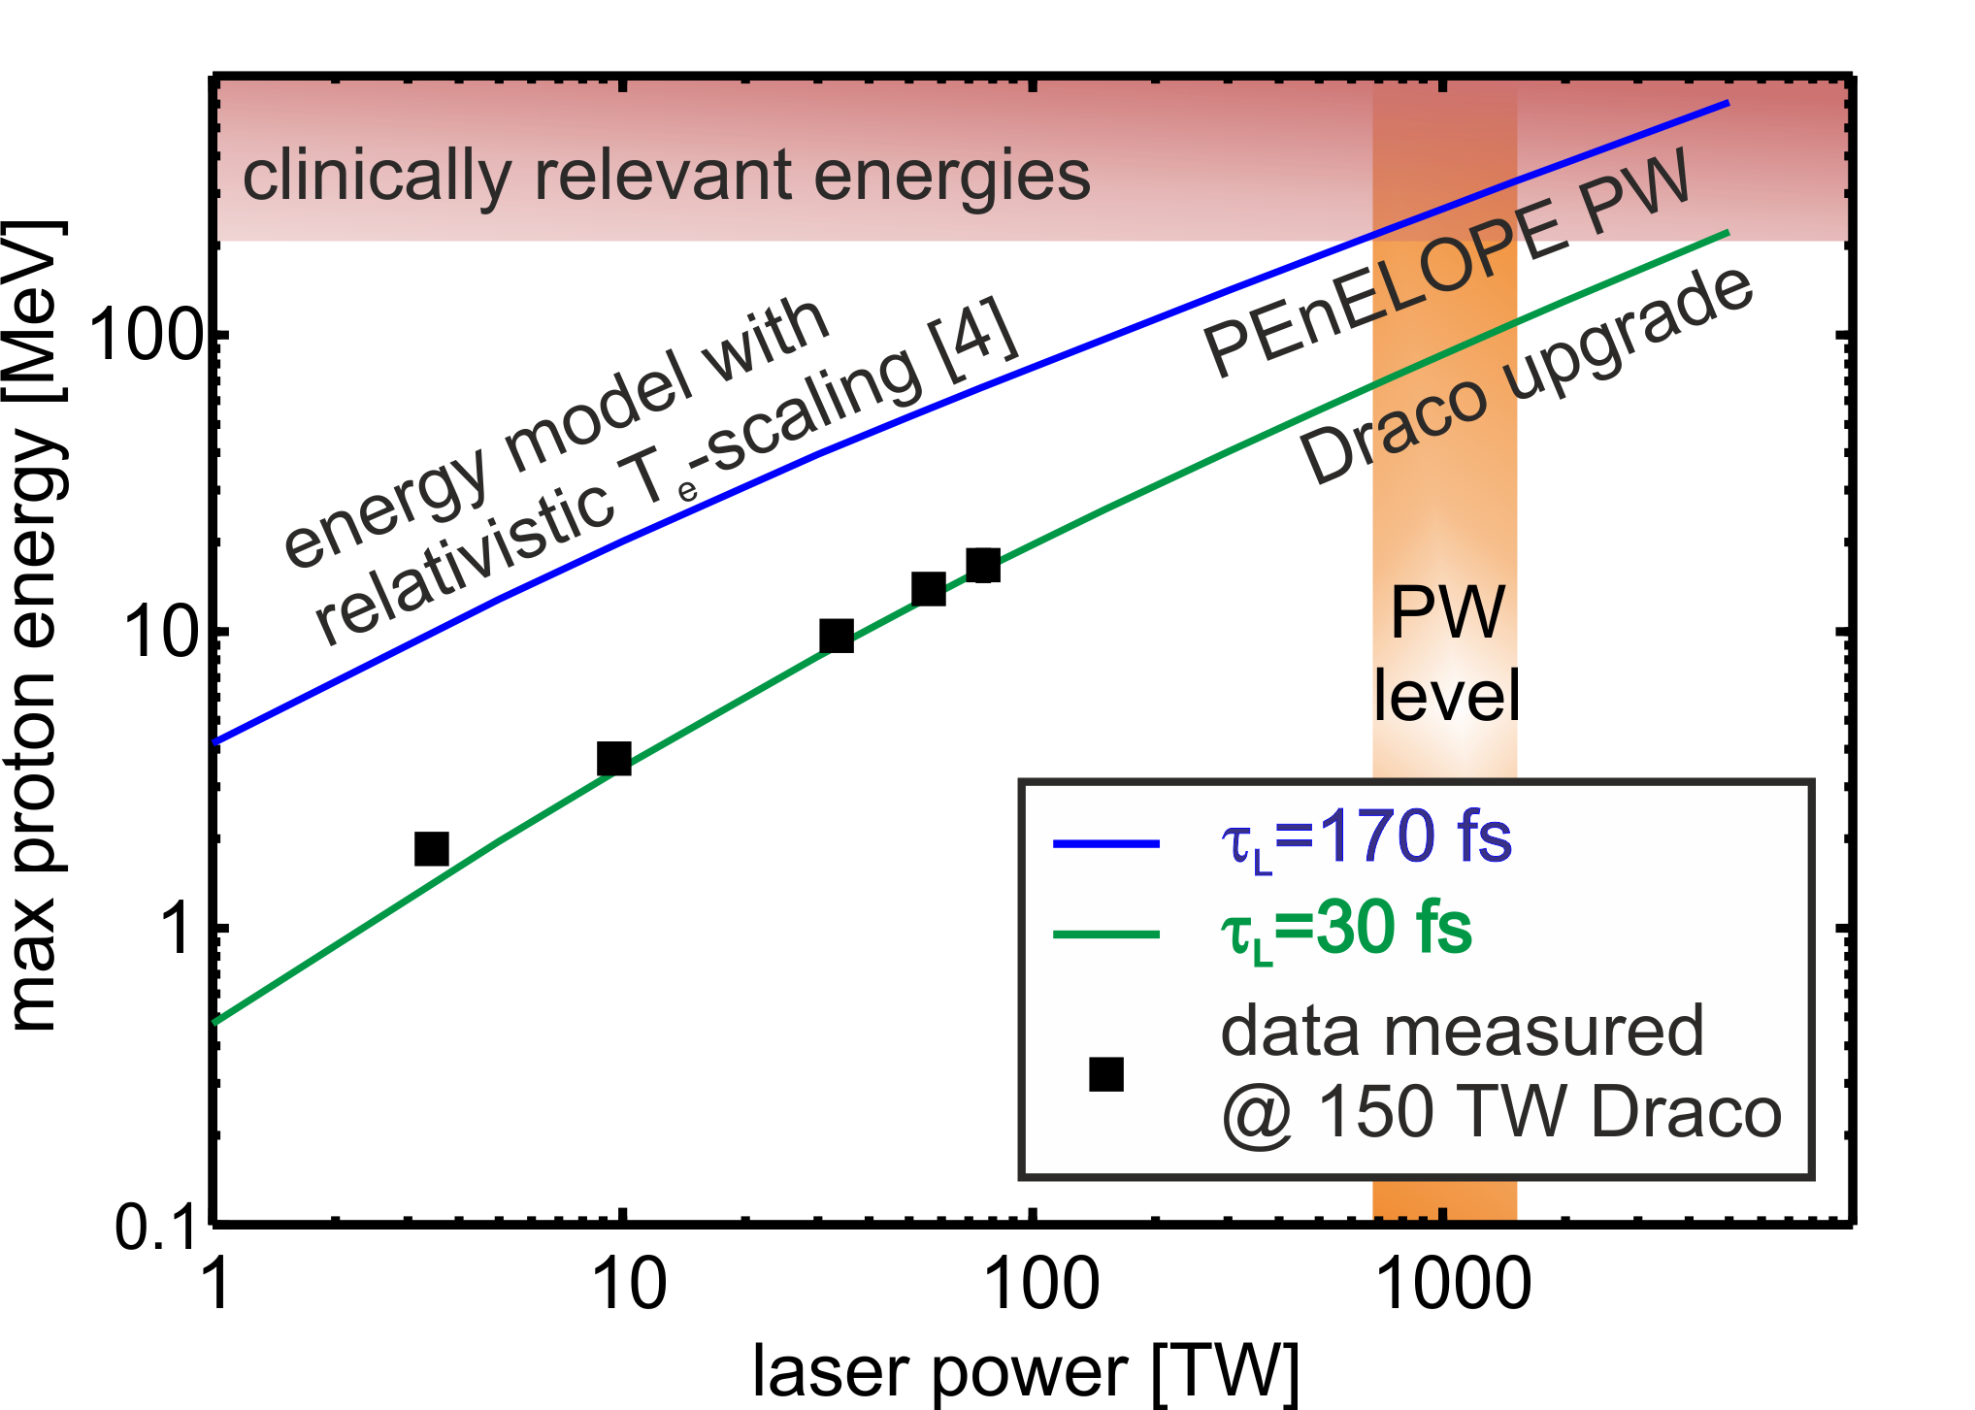
TNSA regime – Proton energy scaling
*
*T. Kluge et al., PRL 107 (2011), 205003
K. Zeil et al., NJP 12, 045015 (2010) updated 10/2015

Slide 12

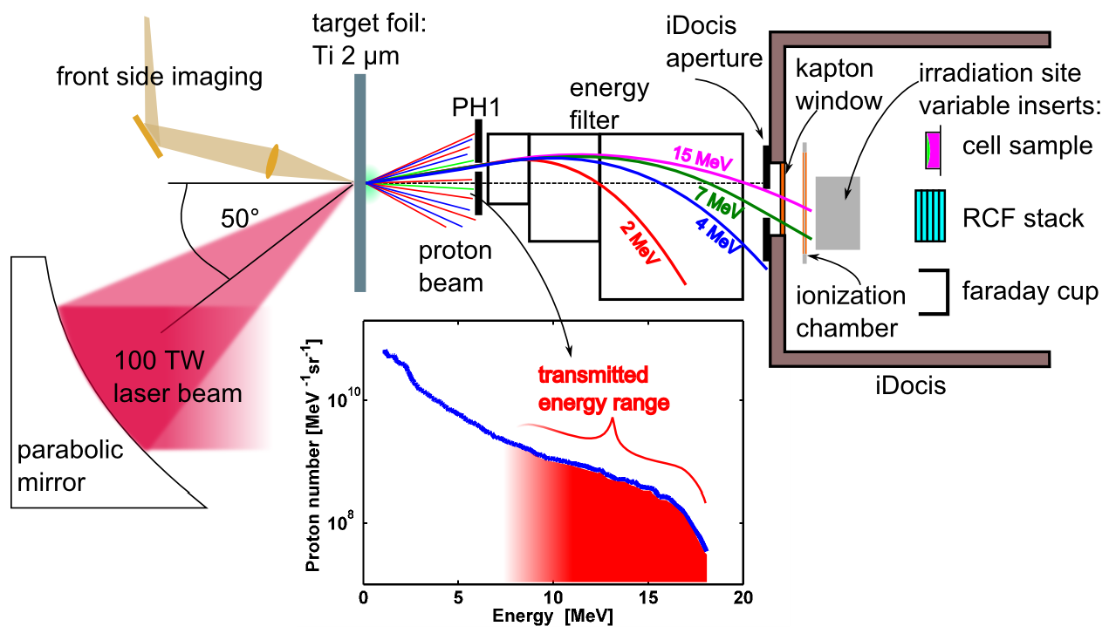
Dose dependent cell irradiation
integrated
Dosimetry and
cell irradiation
system
Provision of sufficiently energetic proton pulses
Establishment of dosimetry protocol, online and absolute dosimetry

Slide 13
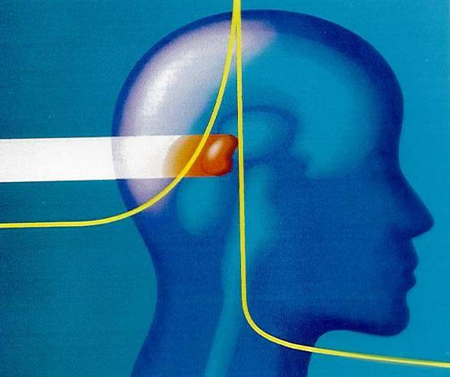
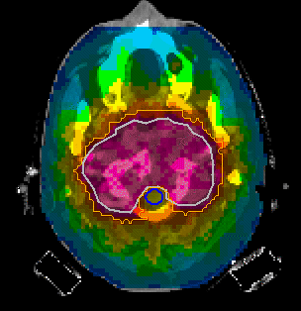
Motivation (ion beam cancer treatment)
Localized dose deposition allows for precise tumor treatment
Photon irradiation
(9 fields)
¹²C-ion irradiation
(2 portals)
© GSI
[courtesy O. Jäkel, DKFZ]
U. Schramm, HZDR

Slide 14
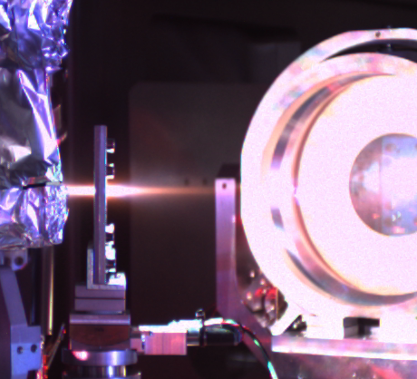
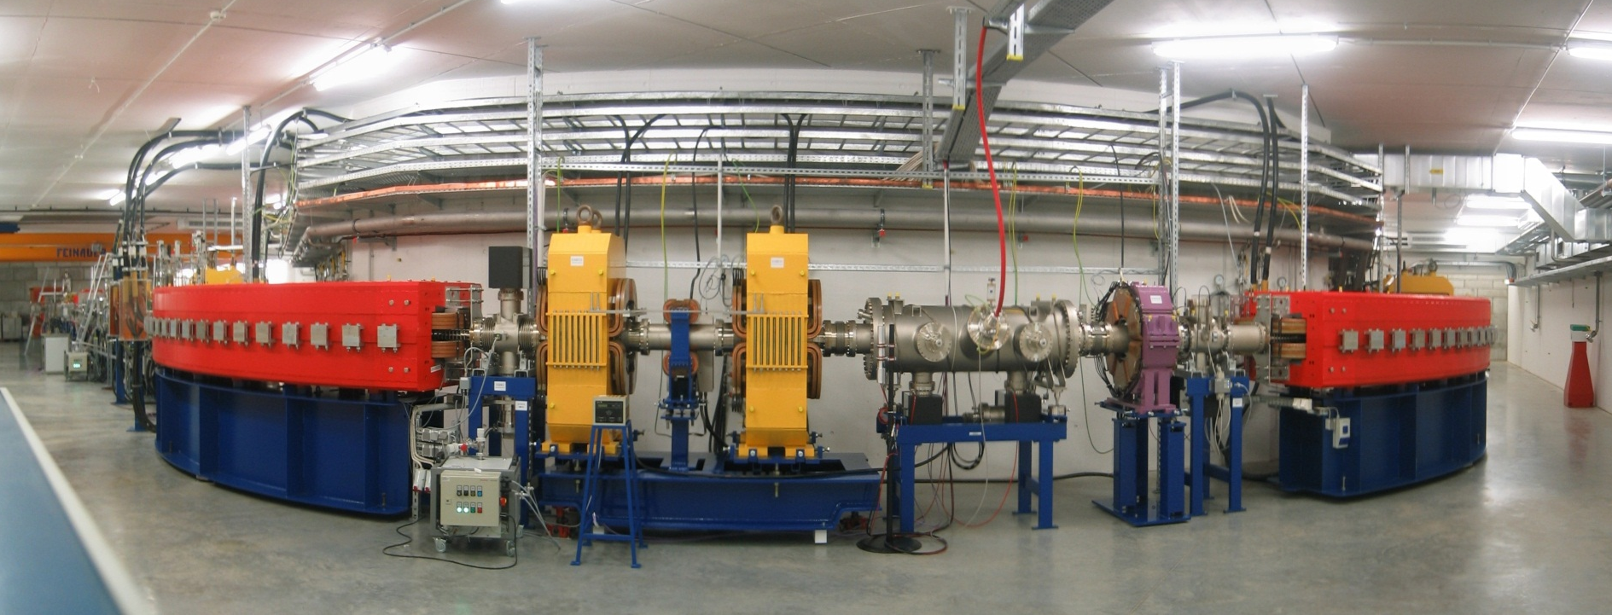
Motivation (ion beam cancer treatment)
Localized dose deposition allows for precise tumor treatment
Compact laser plasma acceleration for wider spread
[HIT Heidelberg]
U. Schramm, HZDR

Slide 15
Translational Research - Concept
Laser driven dose delivery system
Clinical practice
well controlled laser proton accelerator
precise and safe beam delivery
spatial & spectral shaping
Clinical trials
absolute real-time dosimetry
In vivo – animals (3D)
laser development
In vitro – cells (2D)
proton energy generation
basic research
high pulse dose rate
biological effectiveness RBE
efficient spectral distribution
Laser-plasma acceleration
U. Schramm, HZDR
Notes:
Development of technical components – radiobiology is of cause equally important → überleitung zur nächsten
Energy increase no matter with which mechanism

Slide 16
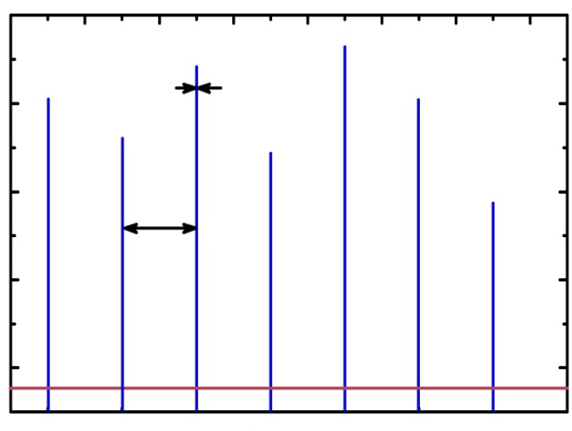
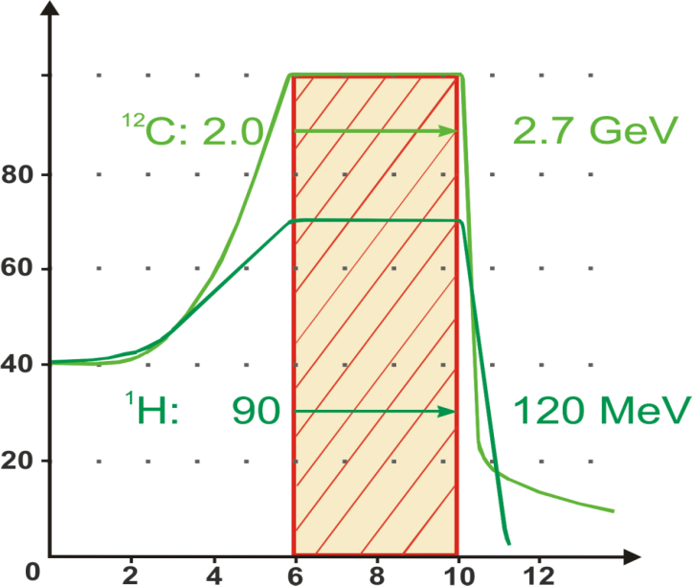
Translational Research - Concept
Laser driven dose delivery system
Clinical practice
~1ns
~10⁸ Gy / min
Proton number
10s
Clinical trials
~ Gy / min
Time
In vivo – animals (3D)
Energies
In vitro – cells (2D)
relative dose [%]
basic research
high pulse dose rate
biological effectiveness RBE
depth in water [cm]
U. Schramm, HZDR
Notes:
Development of technical components – radiobiology is of cause equally important → überleitung zur nächsten
Energy increase no matter with which mechanism

Slide 17
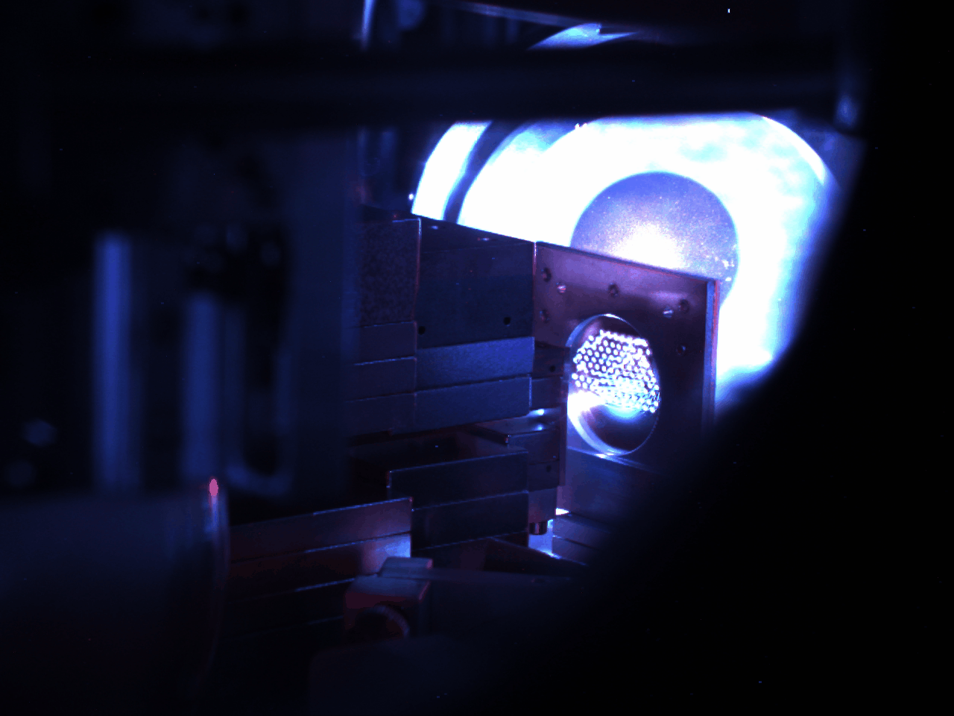
Proton spectra – average dose
Proton energies > 5 MeV
Dose rates of Gy/min
between 0.1 and 10 Gy
(pulse dose / stability /
average dose rate)
Currently limiting the average dose rate as shot rate limited to 1/10s
(can be solved)
U. Schramm, HZDR

Slide 18
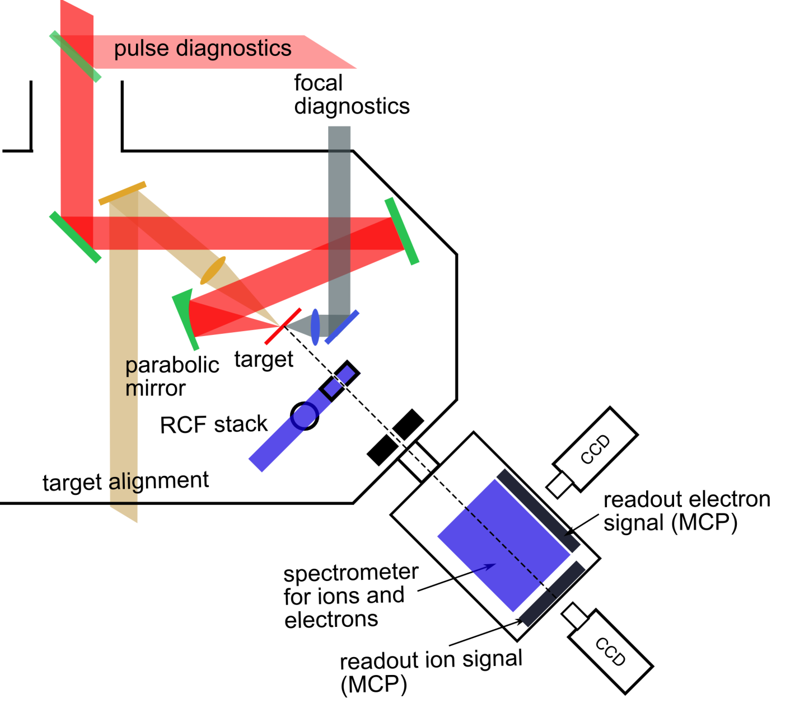

Sample irradiation and dosimetry
Proton energies > 5 MeV
Dose rates of Gy/min
between 0.1 and 10 Gy
(pulse dose / stability)
Energy filtering / transport
(radiation protection)
Dipole filter
Online and absolute offline
dosimetry
Transmission
ionization
chamber
Homogeneous irradiation
Sample size ~ cm²
integrated
Dosimetry and
cell irradiation
system (Faraday-cup, RCFstacks, cell samples)
Cell irradiation in air
U. Schramm, HZDR

Slide 19
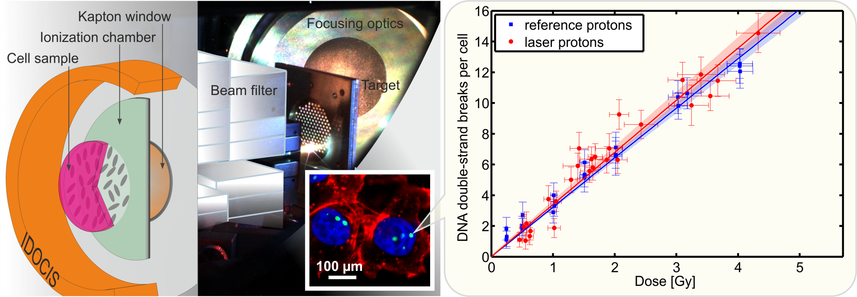

Cell irradiation experiment – final results
Direct comparison of laser driven and conventionally accelerated protons
No difference between both radiation types for the used SKX cell-line
  → no influence of time structure / pulse dose rate (cf. other groups)
K. Zeil et. al., Applied Physics B 110 (2013), 437
U. Schramm, HZDR

Slide 20
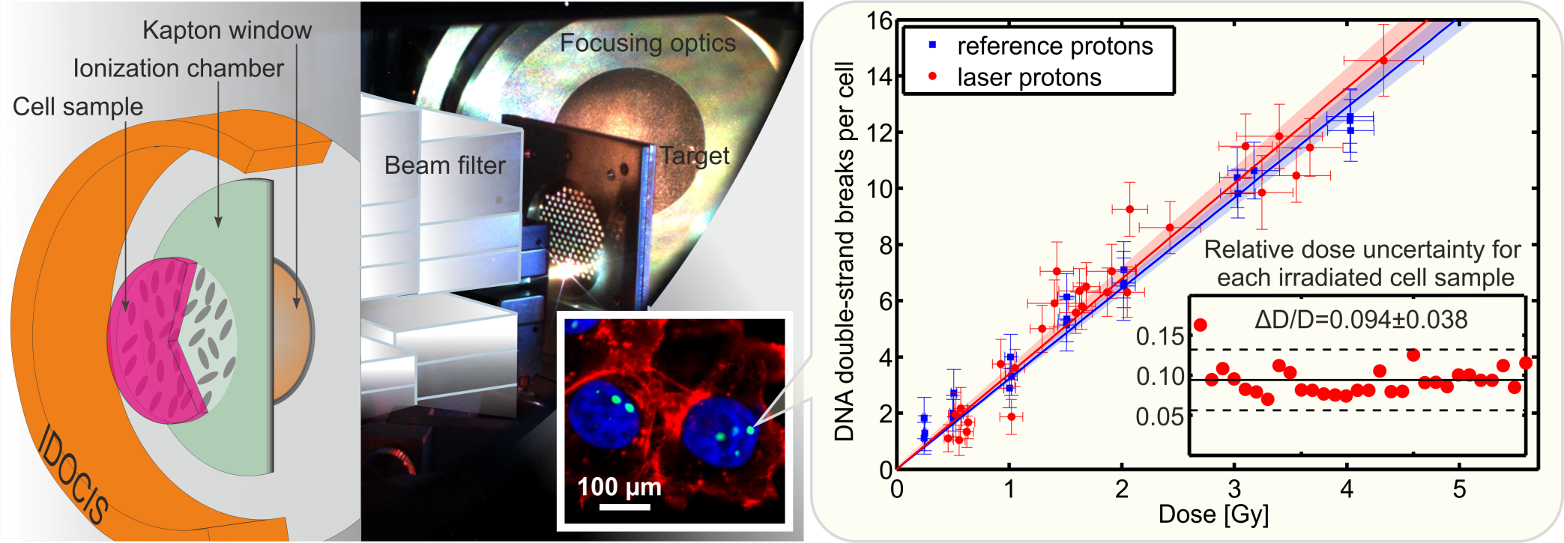
Cell irradiation – dose errors
Translational aspect – Scalability to radio-therapy:
  Dose controlled irradiation (over 4000 shots)
  Relative error below 10% → clinical precision standard (3-5%) within reach
  Importance of laser repetition rate for average dose (taking care of cell repair)
  No aim for reaching non-linear behaviour due to particle flux, structure of pulse
  train may be of interest (more studies with different cell lines)
U. Schramm, HZDR
Notes:
Dose controlled: applying dose and measure dose
Zitat christian

Slide 21
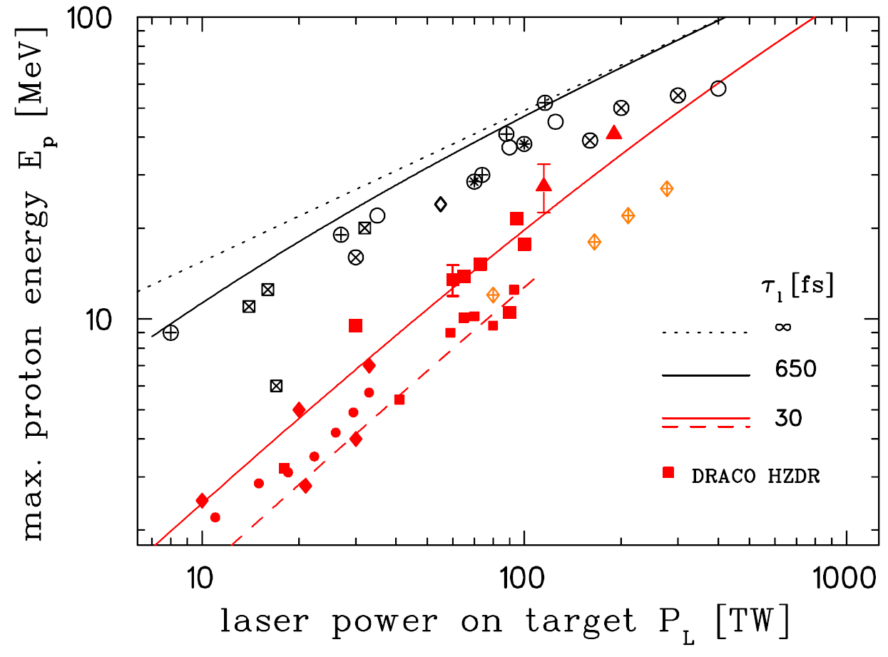
TNSA – proton energy power scaling
maximum energies @ linear laser polarization
PW class
K. Zeil, et al, NJP 12, 045015 (2010) updated NIM 10/2015

Slide 22
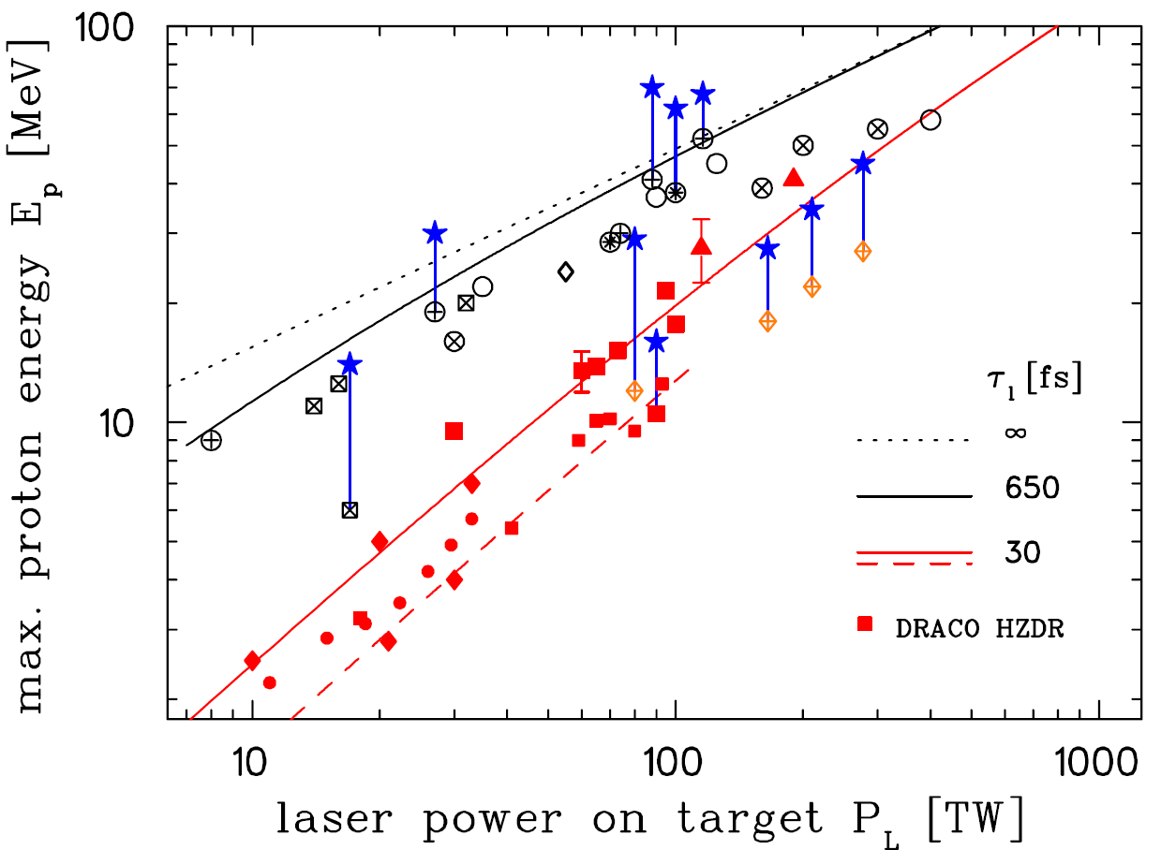
TNSA – proton energy power scaling
Enhanced performance with
dedicated targets (hollow cones,
RMTs, foam coating, ultra-thin)
volume interaction (relativistic
transparency, BOA, …)
K. Zeil, et al, NJP 12, 045015 (2010) updated NIM 10/2015

Slide 23
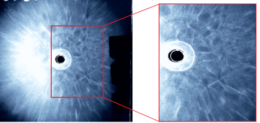
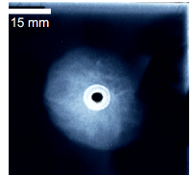
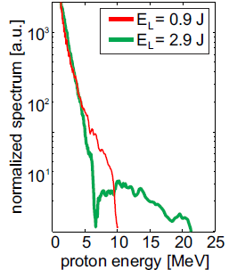
TNSA – impact of electron dynamics
Ion beam break-up at high intensities
2 μm titanium
Proton beam profiles (TNSA)
J. Metzkes, et al., NJP 16, 023008 (2014) (TNSA only)

Slide 24
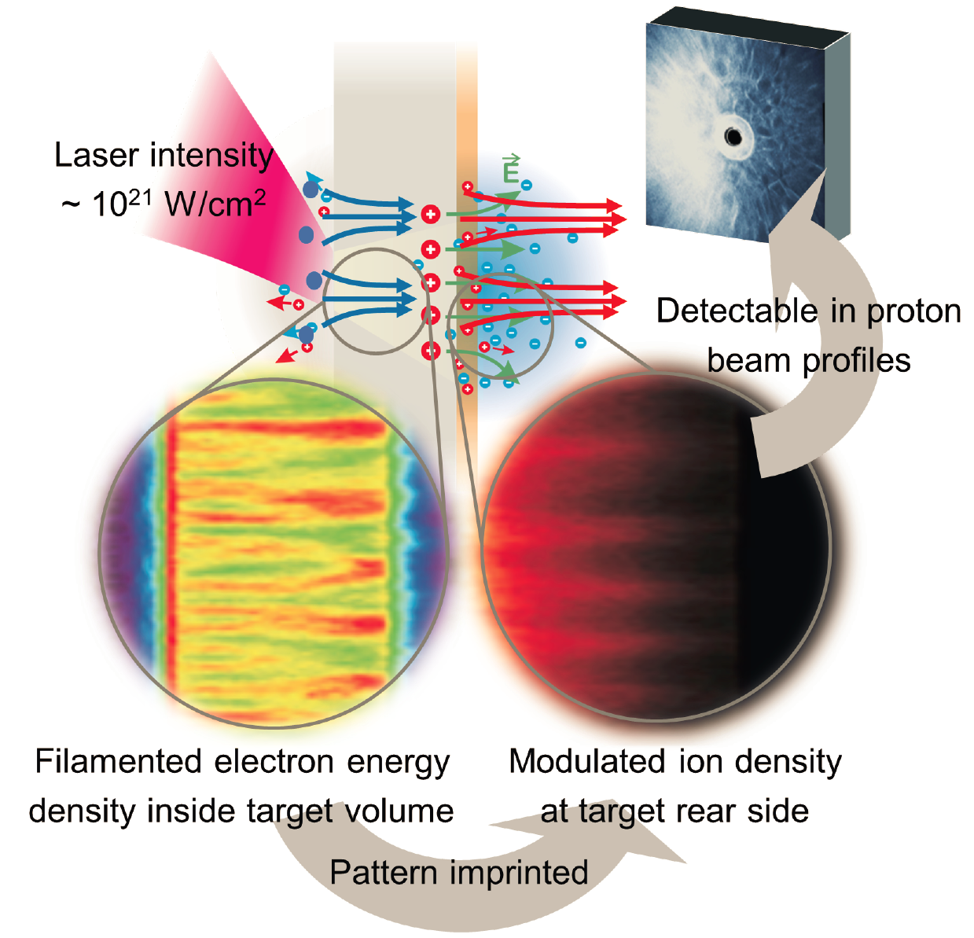
TNSA – impact of electron dynamics

Slide 25
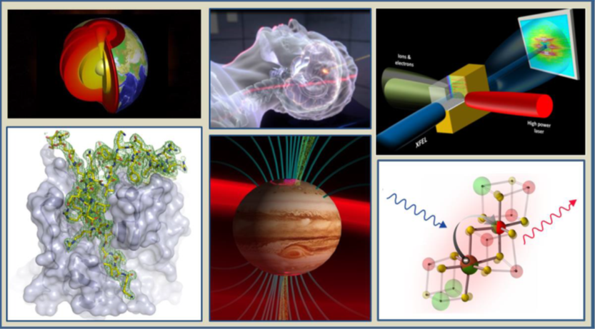
Helmholtz International Beamline (HIB) at the European XFEL
Worldwide unique opportunities
for new scientific discovery in research on matter under extreme condi- tions, plasma, planetary and strong-field physics, high-field magnetism, ultrafast chemistry, and structural biology.
User Consortia
> 130 institutions from 23 countries, first bindung financial commitments, for example from UK (8 M€)
close connections to other large European research infrastructures, e. g. ELI
Budget: 47,5 M€
Realization: 2016-2020ff

Slide 26
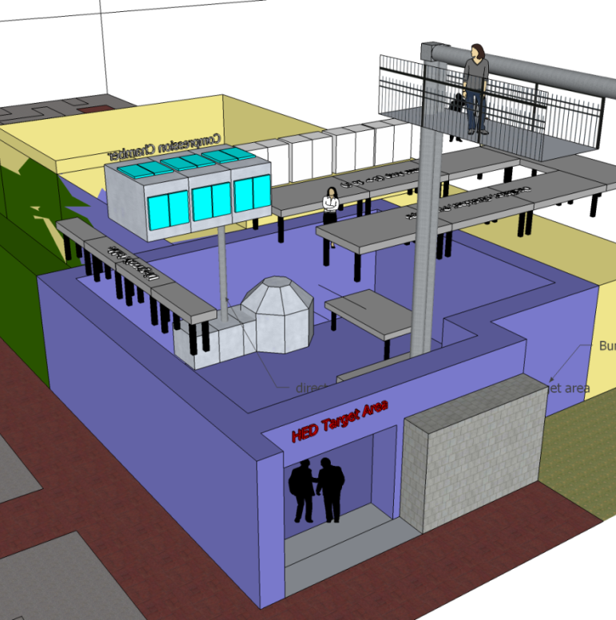
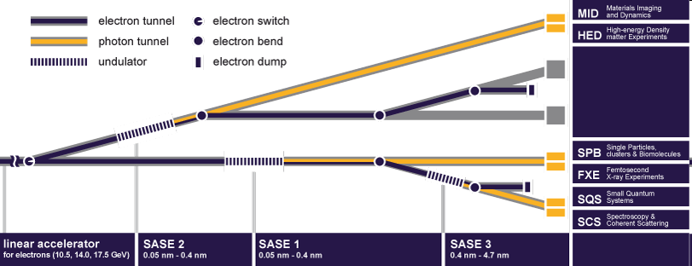
Helmholtz Intl Beamline for Extreme Fields (HIBEF)
Phase 1 (2018 - )
100 TW Ti:Sa (3 J, 30 fs, 10 Hz)
(250 TW, 7.5 J, 5 Hz)
100 J ns-pulse (2-10 ns, 10 Hz) shaped
diode pumped (DIPOLE, UK)
1 MJ magnet pulser (60 T, 1 ms)
Radiation shielded lab

Slide 27
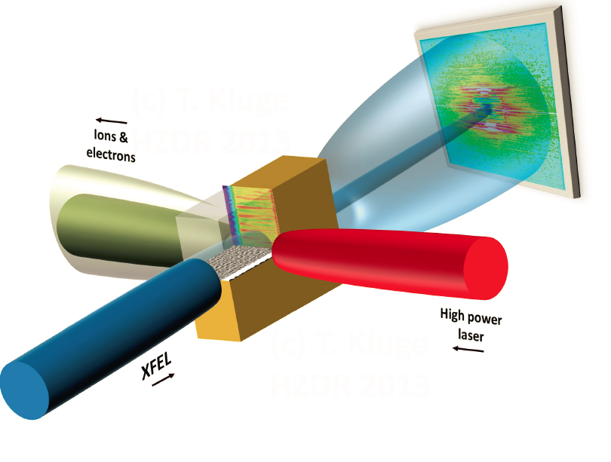
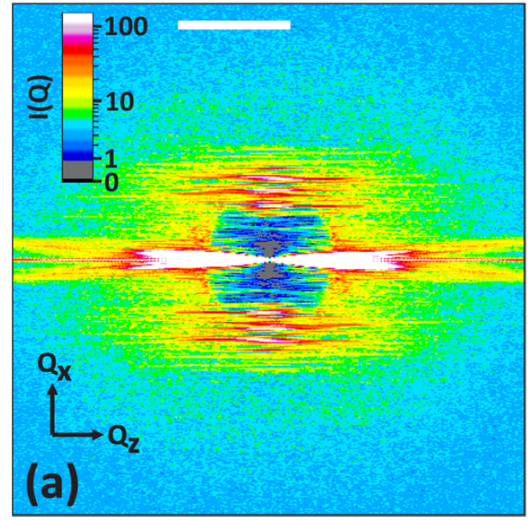
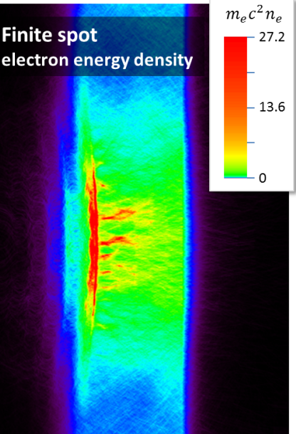
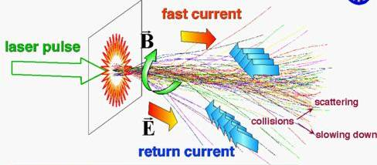
Relativistic plasma instabilities important at highest laser intensity (medical-relevant ion energies) → HIBEF
Phys. Plasmas 21, 033110 (2014)
Phys. Plasmas 23, 033103 (2016)
0.1 nm⁻¹
Predicted SAXS (10¹⁰ ph, 8 keV)
ionization dynamics, heating & resistivity
electron transport, return current neutralization
filamentation, hole boring
e-e & e-i equilibration
quasi-static fields
....
Laser
10¹³ A/cm², > 1000 T, 10¹³ V/m, ~keV solid density
See talk OA4-02

Slide 28
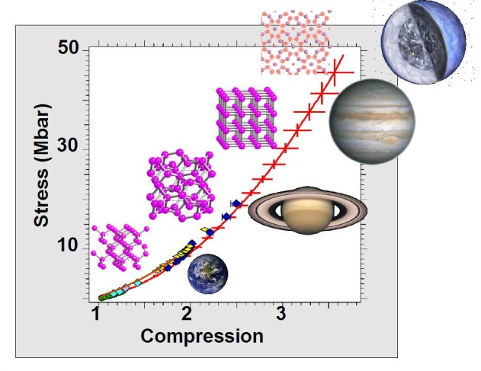

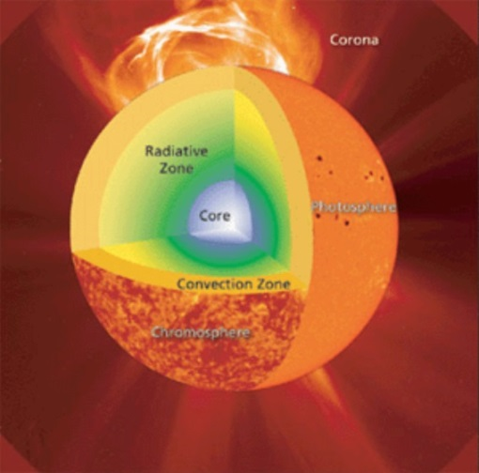
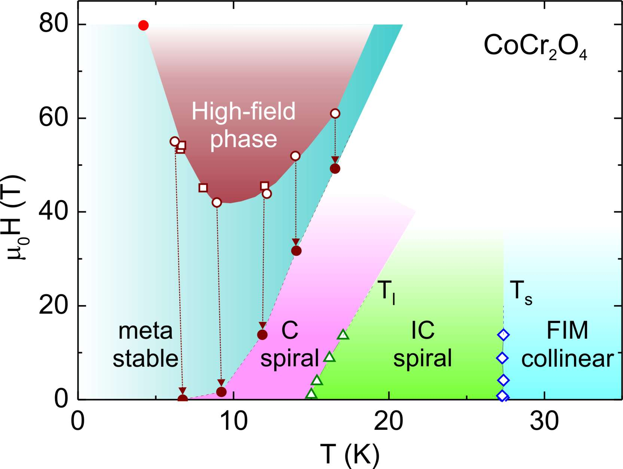
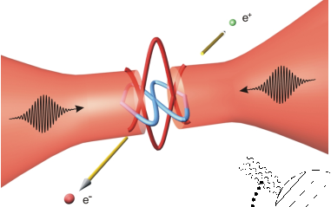

Helmholtz Intl Beamline for Extreme Fields (HIBEF)
Extreme Pressures
Extreme Temperatures
Extreme Fields:
structure of
QED vacuum
Magneto-structural transitions
Nat Mater 9, 624 (2010), Rev Mod Phys 84, 1607 (2012); Phys Plasmas 21, 033110 (2014);
New J Phys 16, 023008 (2014); Opt Comm 267, 318 (2006); Phys Rev Lett 110, 115502 (2013)
Notes:
28

Slide 29

HIBEF: Laboratory Astrophysics
Recent example:
Laboratory Astrophysics at HIBEF*:
Turbulent Mixing hydrodynamics in: supernovae explosions, stellar convection, molecular clouds,…
Non-LTE photoionization (PI) physics, e.g., in x-ray binaries, black hole accretion disks
Intergalactic B-field enhancement from PI-driven Weibel instabilities by the first stars
Particle kinetics in collisionless shocks – thermal/non-Maxwellian electrons/ions, B-field/density fluctuations
Nucleosynthesis in hot plasma: Type II SNe
Magnetic Reconnection in shocks
…..
Cosmic Jets of Young Stars Formed by Magnetic Fields
International team of researchers uses laser light and intense magnetic fields to simulate astrophysical jets in the lab (“Science”, DOI: 10.1126/science.1259694)
Press Release of 16 October
*Astro-HIBEF working group: H. Takabe (HZDR),
R.P. Drake (Michigan), M. Koenig (LULI), Y. Li (IOP-CAS)

Slide 30


U. Schramm, S. Kraft, K. Zeil, J. Metzkes,
T. Richter, C. Richter, et al.
Irman, A. Jochmann, et al.
+ P. Michel, U. Lehnert & ELBE team
M. Bussmann, A. Debus, T. Kluge, et al.
M. Siebold, S. Bock, U. Helbig, F. Kroll,
F. Röser, M. Löser, et al.
T. Cowan, R. Sauerbrey
J. Pawelke, L. Karsch,
W. Enghardt, M. Baumann,
et al.
E. Beyreuther, Y. Dammene,
L. Laschinsky,
D. Naumburger, et al.
Notes:
30

Slide 31

… thank you for your attention

Slide 32


Thomson X-ray source (@ELBE)
Single pixel absorption events analysis
X-ray CCD camera
0.36π μsr solid angle
Emittance means angular spread,
smearing the spectrum
In situ diagnostics (energy, emittance)
using 1 J laser pulse and 1 nC charge (from SRF-gun):
1x10⁸ photons per shot in 1.6π μsr (~1/γ)
A. Jochmann et al., Physical Review Letters 111 (2013), 114803

Slide 33


Compact pulsed magnet gantry design
Pulsed high-field (40T solenoid, 8T dipole) air coil magnets for beam guiding
U. Masood, et al., Appl. Phys. B, online first DOI 10.1007/s00340-014-5796-z

Slide 34




Generation of spread-out Bragg peaks from broad spectra
Proximal
End
TUMOR
Distal
End
TNSA spectrum
scaled to therapeutic
energy range
Broad-band
(ΔE/E=20%)
Mono-energetic
(ΔE/E=0.1%)
energy selection system
SOBP
x2
x10
x1
Geant4
simulation
x1
x1
accumulated
SOBP in water phantom
U. Masood et al., submitted 2013

