Slide 1
MARS15 Simulation of Radiation Environment at the ESS Linac
N. Mokhov, Yu. Eidelman, I. Rakhno, L. Tchelidze and I. Tropin
SATIF-13
October 10-12, 2016

Slide 2
Outline
Introduction
ESS MARS Model
Beam Loss Model
Electromagnetic Fields and Acceleration
Normal Operation
Impact on Environment
Beam Accident
Conclusions

Slide 3
Introduction
The ESS accelerator complex is under construction in Lund, Sweden. It will deliver a 5-MW, 2-GeV proton beam for the European Spallation Source facility. Comprehensive MARS15 studies were performed to evaluate prompt and residual radiation levels induced by nominal and accidental beam losses in the ESS Linac and beam transfer lines to provide a basis for radiation shielding design verification through the accelerator complex.

Slide 4
ESS MARS15 Model
Included in the MARS15 model is the newest information – based on the engineering design - on beam-line components such as quadrupole magnets, accelerating cavities and cryomodules as well as as-built Linac tunnel and shielding layout with all the details available on geometry, materials and electromagnetic fields.
This info from the ESS CAD teams was obtained in the form of STEP files and semi-automatically converted to the MARS15 ROOT geometry modules. The element sequence was built and the entire Linac structure managed and linked to the above geometry modules and to materials/field maps by means of the advanced Beamline Builder.

Slide 5
MARS15 (2016) in this Study
Customized steppers (with high-order Runge Kutta algorithms) were created for optimal particle tracking in SRF, quadrupole/dipole magnets and thick shielding.
For inelastic nuclear interactions, a combination of LAQGSM and CEM event generators is used at 0.15 – 2 GeV, extended TENDL-based generators below 0.15 GeV down to 1 MeV (charged particles) and 14 MeV (neutrons), and MCNP libraries for neutrons below 14 MeV.
Energy thresholds are in the 0.001 eV to 100 keV range.
Variance reduction techniques: multi-step and splitting/Russian roulette.
A built-in set of flux-to-dose (FTD) conversion factors to calculate - in the course of Monte-Carlo - effective prompt dose distributions: ICRP103 + ICRP60 + Cossairt (2009) + Pellicioni (2000). These FTD are in a rather good agreement with ESS-0019931.

Slide 6
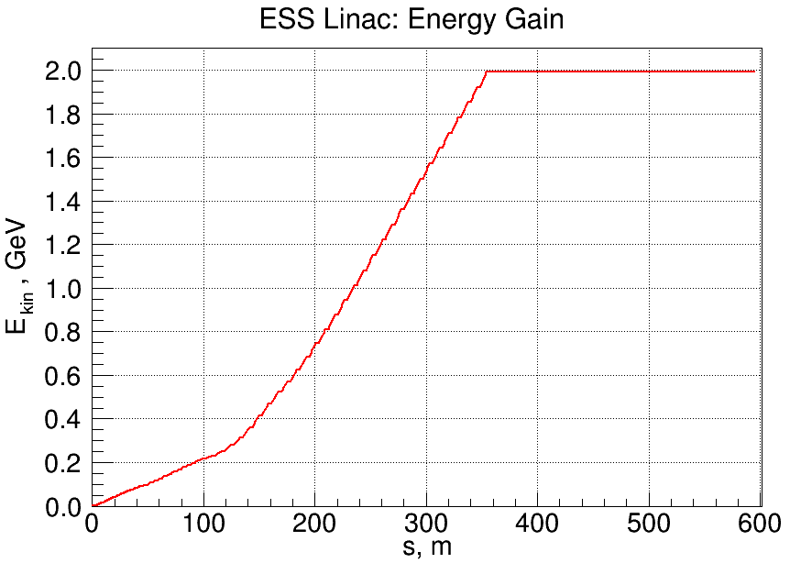
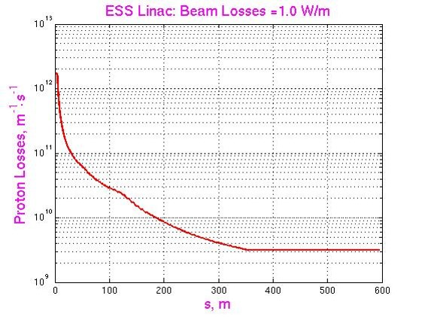
Beam Loss Model
1 W/m beam loss rate – uniform longitudinally and on beampipe aperture at 3mrad grazing angle in beam reference system - was considered as a design criteria and an upper limit during normal operations. This was derived from hands-on maintenance conditions as adopted at ESS.

Slide 7
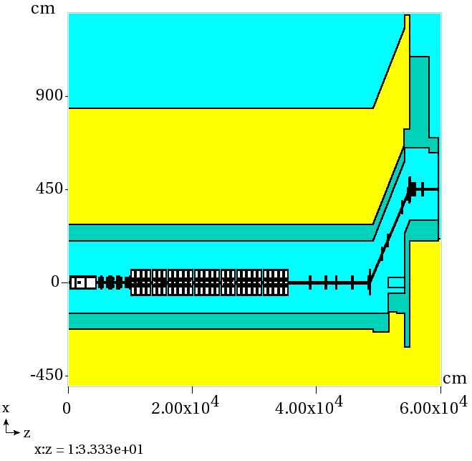
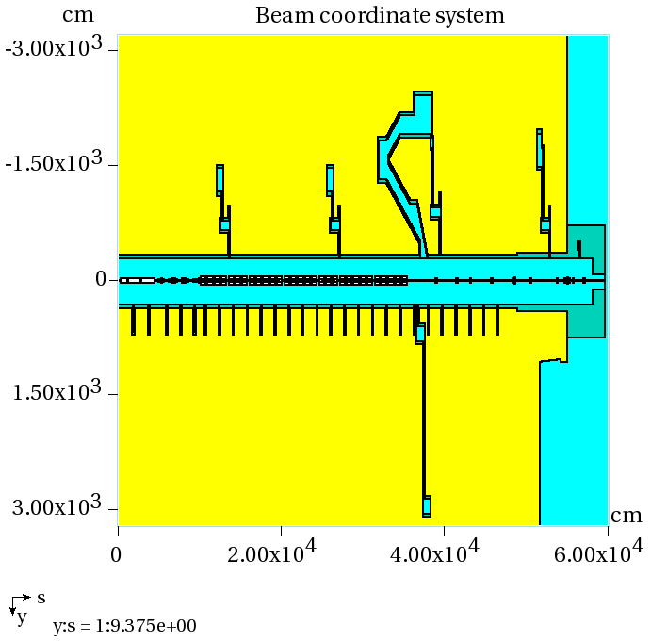
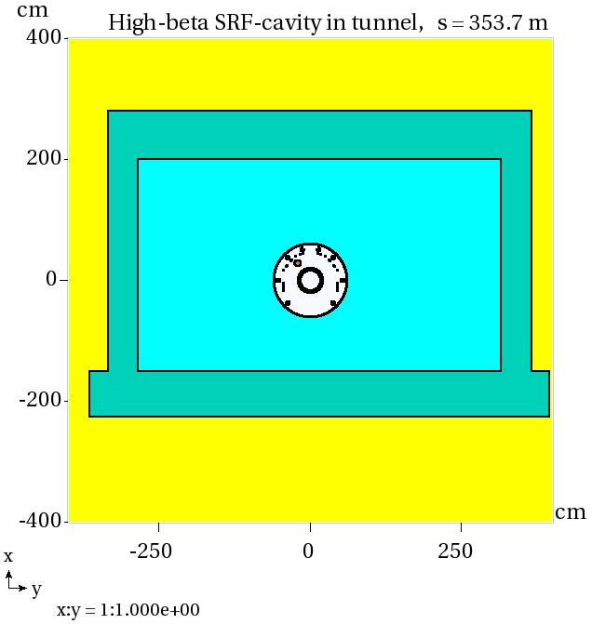
ESS in MARS15 Model
Side view
Plan view
Tunnel x-section
ESS specific description of 32
materials is used in the model

Slide 8
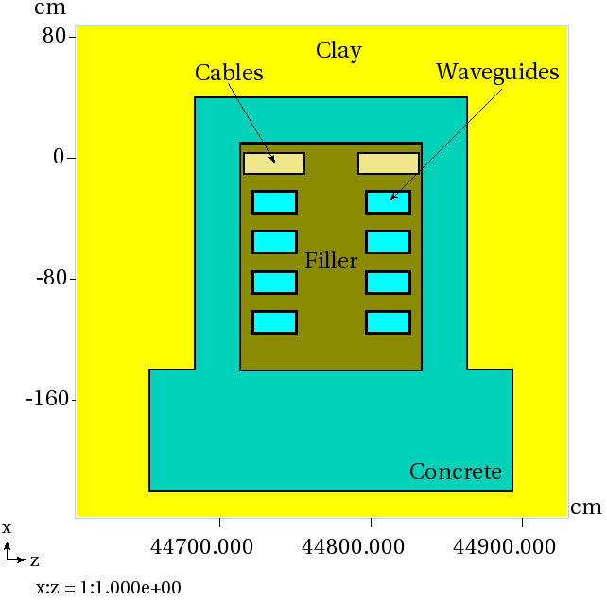
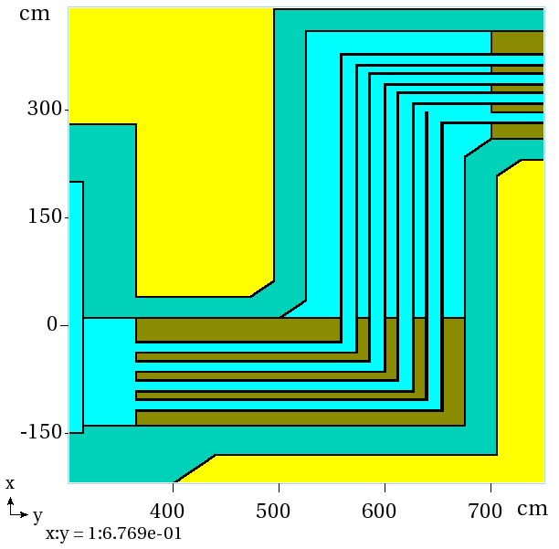
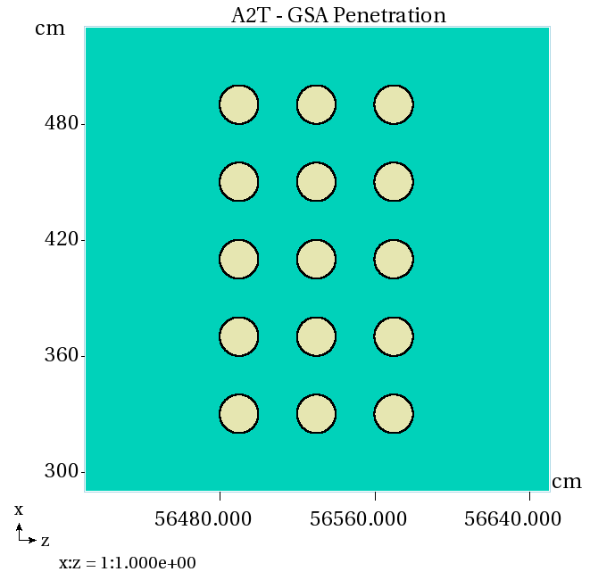
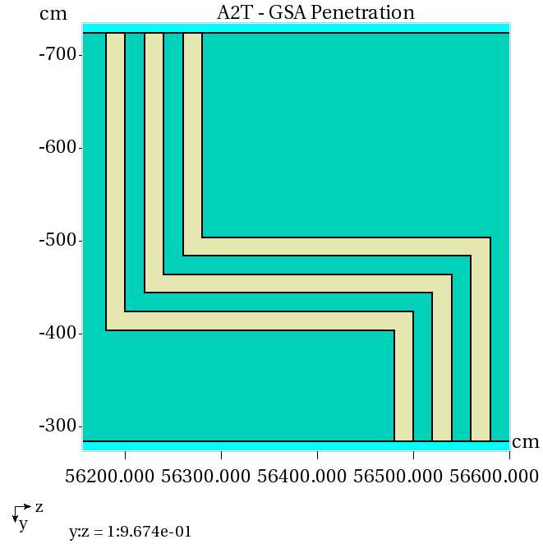
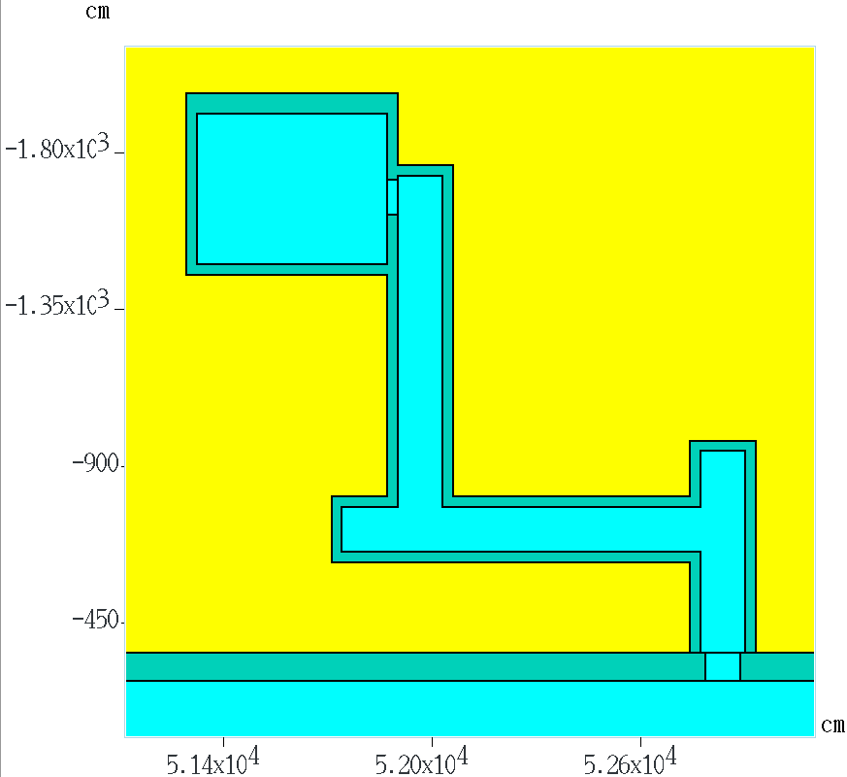
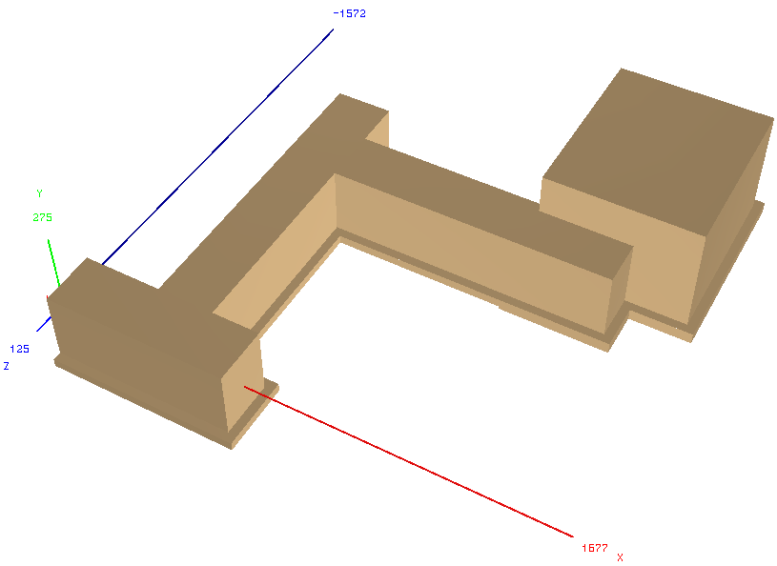
Stubs, Exits and Cable Penetrations in the Model
Stubs and sand-bag filling
Cable penetrations
Personnel emergency exit

Slide 9
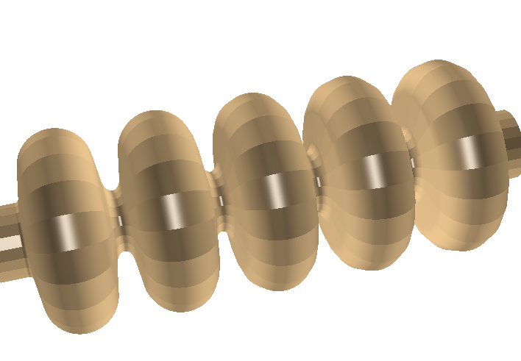
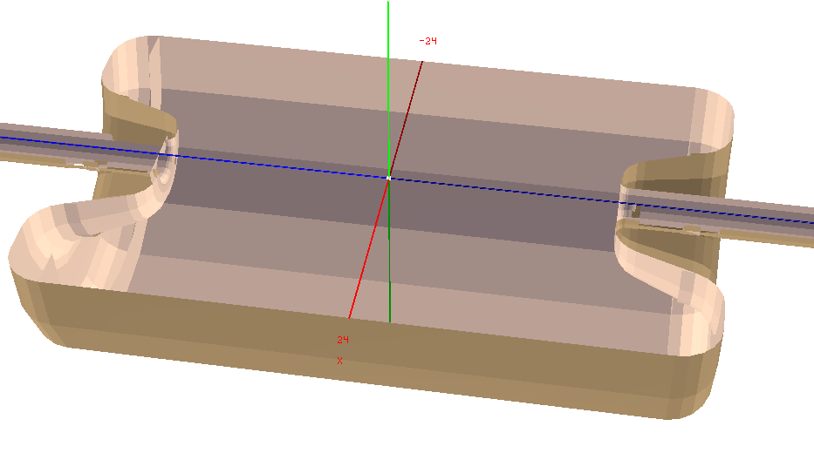
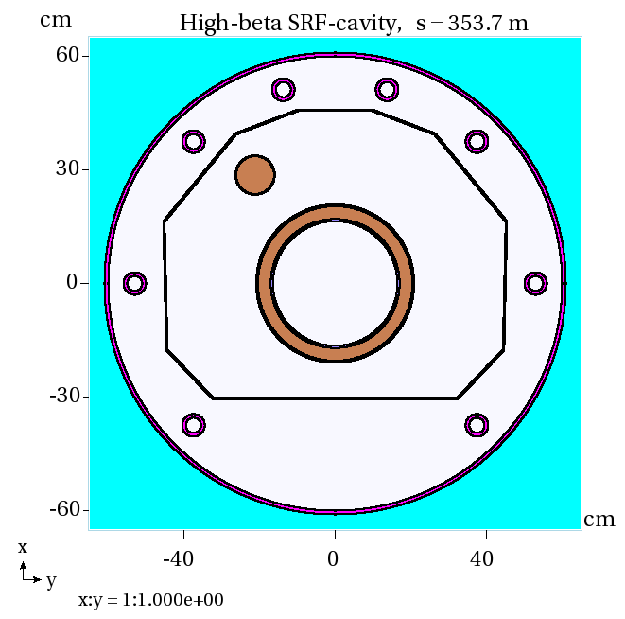
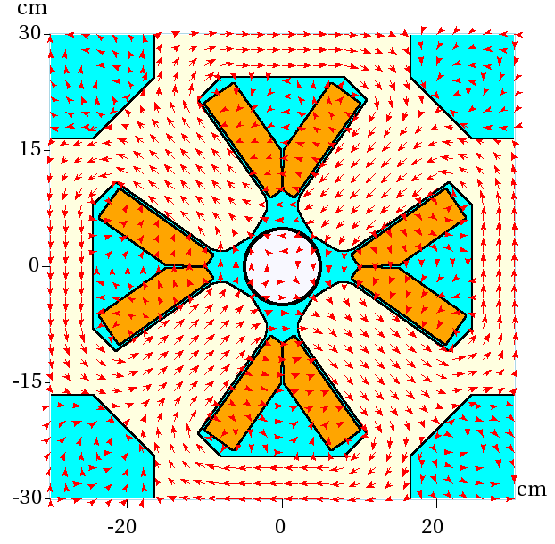
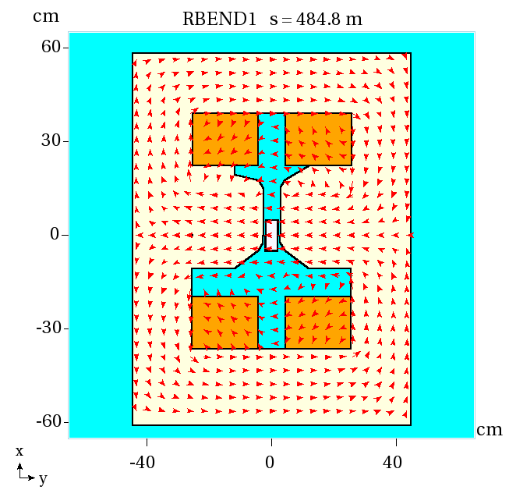
SRF Cavities and Magnets in MARS15 Model
ESS CAD STEP files MARS ROOT geometry
Field maps &
analytics for E_{z}
Spoke cavity
(composite shapes)
High-β cavity
Quad
High-β cavity
Dipole

Slide 10
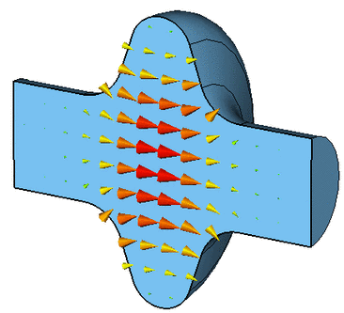
Acceleration: E-Kick & Deflection Model (KDM)
Kick in kinetic energy :
where T is the transit factor:
Momenta of particle (i/f – before/after kick):
From conservation of the transverse momentum :
The amplitude (voltage) E₀ and phase φ₀ for each cavity vs
its number (position) in the Linac were provided by ESS

Slide 11
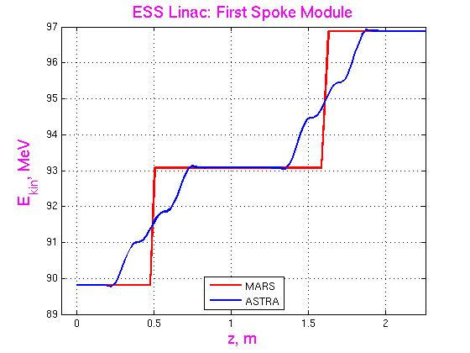
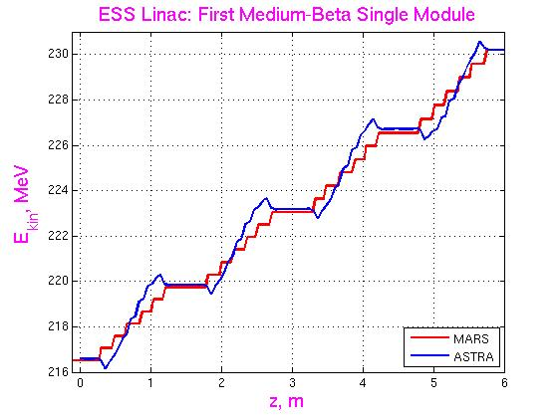
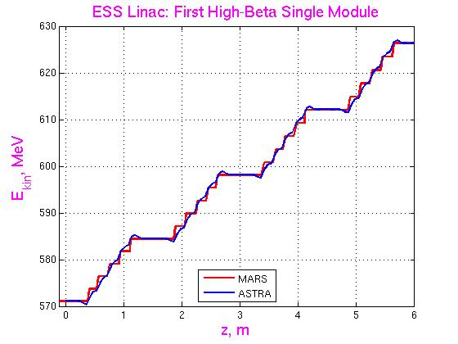
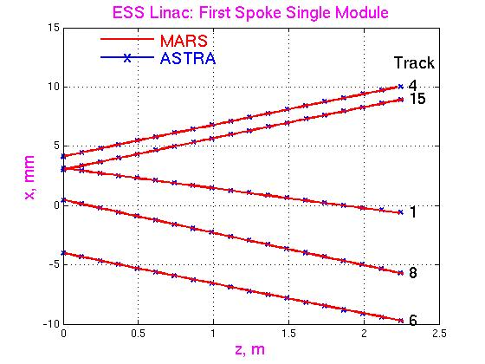
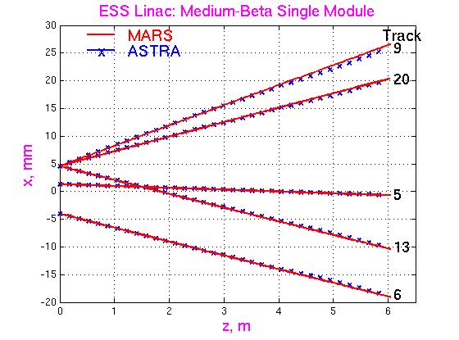
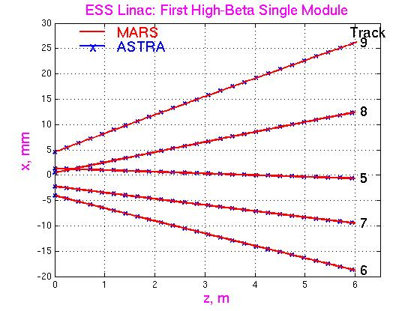
KDM vs ASTRA Verification
Acceleration
Spoke
Medium-β
High-β
Tracking
Spoke
Medium-β
High-β

Slide 12
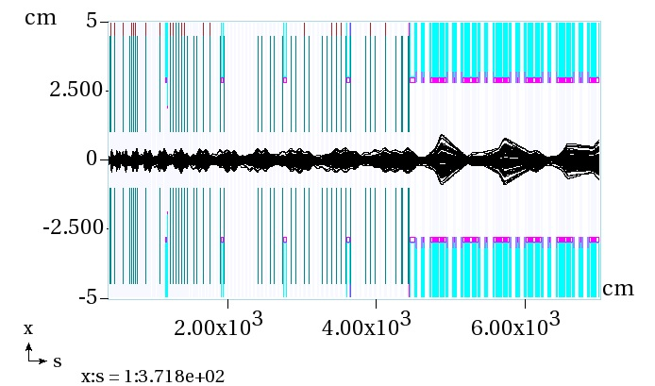
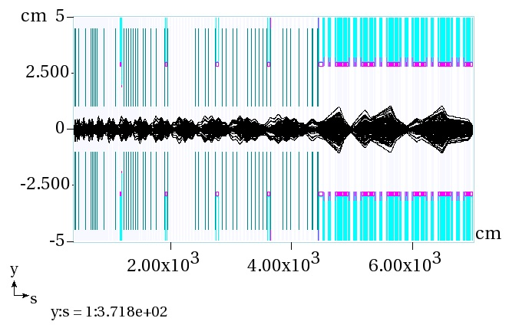
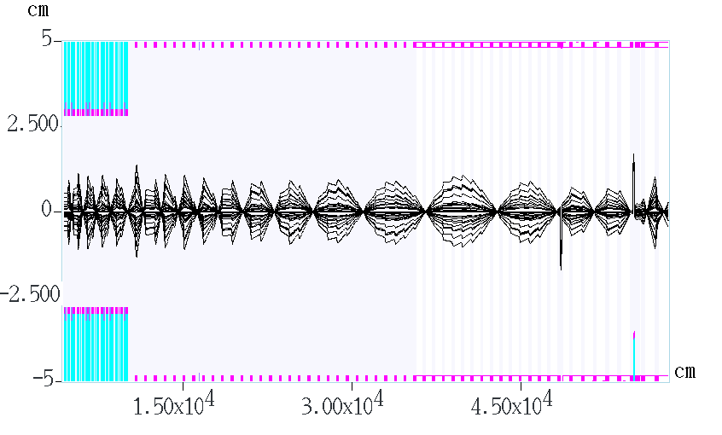
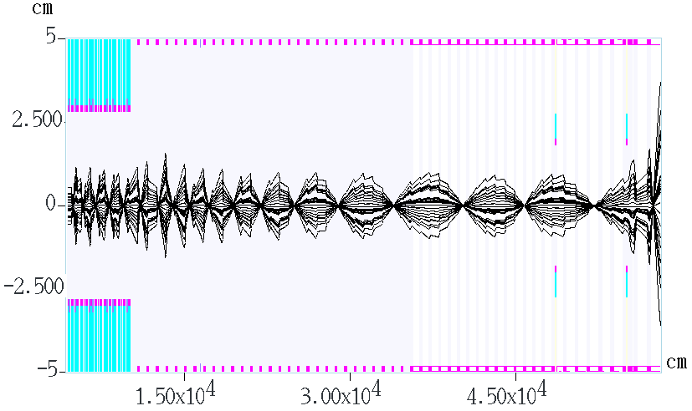
Acceleration & Tracking: Consistency Check
Vertical
Horizontal
DTL
DTL
Spoke
Spoke
Vertical: Spoke to Target
Horizontal: Spoke to Target

Slide 13
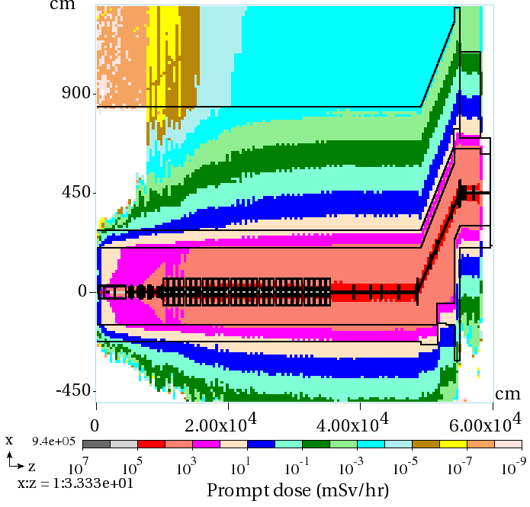
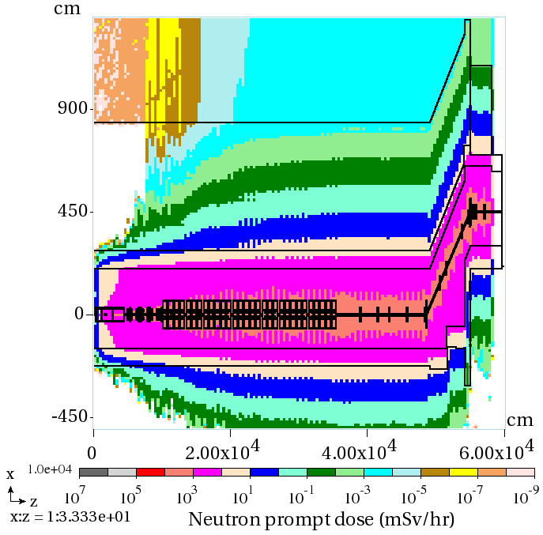
Normal Operation: Prompt Dose
Maxima at top of berm:
0.65 μSv/hr (z~400 m)
0.86 μSv/hr (z~540 m)
0.63 μSv/hr (z~400 m)
0.85 μSv/hr (z~540 m)
Total
Neutrons
Vertical scan through the beamline center

Slide 14
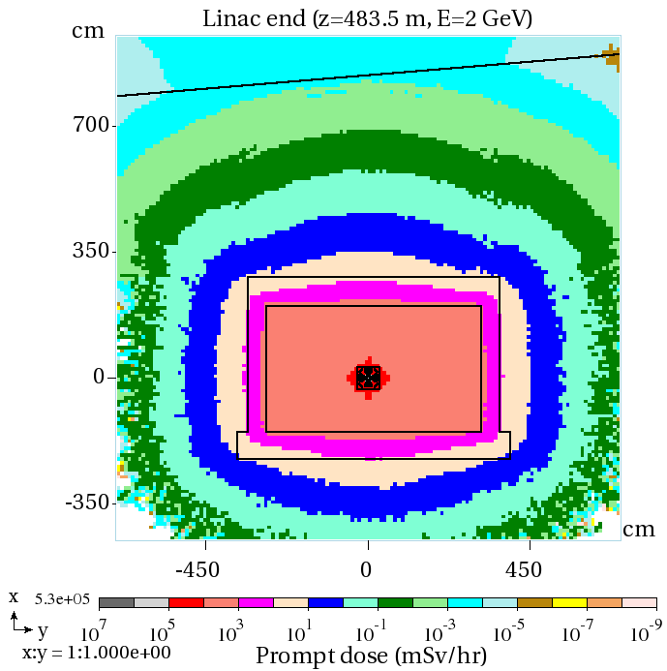
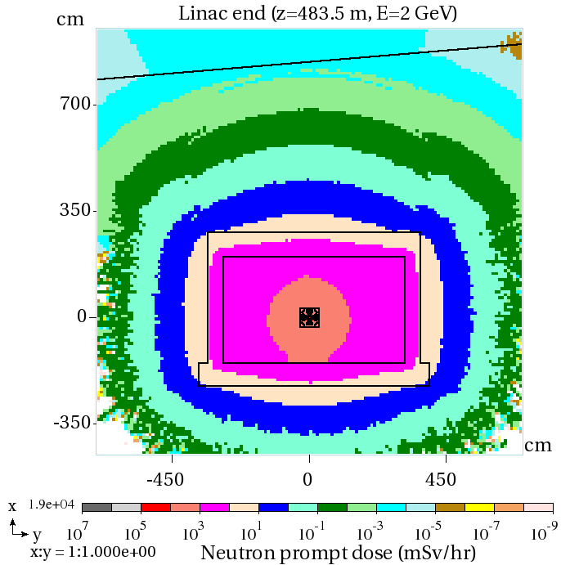
Normal Operation: Prompt Dose at Linac End
Total
Neutrons
XY-view at z=483.5 m, E_{p}=2 GeV

Slide 15
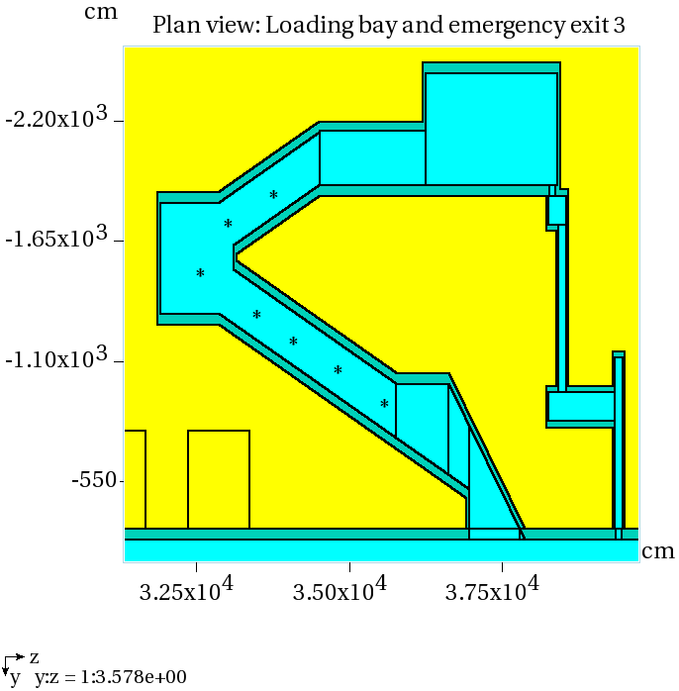
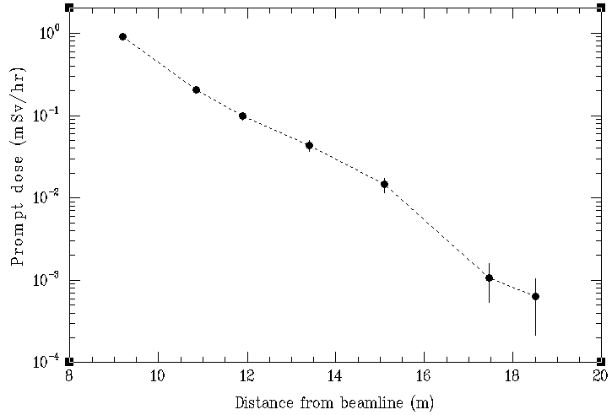
Prompt Dose in ESS Associated Systems
Dose in HEBT loading bay at 7 locations indicated
Prompt dose distributions for 1 W/m beam loss normal operation were calculated on the berm, in klystron gallery and stubs (with and w/o filler), at emergency exits, in HEBT loading bay, A2T-GSA penetration, HVAC exhaust pipes, alignment penetrations, and cryogenic transfer line

Slide 16
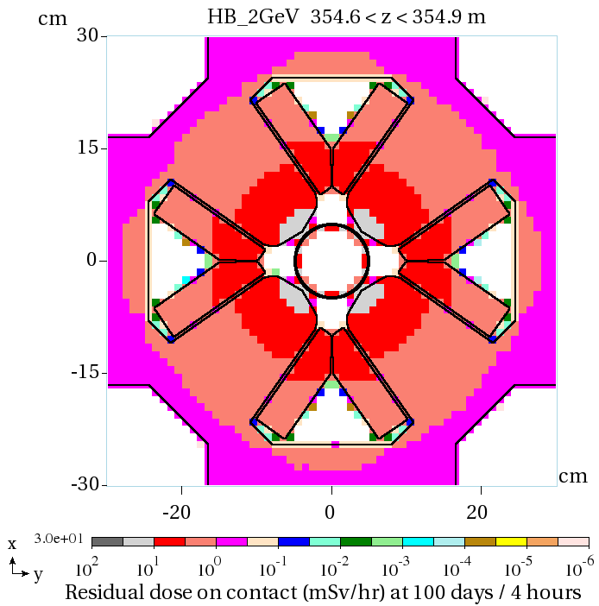
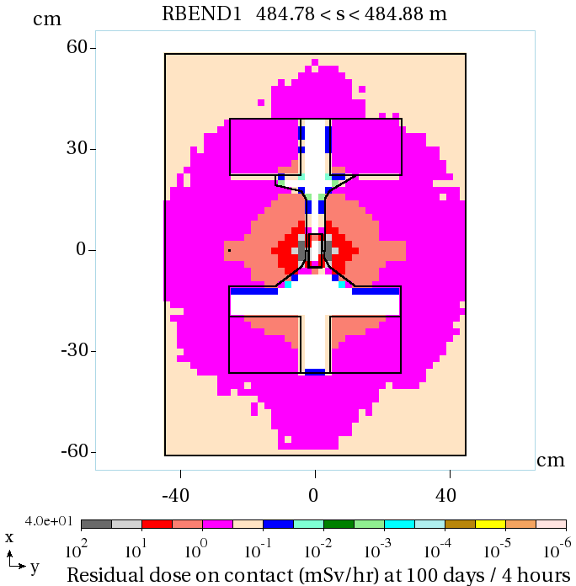
Linac Component Activation
Residual dose on the outer surface of magnets – after 100 days of irradiation and 4 hours of cooldown – ranges from 0.3 to 1 mSv/hr, in a full consistency with the 1 W/m rule. At the same conditions, the maximum contact dose on the concrete walls is 0.01 mSv/hr
Hottest quad at 354.6 m
First dipole magnet at 484.8 m

Slide 17
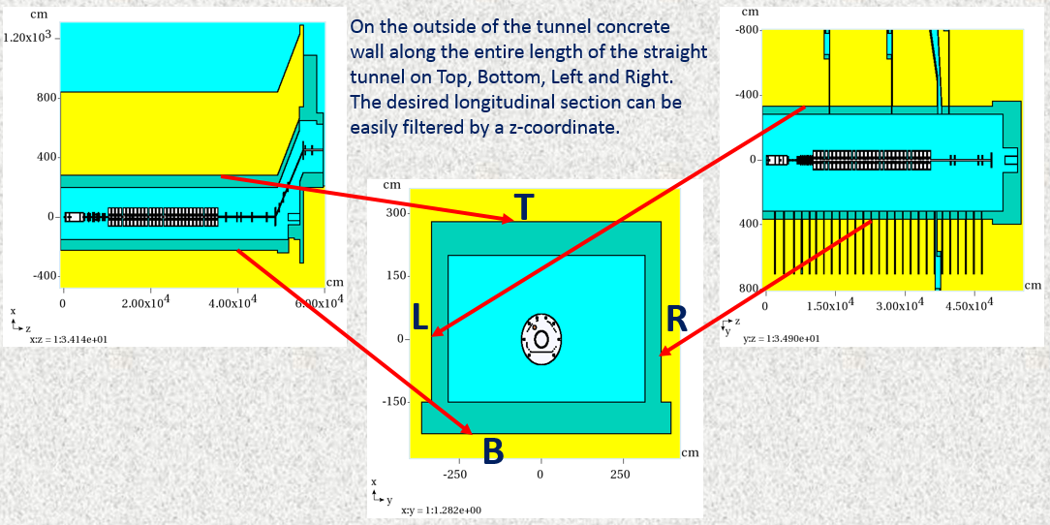
Environmental Impact of ESS Normal Operation
MARS15 calculated source terms for dose on the berm, skyshine and soil/groundwater activation studies
The source terms files T, B, L and R with NI, jj, E, W, x, y, z, dcx, dcy, dcz
where NI is history number (irrelevant here); jj is particle ID:
1 (p), 2 (n), 3 (π⁺), 4 (π⁻), 5 (K⁺), 6 (K⁻), 7 (μ⁺), 8 (μ⁻), 9 (γ), 10 (e⁻), 11(e⁺), others are
various fragments; E is particle kinetic energy, GeV; W is statistical weight; x, y, z are
coordinates in cm, and dcx, dcy, dcz are direction cosines.

Slide 18
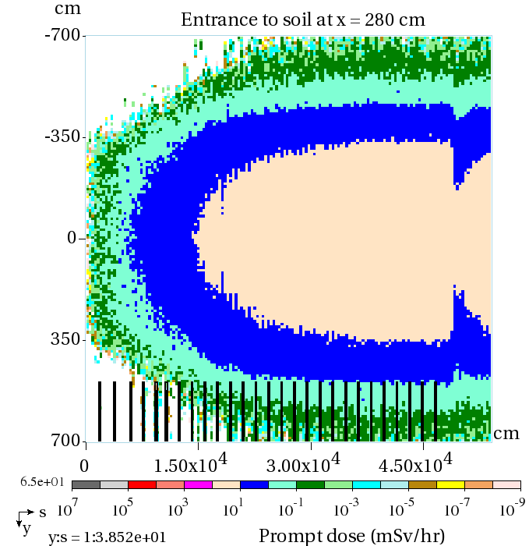
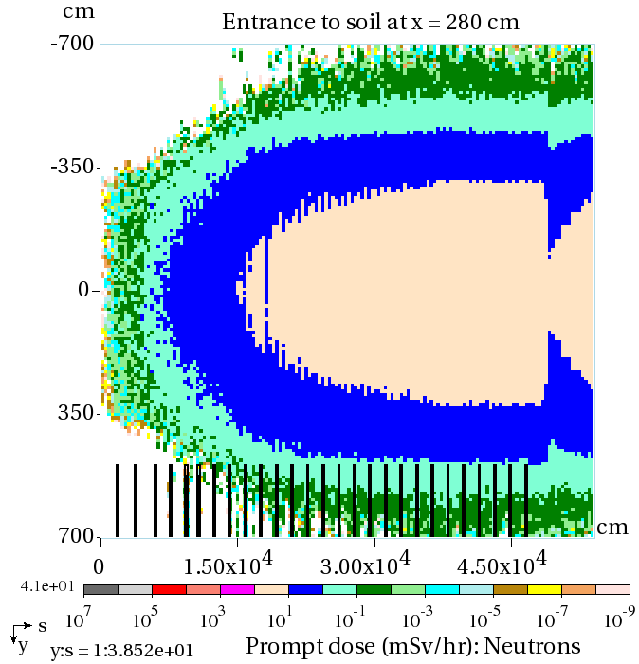
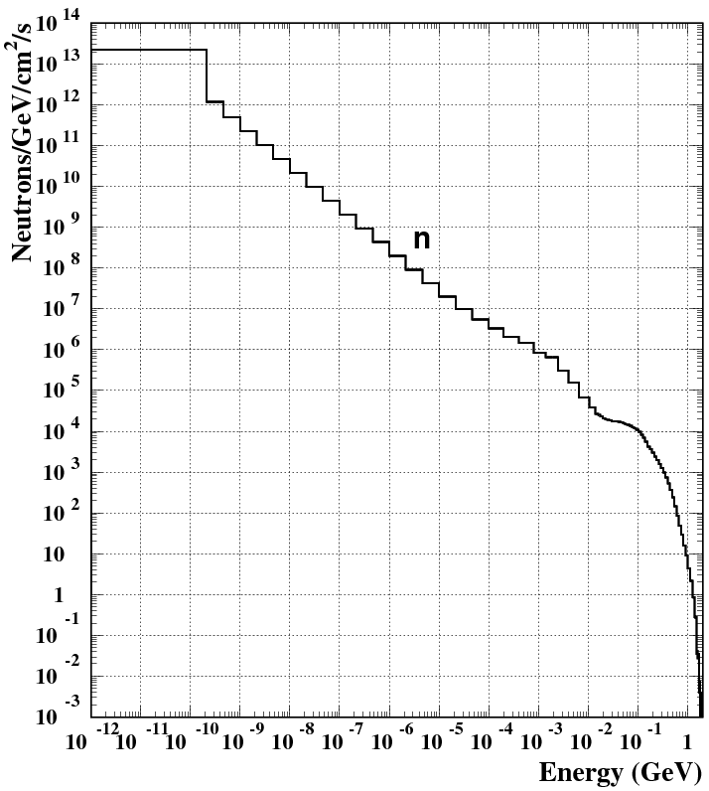
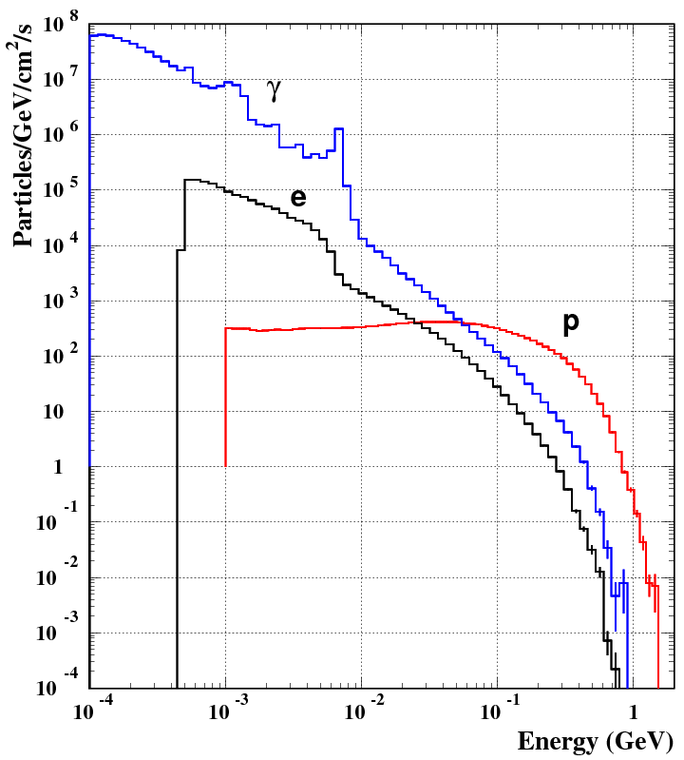
Prompt Dose and Energy Spectra from T-file
Entering soil just
above tunnel ceiling
<E_{n}> = 18.6 MeV
<E_{p}> = 163 MeV
<E_{γ}> = 13.6 MeV
<E_{e}> = 51 MeV

Slide 19
Tunnel Air Activation at Normal Operation
MARS15 calculated nuclide production per sec in air of ESS tunnel 0 < s < 600 m
for steady-state beam loss rate of 1 W/m: Total, produced in low-energy (E < 14 MeV)
and high-energy (E > 14 MeV) nuclear reactions
Isotope |  | Total | Low-E | High-E
H | 3 | 1.94E+09 | 4.56E+08 | 1.48E+09
Be | 7 | 7.79E+08 | 0.00E+00 | 7.79E+08
Be | 10 | 4.71E+08 | 0.00E+00 | 4.71E+08
C | 11 | 1.22E+09 | 0.00E+00 | 1.22E+09
C | 14 | 1.53E+11 | 1.52E+11 | 8.49E+08
N | 13 | 1.91E+09 | 4.47E+07 | 1.86E+09
O | 14 | 1.62E+08 | 0.00E+00 | 1.62E+08
O | 15 | 1.74E+09 | 5.75E+05 | 1.74E+09
O | 19 | 2.93E+05 | 0.00E+00 | 2.93E+05
F | 18 | 6.21E+06 | 0.00E+00 | 6.21E+06
Ne | 23 | 7.07E+05 | 0.00E+00 | 7.07E+05
Ne | 24 | 1.54E+05 | 0.00E+00 | 1.54E+05
Na | 22 | 2.02E+06 | 0.00E+00 | 2.02E+06
Na | 24 | 3.19E+06 | 0.00E+00 | 3.19E+06
Na | 25 | 1.26E+06 | 0.00E+00 | 1.26E+06
Mg | 27 | 1.86E+06 | 0.00E+00 | 1.86E+06
Mg | 28 | 6.25E+05 | 0.00E+00 | 6.25E+05
Al | 26 | 2.75E+06 | 0.00E+00 | 2.75E+06
Al | 28 | 6.98E+06 | 0.00E+00 | 6.98E+06
Al | 29 | 3.56E+06 | 0.00E+00 | 3.56E+06
Si | 31 | 3.98E+06 | 5.04E+00 | 3.98E+06
Si | 32 | 2.31E+06 | 0.00E+00 | 2.31E+06
P | 30 | 2.03E+06 | 0.00E+00 | 2.03E+06
P | 32 | 3.07E+07 | 0.00E+00 | 3.07E+07
P | 33 | 2.21E+07 | 0.00E+00 | 2.21E+07
P | 35 | 2.46E+06 | 0.00E+00 | 2.46E+06
S | 35 | 2.94E+07 | 1.75E+04 | 2.94E+07
S | 37 | 8.54E+06 | 3.54E+06 | 5.00E+06
S | 38 | 5.29E+06 | 6.39E+00 | 5.29E+06
Cl | 34 | 1.32E+06 | 0.00E+00 | 1.32E+06
Cl | 36 | 7.54E+07 | 1.54E+06 | 7.39E+07
Cl | 38 | 4.91E+07 | 2.29E+04 | 4.91E+07
Cl | 39 | 8.72E+07 | 1.06E+06 | 8.61E+07
Cl | 40 | 9.60E+06 | 2.12E+06 | 7.48E+06
Ar | 37 | 8.05E+07 | 2.36E+07 | 5.69E+07
Ar | 39 | 3.05E+08 | 9.83E+07 | 2.06E+08
Ar | 41 | 9.05E+08 | 9.05E+08 | 0.00E+00
K | 38 | 1.63E+06 | 0.00E+00 | 1.63E+06
K | 40 | 6.63E+06 | 0.00E+00 | 6.63E+06

Slide 20
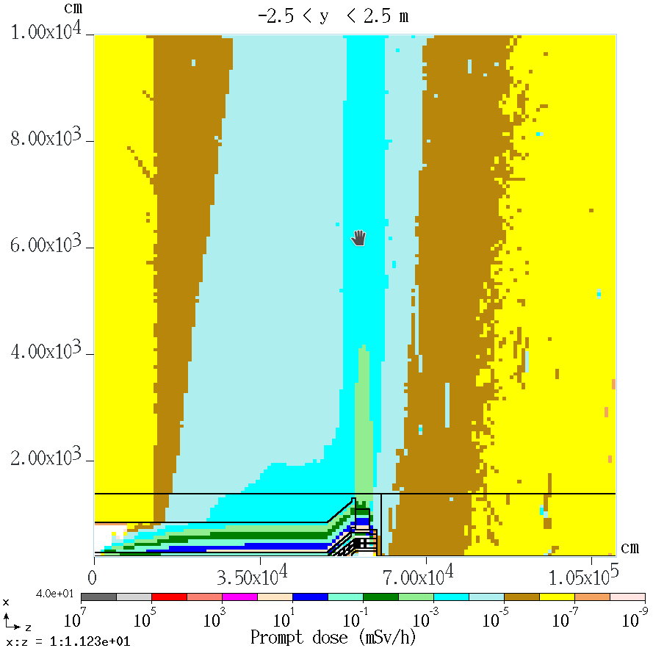
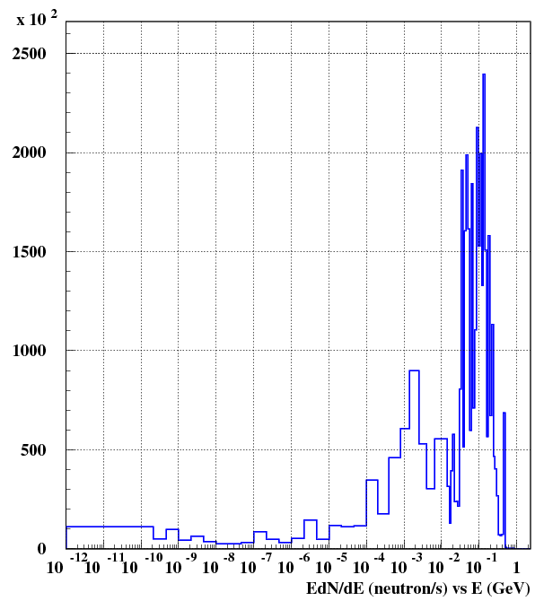
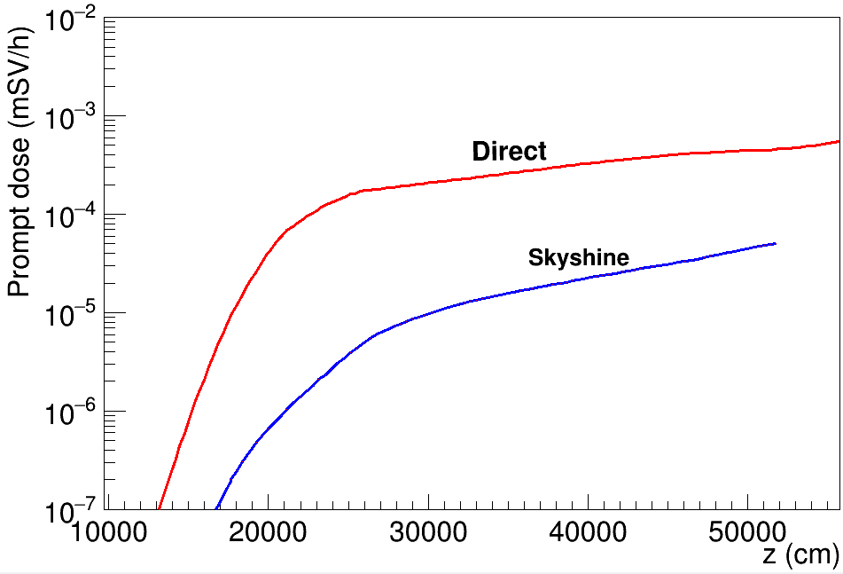
Direct & Skyshine Radiation
Direct on berm
On berm
10×10 km atmosphere with the air density gradually decreased with height according to the NASA Earth Atmosphere Model

Slide 21
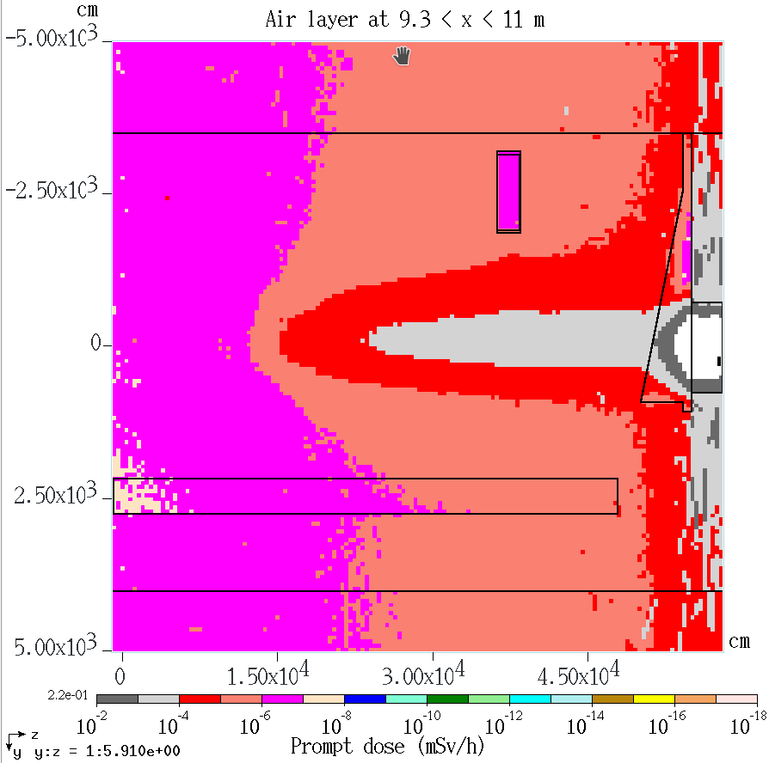
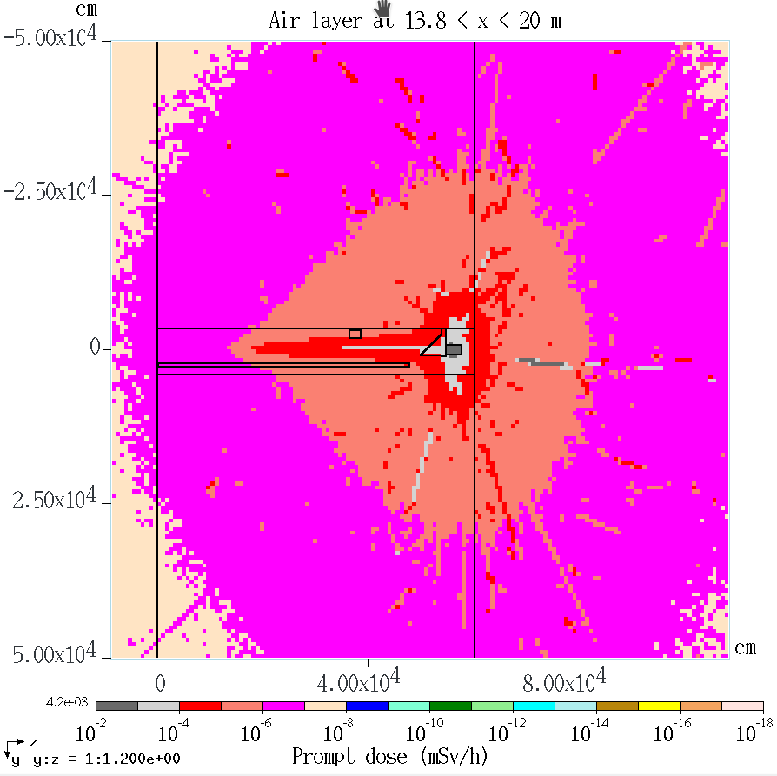
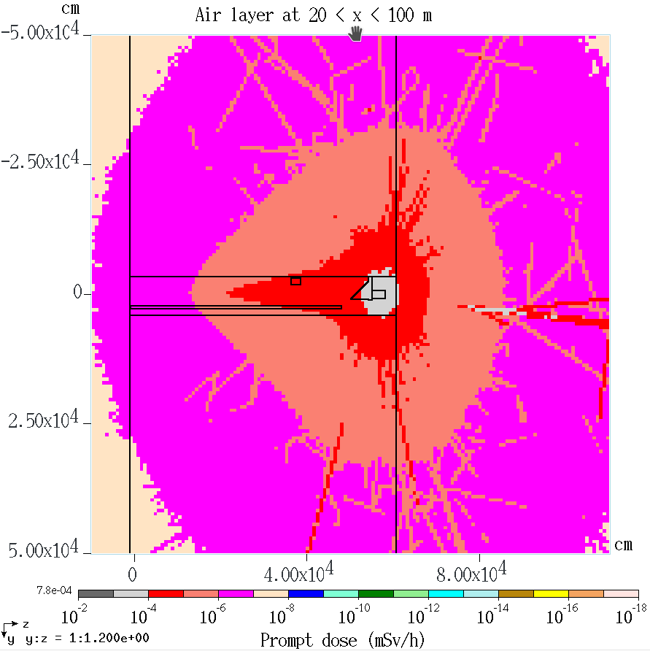
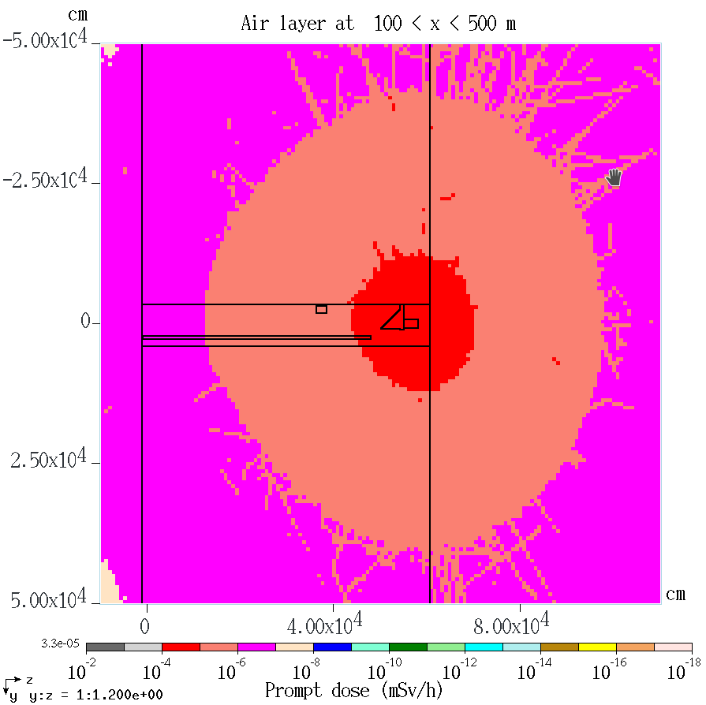
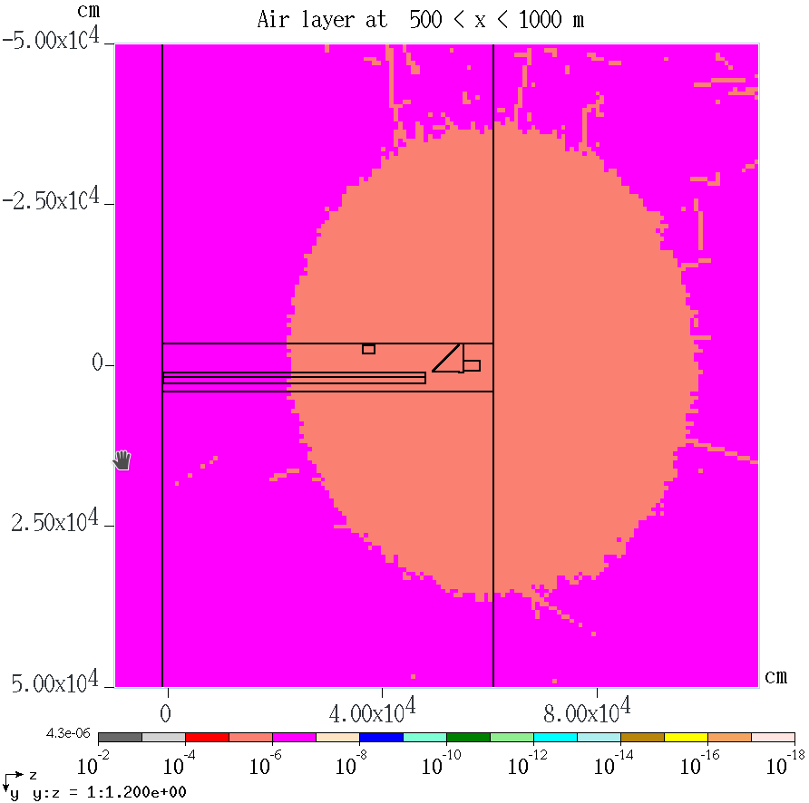
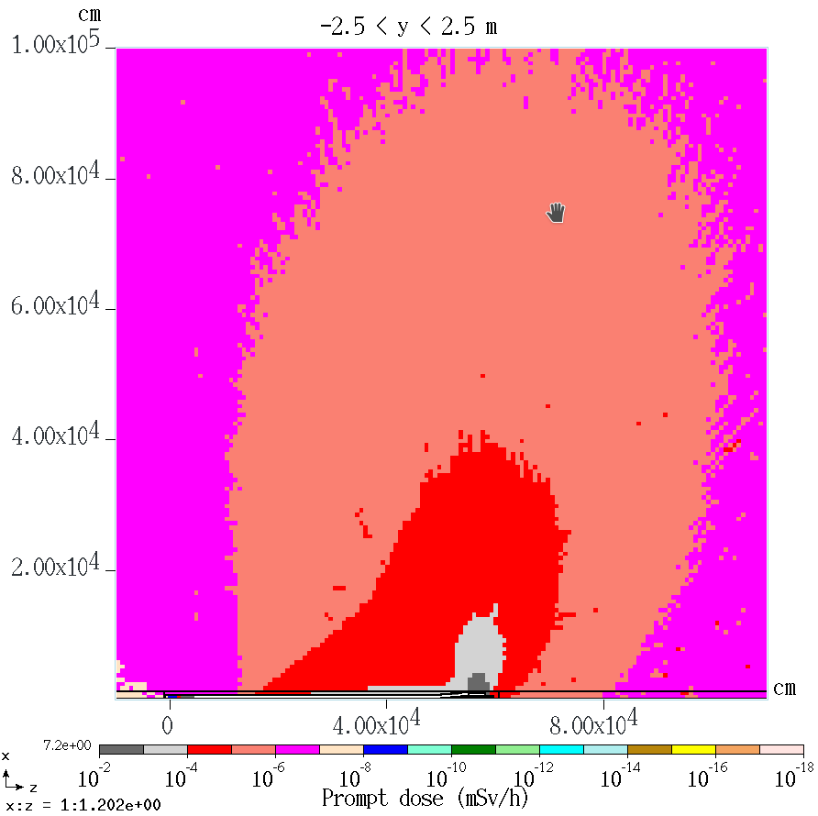
Skyshine: Dose Isocontours at Different Heights
Just above the berm
Side view

Slide 22
Worst Case Accidental Beam Loss
The consideration is given to the impact on radiation environment of the accidental point loss of the full beam. The primary concern is the corresponding peak prompt dose rate on top of the berm and in the hottest point in klystron gallery.
A preliminary MARS15 analysis has shown that the worst case corresponds to a 2 GeV beam lost downstream of the high-beta linac at z ~ 447 meters just upstream of the quadrupole magnet quad-475 in front of the stub mouth. That is for the point beam hitting the beam pipe at a grazing angle of 3 mrad towards vertically up. There is a 2-fold increase in the dose rate for the worst stub if the loss point is in a horizontal plane towards the stub.
The rate of 2 GeV protons that corresponds to the full 5 MW beam is 1.5625×10¹⁶ p/s.

Slide 23
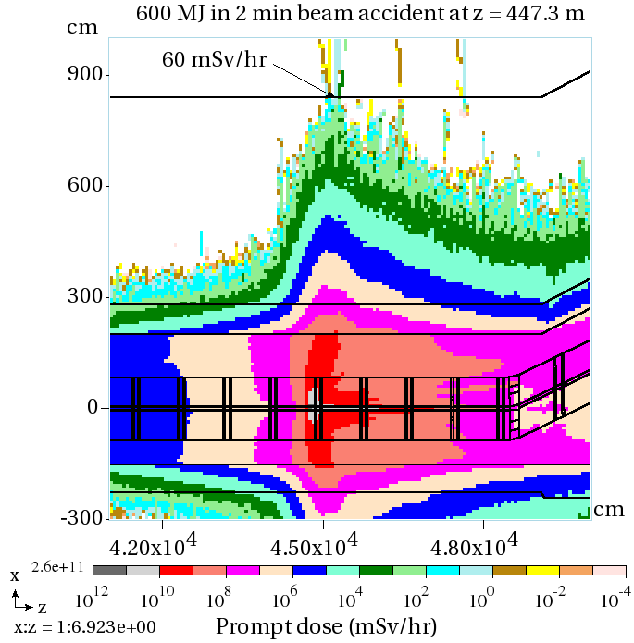
Prompt Dose for the Worst Case Beam Accident
Beam loss at 3 mrad vertically up
Beam loss at 3 mrad horizontally towards the stub
Maximum at berm: 60 mSv/hr compared to 0.65 μSv/hr for steady-state normal operation. Peak in the hottest quad coil 20 W/cm³
Maximum at klystron gallery entrance: 20 mSv/hr compared to 1.2 μSv/hr for steady-state normal operation, both with filler in the stub

Slide 24
Conclusions
Comprehensive study of the ESS radiation environment was performed with the MARS15 model based on the latest engineering design including SRF, quads and dipoles as well as as-built Linac tunnel and shielding layout with all the details available on geometry, materials and electromagnetic fields.
Prompt dose distributions were calculated in the tunnel and its surroundings for both normal operation and worst-case beam accident. At normal conditions, the dose rates on the berm and in all the accessible associated systems – with a couple exceptions (e.g., emergency exit #4) - do not exceed 1 μSv/hr.
Skyshine: Dose isocontours were calculated over the ESS site.
Residual dose rates in the tunnel were calculated as well, with source terms on the tunnel wall outside generated for subsequent soil and groundwater activation analyses.
Results obtained for the full beam loss accident can help derive regulatory limits on allowable duration of the accident and on specifications for corresponding beam instrumentation and control systems.

