Slide 1
Dark Current and Radiation Shielding Studies for the ILC Main Linac
N. Mokhov, I. Rakhno, N. Solyak, A. Sukhanov and I. Tropin
SATIF-13
October 10-12, 2016

Slide 2
Outline
Introduction
Field Emission and Particle Tracking in SRF
MARS Model
Normal Operation: Radiation in Components and Tunnel
Commissioning Mode: Radiation Loads on Components and Service Tunnel Shielding
Conclusions

Slide 3
Introduction
Dark current (DC) particles in SRF linac produce radiation affecting
  beam line components and cables inside cryo-module (CM)
  electronics outside of CM in the linac tunnel
  electronics and personnel in the service part of the linac tunnel
Extensive investigation of DC radiation is required during the design of SRF linac
  protect accelerator components from radiation damage
  optimize thickness and cost of radiation shielding
Run MARS15 for the worst case DC model

Slide 4
Design of ILC Kamaboko Tunnel
In the current design, there is a 3.5m wall between main and service tunnels
Change request: Reduce wall thickness (cost saving)
Thickness of the wall (1.5-3.5 m)
separating service and operational
parts of the tunnel is determined
by the maximum beam losses.
Reduction of the wall thickness is
a cost effective solution

Slide 5
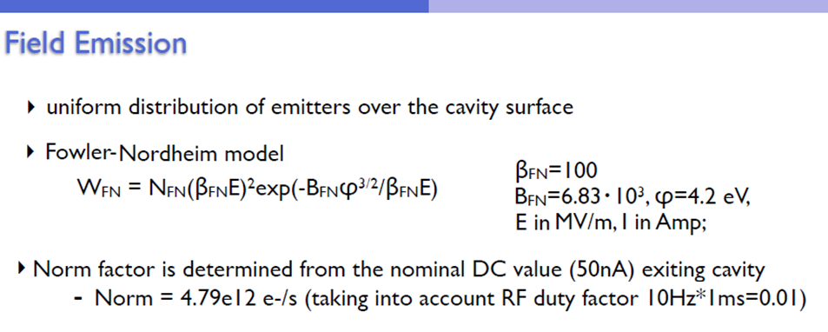
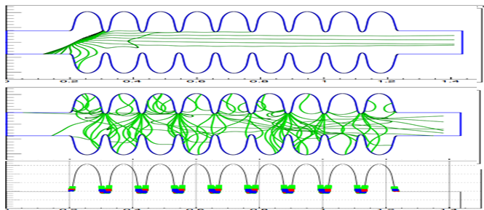
E_{acc} = 31.5 MV/m,
DF: 1ms x 10 Hz = 1%
38-m RF unit (period):
4 CM, 26 1.3-GHz cavities,
focusing quad
38m ×40 units = 1.5 km
A detailed modeling is performed for the dark current electrons which are emitted from the surface of the RF cavities and can be repeatedly accelerated in the high-gradient fields in many RF cavities.

Slide 6
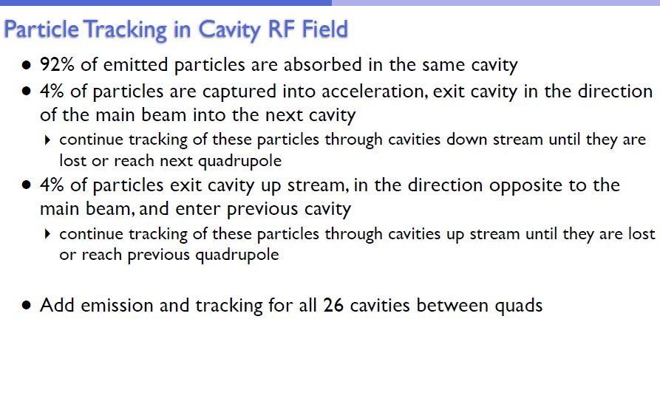

Slide 7
ILC MARS15 Model
Advanced MAD-MARS Beamline
Builder that generates 3D ROOT
geometry for appropriate linac
sections; high-order Runge-Kutta
stepper; energy thresholds
0.001 eV (n) to 100 keV;
start from pre-generated 3D DC
distribution.
SRF cavity
Tunnel-x-section
Cryo-module
Quadrupole magnet

Slide 8
Modes of Operation
Normal mode, with quadrupole magnets turned ON
Commissioning mode, with quadrupole magnets turned OFF, four scenarios:
  Straight section of the linac (bunch compressor) with steering & correcting magnets turned OFF
  Curved section, which follow Earth curvature with steering & correcting magnets OFF
  Curved linac with perfect alignment and steering magnets ON, but correctors OFF
  Curved linac with random misalignment and with steering and correcting magnets ON – the worst, used for radiation studies here
Steady state equilibrium DC losses

Slide 9
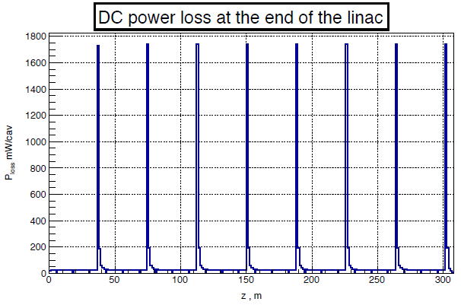
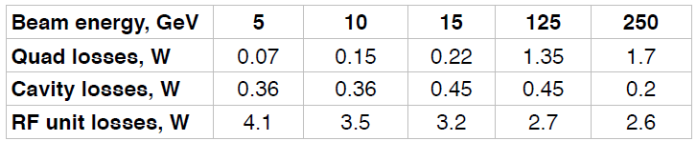
Normal Operation Mode
Prompt dose (mSv/hr)
25 μSv/hr after 1.2 m concrete

Slide 10
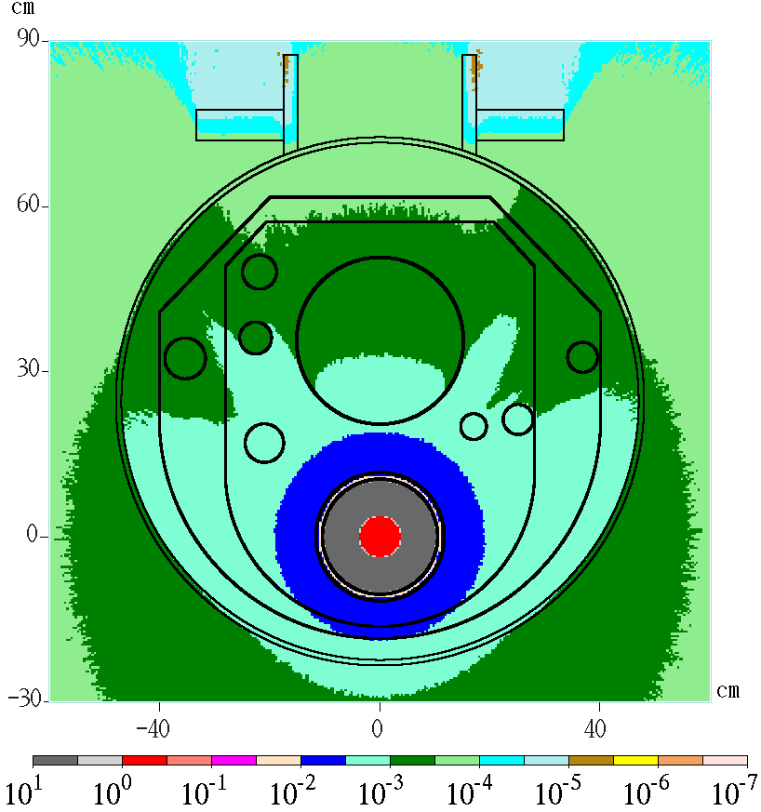
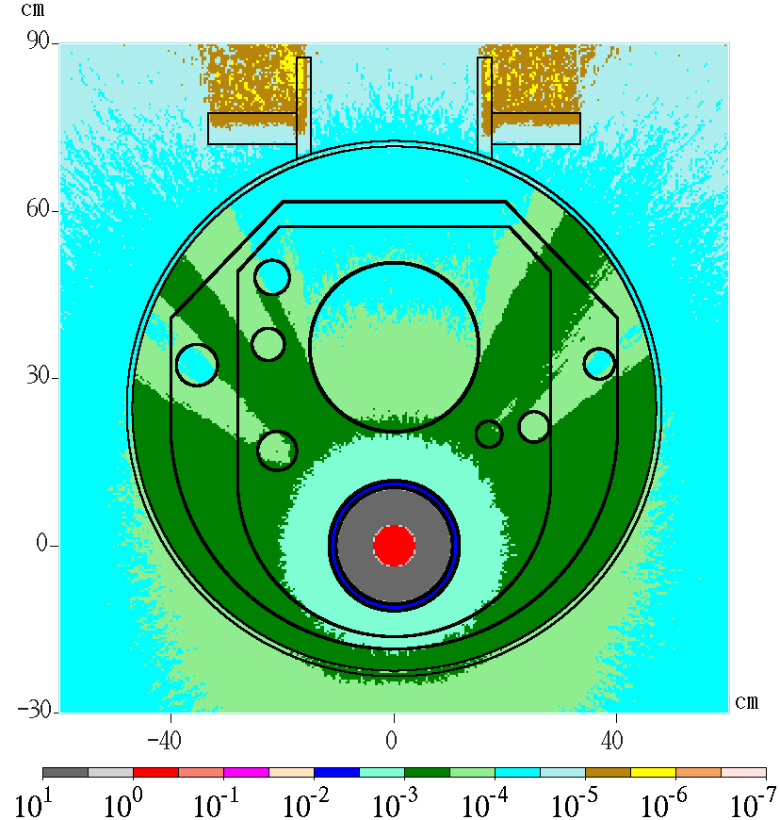
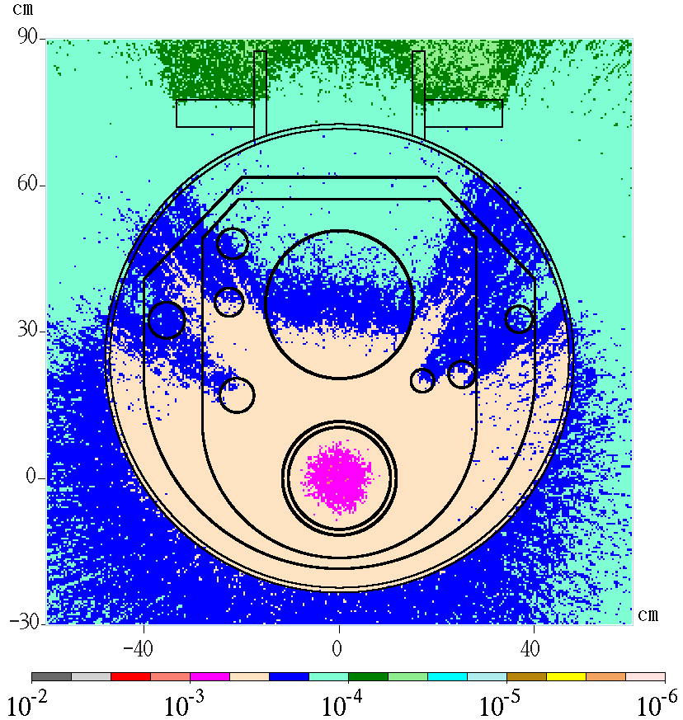
Normal Mode: Radiation in Cryomodule
Total prompt dose (a.u.)
e± prompt dose (a.u.)
Neutron flux > 100 keV (a.u.)

Slide 11
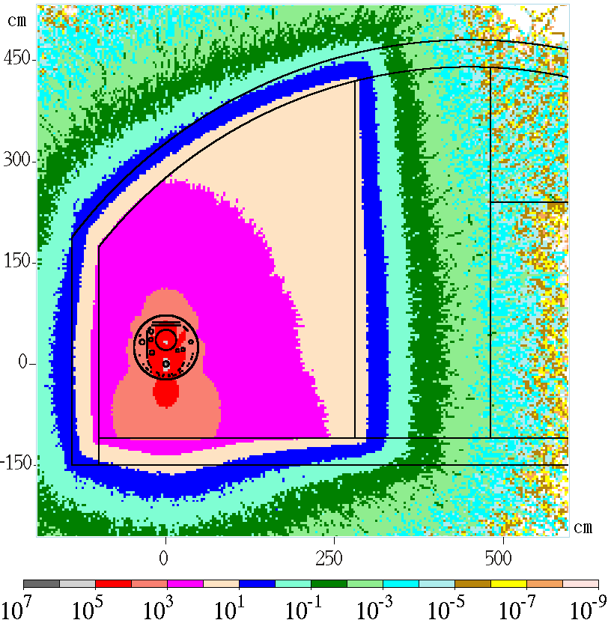
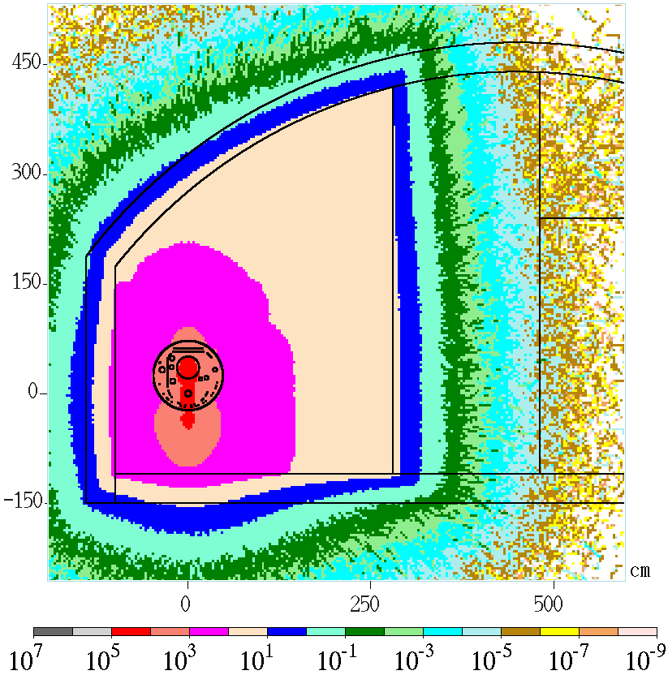
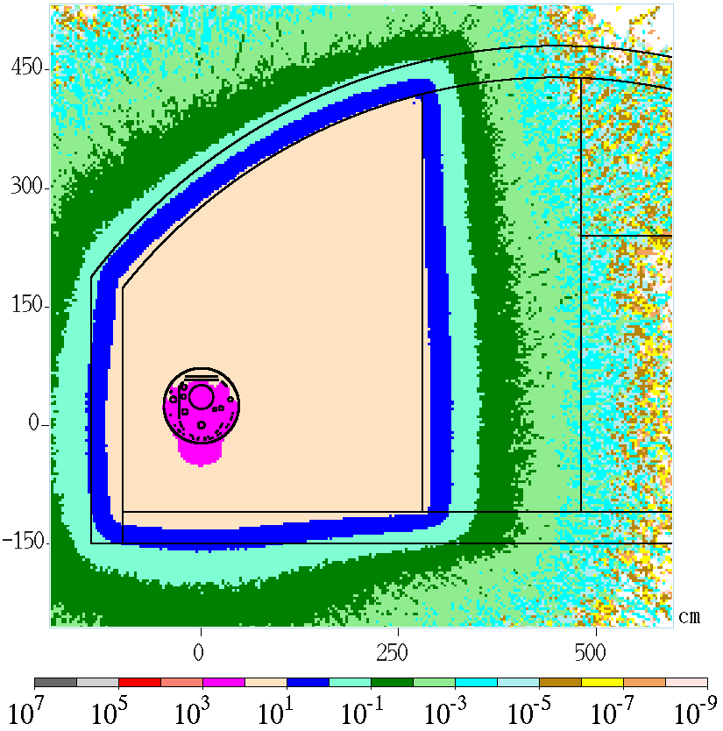
Normal Mode: Radiation in Tunnel
Dose right after quadrupole
Total prompt dose (mSv/hr)
Photon prompt dose (mSv/hr)
Neutron prompt dose (mSv/hr)

Slide 12
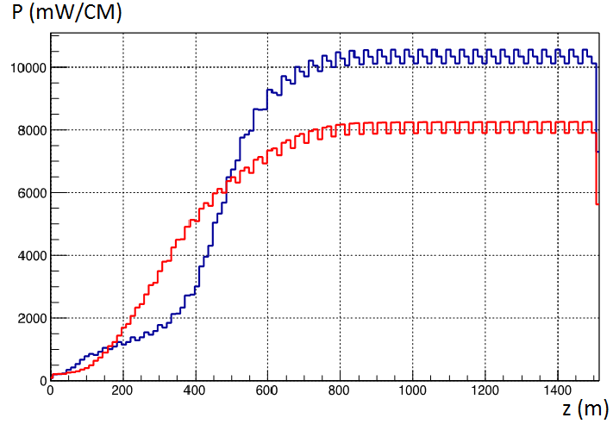
Commissioning Mode (Quads OFF)
Power loss per cryo-module along curved linac:
a source for MARS15 modeling
  Red – steering magnets ON, correctors OFF
  Blue - steering magnets ON, correctors ON
The loss in the plateau region—beyond 800m—is used to build the source for MARS15.
One needs about 700m to reach approx. uniform dose distribution.

Slide 13
Energy Spectrum of Lost Electrons (per RF Unit)
Curved linac, steering/correctors ON, Quad OFF
Black – 1st period,
red – 10th period,
green – 20th period
blue – 24th period
magenta – 30 thru 40th period

Slide 14
Energy Spectrum of Propagating DC Electrons
At the end of each RF unit
Curved linac, steering/correctors ON, Quad OFF
Black – 1st period,
red – 10th period,
green – 20th period
blue – 24th period
magenta – 30-40th period

Slide 15
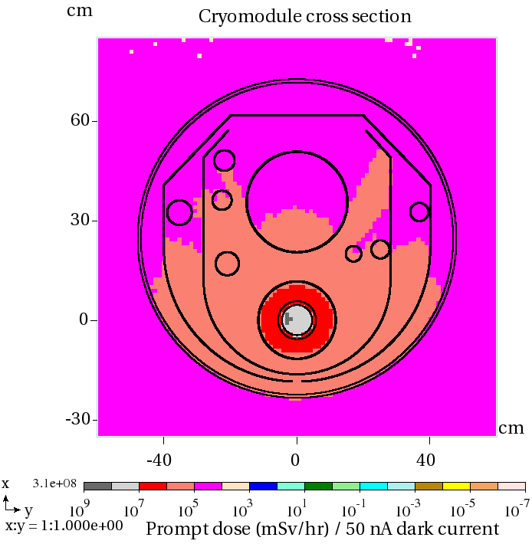
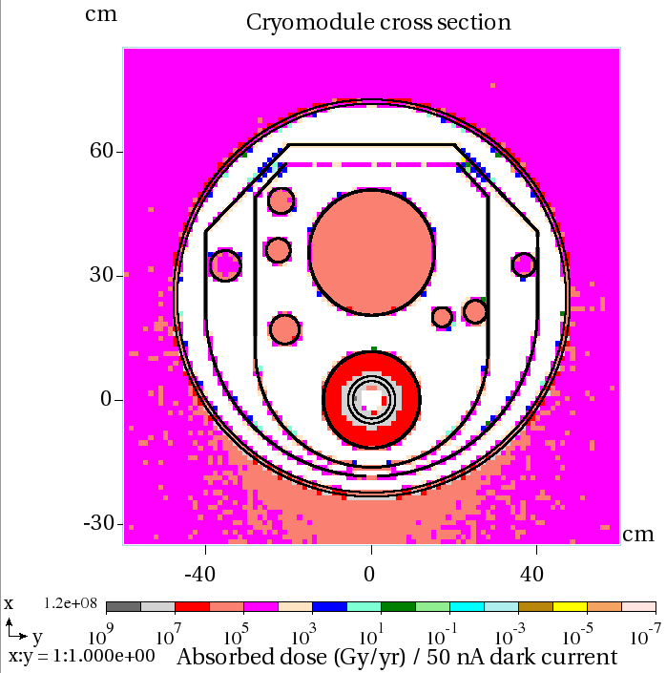
Commissioning Mode: Radiation in CM
Total prompt dose (mSv/hr)
Total absorbed dose (Gy/yr)

Slide 16
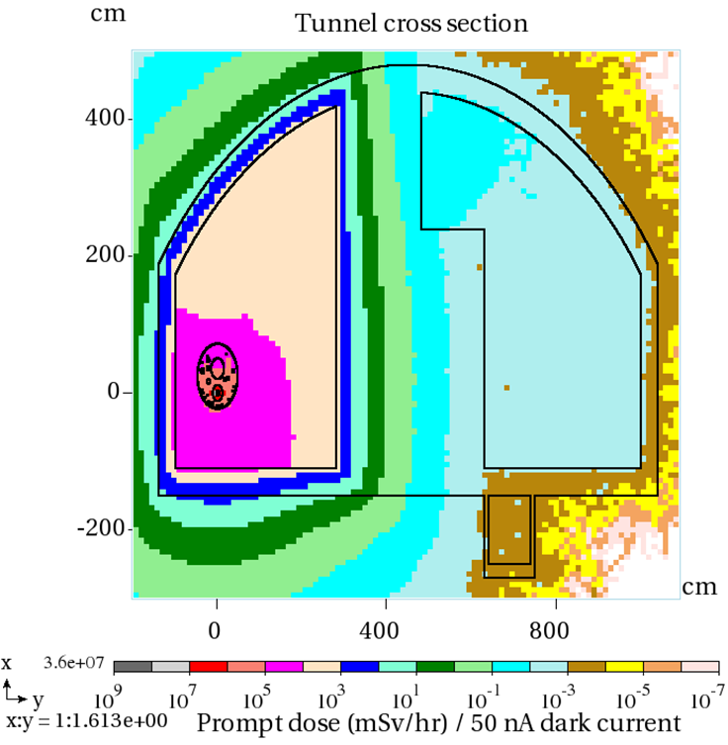
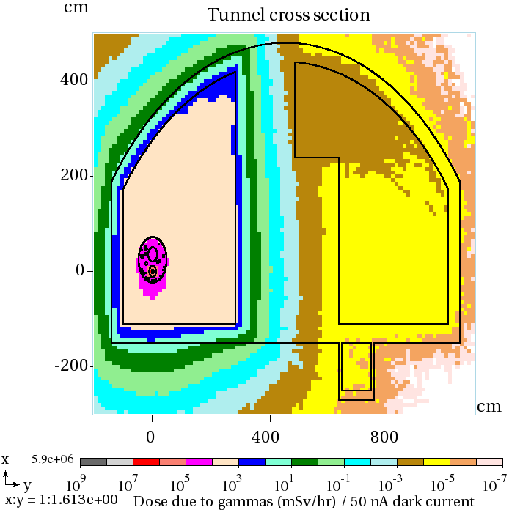
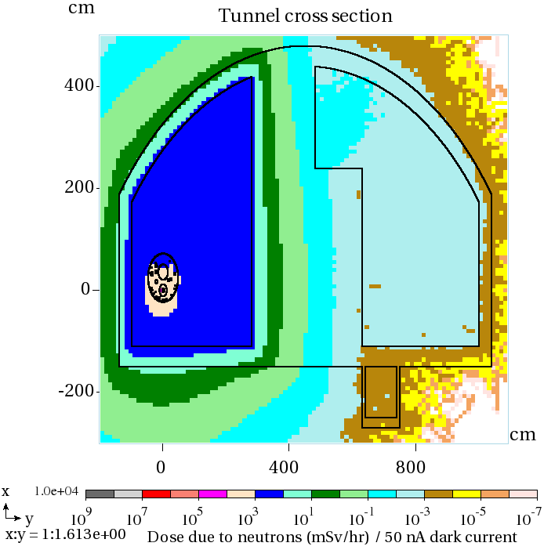
Commissioning Mode: Radiation in Tunnel
Total prompt dose (mSv/hr)
Photon prompt dose (mSv/hr)
Neutron prompt dose (mSv/hr)
25 μSv/hr after 2.2 m concrete

Slide 17
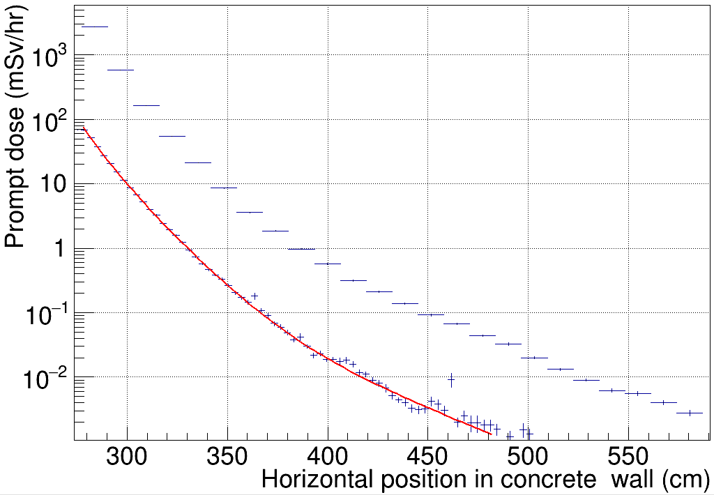
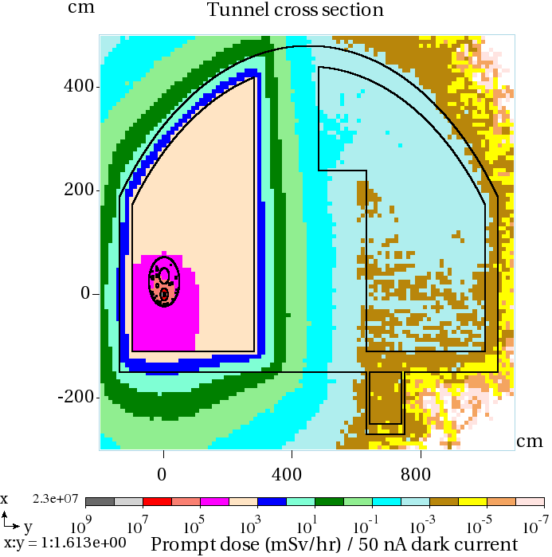
Total prompt dose (50 nA dark current in each cavity)
Case-B
A
B
Curved linac with Quads OFF
Case-A
Quad @250GeV
25 μSv/hr
1.2m
~2.2m
Case-A: peak dark current losses after quad; T_{max}= 0.8 GeV, (quad at 250GeV)
Case-B – 40 RF periods, steady-state, T_{max}=19.2 GeV (x 20 vs. Case-A)

Slide 18
Conclusions
In the worst Case-B scenario (all quads are OFF) with 50 nA dark current in each cavity, the beam losses and radiation levels reach steady-state regime after ~800m.
Case-B energy spectrum of lost particles in steady-state extends up to 19.2 GeV compared to only 0.8 GeV in the nominal Case-A
Radiation levels in Case-B are an order of magnitude higher than in Case-A; the design level of 25 μSv/hr in the service tunnel is reached with 1.2 and 2.2 meter thick concrete walls for Case-A and Case-B, respectively. The major contribution to dose behind the wall is due to neutrons
The current design of the ILC Main Linac tunnel with the concrete wall of 3.5 m provides a large safety margin in protection the personnel and electronics in the service tunnel; consider the wall thickness reduction to 2.5-2.7 meters

