Slide 2
Radiation Protection assessment of the LIEBE target (circulating Lead Bismuth Eutectic) at ISOLDE
S. Damjanovic, J. Vollaire HSE-RP - CERN
SATIF2016 - Helmholtz-Zentrum Dresden-Rossendorf

Slide 3
Outline
Overview of ISOLDE (On-Line Isotope Mass Separator)
Lifecycle of ISOLDE targets
The LIEBE target (circulating Lead Bismuth Eutectic loop)
Calculations of the residual dose rate after irradiation
Calculations of the radionuclides inventory
Conclusions and Perspectives
SATIF2016 - Helmholtz-Zentrum Dresden-Rossendorf

Slide 4
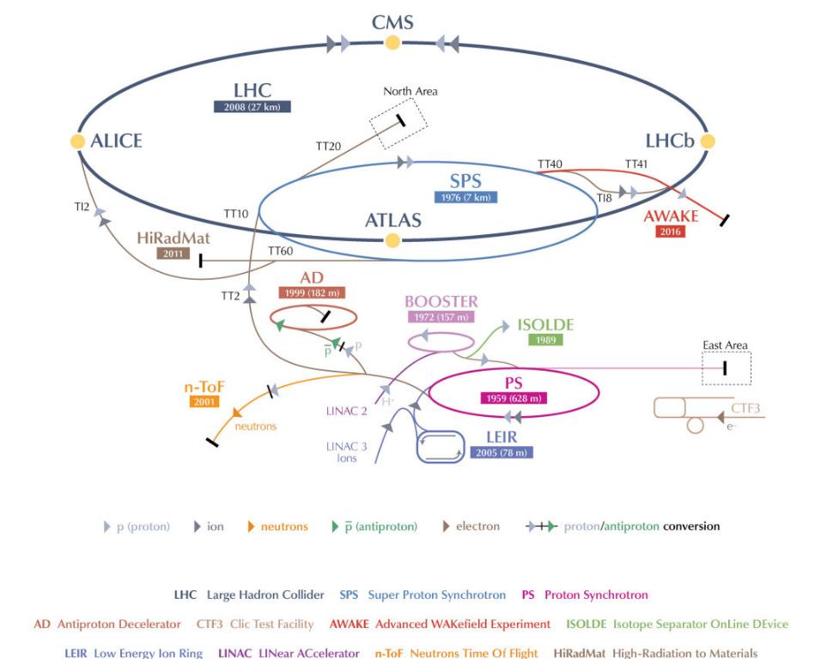
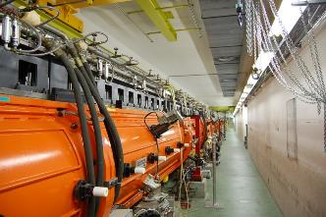
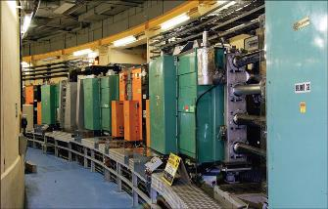
ISOLDE in CERN accelerator complex
Linac2 (proton injector)
50 MeV
PS Booster - 1.4 GeV beam
Facility dedicated to the production of a large variety of Radioactive Ion Beams (RIBs) for a wide experimental program
SATIF2016 - Helmholtz-Zentrum Dresden-Rossendorf

Slide 5
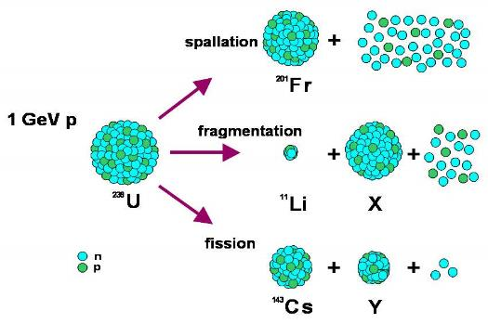
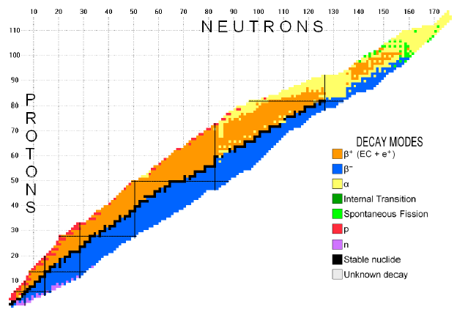
The ISOLDE principle
Routine use of actinide targets (80% of targets are made of UCx)
Up to 600 isotopes of more than 60 elements (Z=2 to 88) have been produced
1.4 GeV
Spallation
Fission
Fragmentation
~ 20 cm long target
SATIF2016 - Helmholtz-Zentrum Dresden-Rossendorf

Slide 6
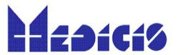
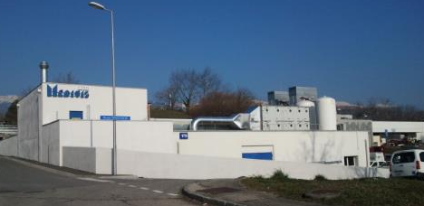
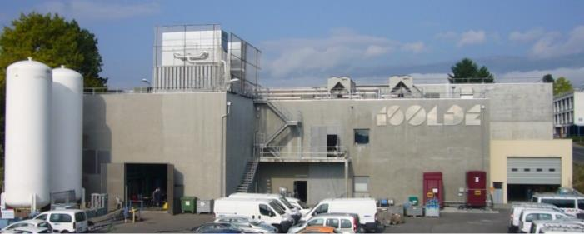
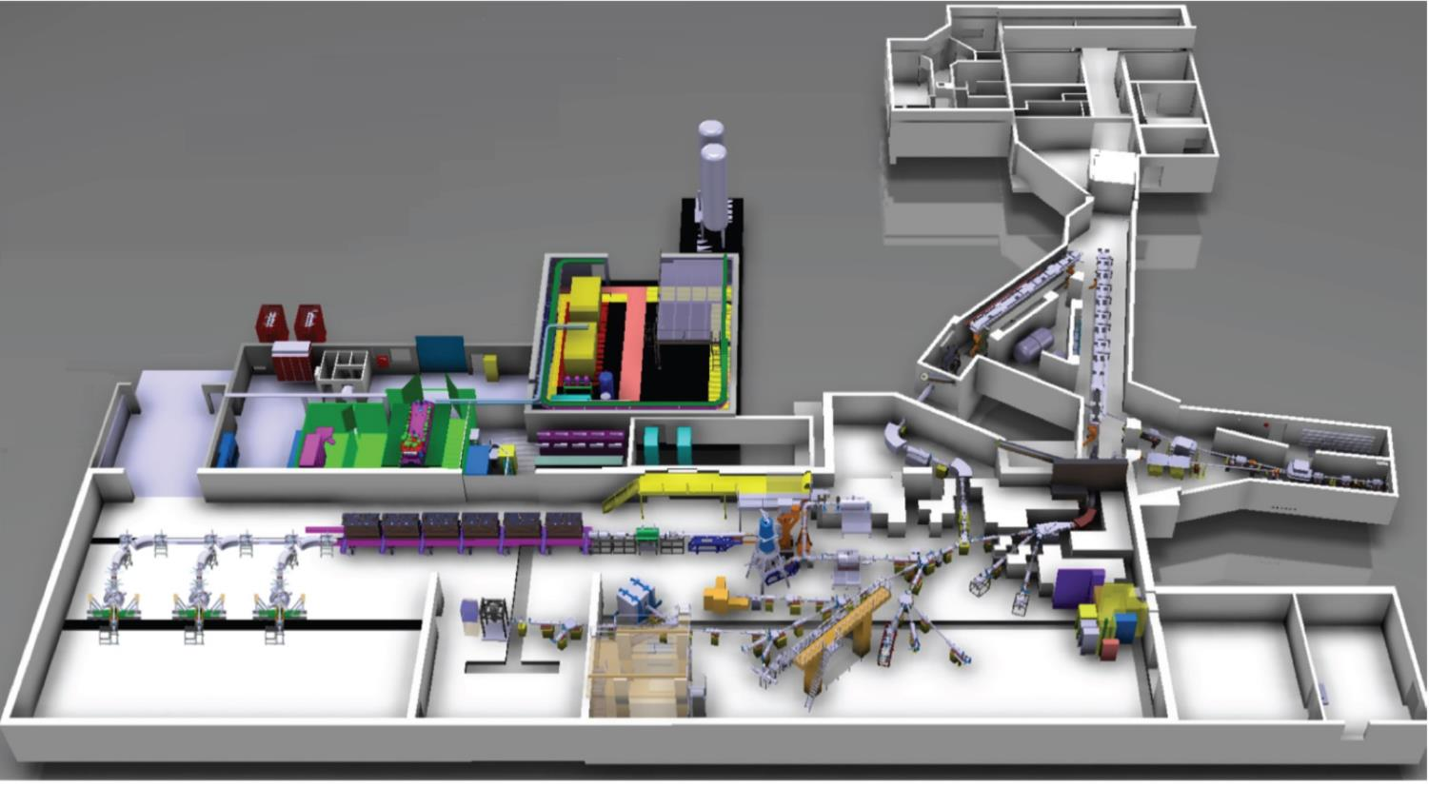
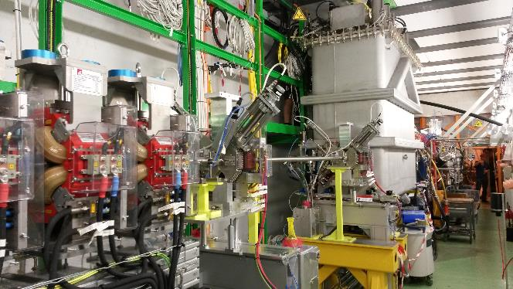
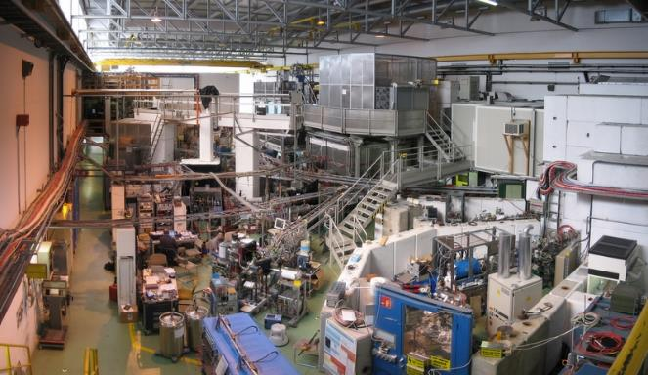
The ISOLDE facility
Laboratories and
CERN-MEDICIS
(2017)
Target area
- mass separators
HRS
WITCH
GPS
HIE ISOLDE LINAC
TAS
VITO
NICOLE
MINIBALL
IDS
CRIS
COLLAPS
Travelling
setups
ISOLTRAP
SATIF2016 - Helmholtz-Zentrum Dresden-Rossendorf

Slide 7
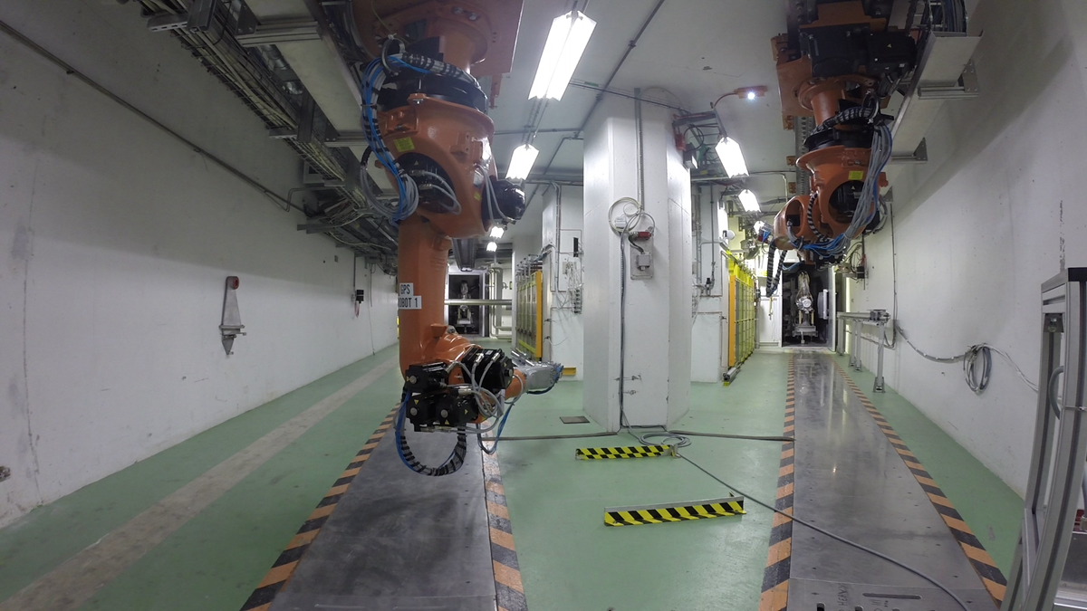
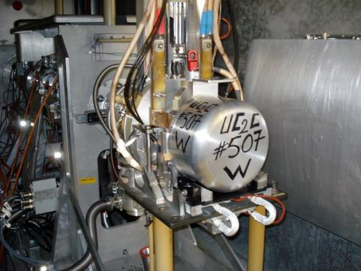
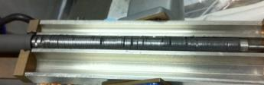
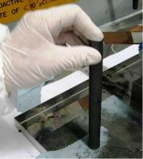
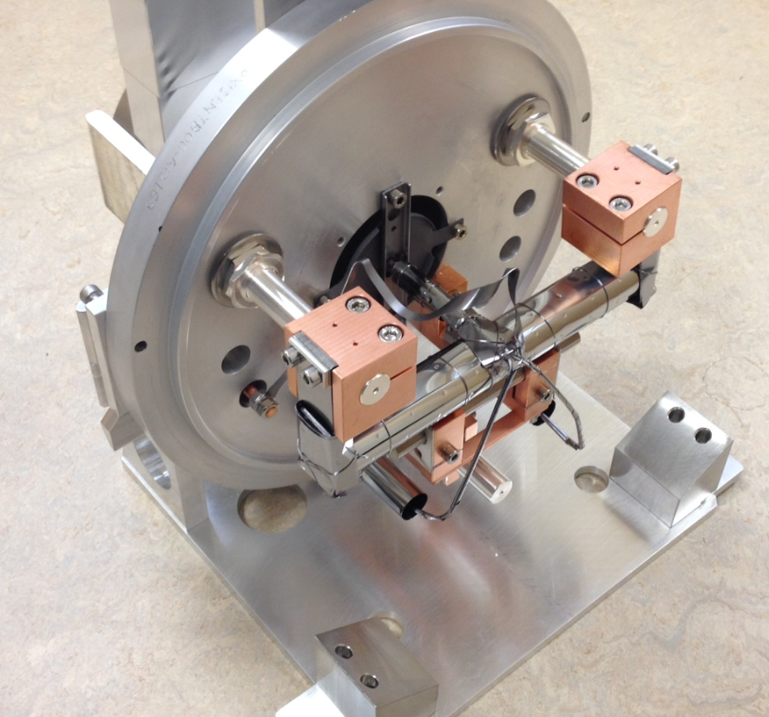
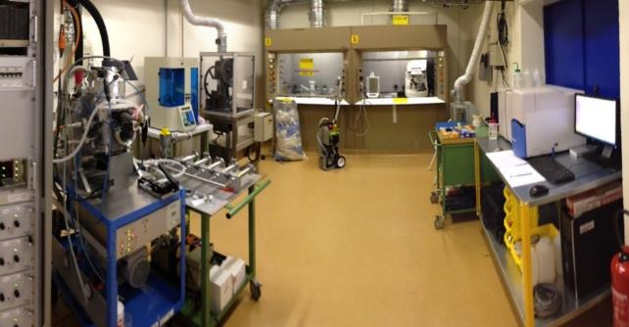
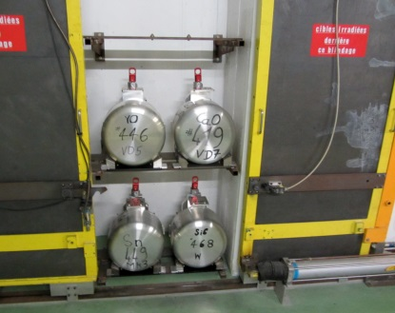
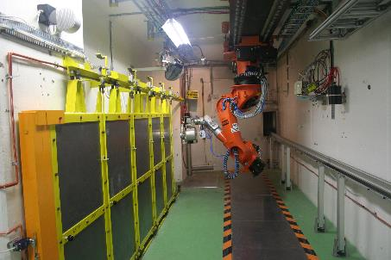
ISOLDE targets lifecycle
Target production
Target Installation
Dump
1.4 GeV
protons
Two robots for the two target stations (Front Ends)
Target Removal and temporary storage
UCx pills produced in dedicated laboratory
About 30 targets used per year (80 % UCx)
SATIF2016 - Helmholtz-Zentrum Dresden-Rossendorf

Slide 8
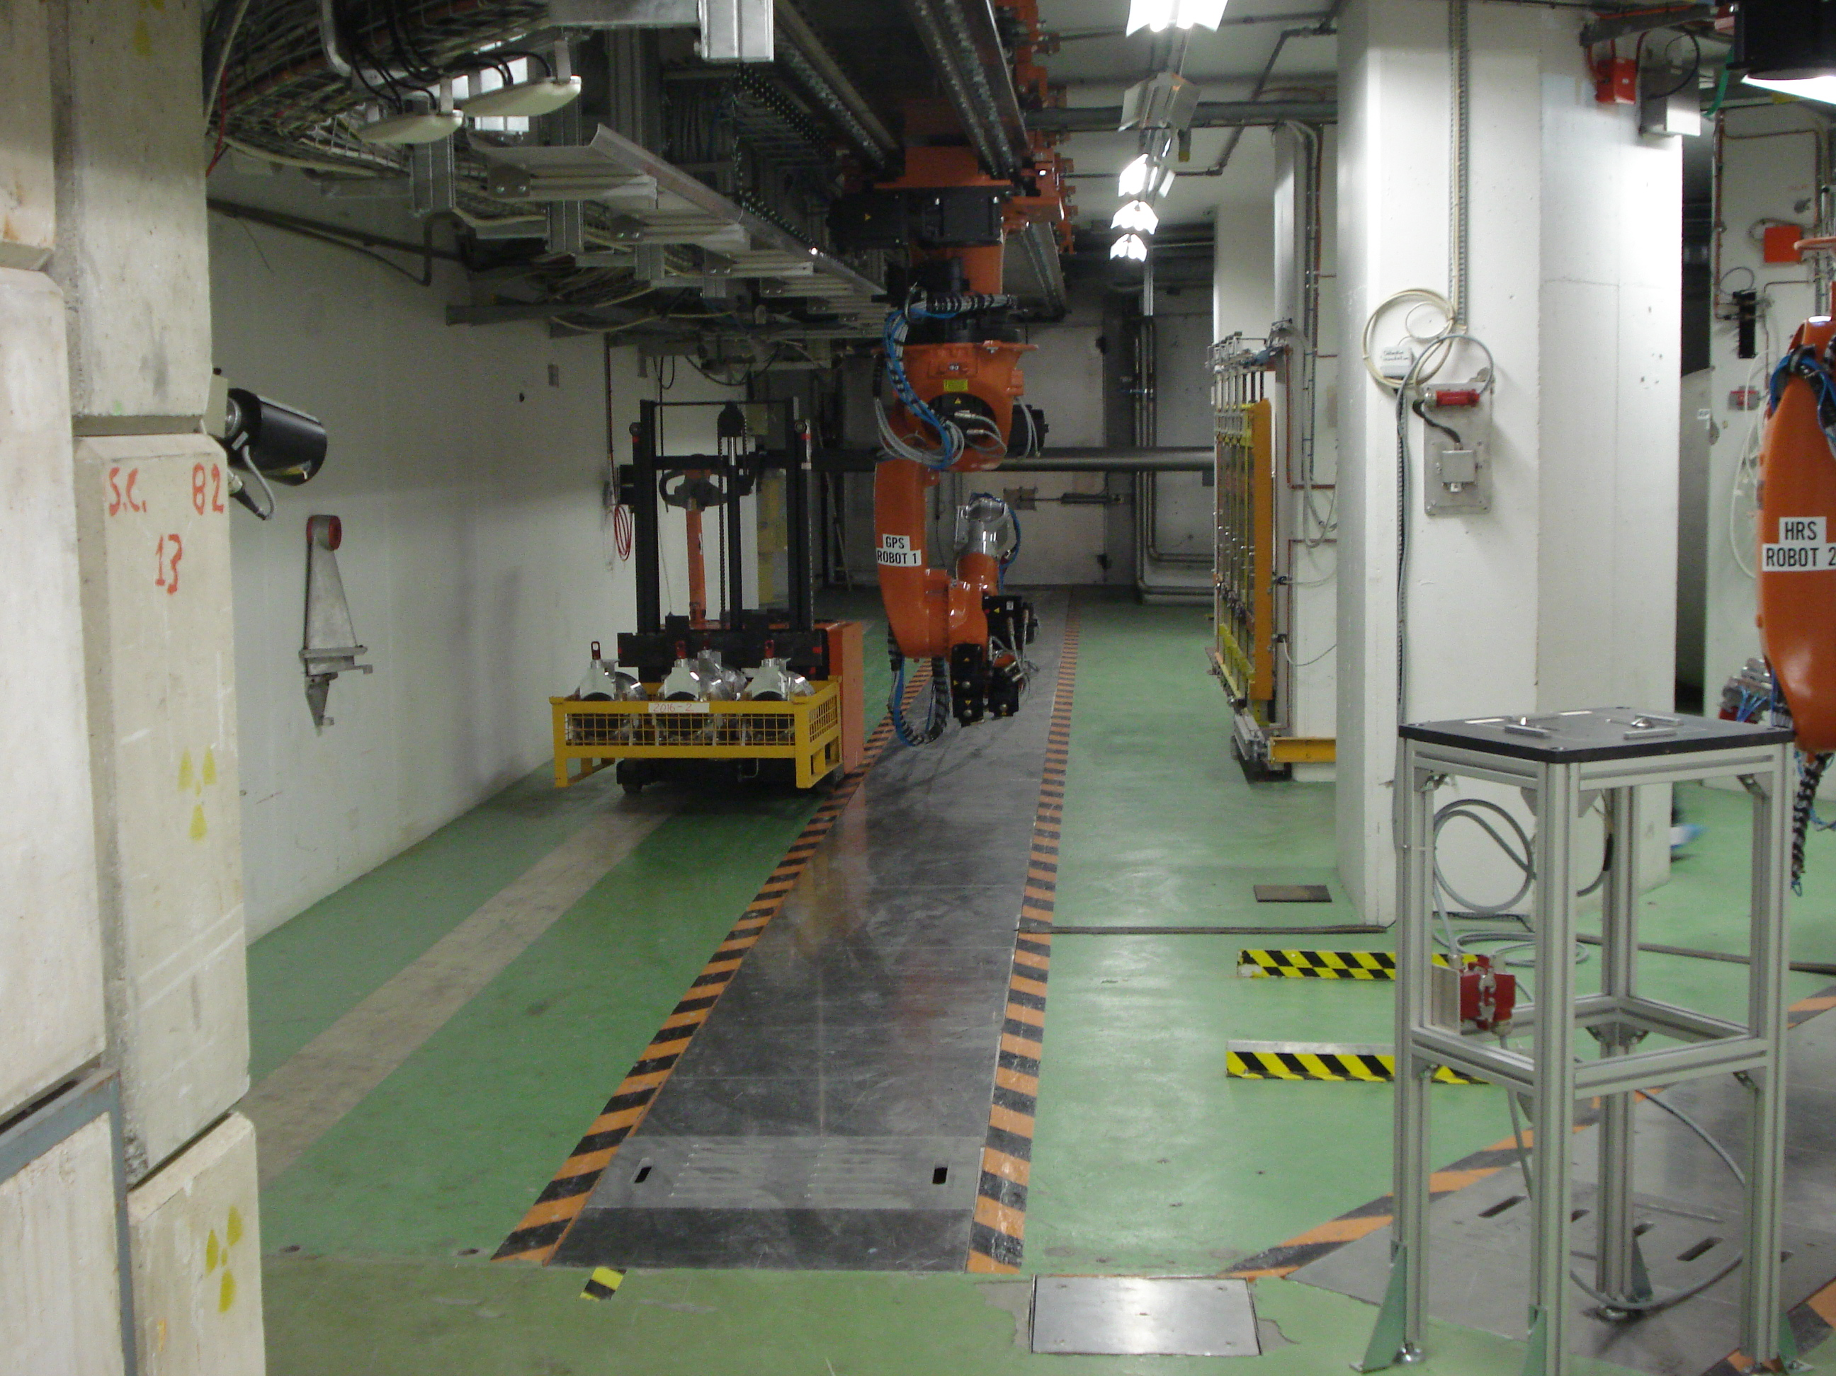
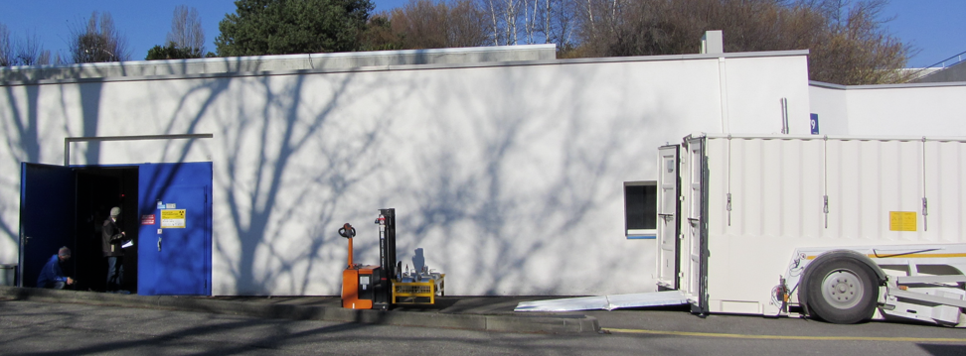
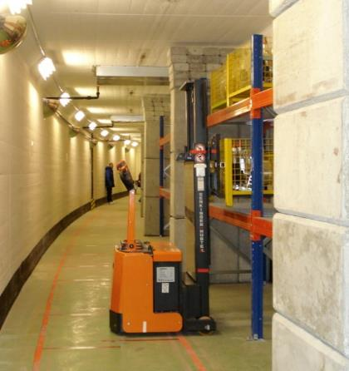
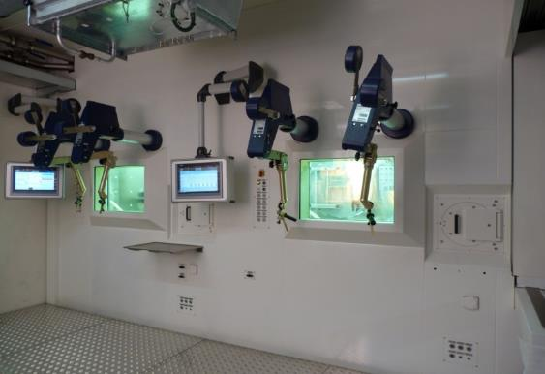
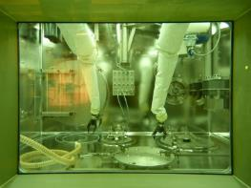
ISOLDE targets lifecycle
Yearly target transport to longer term storage area
Carefully planned and well optimized intervention (prior to annual maintenance)
Target dismantling
New hot cell (one part under inert atmosphere)
Separation of material and re-oxidation of UCx
(Not commissioned yet)
SATIF2016 - Helmholtz-Zentrum Dresden-Rossendorf

Slide 9
The LIEBE target (prototype)
Context: R&D for the design of the EURISOL target (next generation of ISOL facility with 100 kW beam)
LIEBE: Liquid Eutectic Lead Bismuth Loop Target for EURISOL (liquid target for RIBs production)
Advantages: Possibility to enhance the production of short-lived isotopes and possible higher power
Challenges: Target design must be compatible with ISOLDE infrastructure (dimension, handling, cooling, safety including Radiation Protection….)
Status: The target assembling has started and the test online is planned for the end of 2017
SATIF2016 - Helmholtz-Zentrum Dresden-Rossendorf

Slide 10
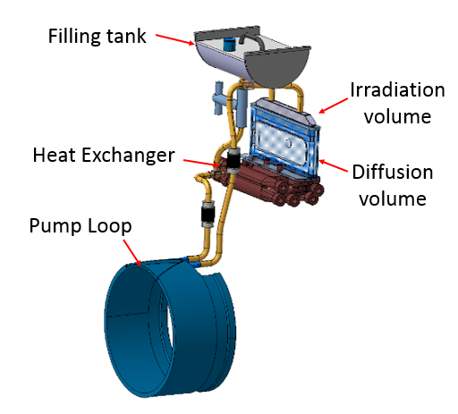
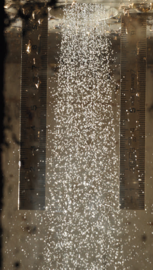
Overview of the Target Design
LBE envelope
Filling tank (used for starting-up)
Irradiation volume (proton beam)
Diffusion volume (grid at the exit of the irradiation volume)
Heat exchanger (water cooled)
A pump for the LBE circulation
Temperature monitoring and heating of the target
Elements for the secondary beam extraction (as in a standard static target)
LBE shower tests
SATIF2016 - Helmholtz-Zentrum Dresden-Rossendorf

Slide 11
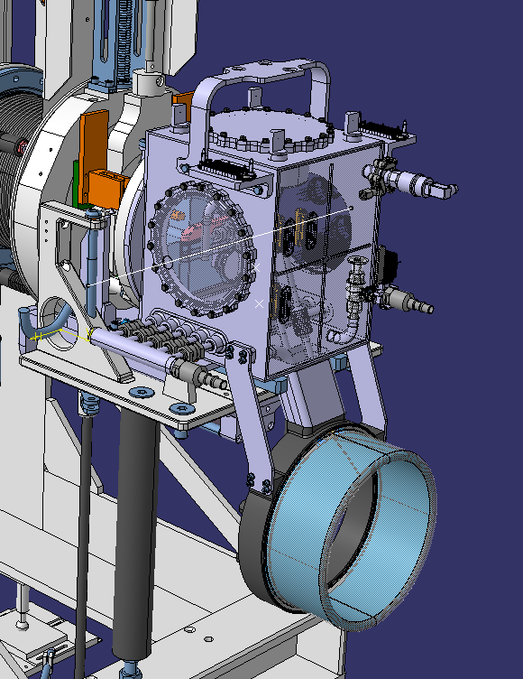
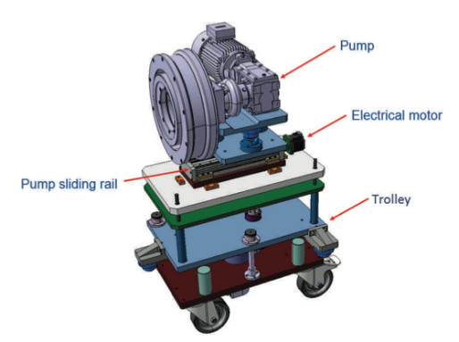
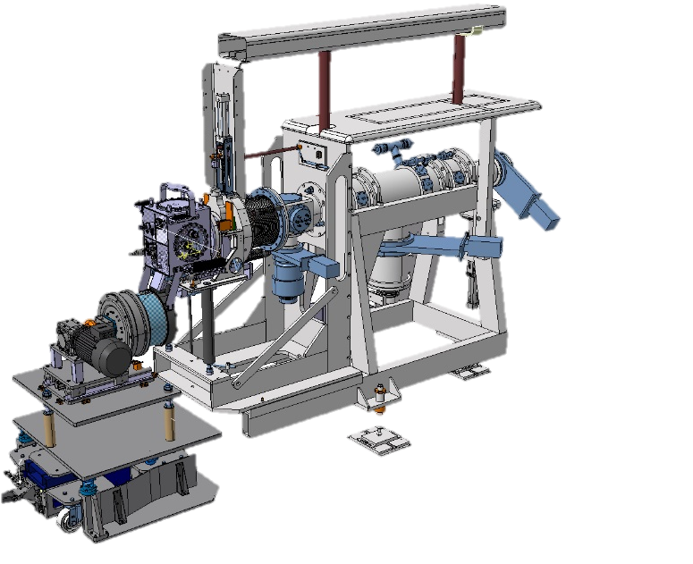
Overview of the Target Design
Double enclosure for containment in case of failure
The pump (rotating permanent magnet) is an external system (careful adjustment)
Target
Pump trolley
Target on the Front-End with the pump
SATIF2016 - Helmholtz-Zentrum Dresden-Rossendorf

Slide 12
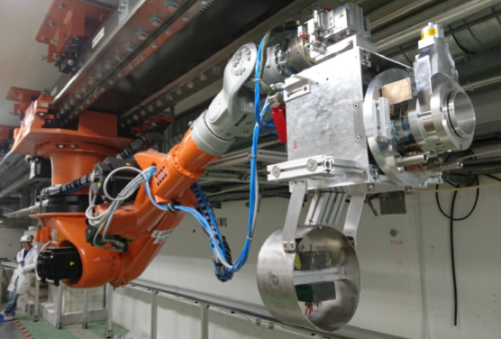
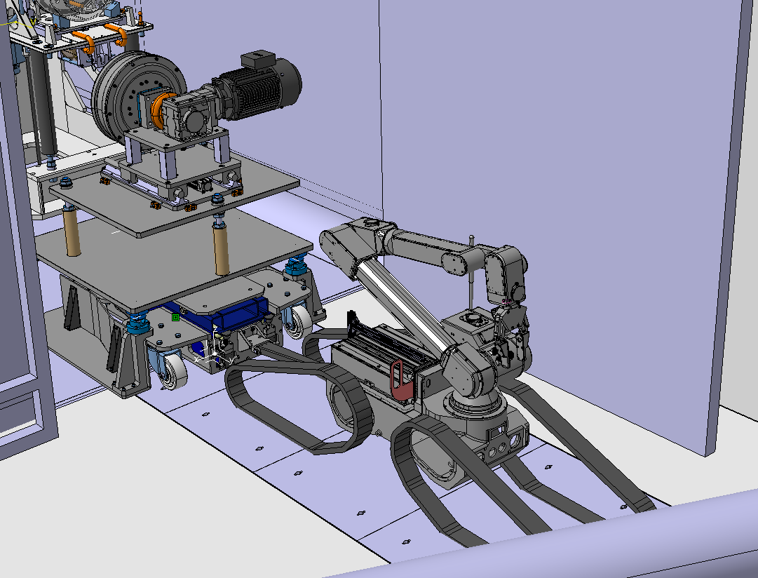
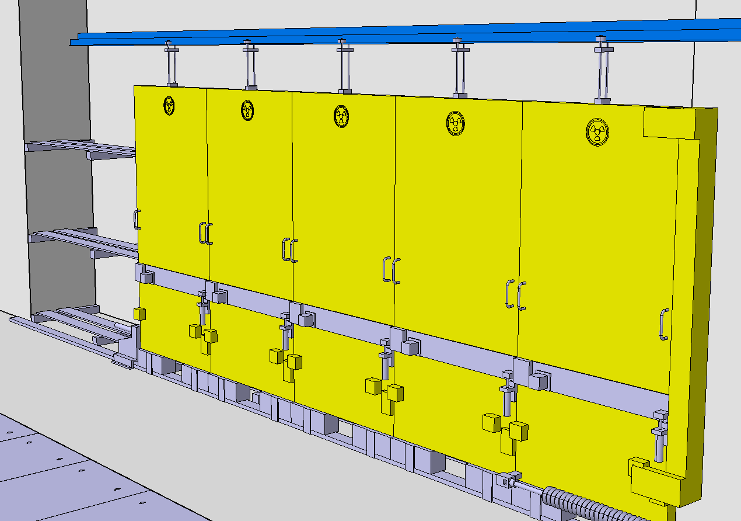
LIEBE Target Handling
Handling Test
Target installation and removal performed with the standard ISOLDE robot (load test performed)
Pump installation and removal with a remotely guided robot (used for inspection or simple tasks)
Short human intervention necessary for the target connection
Target removal performed remotely (installation on storage shelves)
Pump installation
Modified storage
SATIF2016 - Helmholtz-Zentrum Dresden-Rossendorf

Slide 13
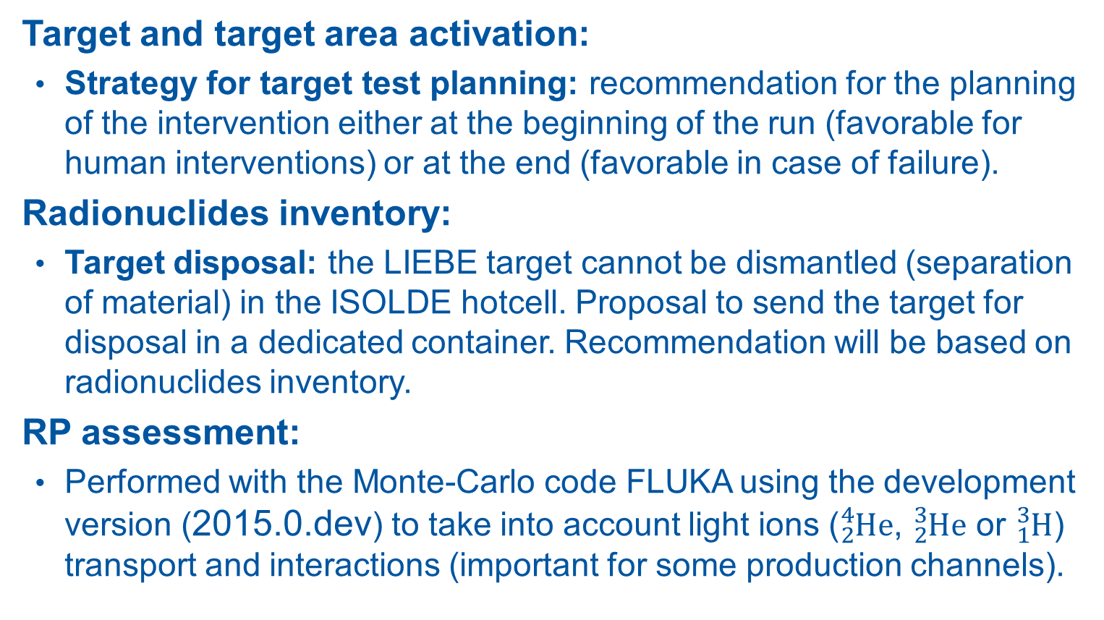
Radiation Protection Assessment
Target and target area activation:
  Strategy for target test planning: recommendation for the planning of the intervention either at the beginning of the run (favorable for human interventions) or at the end (favorable in case of failure).
Radionuclides inventory:
  Target disposal: the LIEBE target cannot be dismantled (separation of material) in the ISOLDE hotcell. Proposal to send the target for disposal in a dedicated container. Recommendation will be based on radionuclides inventory.
RP assessment:
  Performed with the Monte-Carlo code FLUKA using the development version (2015.0.dev) to take into account light ions (${}_{2}^{4}{He}$, ${}_{2}^{3}{He}$ or ${}_{1}^{3}H$) transport and interactions (important for some production channels).
SATIF2016 - Helmholtz-Zentrum Dresden-Rossendorf

Slide 14
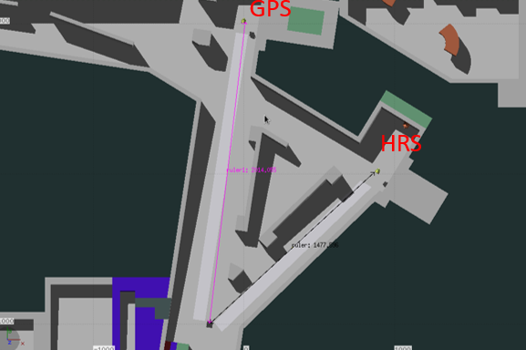
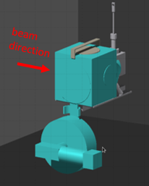
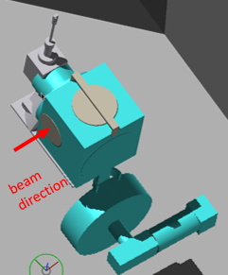
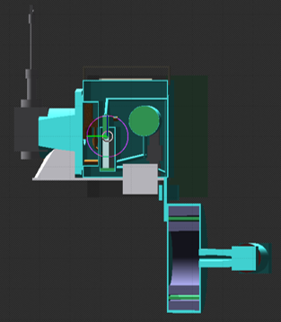
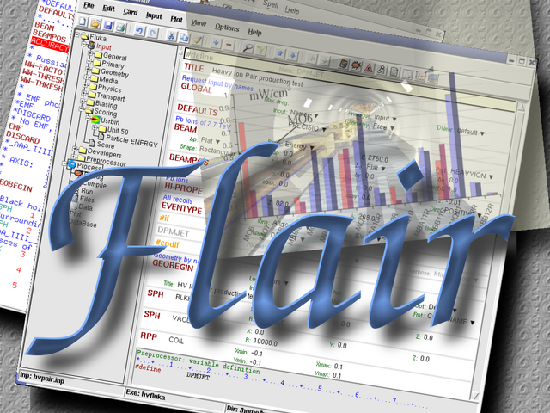
Geometry and beam parameters
Detailed target geometry inserted in the “reference” FLUKA model of the ISOLDE target area
Target Area (top view)
Target (side view)
Target (side view)
Target (vertical cut)
Irradiation Parameters (build-up):
  5x10¹⁸ protons on target delivered in 5.8 days at the nominal average intensity of 2 μA (1.25x10¹³ pps) and with a beam energy of 1.4 GeV
SATIF2016 - Helmholtz-Zentrum Dresden-Rossendorf

Slide 15
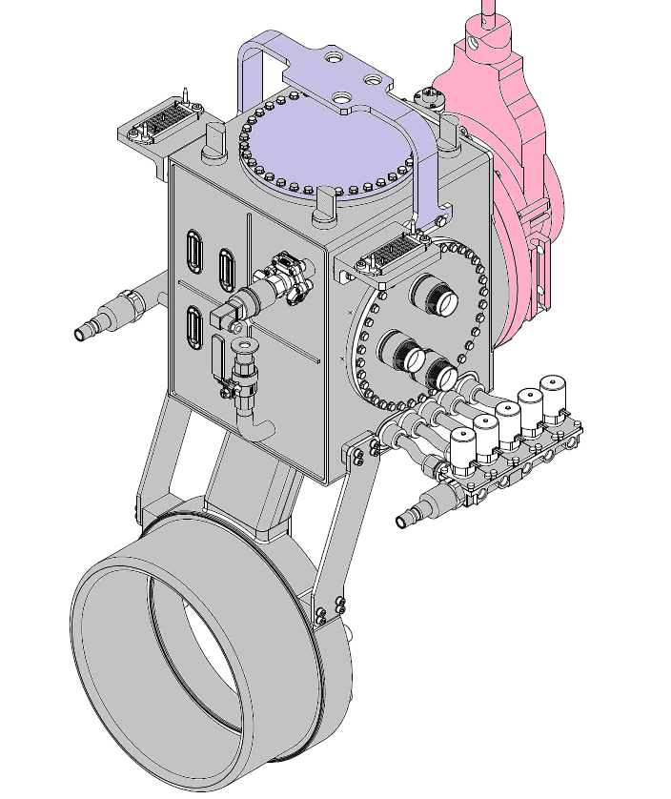
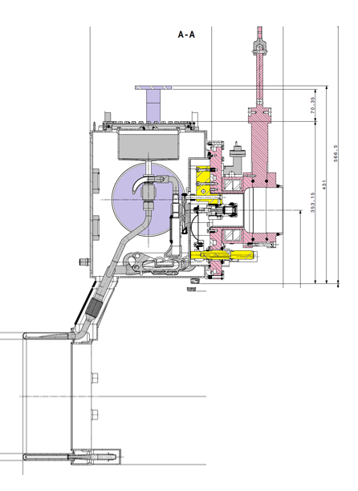
Material Description
Structural materials
Total: ~ 55 kg for the structural material
LBE eutectic: mixture of 44.5 % of lead and 55.5 % of bismuth (mass fraction). About 1 liter for a mass of ~10 kg.
LIEBE target weighs more than 60 kg: to be compared with a standard ISOLDE target mass of 30 kg with mainly aluminum as structural material
SATIF2016 - Helmholtz-Zentrum Dresden-Rossendorf

Slide 16
Residual Dose rate calculations
Calculation take two contributions into account:
  The LBE irradiation occurs in the upper part of the target but once the pump and heating will be stopped the LBE will solidify in the lower part of the target
  Activation of the structural part of the target performed by setting LBE as vacuum for the production and transport of particle from radioactive decays
  Contribution from the LBE estimated by sending the beam to a dummy LBE load in the lower part of the target. Dummy load surround by a “black-hole” layers in the prompt part of the transport to filter secondary particles
  Two contributions are added to have an estimate of the residual dose rate
SATIF2016 - Helmholtz-Zentrum Dresden-Rossendorf

Slide 17
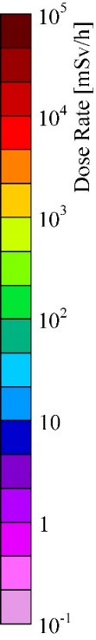
Residual Dose rate calculations
One hour cool down
Horizontal view (target area)
Vertical cut
Residual dose rate from “non-LBE materials” (target, dump, walls…)
Residual dose rate due to LBE (lower part of the target)
SATIF2016 - Helmholtz-Zentrum Dresden-Rossendorf

Slide 18
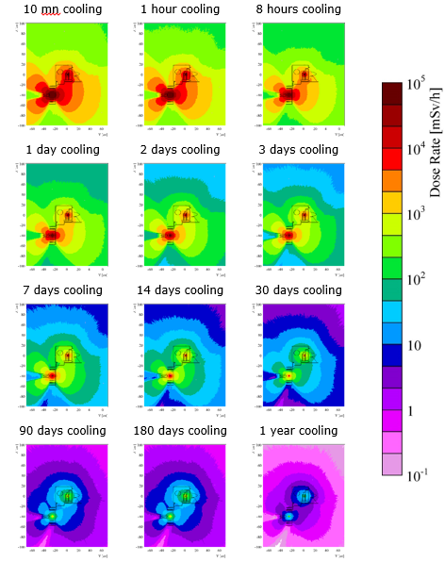
Summary residual dose rate
100 mSv/h
LIEBE target more penalizing than a standard target (higher mass and different material)
One month to reach 100 mSv/h at 40 cm (Prohibited Area)
SATIF2016 - Helmholtz-Zentrum Dresden-Rossendorf

Slide 19
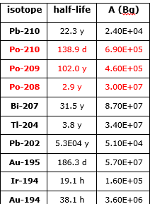
Radionuclides inventory (disposal)
  Same irradiation pattern as for the residual dose rate but cooling times of 3, 10 and 30 years considered
  Calculation performed in a single step: beam impinging on the irradiation container
  The LBE flow ensures an homogeneous mixing of the radionuclides produced
  LBE and all other materials considered (score separately)
  All produced radionuclides remain in the target
Subset of the inventory for LBE
(3 years decay)
…….
In red alpha emitters
SATIF2016 - Helmholtz-Zentrum Dresden-Rossendorf

Slide 20
Conclusions and Perspectives
  Detailed FLUKA model of the ISOLDE facility and LIEBE target was used to make a radiological assessment
  Recommendation to perform the LIEBE target test at the end of the run (longer cool down if intervention needed)
  The radionuclides inventory will be provided to waste disposal expert in PSI who advises on acceptance criteria
  Online test planned in November 2016 is postponed to the end of the run in 2017 (target/pump not ready)
  Irradiation of LBE (offline) considered this year as a possible benchmark experiment (controlled conditions)
  Possibility for online experiment to benchmark codes capabilities in predicting production of short half-lives radionuclides
SATIF2016 - Helmholtz-Zentrum Dresden-Rossendorf

Slide 21
Acknowledgements
  LIEBE project team and in particular Dr. Melanie Delonca (who defended her PhD thesis on LIEBE a few weeks ago)
  The different contributors to the geometry of the ISOLDE target area (R. Luis, Y. Romanets, L. Morejon and R. Augusto)
  The FLUKA developers for providing a development version including the transport and interactions of light ions
SATIF2016 - Helmholtz-Zentrum Dresden-Rossendorf

