Slide 1
Ionizing Radiation Hazards at SLAC from Optical Laser Light Interacting with Matter
Johannes Bauer, James Liu, Sayed Rokni, Ted Liang*
SLAC National Accelerator Laboratory * also Georgia Institute of Technology
SATIF-13, HZDR, Dresden, Germany, October 10-12, 2016

Slide 2
Outline
Overview of Laser Experiments at MEC
Solid Targets
Mechanism for creation of Ionizing Radiation
RP Model (based on PIC Code EPOCH and FLUKA) and measurements
Gas targets
2

Slide 3
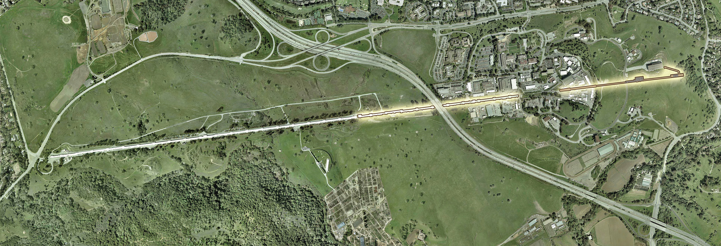
SLAC and LCLS
Laser Facility at SLAC National Accelerator Laboratory, part of Linac Coherent Light Source (LCLS), at its Matters in Extreme Conditions instrument (MEC)
MEC
LCLS
Laser hazards unrelated to X-rays from LCLS
3

Slide 4
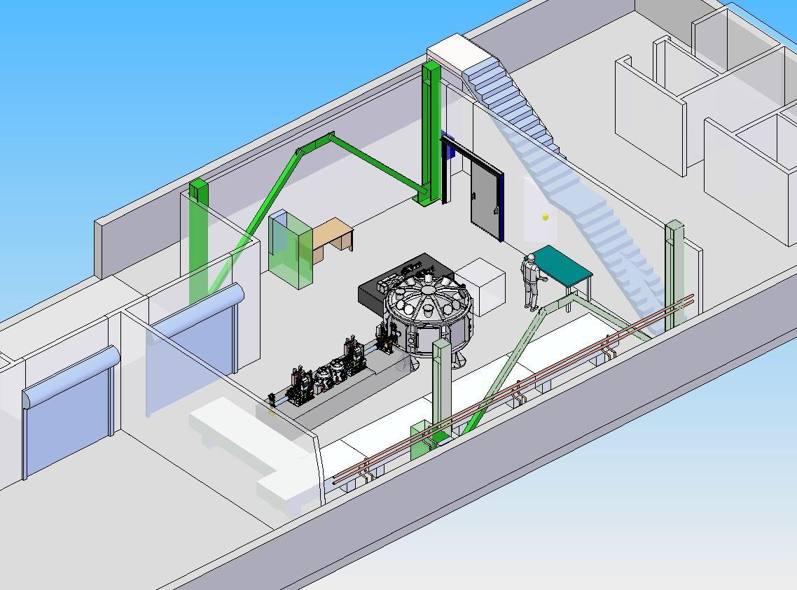
MEC Instrument
Matter in Extreme Conditions (MEC) = LCLS FEL beam (up to 12 keV X-rays) + Optical Laser Beam
Warm Dense Matter (inside Jupiter)
Hot Dense Matter (inertial confinement at NIF)
Shock Waves (through matter)
Electron Acceleration & X-ray Generation
Proton Acceleration
target chamber
FEL beam
optical laser
4

Slide 5
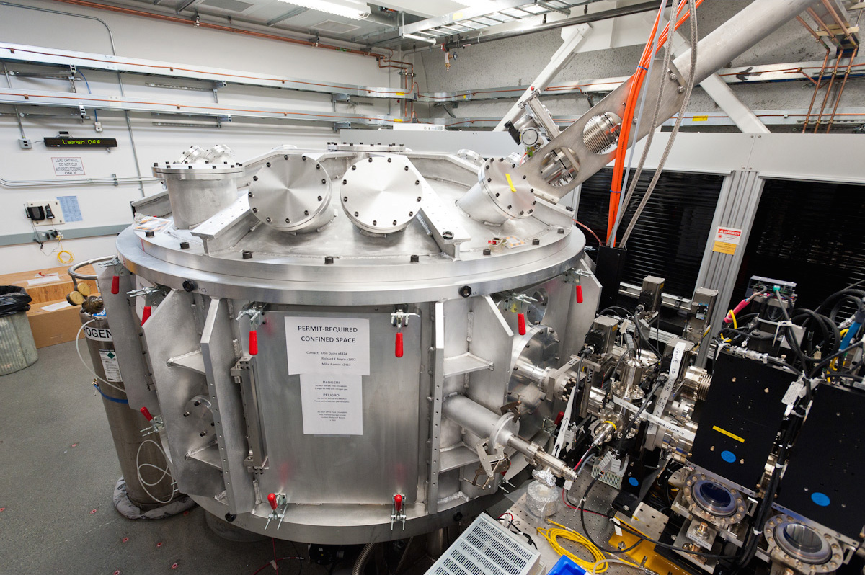
MEC Instrument (2)
5

Slide 6
MEC Laser Parameters
Power:
4 TW: 150 mJ, 10 Hz 2012 - 2014
25 TW: 1 J, 5 Hz since 2014
200 TW: 8 J, 1 shot / 8 min starting 2017
Pulse Duration: ~40 fs
Optics: focuses beam to few μm diameter
→ Irradiance [W/cm²]
= power per area =
energy
time * area
6

Slide 7
Three Types of Experiments
Solid Targets:
Metals (Au, Cu, Ni, etc.); plastics
Mainly study of Matter in Extreme Conditions (warm dense matter like in Jupiter, confinement for NIF)
Also proton acceleration
Liquid (Frozen) Targets
Stream of Liquid H₂, D₂, etc., freezes in vacuum
Main goal ion (proton) acceleration
Gas Targets
Few mm to tens of cm long gas cells; gas jets
Mainly electron acceleration with Betatron X-ray generation
Hot electrons to MeV level creating Bremsstrahlung
Protons to 10s MeV
Laser Wakefield Acceleration of electrons to few 100 MeV
Photons at 10s of keV
7

Slide 8
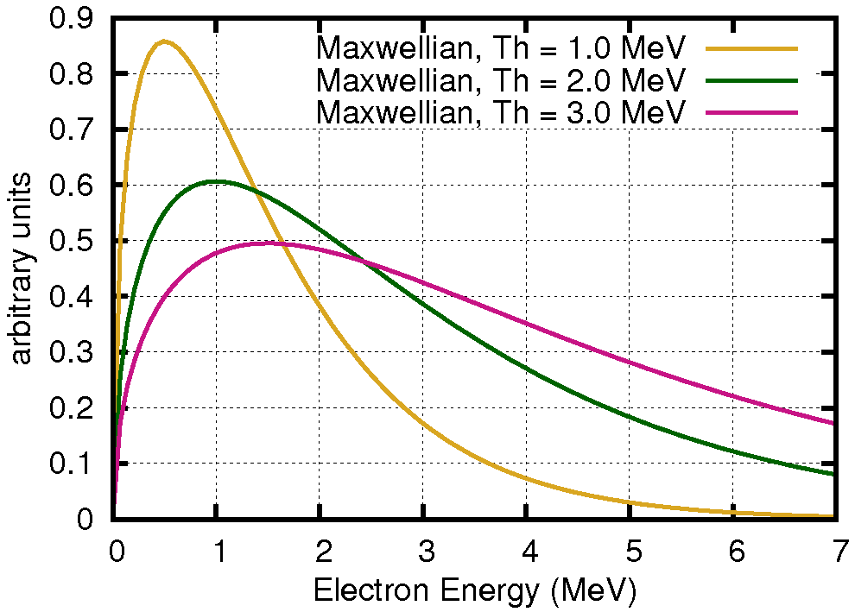
Ionizing Radiation from Laser on Solid Targets
Plasma
Target
Laser
e⁻
X ray
e⁻
ions
Laser creates plasma
Electrons accelerated by strong electric field of laser light → PIC code EPOCH
Hot electron energy distribution described with temperature T_{h}
Bremsstrahlung by interaction with target material → FLUKA
I (W/cm²) | T_{h} (MeV)
1x10¹⁸ | 0.1
1x10¹⁹ | 0.7
1x10²⁰ | 3.0
8

Slide 9
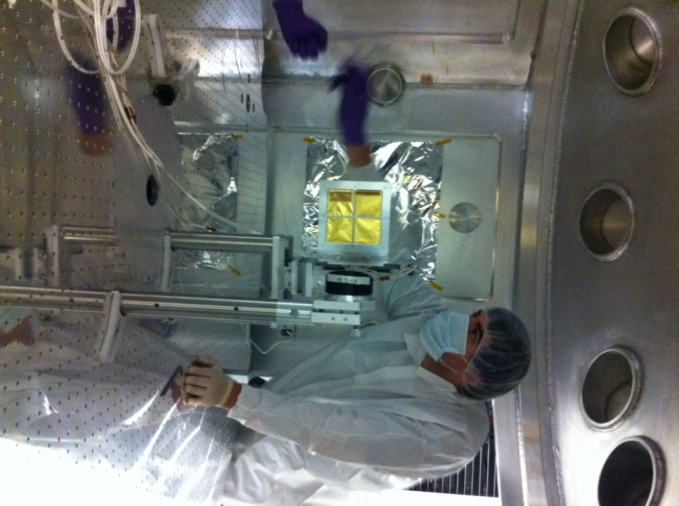
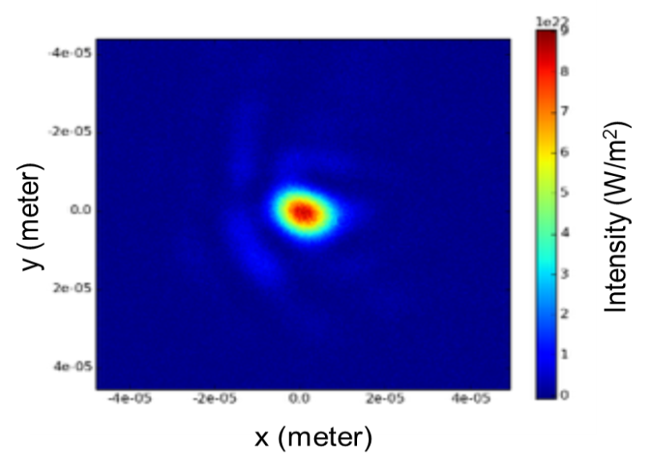
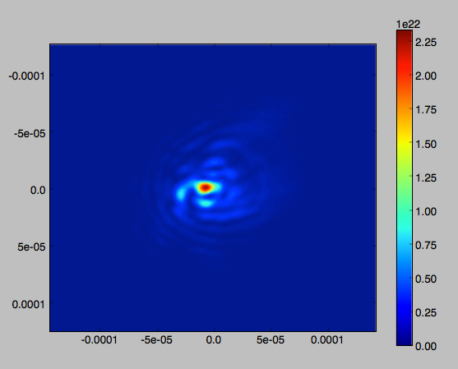
Targets inside Chamber, Laser Beam
Gaussian peak = good beam
Many small peaks = not so good
Target in center
Intensity (W/m²)
Spot size (m)
9

Slide 10
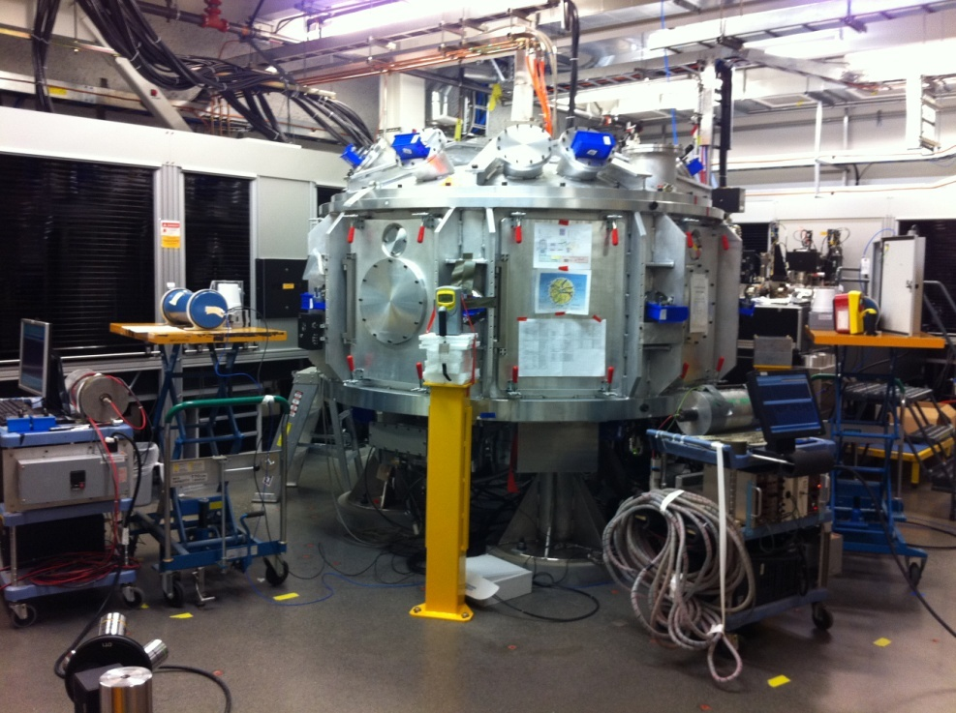
Radiation Monitors around MEC Target Chamber
Ion Chamber photon detectors
Moderated BF₃ neutron detectors
Passive dosimeters
10

Slide 11
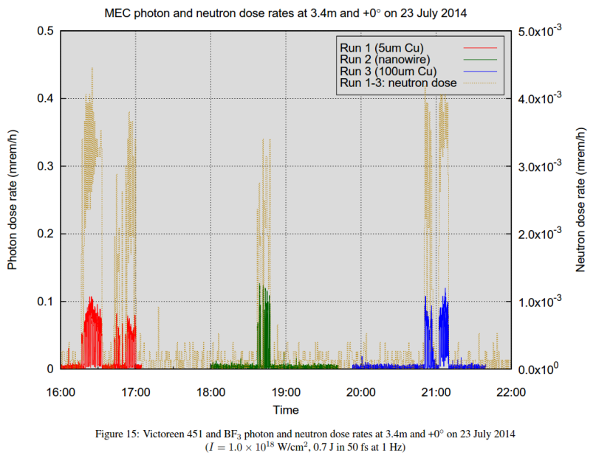
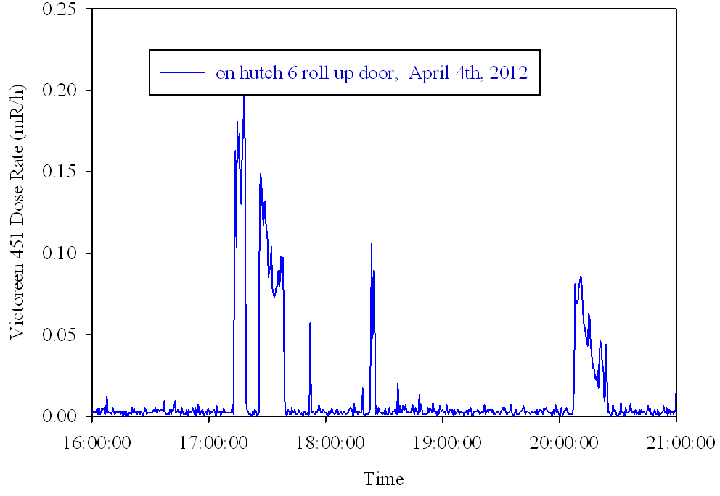
Solid Target Dose Rate Measurements
HPI 6032 ion chamber
6x10¹⁷ W/cm², 30 mJ, 10 Hz
Dose rate outside hutch
1x10¹⁸ W/cm²
Neutrons vs. photons
1 mm Cu
100 μm Au
Up to 2 μSv/h outside hutch
Strong correlation, but…
…on different scales neutron ~ 25x less than photons
11

Slide 12
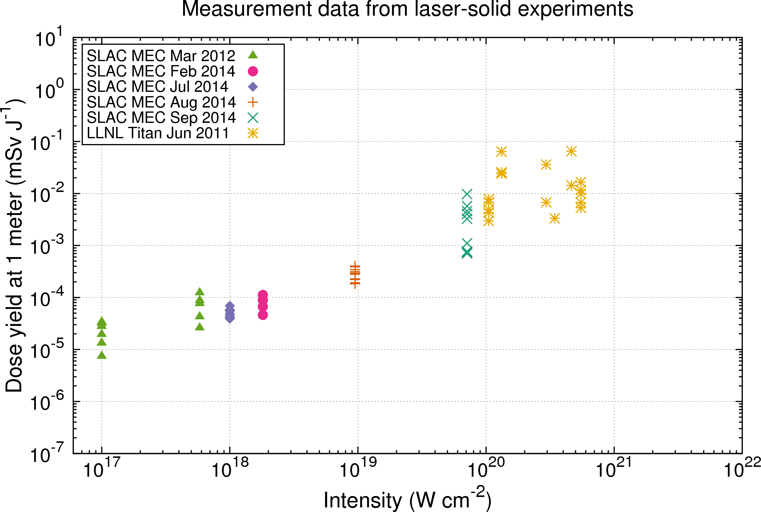
SLAC Measurements
Measurements over years at MEC (SLAC) and at Titan (LLNL)
At various angles, mostly with ~1 inch (2.54 cm) Al as shielding
12

Slide 13
Particle-In-Cell Code: EPOCH
Particle-in-cell (PIC)
Simulates Maxwell’s equations: EM fields + charged particles
Physical particles represented by macro-particles containing many physical particles
Implemented in 2D version of EPOCH
Step 1: Code moves charged particles in space under influence of EM fields, calculates currents from particle motion
Step 2: Code determines EM field based on new positions and currents
Repeated in 0.1 fs steps over time from 0 to 600 fs
Plot direction and energy of (macro)particles both inside area and those that have left the area
Arber, T. D. et al., Contemporary particle-in-cell approach to laser-plasma modelling, Plasma Phys. Control. Fusion 57, 113001 (2015).
https://cfsa-pmw.warwick.ac.uk/EPOCH/epoch
13

Slide 14
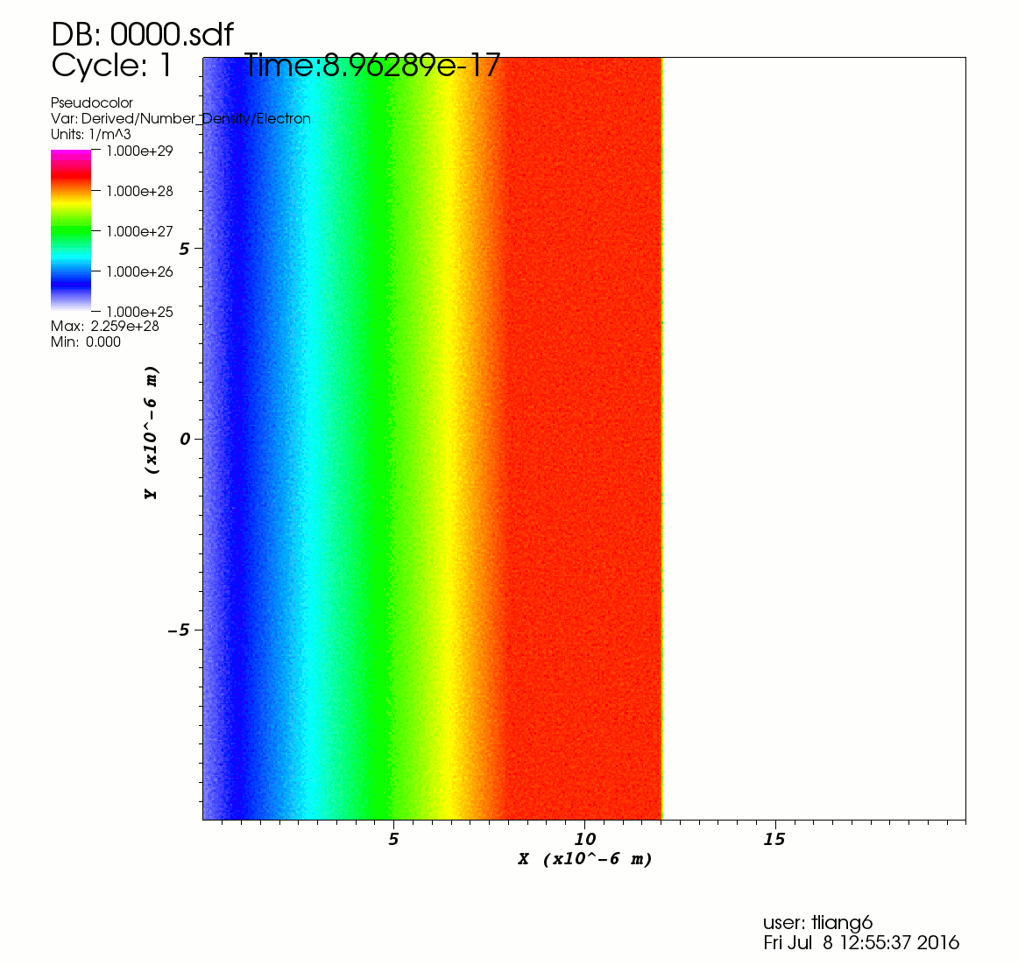
Example of PIC Simulation
10²⁰ W/cm²
Laser direction
14
Density ramp of pre-plasma

Slide 15
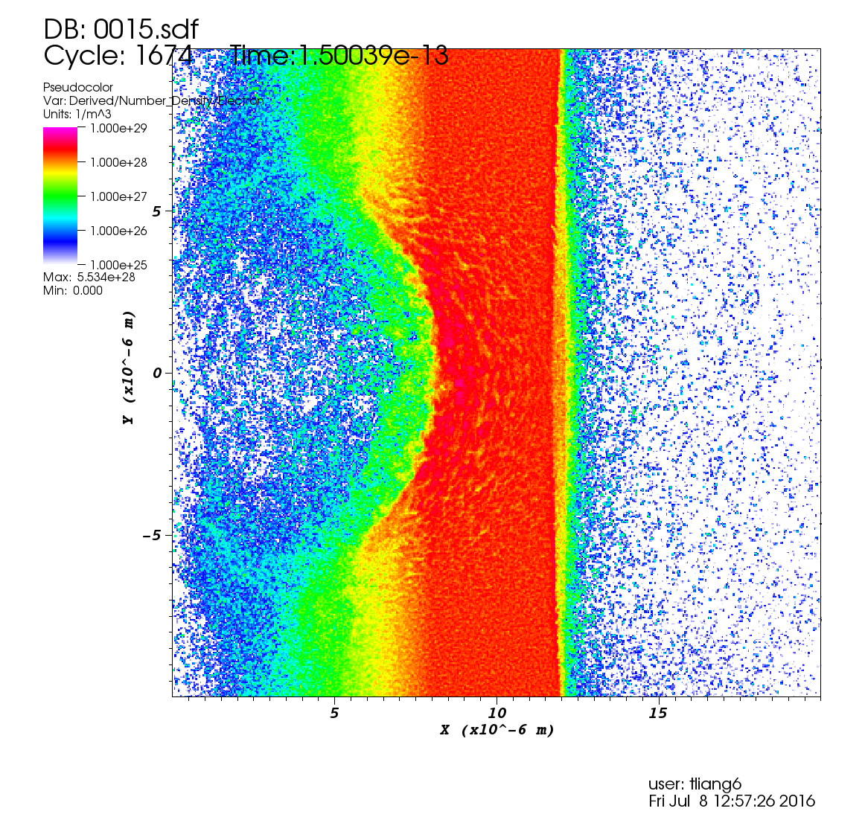
Example of PIC Simulation
10²⁰ W/cm²
Electron density per grid, snapshots every 10 fs
Laser direction
Density ramp of pre-plasma
15

Slide 16
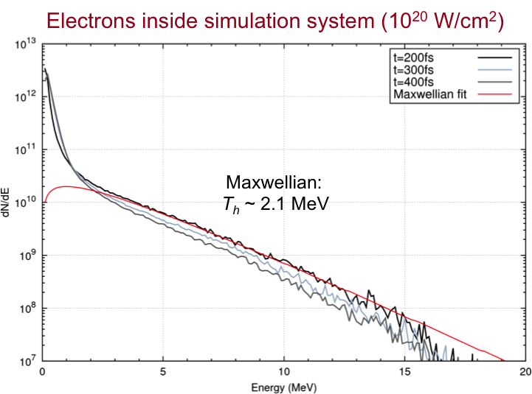
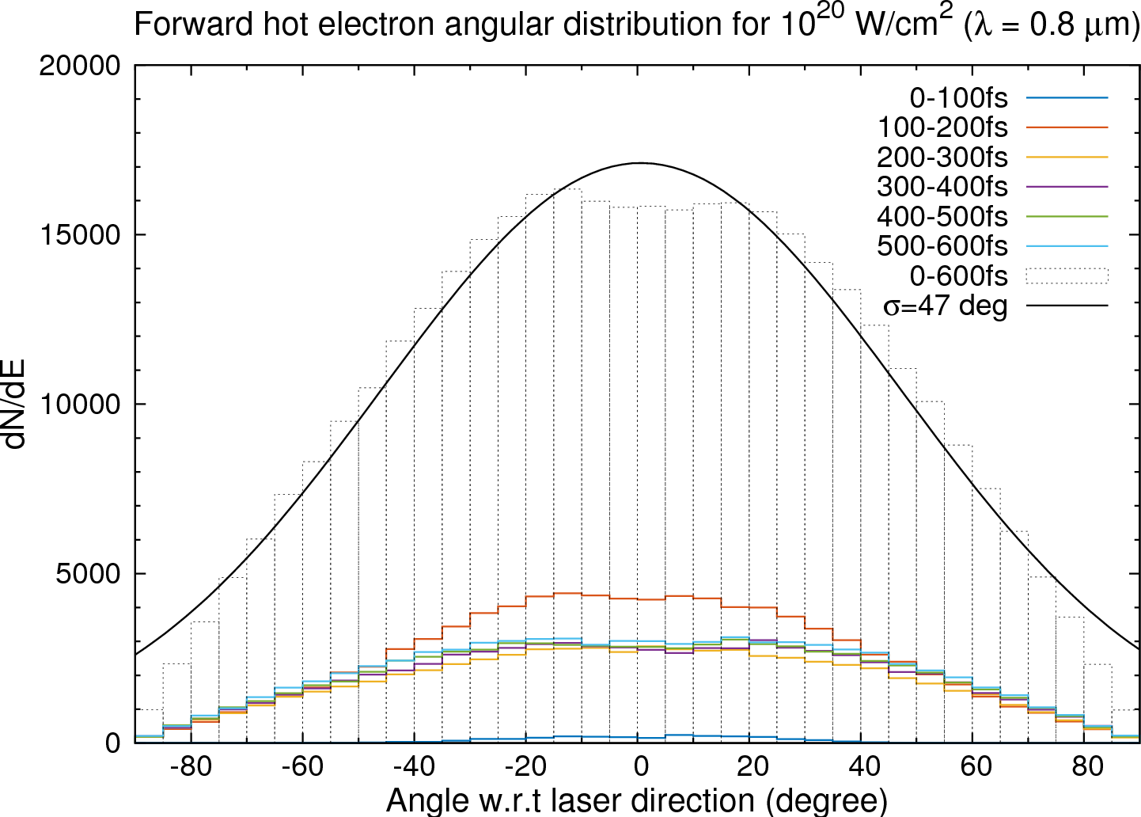
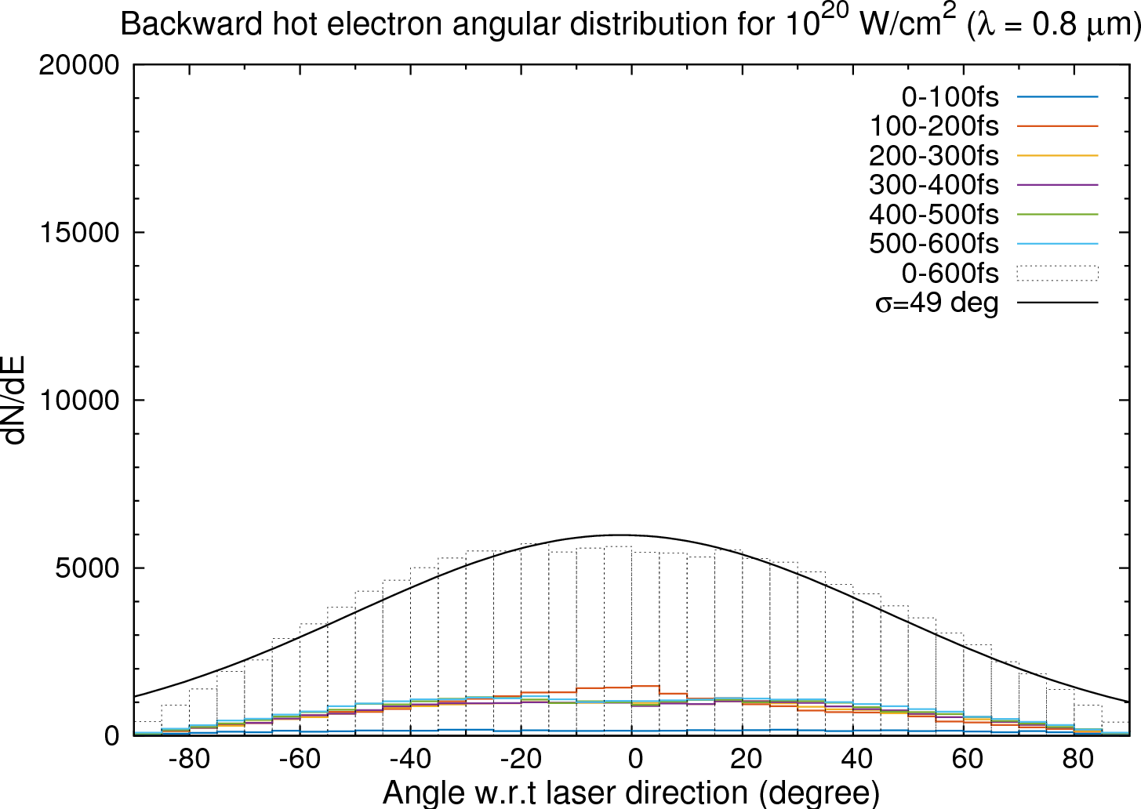
Results from PIC Simulation (1)
Cold e-
Sample spectrum of hot electrons
Hot e-
Angular distribution around 0º
Angular distribution around 180º
16

Slide 17
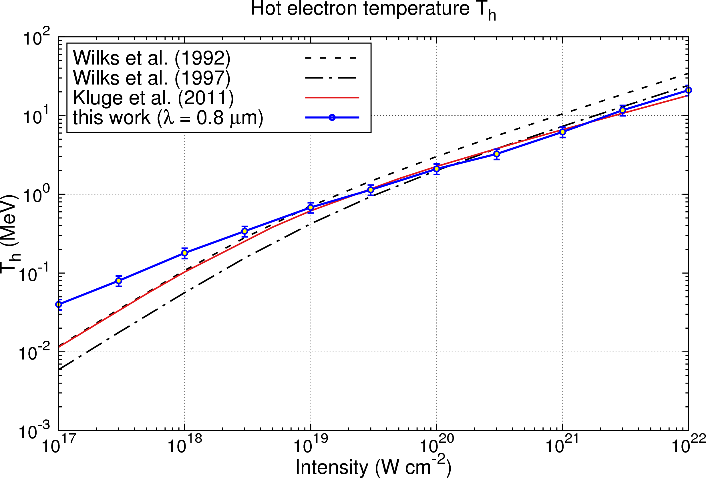
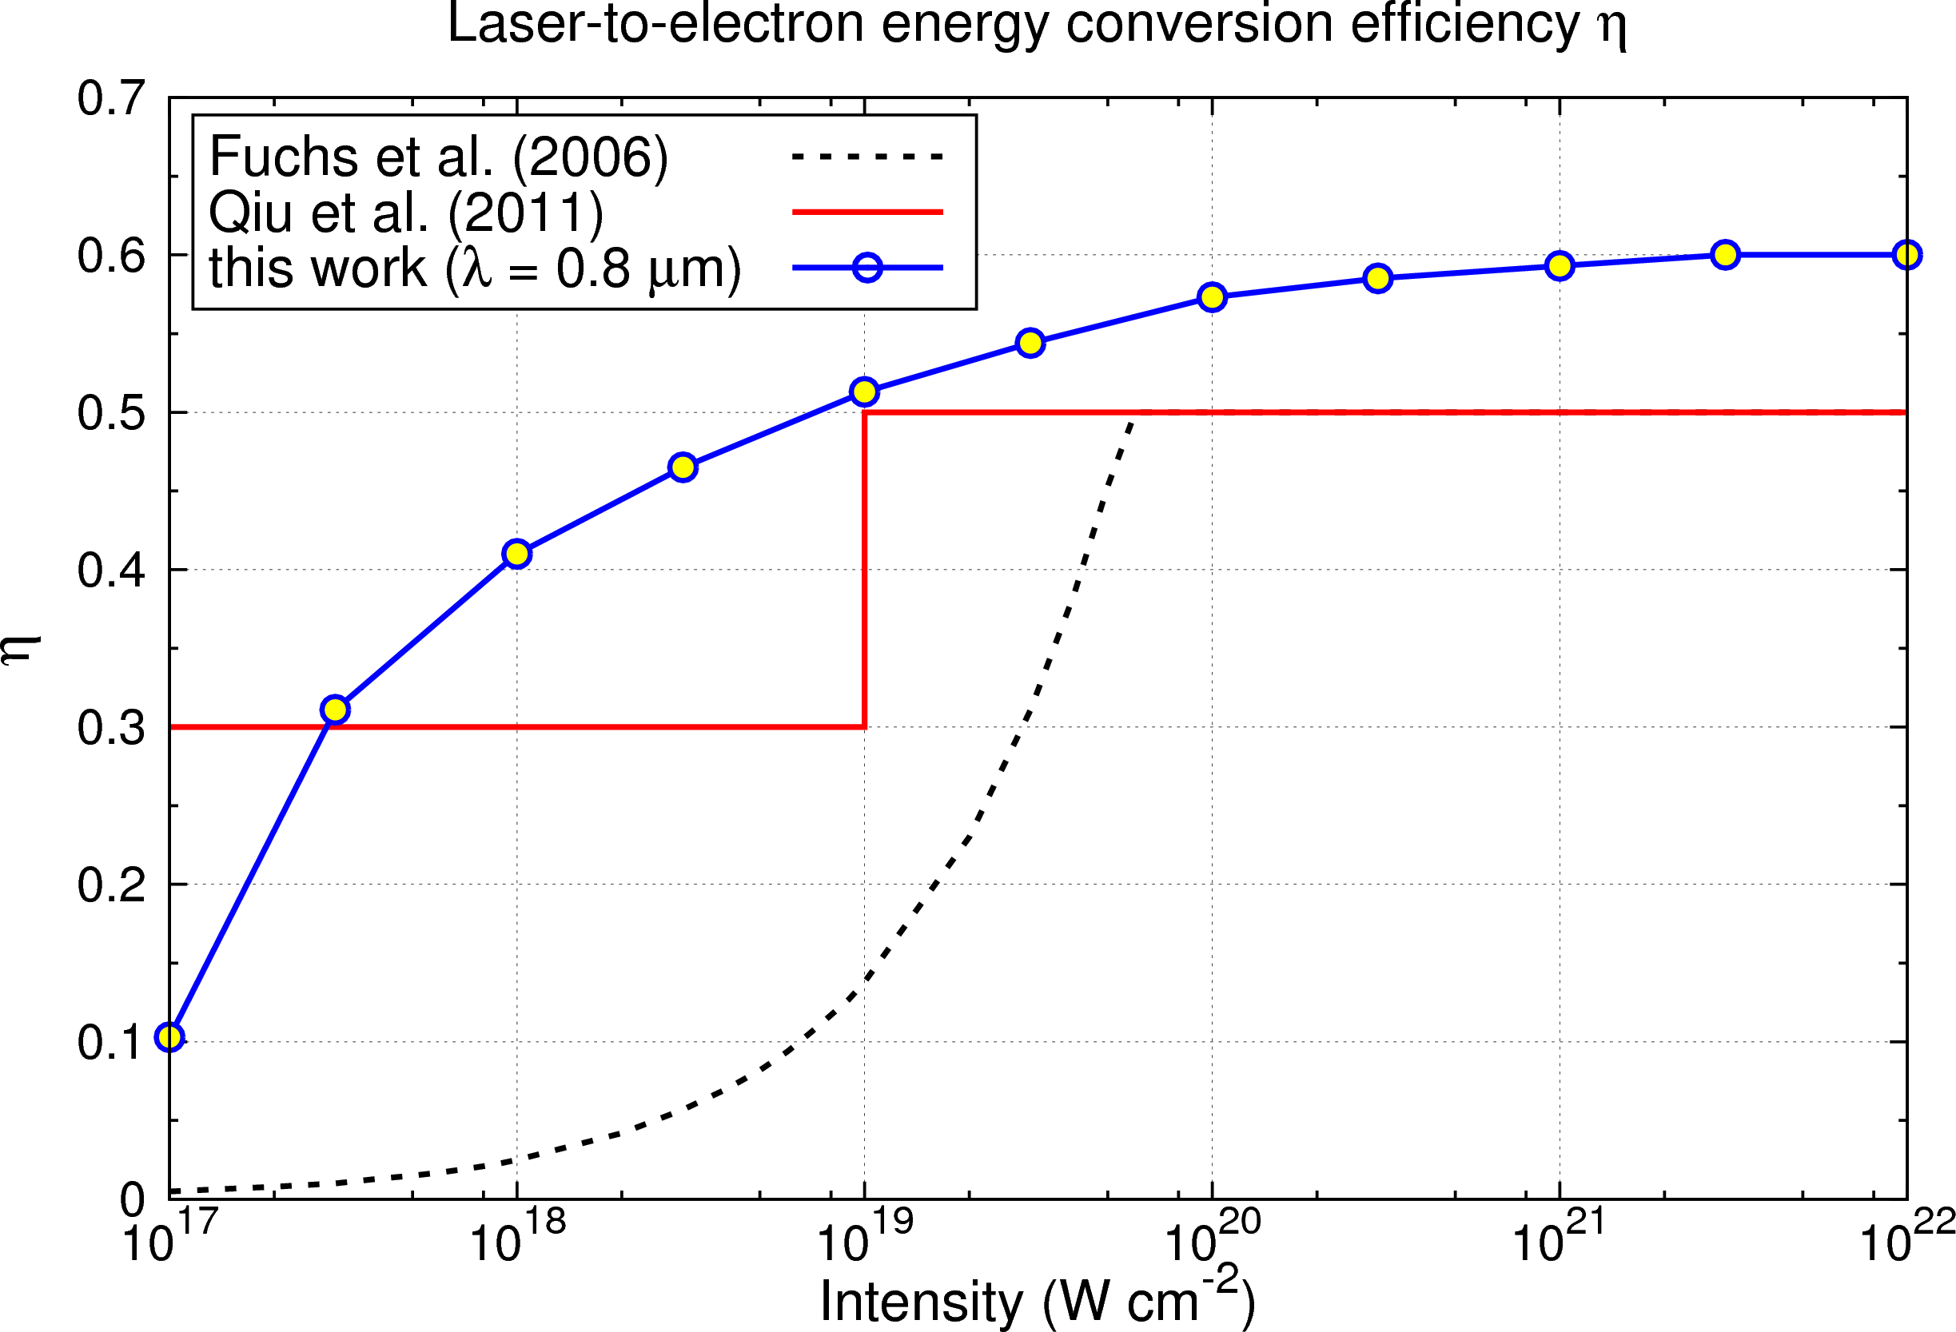
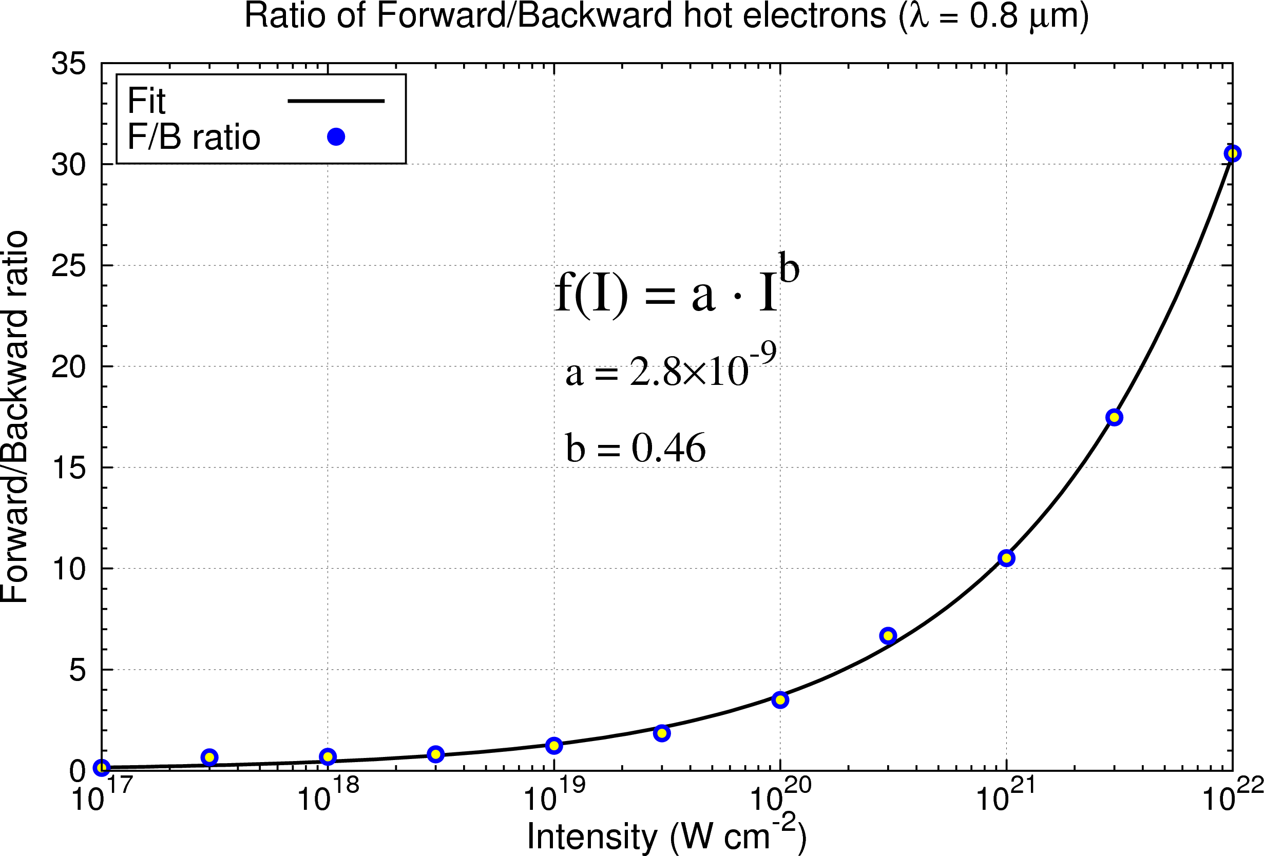
Results from PIC Simulation (2)
Hot Electron Temperature vs Irradiance
Optimization of parameters for highest dose yield
Forward-backward hot electron yield vs irradiance
Fraction of laser energy converted to ionizing radiation vs irradiance
17

Slide 18
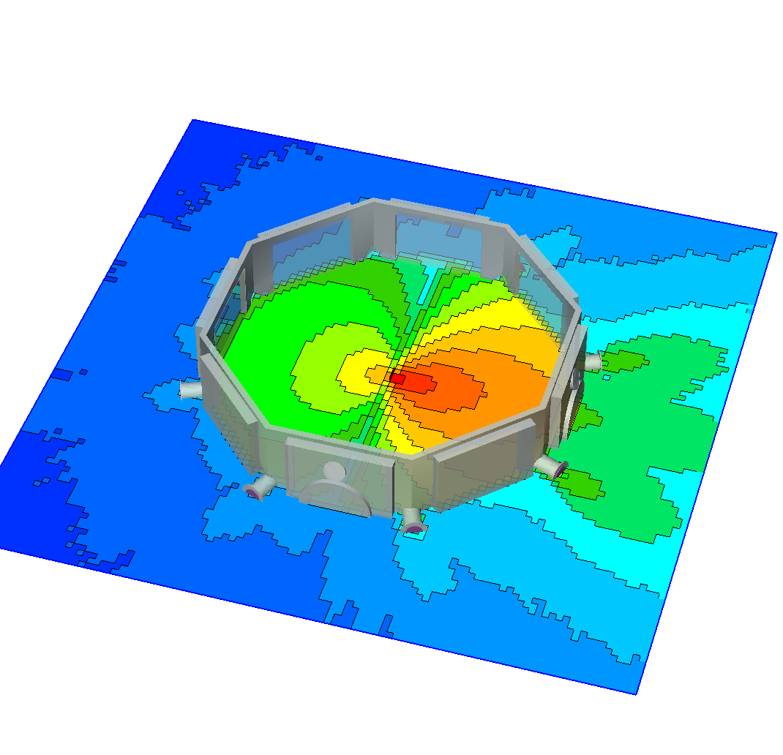
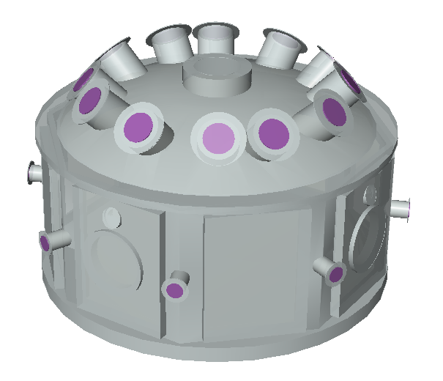
Particle In Cell Code: EPOCH
Target
Energy distribution + Angular distribution + Laser absorption +
Geometry
____________________________
➔ FLUKA dose yield calculation
EPOCH:
Laser
Simulation from EPOCH
Simulation from FLUKA
18
3D geometry in FLUKA

Slide 19
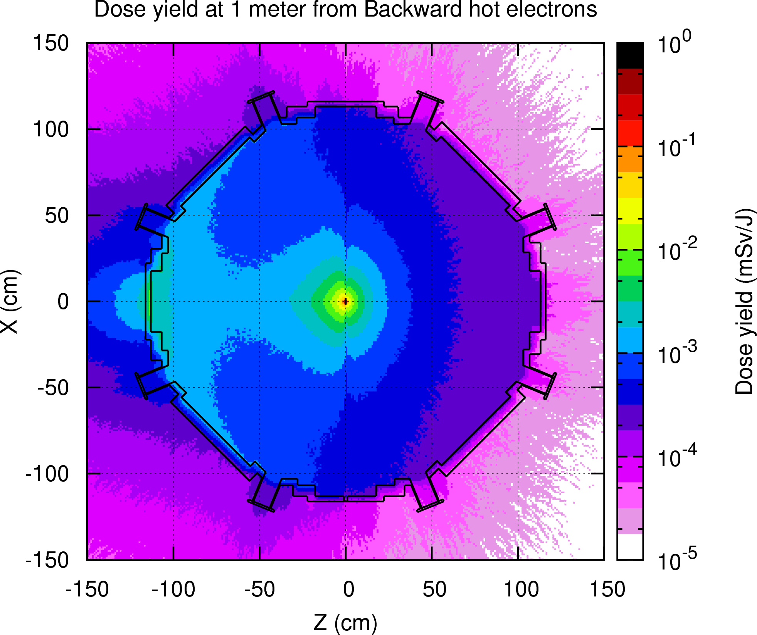
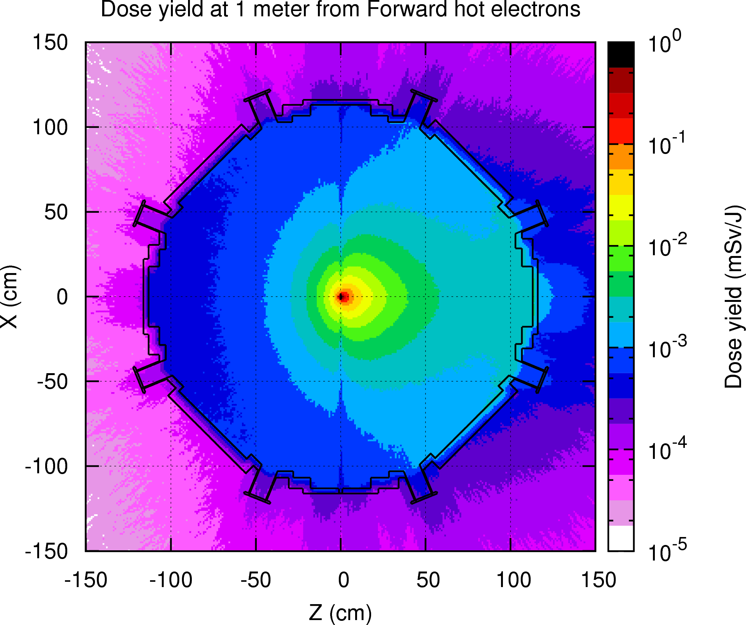
Example of FLUKA Simulations
Backward dose mainly from interaction with target chamber
Forward dose mainly from interaction with target in center
Taking sum of dose outside target chamber
19

Slide 20
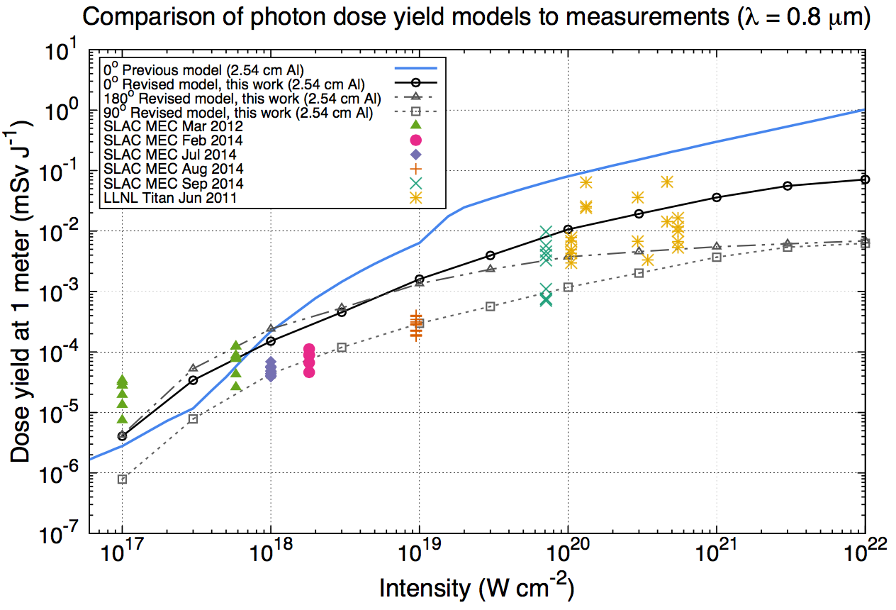
RP Dose Yield Model & SLAC Measurements
previous model
0º direction
180º direction
90º direction
“Revised Model” is basis to determine controls
Includes 2.54 cm Al
Measurements at various angles
Publication submitted to Radiation Protection Dosimetry
20

Slide 21
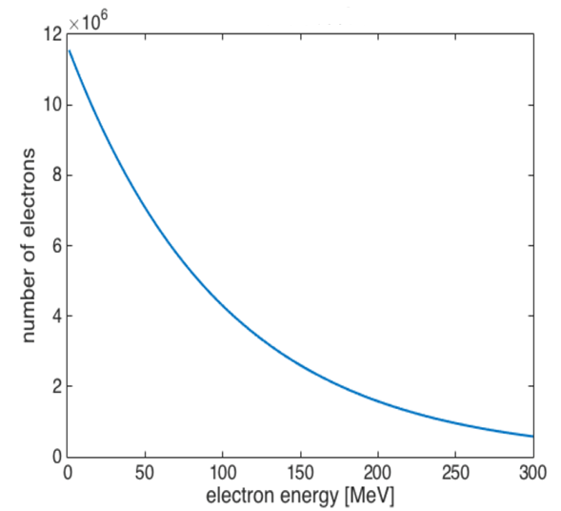
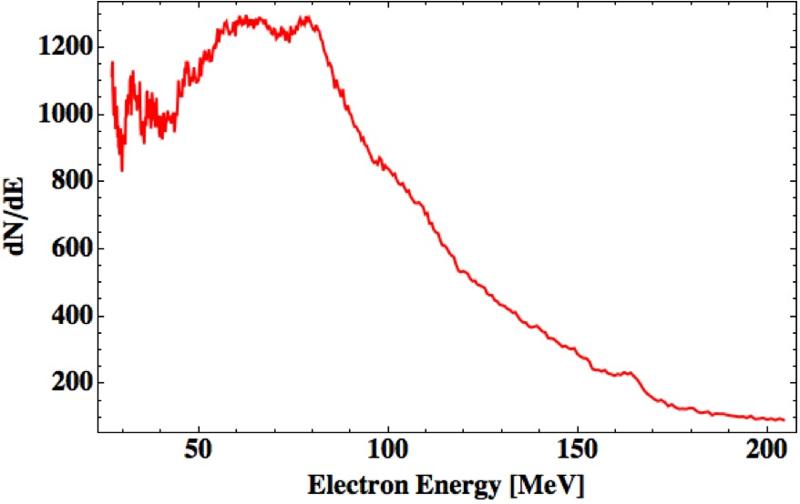
Gas Targets: Experiments
Laser Wakefield Acceleration
→ electron acceleration
→ Betatron oscillation in electric field → short-pulse X-rays used in experiments (similar to FEL X-rays, weak)
Average electron spectrum assumed for 2015 experiment
~1.5% conversion efficiency
1.5 mW at 0.1 Hz
Measured electron
spectrum
number of electrons / MeV
21

Slide 22
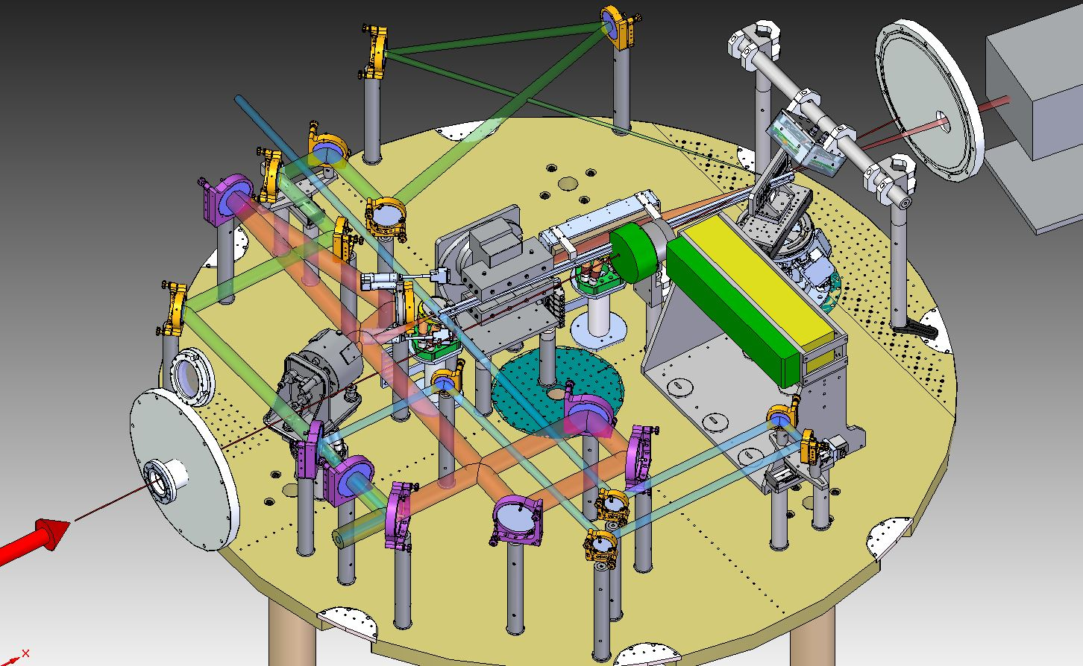
Gas Targets: Shielding
2015 Experiment: 1 J, 12,000 shots in few weeks
8 cm tungsten
10 cm lead
Substantial shielding, but only in forward direction
22

Slide 23
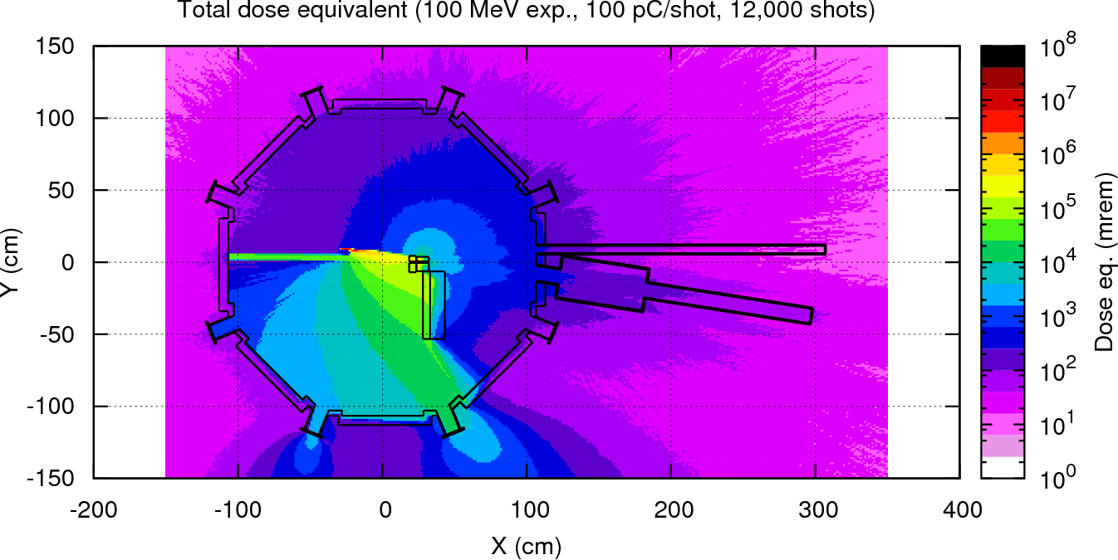
Simulations around Target Chamber
50 mrem
20 mrem
200 mrem
75 mrem
2000 mrem
250 mrem
5000 mrem
Outside target chamber measurements (1 m, not at 0°)
total 12 mSv (1200 mrem) total
23

Slide 24
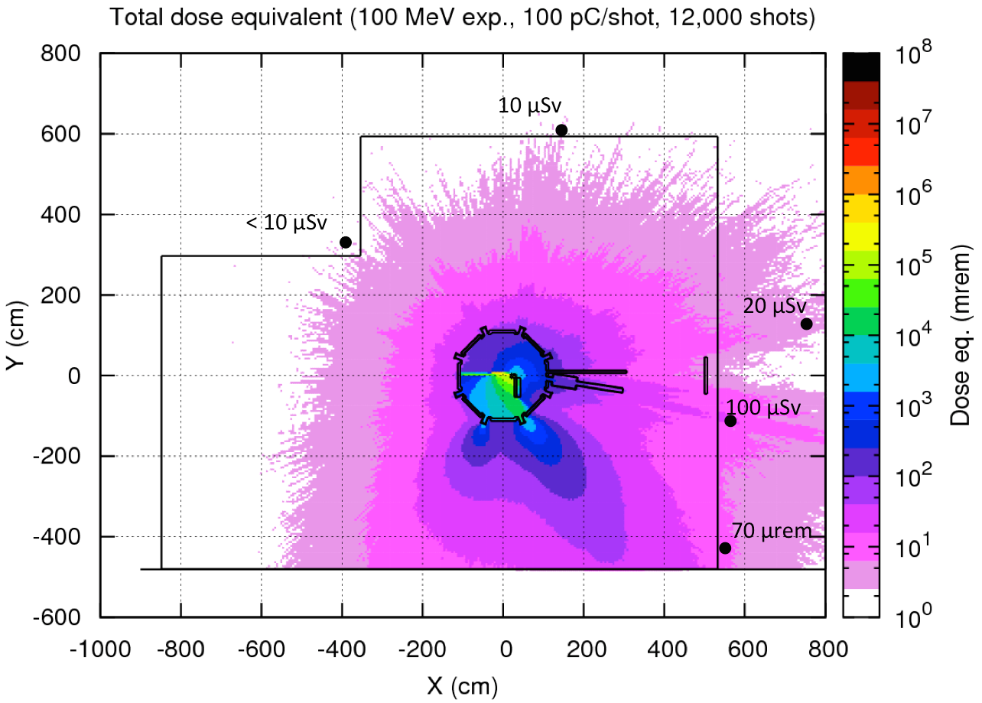
Simulations and Measurements outside Hutch
Goal: 100 μSv (no dosimeters)
Measurements outside hutch
(5 m, 0° behind shielding)
Maximal 84 μSv total
24

Slide 25
Conclusion
Ionizing Radiation from lasers need to be addressed
Solid Targets
SLAC developed source term
Measurements comparing against models
Latest model based on PIC simulations
Gas Targets
Source term better known
Simulations to design shielding
Laser research field is growing
25

Slide 26
Thank You!
26

