Slide 1

Evaluation of neutron dose reduction options with a shielding aspect at the proton therapy facility
SATIF-13, Dresden Germany, 10-12. October 2016
HAN, sang-eun (k496hse@kins.re.kr) Korea Institute of Nuclear Safety, Ref. of KOREA
Notes:
Thank you mr. chairman.
Hello. Everyone. My name is Han, sang eun from rep. of Korea.
I’m belonging to KINS which is one of regulatory body in our country.
I’m very glad to get here, beautiful city Dresden for presentation.
To tell the truth, I don’t know well about acc. Physics or science. But I think secondary neutron problem is important in the aspect of radiation safety.
So, I prepared this presentation.

Slide 2


SATIF-13, Dresden Germany
Ⅰ. Backgrounds

Slide 3
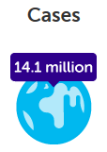
Ⅰ. Backgrounds
1. Status
● Proton therapy demand is increasing
- Cancer is the leading cause of death
(WHO, World cancer report 2014)
- For effective treatment
● Proton therapy research is expanding
- Facilities are increasing worldwide
- Korea : 2 operating and more plans
Cases
In 2012
Cases
In 2030
67%
increase
14.1 million
23.6 million
Status |  | Amount
Operating | Facilities | 65
 | Countries | 16
Under construction | Facilities | 37
 | Countries | 17
Ref. PTCOG web site (2016)
Notes:
As you know, Cancer is the leading cause of death over the world.
According to W-H-O, there were 14mil of cancer in 2012. but unfortunately, this will increase in the future. About 24mil cancers were predicted.

Slide 4
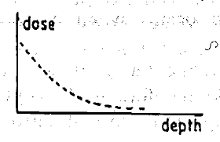
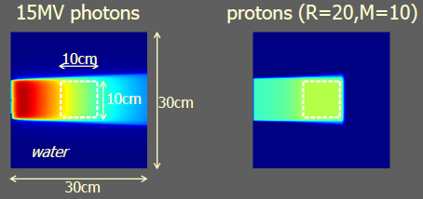
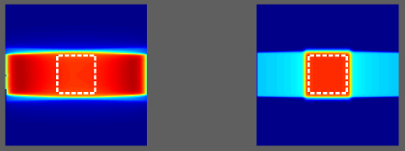
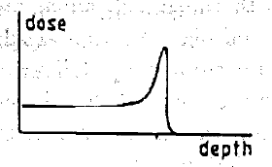
Ⅰ. Backgrounds
2. Feature of proton
 | Dose distribution | Relative Biological Effectiveness | Clinical application
Photon | - Skin does is higher than deep seat | RBE = 1 | - Unintentional radiation effect to normal tissues
Proton | - Particle lose energy near the end of range |  | - Effective to deep seat tumor (Head & neck, brain, etc.)

Slide 5
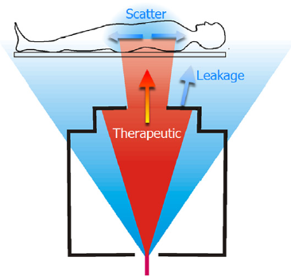
Ⅰ. Backgrounds
3. Key issue : secondary neutrons
Secondary neutron from nuclear interactions (P-N reaction)
cf. average neutron yield : 0.2 ~ 2
Unwanted neutron field & exposure
cf. photon/other ptls. are negligible
Problems on radiation safety
a. Patients/Workers exposure
- Potential health risk increasing
b. Increment of safety burdens
- Shielding, Safety equipment, etc.
Image Ref. : Wayne D Newhauser, The physics of proton therapy (2015)

Slide 6
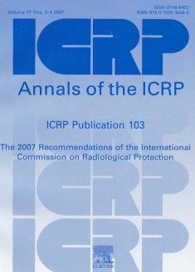
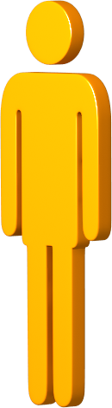
Ⅰ. Backgrounds
3. Key issue : secondary neutrons -continue
● Exposure level : 0.1 ~ 10 mSv/Gy
(NCRP Report No.170, 2011)
=> Ex. 72Gy treatment plan : 7.2 ~ 720 mSv
● cf. lifetime cancer risk : 2.7 ~ 8 %
(Lung cancer patient who received proton
therapy, Jiang et al., 2005)
“ 100 mSv is the threshold level for health risk (acute or chronic) ”
“ Nominal risk coefficients for cancer and heritable effects 5.7 % per Sv ”
Is it serious ?
Hm .....
Notes:
We started this research.

Slide 7

SATIF-13, Dresden Germany
Ⅱ. Modeling & Dose assessment

Slide 8
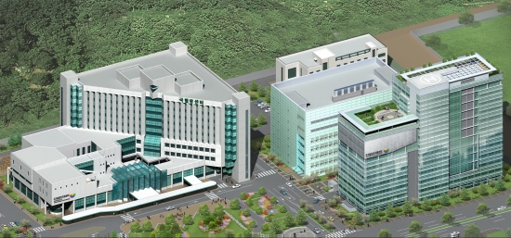
Ⅱ. Modeling & Dose assessment
1. Target site overview : National Cancer Center (NCC)
● Location : Proton Therapy Center(B2), Go-yang city, Ref. of Korea
● IBA’s Cyclotron accelerator(2.3Tesla) / 230 MeV max. / 1~300 nA
● The first proton therapy facility in Korea (2007) /1,496 patients (~ 2014)

Slide 9
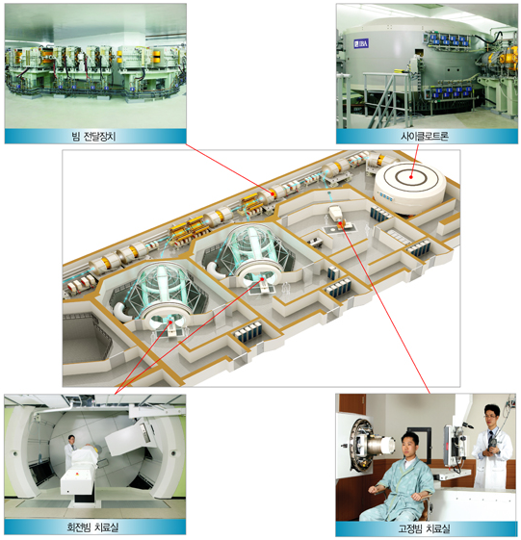
Beam Transport System
Cyclotron accelerator
Image Ref. : National Cancer Center (http://www.ncc.re.kr)
Gantry room
Fixed beam room

Slide 10

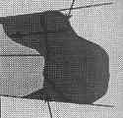
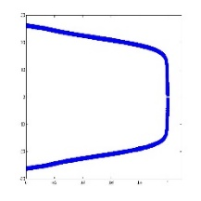
Ⅱ. Modeling & Dose assessment
2. Proton beam nozzle mechanism – Double(passive) scattering
1st Scatterer
Range
Modumator
2nd Scatterer
Aperture
Target
Lateral
Axial
Image Ref. : D. Prieels, Introduction to IBA nozzle (2005)

Slide 11
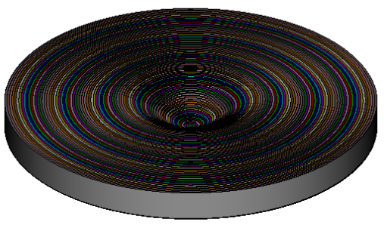
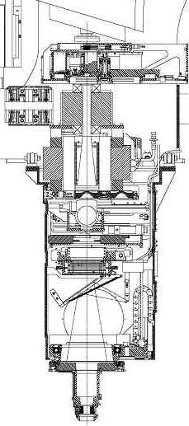
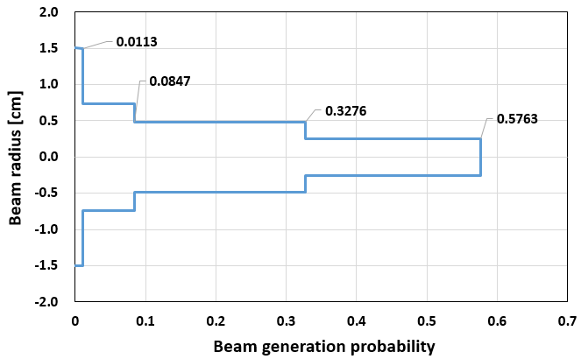
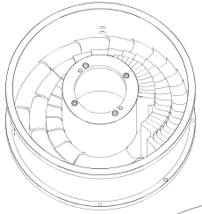
Ⅱ. Modeling & Dose assessment
3. Modeling on MCNP
● Nozzle & Facility : From original CAD drawing
● Beam dynamics & Major component
- Proton beam : Max. 230 MeV , Cylindrical weighted (step) prob. (from measurement)
- Range modulator : Consisted of 23 spiral step
- Second scatterer : Gaussian function applied
b. Second Scatterer
c. Range Modulator
a. Beam Nozzle
Notes:
In order to realize this nozzle. we used MCNP monte carlo particle transport code.
Basic information & data came from the original CAD drawing.
Proton beam was defined with cylindrical weighted prob. and this data was from measurement in NCC.
And major components such as RM, SS were depicted in detail.

Slide 12
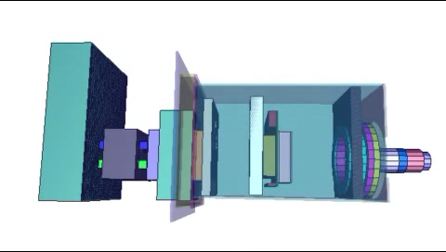
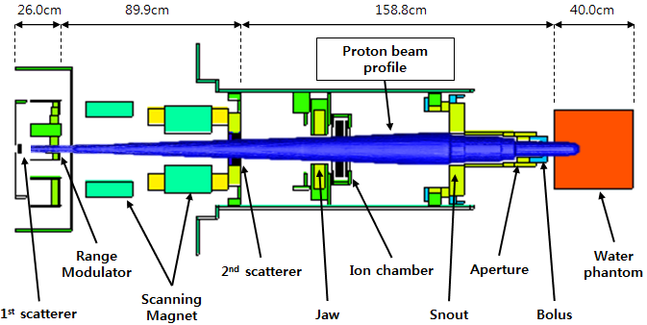
Ⅱ. Modeling & Dose assessment
● Proton Beam Nozzle

Slide 13
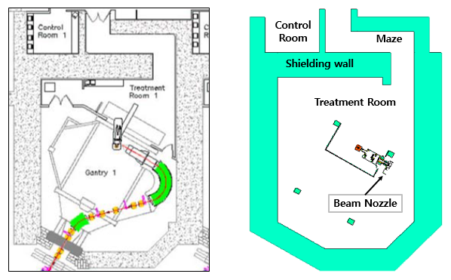
Ⅱ. Modeling & Dose assessment
● Treatment facility : Architectural drawing vs MCNP modeling

Slide 14
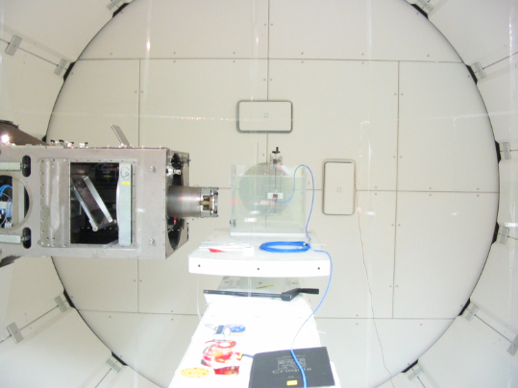
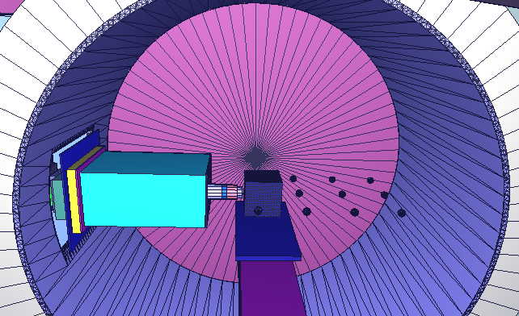
Ⅱ. Modeling & Dose assessment
● Treatment room : MCNP modeling (3D) vs Real image

Slide 15
Ⅱ. Modeling & Dose assessment
3. Modeling on MCNP - continue
● Simulation code : MCNP6 (ver.1.0)
- Dose conversion constant : ICRP 74 (1997)
※ ICRP 116 (2010) will be compared soon
- Physics data library : ENDF/B-VII (below 150 MeV)
- Nuclear interaction physics model : CEM03.03, LAQGSM03.03
● Text editing : Ultraedit (ver. 21)
● Data analysis : Origin, Tecplot, MS excel
● Image processing : MCNP visual editor, Tecplot
● Computing : HP Z820 workstation (8 cores, 24 thread parallel)

Slide 16
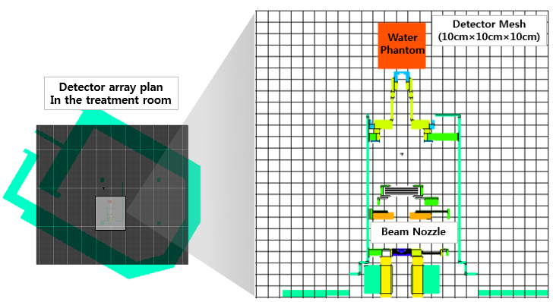
Ⅱ. Modeling & Dose assessment
4. Dose calculation
● Method : Mesh tally (X : -800 ~ 850 cm, Y: -120 ~ 0 cm, Z: -400 ~ 1150 cm,
10 cm distance, total points: 183,530)
● Quantity : Neutron Flux [#/cm2/sec] -> Dose conversion with ICRP 74 DCF
● Continuous profile with polynomial interpolation (Tecplot 360 EX software)

Slide 17
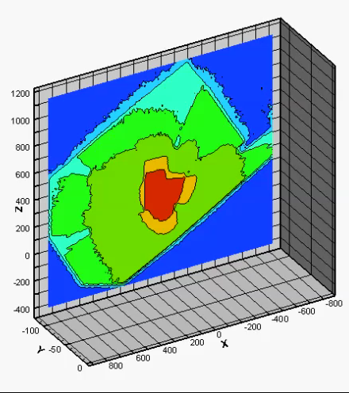
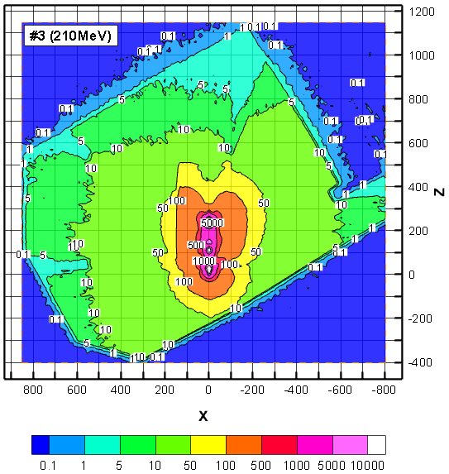
Ⅱ. Modeling & Dose assessment
● Dose level in treatment room : ~ 500 mSv/h (nozzle surface),
< 100 mSv/h (within 2m), 5 ~ 50 mSv/h (most treatment space)

Slide 18
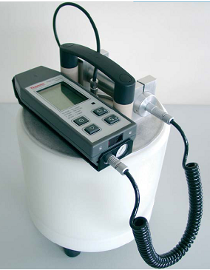
Ⅱ. Modeling & Dose assessment
5. Measurement - Instrument
● Wide Energy Neutron Detector (Thermo, model FHT 762, WENDI-2)
● Calibration : KAERI (KOLAS approved laboratory), Cf-252 source
- Calibration factor : 0.95 (7.5% uncertainty at 95% confidence level)
Specification of WENDI-2
Detector |  | He-3 proportional
Quantity |  | ICRP 74 ambient dose equivalent (rate)
Detection range | Energy | 25meV ~ 5GeV
 | Dose | 0.01 μSv/h ~ 100 mSv/h
 | sensitivity | 0.84 cps per μSv/h

Slide 19
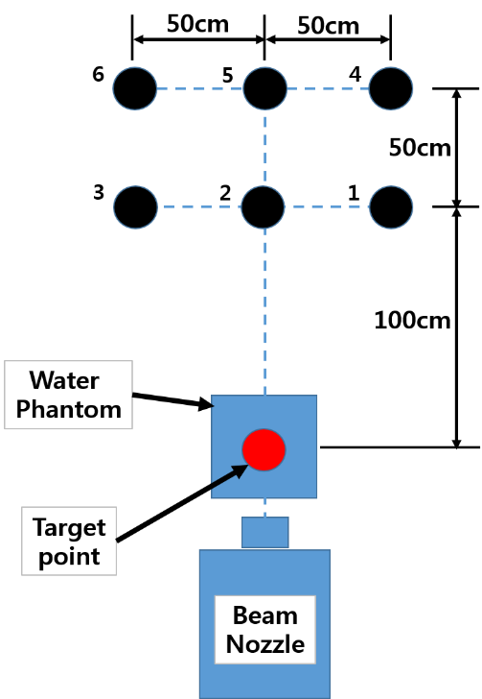
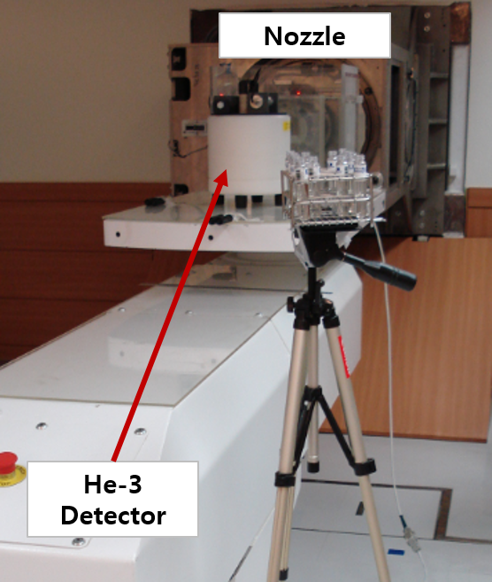
Ⅱ. Modeling & Dose assessment
5. Measurement - Setup
● 6 points near the target were selected (parallel to floor)
- Beam opening : 8 cm (diameter)
- Water phantom : 40 cm × 40 cm × 40 cm
- Beam energy : 220MeV, Range modulation : 5cm, Current : 6nA

Slide 20
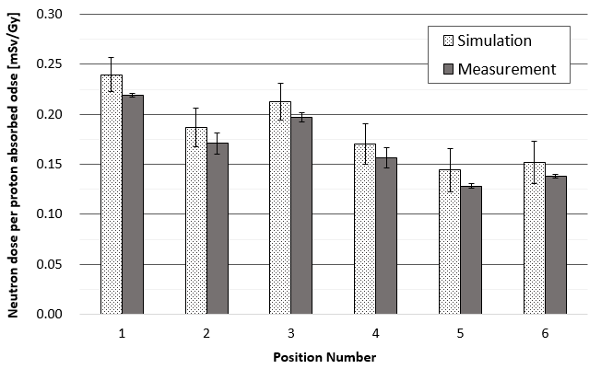
Ⅱ. Modeling & Dose assessment
5. Measurement - result
● Measured value was lower than simulation up to 13 %
- Simulation : 0.14 ~ 0.24 mSv/Gy, Measurement : 0.13 ~ 0.22 mSv/Gy

Slide 21


SATIF-13, Dresden Germany
Ⅲ. Dose reduction
Uhm… hundreds of mSv…..
I have an idea !!
How can we minimize secondary exposure ?

Slide 22
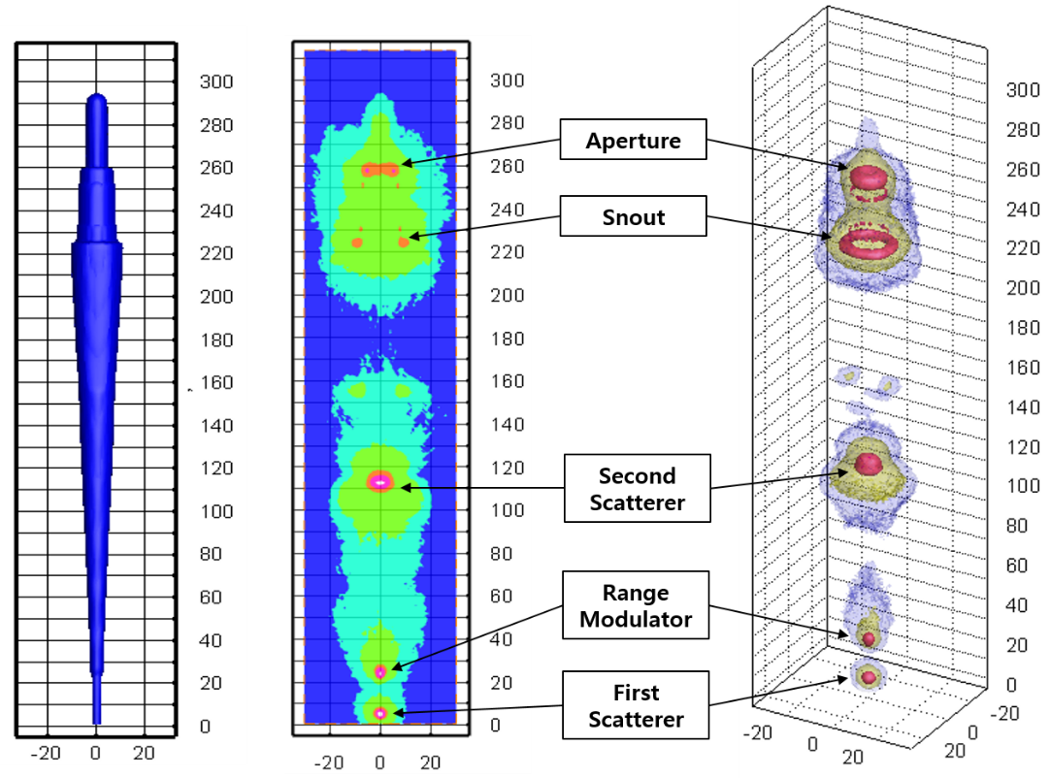
Ⅲ. Dose reduction
1. Origin of neutrons
● Major source is nuclear interaction between proton and nozzle components
- Flux (simulation) : (2.85 ~ 4.11) × 10⁷ #/cm²/sec
- P-N reaction cross section of Lead : ~ 1000 mb ( cf. Al : ~ 100 mb)

Slide 23
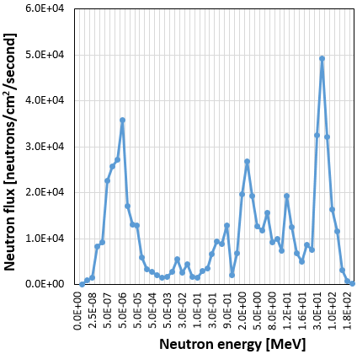
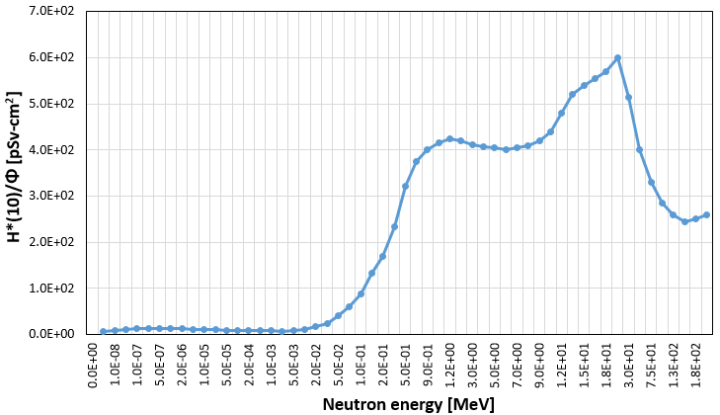
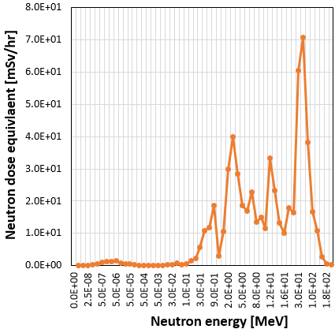
Ⅲ. Dose reduction
2. Energy dependency of dose
● Health risk is rely on neutron energy
- Even though flux is high, low E (< 20 keV) neutrons are less contributable
=> Neutron moderation would be possible technique
a. Flux distribution (Simulation)
b. Dose conversion factor (ICRP 74)
b. Neutron dose (@ target)

Slide 24
Ⅲ. Dose reduction
3. Neutron dose reduction ideas
● Nozzle shielding (Source oriented)
- Packaging nozzle surface with neutron moderator (PE, BPE, PET)
● Patient shielding (Object oriented)
- Protecting patient except for treatment area with neutron moderator
● Nozzle component material substitution
- Major source material : Lead & Brass => low N generating ( ex. Al alloy )

Slide 25
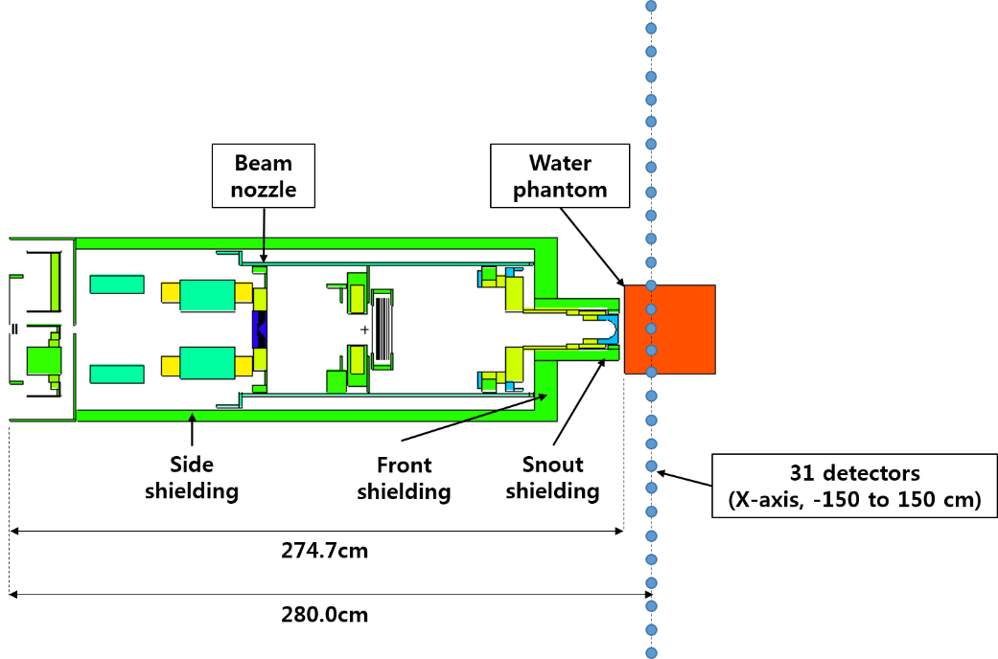
Ⅲ. Dose reduction
4. Nozzle shielding
● Nozzle was packed with shielding material
● Reduction effect was checked 31 detectors (on the target plain)
- at 210 MeV proton

Slide 26
Ⅲ. Dose reduction
4. Nozzle shielding – continue
● Material selection
- Low Z material, solid, enough mechanical strength => PE, PET, Borated PE
Material | Density [g/cm³] | Atomic composition with weight Fraction
Polyethylene (PE) | 0.93 | H: 0.144, C: 0.856
Polyethylene, 5% Borated (Borated PE) | 1.00 | H: 0.137, B: 0.050, C: 0.813
Polyethylene, 10% Borated (Borated PE) | 1.00 | H: 0.125, B: 0.100, C: 0.775
Polyethylene Terephthalate (PET) | 1.38 | H: 0.042, C: 0.625, O: 0.333

Slide 27
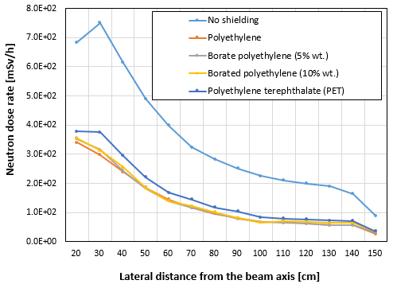
Ⅲ. Dose reduction
4. Nozzle shielding – continue
● Material selection => polyethylene
- PET was slightly less effective than others

Slide 28
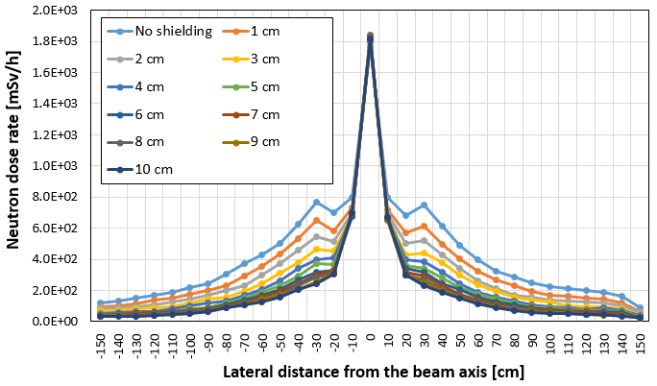
Ⅲ. Dose reduction
4. Nozzle shielding – continue
● Shielding thickness (Polyethylene)
- Dose reduction effect increased along the thickness increase (1 ~ 10 cm)

Slide 29
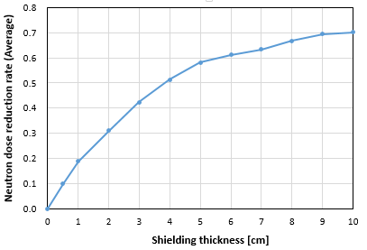
Ⅲ. Dose reduction
4. Nozzle shielding – continue
● Shielding thickness => ~ 5 cm PE shielding is practical
- Up to 70 % reduction at 10 cm But 5 cm (58 % reduction) was effective

Slide 30
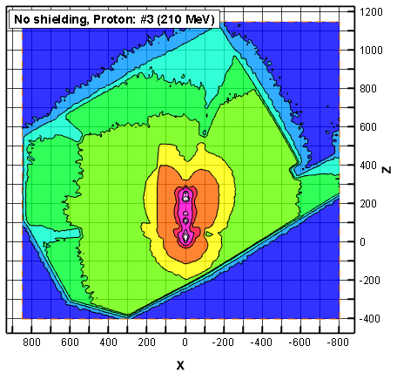
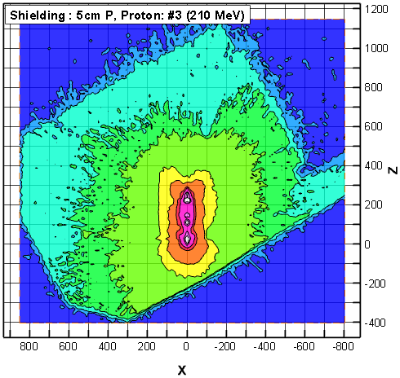
Ⅲ. Dose reduction
● Overall dose reduction effect was identified with nozzle shielding
- Nozzle shielding is able to minimize facility shielding burdens as well

Slide 31
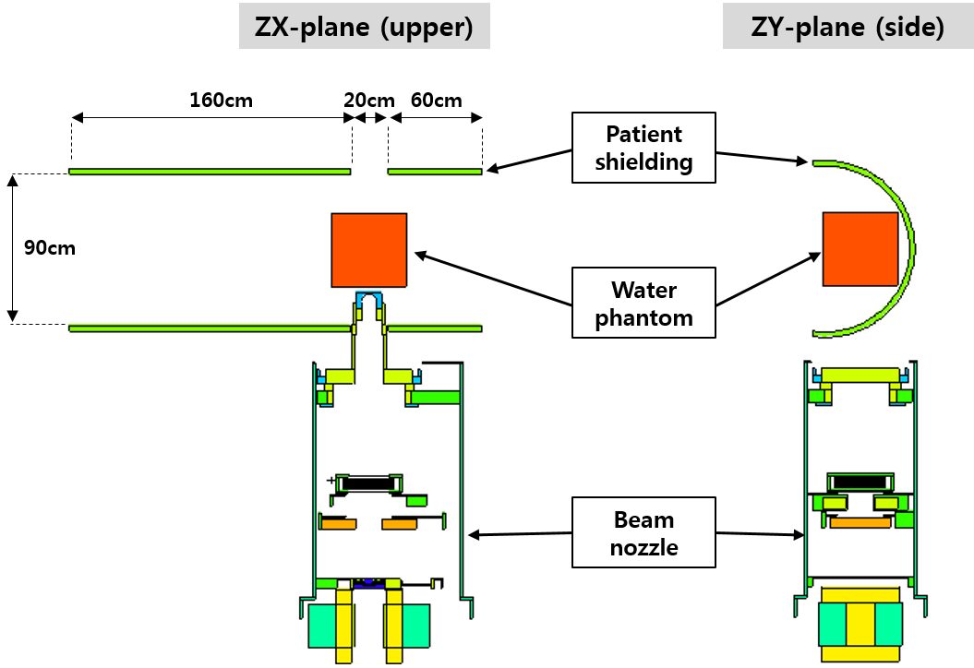
Ⅲ. Dose reduction
5. Patient shielding
● Protecting other organs except for target
- Limitation : should not bother therapy procedure, feeling of isolation
- Shielding geometry : half cylinder with 160 and 60 cm length, 90cm dia.
- Shielding material : polyethylene (1 ~ 10 cm thickness)

Slide 32
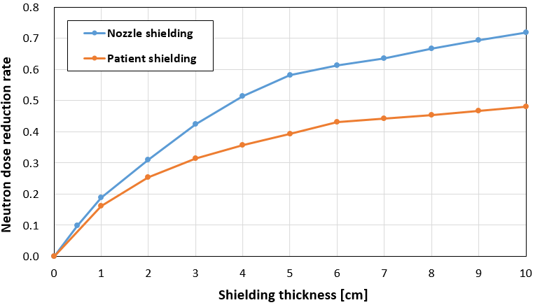
Ⅲ. Dose reduction
5. Patient shielding - continue
● Shielding effect
- Not high as much as nozzle shielding
∵ Dominant source (snout & aperture) can not be blocked
- Average reduction at 5 cm thickness : 39 % ( c.f. 58 % at nozzle shielding)

Slide 33
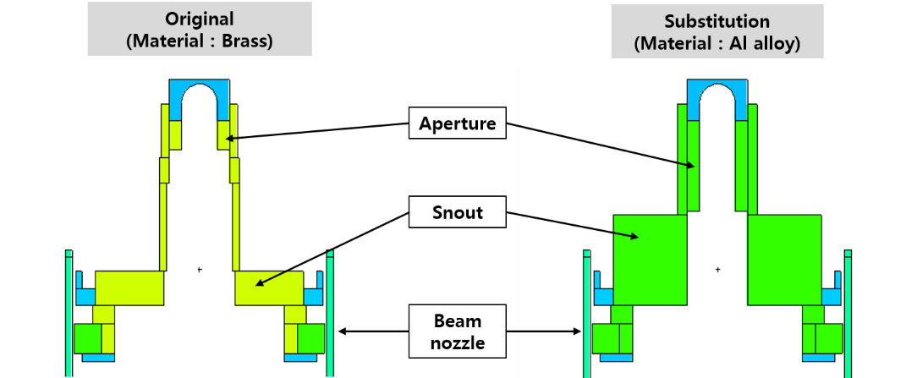
Ⅲ. Dose reduction
6. Nozzle component material substitution
● Basic idea
- Brass/Lead is high N generating => replace to less generating material
(PN cross section of Cu : ~ 500 mb but Al : ~ 100 mb)
- Al alloy was applied and snout volume was increased in order to block proton beam leakage

Slide 34
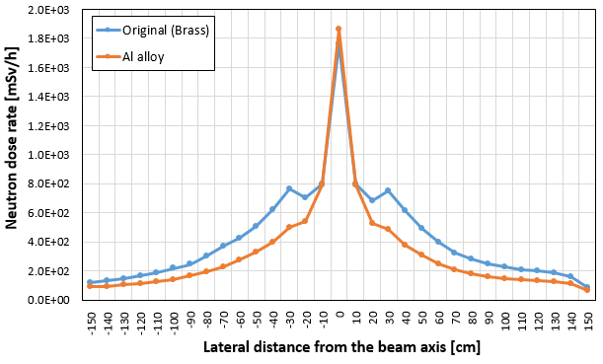
Ⅲ. Dose reduction
6. Nozzle component material substitution - continue
● Shielding effect
- Average dose reduction rate : 31 %
- Limitation : Need to consider beam dynamics
- But, more research needed for this option
∵ One of ultimate solution for neutron reduction

Slide 35
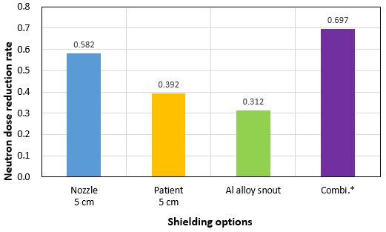
Ⅲ. Dose reduction
7. Combination of above options
● Each option is applicable independently
: Nozzle shielding (5 cm PE) + Patient shielding (5 cm PE)
+ Snout & aperture material substitution (Al alloy)
● Shielding effect : 70 %

Slide 36

SATIF-13, Dresden Germany
Ⅳ. Conclusion

Slide 37
Ⅳ. Conclusion
● Three options were suggested for reduction
- Ex) Estimated exposure for 72 Gy treatment plan
Reduction | Reduction rate | Expected exposure [mSv]
 |  | Target position | Except for target ( 0 ~ 50cm axial )
No options | 0.00 | 397.9 | 285.9 ~ 21.4
Nozzle shielding with 5cm PE | 0.58 | 167.1 | 120.1 ~ 9.0
Patient shielding with 5cm PE | 0.39 | 242.7 | 174.4 ~ 13.0
Substitution of material (Al alloy) | 0.32 | 270.6 | 194.4 ~ 14.5
Combination of potions | 0.69 | 123.4 | 88.6 ~ 6.6
- More study is being prepared to support this result
(Real scale PE shielding & Measurement with He-3/CR-39)
● Application
- Operation of facility, Nozzle manufacturing

Slide 38
Thank you

