Slide 1
Radiation Heat Load and Coil Lifetime Calculations in Support of FRIB Magnet Design
Dali Georgobiani, Marc Hausmann, Mauricio Portillo, Earle Burkhardt, Georg Bollen
Facility for Rare Isotope Beams (FRIB) Michigan State University, East Lansing, MI 48824 USA

Slide 2
Outline
Brief introduction to FRIB
Radiation transport scope within the project
Radiation transport analysis of the fragment separator magnets
Examples of calculations for magnets exposed to high radiation levels
Room temperature quadrupole magnet – coil lifetimes
Superconducting quadrupole magnets – cryogenic component heat loads, coil lifetimes
Superconducting dipole magnets – cryogenic component heat loads, coil lifetimes, poletip thermal analysis
Summary and conclusions

Slide 3
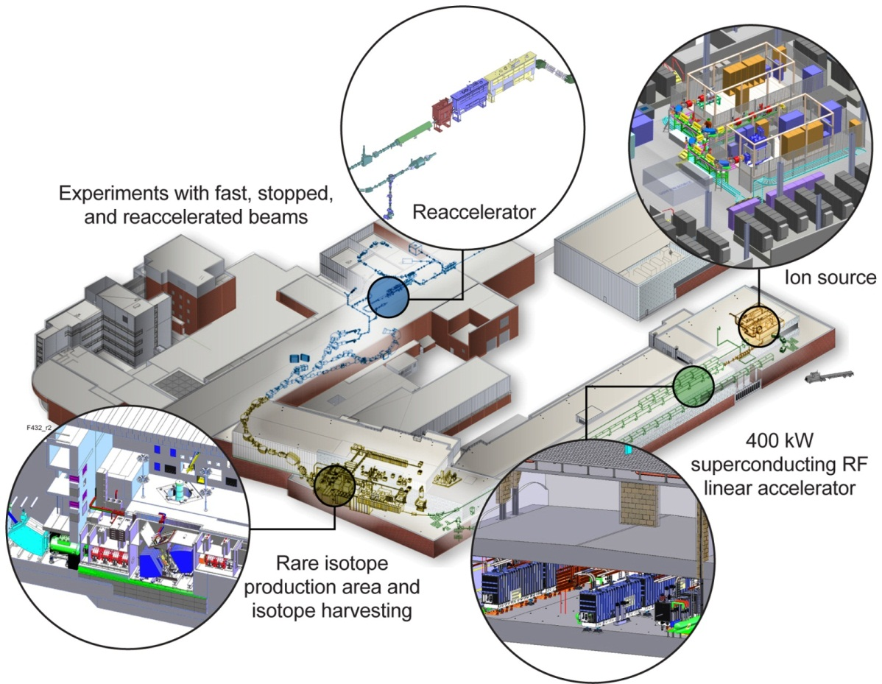
Facility for Rare Isotope Beams A Future DOE-SC National User Facility
Funded by DOE–SC Office of Nuclear Physics with contributions and cost share from Michigan State University and State of Michigan
Serving over 1,300 users
Key feature is 400 kW beam power for all ions (5x10¹³ ²³⁸U/s)
Separation of isotopes in-flight
Fast development time for any isotope
Suited for all elements and short half-lives
Fast, stopped, and reaccelerated beams
Notes:
$730M TPC,

Slide 4
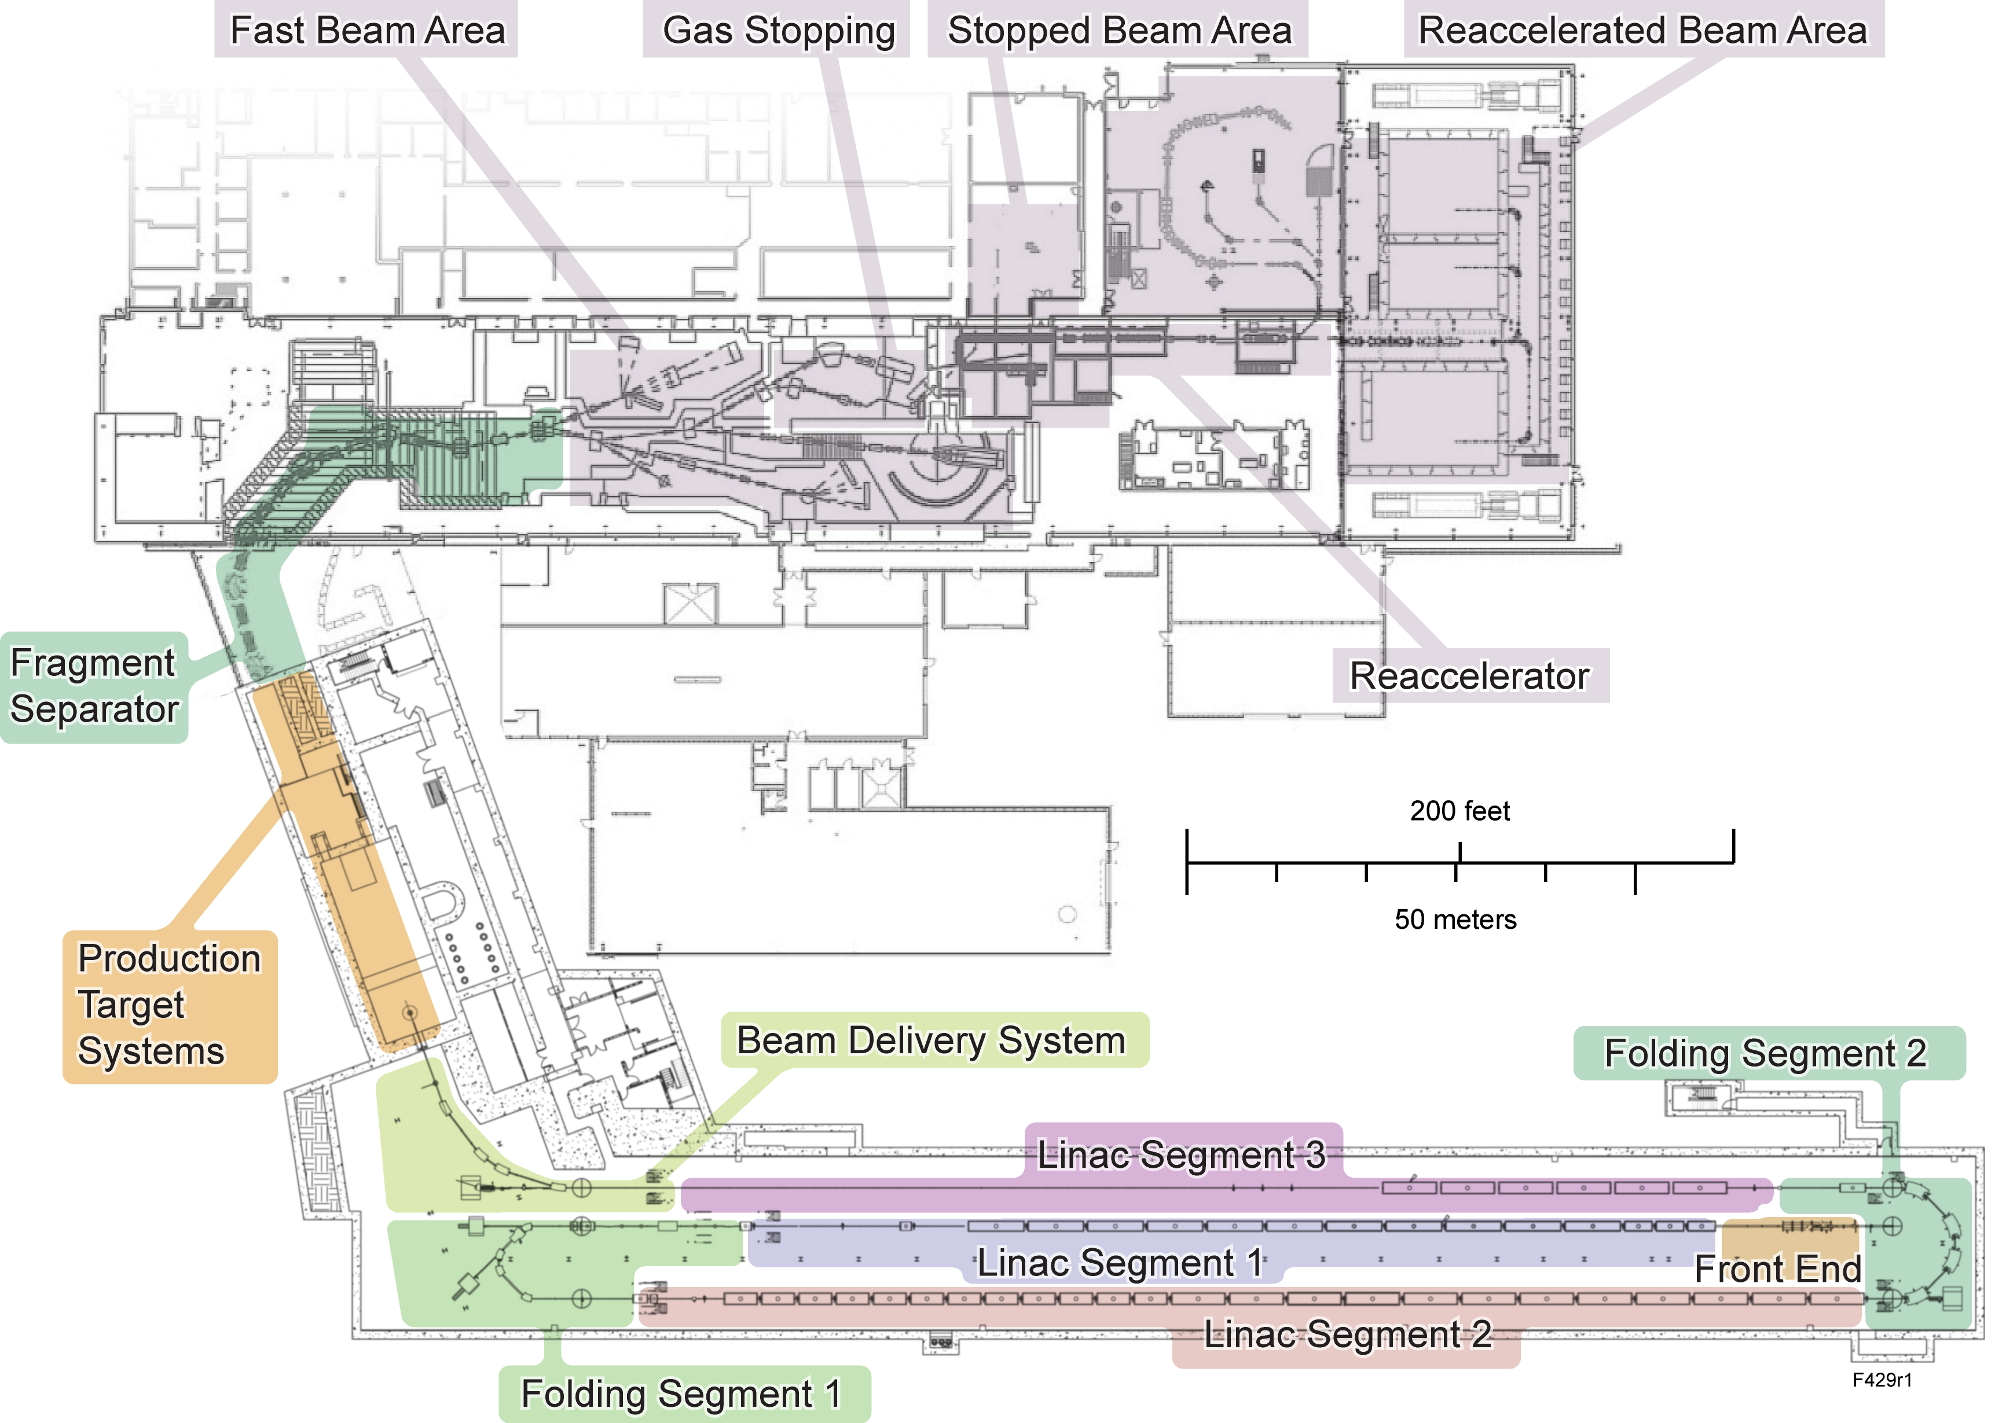
Radiation Transport Scope Technical Design and Safe Operation of Entire Project is Supported by Radiation Calculations
FRIB facility
Accelerator Systems
Experimental Systems
Experimental areas
Technical scope
Bulk, local shielding
Component and material choices
Hands-on, remote handling
Personnel, public doses
Target facility model
Encompasses pre-target beam delivery system (BDS) area, production target systems (hot cell), fragment separator
Rare isotope beams
400 kW beam (~ 100 kW at target, ~ 300 kW at beam dump)
1 W/m beam losses

Slide 5
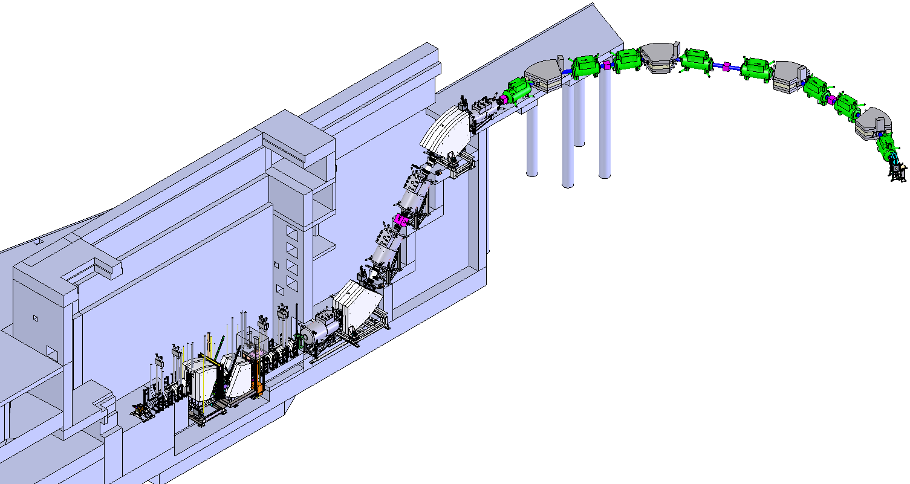
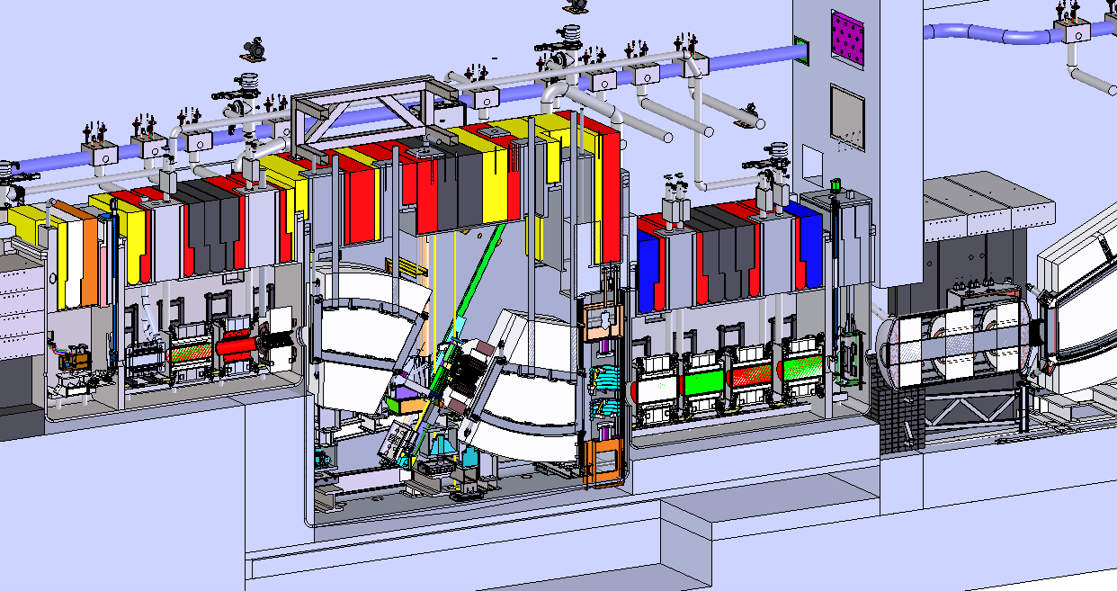
Fragment Separator
Three stage fragment separator for production and delivery of rare isotopes with high rates and high purities to maximize FRIB science reach
Primary beam power of 400 kW
Beam energies of ≥ 200 MeV/u
Hot cell: High radiation environment
Two major sources: beam on target (100 kW) and on beam dump (300 kW)
Radiation heat loads to magnets produce doses of orders of several MGy
Magnet coil quenching, component lifetime concerns

Slide 6
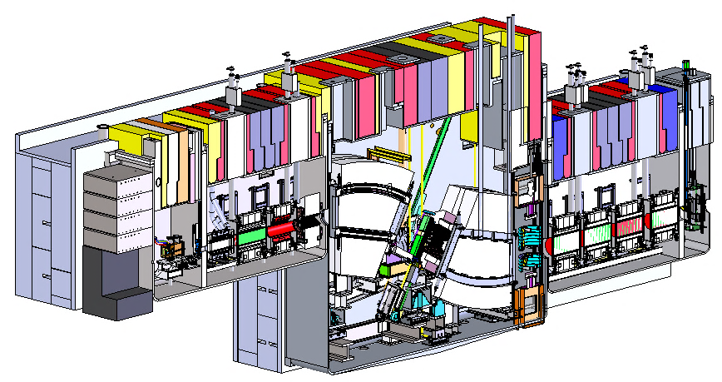
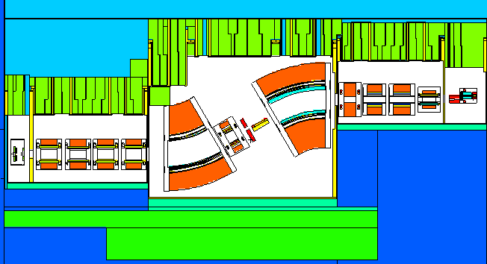
Radiation Transport Model High Level of Detail Supports Construction and Preparation for Operations
Calculations are based on models developed from mechanical and facility design
Model and materials are updated as the project progresses
Updates are provided by mechanical design group and magnet systems department
Capability of the models to transport ions in magnetic fields is important
Magnetic fields correspond to those needed for beam optics and are provided by fragment separator group
3D engineering design of the preseparator vacuum vessels
Beam direction
M1
Q3
Q2
Q1
M2
D1
Target
Q7
Q6
Q5
Q4
D2
Beam Dump
Wedge
Beam direction
Radiation transport model of the preseparator vacuum vessels

Slide 7
Hot Cell Magnets: Why Important?
Beam induced effects on superconducting magnets and other components are important to FRIB operations
Power losses need to be removed efficiently
Magnet heat loads drive water cooling and cryogenic component design
Coil lifetimes depend on radiation doses
Detailed power deposition information provided to the magnet designers and engineers for final magnet design
Beam optics modes affect the loss characteristics
Requires beam physics and radiation transport calculations
Optics modes developed to maximize rare isotopes to experiment yet minimize damage
FRIB preseparator beam line elements
Target
Q1, Q2, Q3, M1
D1
Wedge
Beam Dump
D2

Slide 8
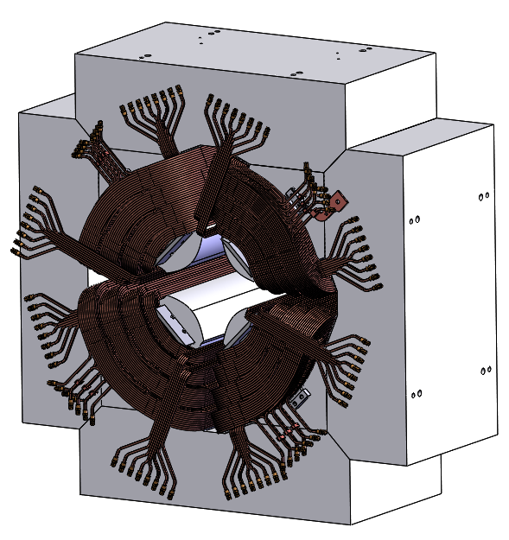
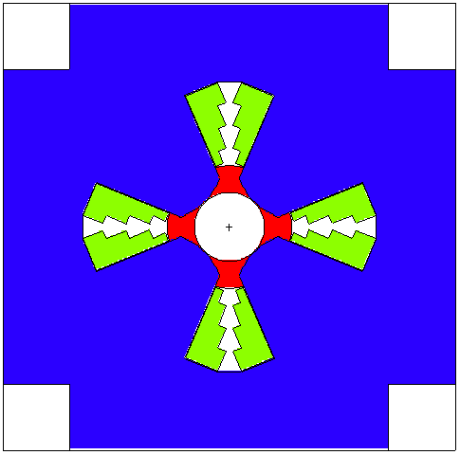
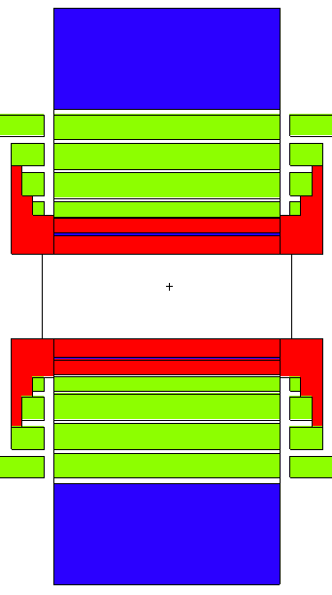
Room Temperature Quadrupole
Q1 coil design support
First magnet after the target – high radiation environment
Coils contain cyanate ester, therefore lifetime concerns
Radiation tolerance 150 MGy
Local shielding optimization:
Shield in front of the magnet reduces coil heat loads 2-4 times
Shield inside the magnet reduces coil heat loads 7 times
Copper or other material
Beam setting example: ⁴⁸Ca, 261 MeV/u
Light, neutron-rich beam; to be used frequently; a worst-case scenario
Peak heat loads into coils ~ 5 mW/cc
Coil lifetimes ~7 years
3D engineering design of Q1
Q1 radiation transport model
Copper filling

Slide 9
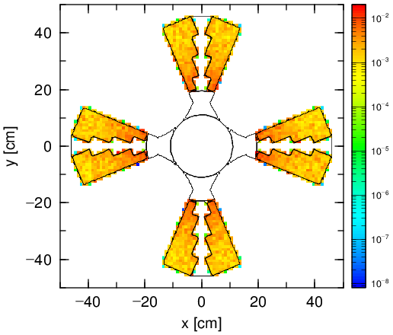
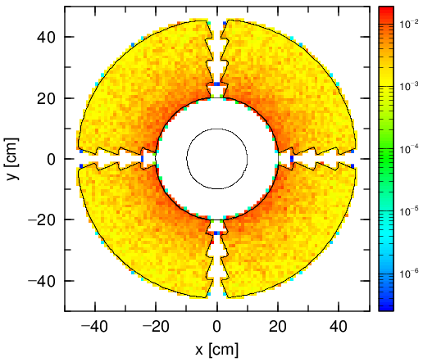
Q1 Coil Heat Loads: Various Beams
FRIB to operate with many beam scenarios
Heat loads calculated for 5 beams planned to be used most often
Coil lifetimes range from
5 years (¹⁶O, 213 MeV/u) to
48 years (²³⁸U, 203 MeV/u)
Annual-time-weighted lifetime is ~30 years
Planned FRIB facility lifetime is 30 years
Heat Load (W/cc)
Heat Load (W/cc)
Inner Coils
Front Coils
Beam | Annual Time, % | Coil Lifetime, years | Total Weighted Lifetime, years
Oxygen-16 | 5 | 5 | 30 (similar to facility lifetime)
Calcium-48 | 21 | 7
Krypton-86 | 27 | 20
Xenon-136 | 12 | 30
Uranium-238 | 35 | 48

Slide 10
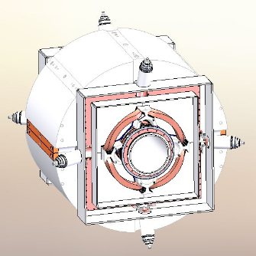
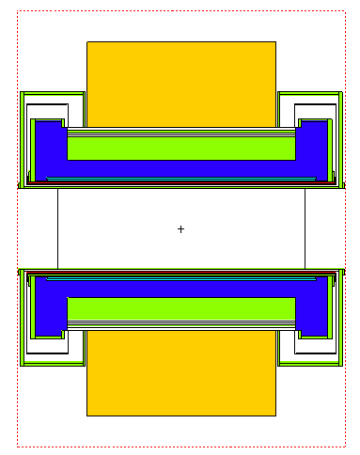
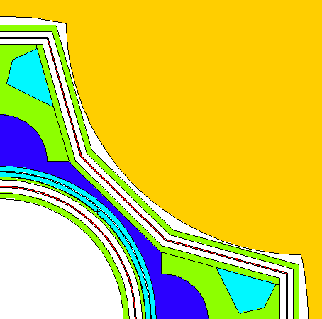
Superconducting Quadrupoles
Q2 & Q3 cryogenic component design support
Heat loads into cryogenically cooled components calculated
Analysis supports cryogenic cooling design finalization
Local shielding suggested, optimized as needed
Worst-case scenarios considered
Beam setting example: ⁴⁸Ca, 261 MeV/u
3D engineering design of Q2
Q2 radiation transport model
Yoke
Coils
Heat loads into cryogenic components
Cryostat
He
Thermal shield

Slide 11
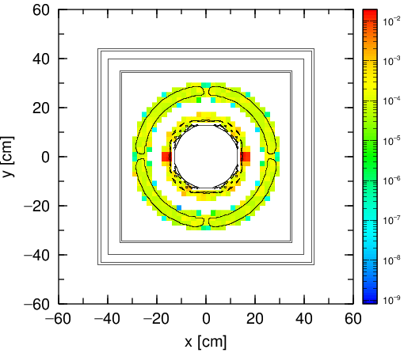
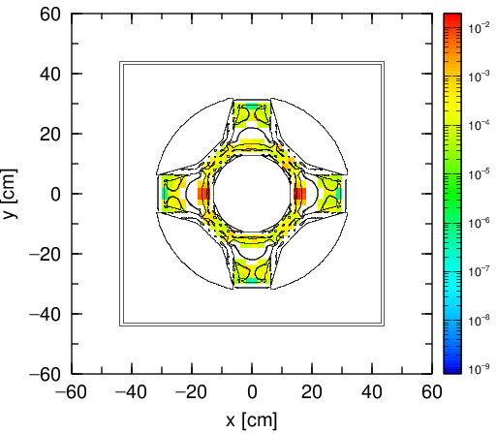
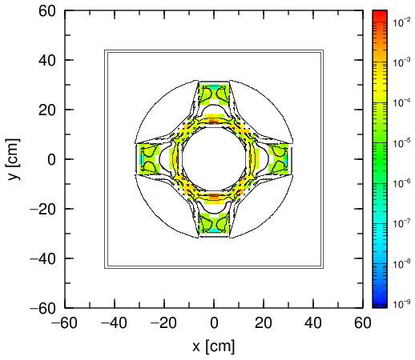
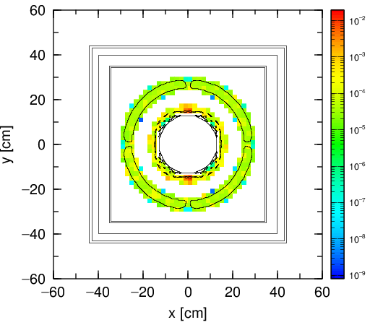
Q2 Coil Lifetime Estimates
Q2 & Q3 coil design support
Peak heat loads into coils need to be reduced
To avoid quenching
To increase coil lifetimes (SC coils contain cyanate ester, Kapton)
Peak heat loads: Corrector coils at the magnet front
~ 20 mW/cc or ~ 2 years coil lifetime for a ⁴⁸Ca, 261 MeV/u beam
Heat load major contributors: Protons (~50%), other light charged particles
Placing 5 cm thick copper or hevimet shield between Q1 and Q2:
~ 2 - 3 times lower peak heat loads
Closest to target -> -> -> Farthest from target
Heat Load (W/cc)
Heat Load (W/cc)
Heat Load (W/cc)
Heat Load (W/cc)

Slide 12
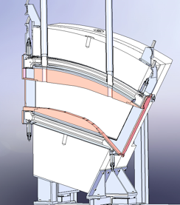
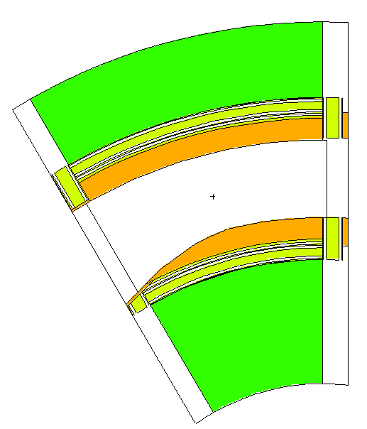
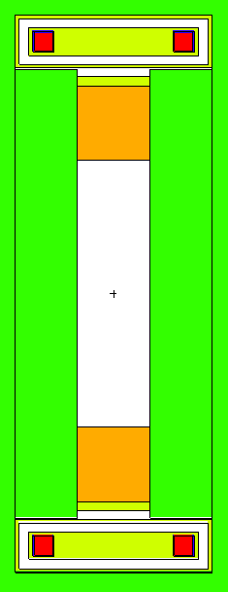
Superconducting Dipoles
First 30°dipole design support
Benchmark cases defined having potential for the most extreme conditions on the magnets
Oxygen primary beams tend to pose the most extremes
Large fraction of the beam reacts
Products and primary beam characterized by some of the highest phase spaces after the target
Calcium primary beams also analyzed
Are also neutron-rich light beams
And will be used relatively often
Uranium primary beam produces much less heat load and damage
Most of the time, we expect to run different beams that do not present extreme cases in terms of heat loads
3D engineering design of D1
D1 radiation transport model
Coils
Copper blockers
Poletips

Slide 13
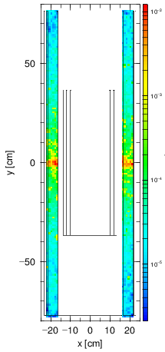
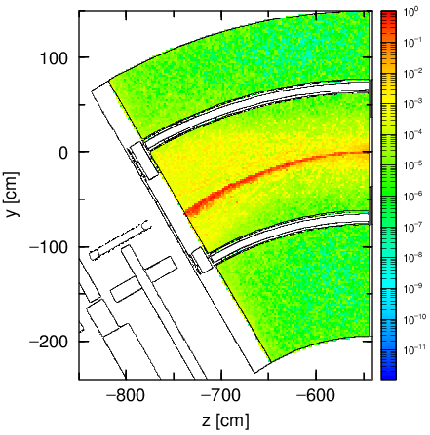
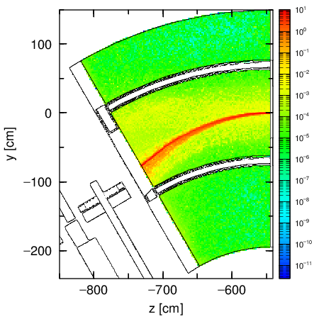
Dipole Component Heat Loads
Dipole cryogenic component heat loads study
Supports cryogenic system design verification
Several worst-case beams studied
Examples: 2 settings of ⁴⁸Ca at 261 MeV/u
Close to primary beam rigidity (center), => ³¹Al
High rigidity (low), => ⁴⁰Mg
Dipole coil heat loads, lifetimes
Same beams, settings
Peak heat load 14 (29) mW/cc
Coil lifetimes 3 (2) years
Local shielding considered
D1 front coil heat load maps
Heat Load (W/cc)
Dipole cryogenic part heat loads
D1 dipole poletip heat load maps
Max 1 W/cc
Max 11 W/cc
Heat Load (W/cc)
Heat Load (W/cc)
Total 0.5 kW
Total 6 kW

Slide 14
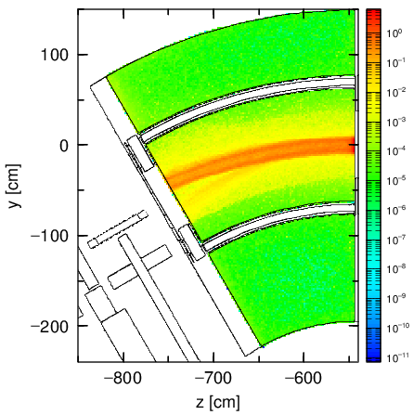
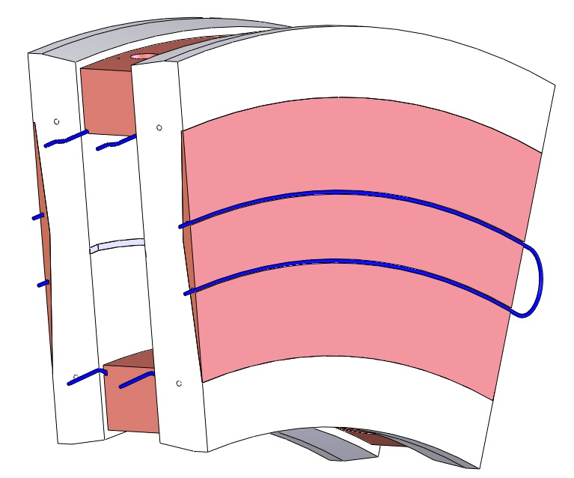
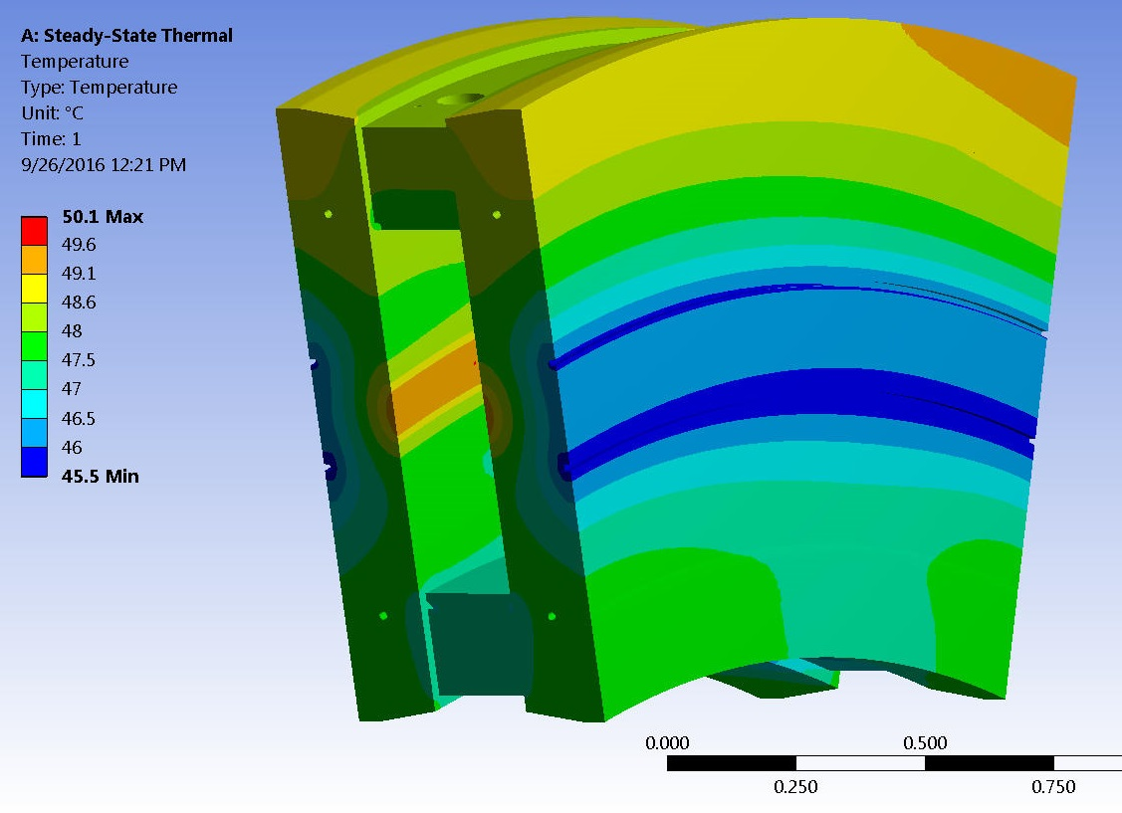
Hot Cell Magnet Detailed Radiation Studies Thermal Analysis for 30°Dipole Poletips
Heat loads in water cooled dipole poletips
A worst-case beam ¹⁶O, 313 MeV/u, => ⁹C
Total heat load into poletips = 3 kW
Water cooling - 2 gpm flow rate
Poletips: T_{max} = 50 ºC
Cooling water: T_{max} = 40 ºC
Another worst-case beam ⁴⁸Ca, 261 MeV/u, => ⁴⁰Mg
Total heat load into poletips = 9 kW
Water cooling – 8.5 gpm flow rate
Poletips: T_{max} = 67 ºC
Cooling water: T_{max} = 45 ºC
But if flow rate is 4.25 gpm then
Poletips: T_{max} = 77 ºC
Temperatures are reasonably low and should not affect magnetic field homogeneity appreciably
Poletip heat map
Poletip simple model
Copper
Heat Load (W/cc)
Total 3 kW
Area with highest power density
Water channels
Poletip thermal map

Slide 15
Summary and Conclusions
FRIB being designed and established at MSU as a national user facility to provide fast, stopped, and reaccelerated beams of rare isotopes
High radiation environment in the project target facility with fragment separator demands detailed analysis of radiation heat loads to beam line components, particularly magnets
Various studies of the magnets exposed to the highest radiation levels performed, component heat loads analyzed
Calculations presented are part of a multi-step, iterative process to validate detailed beam line component designs and support future operations within the facility

Slide 16
References
Monte Carlo particle transport codes PHITS and MCNPX, visualization software VISED, and conversion software MCAM were used
PHITS: T. Sato, K. Niita, N. Matsuda, S. Hashimoto, Y. Iwamoto, S. Noda, T. Ogawa, H. Iwase, H. Nakashima, T. Fukahori, K. Okumura, T. Kai, S. Chiba, T. Furuta and L. Sihver, Particle and Heavy Ion Transport Code System PHITS, Version 2.52, J. Nucl. Sci. Technol. 50:9, 913-923 (2013)
MCNPX: D. B. Pelowitz, ed., MCNPX User's Manual, Version 2.7.0, Los Alamos National Laboratory report LA-CP-11-00438 (2011)
VISED: http://www.mcnpvised.com/
MCAM: Y. Wu, FDS Team, CAD-based interface programs for fusion neutron transport simulation, Fusion Engineering and Design 84 (2009) 1987-1992

Slide 17
Acknowledgements
I would like to express my gratitude to the SATIF-13 organizers…
…To my colleagues at FRIB for all their help and guidance…
…And to fellow participants for their attention!
This material is based on work supported by the U.S. Department of Energy Office of Science under Cooperative Agreement DE-SC0000661, the State of Michigan and Michigan State University. Michigan State University designs and establishes FRIB as a DOE Office of Science National User Facility in support of the mission of the Office of Nuclear Physics.

Slide 18
Radiation Protection Limits
Meet regulatory limits and MSU ALARA (As Low as Reasonably Achievable) limits for general public and radiation workers (Regulatory Requirements, R10103-TD-000014, 13 April 2010)
The site is under NRC license**
Radiation Dose – Worker | Standard*: 5,000 mrem/yr MSU ALARA Goal**: 500 mrem/yr
Radiation Dose – Public | Standard*: 100 mrem/yr and < 2 mrem/(any one hour) MSU ALARA Goal**: 10 mrem/yr and < 2 mrem/(any one hour)
Air - maximum exposure to nearest receptor | Standard*: 10 mrem/y MSU ALARA Goal**: 1 mrem/yr
Groundwater – effluent | ³H Standard*: 1,000 pCi/ml FRIB Design Goal: 20 pCi/ml (drinking water standard***) | ²²Na Standard*: 6 pCi/ml FRIB Design Goal: 0.4 pCi/ml (drinking water standard***)
* Standard refers to 10 CFR 20 (Nuclear Regulatory Commission)
** MSU ALARA – NRC License Number 21-00021-29, MSU Type A Broad Scope License. MSU operates as a fully-licensed, non fuel cycle R&D Type A, NRC broad-scope licensee since 1977
*** Standard refers to 40 CFR 141 (Environmental Protection Agency)

