Slide 1
Measurements and FLUKA Simulations of Bismuth and Aluminum Activation at the CERN Shielding Benchmark Facility(CSBF)
E. Iliopoulou, R. Froeschl, M. Brugger, S. Roesler, A. Infantino, N. Nakao, T. Sanami, T. Kajimoto, A. Siountas, P. Bamidis
SATIF 13, 12/10/2016

Slide 2
Outline
CHARM (CERN High energy AcceleRator Mixed field facility)
CSBF (CERN Shielding Benchmark Facility)
Activation benchmark campaign in July 2015
FLUKA simulations
Sensitivity studies
Results
Conclusions

Slide 3
CHARM - Location

Slide 4
CHARM - Layout
Beam line
Target alcove
Target
Movable shielding
walls

Slide 5
CHARM
Purpose
Study radiation effects on electronic components (R2E project)
Beam characteristics
Primary protons from the PS
24 GeV/c momentum
5 x 10¹¹ protons/pulse
350ms pulse length
max. average beam intensity 6.6 x 10¹⁰ p/s

Slide 6
CHARM
4 movable shielding walls
Target holder

Slide 7
CSBF (CERN Shielding Benchmark Facility)
Combined facility EN/EA, R2E and RP
Purpose
Characterization of the shielding properties of various materials
Deep shielding penetration studies
Detector calibration
Detector inter-comparison
Activation
Situated laterally above the CHARM target
Parasitic use of the radiation field emerging from the CHARM target
80cm cast iron & 360cm of concrete and barite concrete

Slide 8
CSBF – Layout 2015

Slide 9
CSBF - Location

Slide 10
Activation benchmark campaign in July 2015
Bismuth & aluminum samples
11 disk samples
Different heights in the CSBF
Inside CHARM
Copper target
Specific production yield comparison
FLUKA simulations
Measured activity Production yield

Slide 11
FLUKA simulations
Protons with 24GeV/c on Cu target
12mm x 12mm FWHM
Region importance biasing
Usrtrack – scoring for neutron fluence
Weighting with a set of cross sections of Bi(n,xn) and Al(n,a)Na-24
Correct geometry description
Scoring volumes

Slide 12
FLUKA simulations

Slide 13
FLUKA simulations

Slide 14
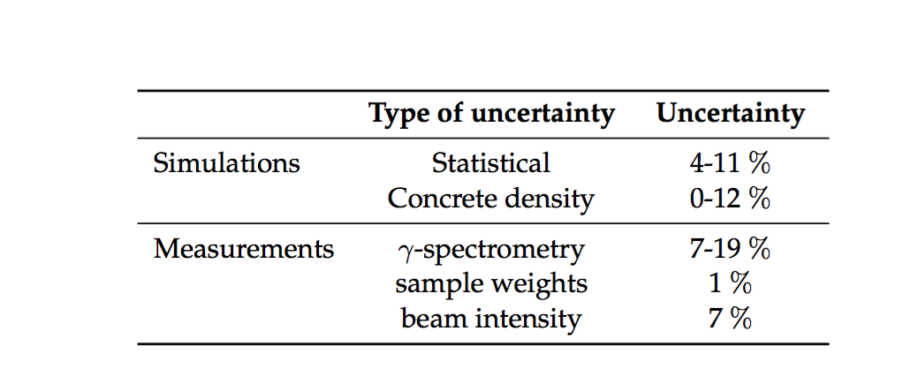
Sensitivity studies
Beam profile on target (FWHM)
From 12mm x 12mm 36mm x 36mm
Negligible impact
Material upstream inside IRRAD
<1% for actual material inside IRRAD
20% hypothetical difference from loading case for RP design study
Density of materials
Concrete, from 2.2g/cm³ 2.4g/cm³
Cast Iron, from 7.3g/cm³ 7.2g/cm³

Slide 15
Samples

Slide 16
Sample placement

Slide 17
Beam intensity profile

Slide 18
Results

Slide 19
Results

Slide 20
Results

Slide 21
Conclusions
Activation campaign at CSBF 2015
Comparison of production yields between FLUKA and
γ-spectrometry measurements
Agreement at a level of a factor of 1.5.
Upgrade of CSBF in 2016, see further details in SATIF13 talk:
R. Froeschl et al: Radiation protection aspects of the commissioning and operation of CERN High energy AcceleRator Mixed field (CHARM) facility in the CERN East Experimental Area

Slide 22
Thank you for your attention!

Slide 23
BACKUP

Slide 24
Upgrade of CSBF
Requirements:
Passive detectors
Activation samples or passive dosimeters
Monte Carlo benchmark studies
Active detectors
On top of the shielding
Deep penetration neutron spectrum
Dosimeters attached to phantoms
On top of the shielding
Deep penetration neutron spectrum
Shielding material test location
Measurement of the attenuation length for different materials
Detailed design based on FLUKA simulations

Slide 25
Upgrade of CSBF –Layout

Slide 26
Upgrade of CSBF

Slide 27
Backup - Upgrade

Slide 28
Backup - Upgrade

Slide 29
Backup - Upgrade

