Slide 1
Abstracting Fluka Line Builder input as GUI elements for linear beamline geometries
Jefferson Lab
Andrea Cowley, George Kharashvili, Pavel Degtiarenko

Slide 2
Precursor Technologies
FLUKA - particle physics Monte-Carlo simulation package
Flair - user friendly interface for FLUKA
Fluka Line Builder - CERN tool to generate FLUKA geometry from set of elements
(Thanks to Alessio Mereghetti and team!)

Slide 3
Need for Speed
Experimental halls have linear beamlines
Frequent changes in this area due to multiple science goals
Every new configuration must be checked
Other areas are mostly static

Slide 4
The Current Toolbox
FLUKA by hand | FLAIR | Line Builder
The next person to use the geometry will be lost Usually needs tweaking after creation Lots of places to make mistakes | Excellent for one-off geometries Speed drops off for multiple devices in one geometry | Super fast at stitching elements Easy to use once configured, one command Requires a Twiss file, which is prone to maths errors

Slide 5
Leveraging Fluka Line Builder
Element database stores discrete structures
Accelerator planning files as construction plan (twiss)
Twiss files for linear sections are simple
Discrete units in linear geometry yields one dimension

Slide 6
Discrete Structures
Line builder database has some free information
No dimensional information
Using comment tags, more info can be added
Two tags satisfy everything needed for TWISS
Database Element
Linebuilder Data
Friendly Name
Machine Tag (Hall A, B, C for JLab)
FLUKA external body name
New Data
Length of external body
Twiss type (VACUMEL or RCOLLIMATOR)

Slide 7
Beampipes from Line Builder
Stored separately from elements
Dynamic lengths, configured using additional file
Added just as an element in linear configurations
Can be abstracted as an element of variable length

Slide 8
Leveraging Flair
Individual beamline elements can be created using flair
Complicated element can be built once by the user most familiar
External body limited by the set allowed by flair
Structures can be debugged individually using built-in debugger
Notes:
External bodies allowed: BOX and RPP

Slide 9
Leveraging FLUKA Text Geometry
Beam Line Builder Element Database requires input files to be split
Fluka.inp -> Bodies, Regions, Materials
Input files are plain-text
A script can quickly split and place files in the needed directories

Slide 10
Proposed Workflow
Create elements and convert with script
Add elements to database
Arrange elements in a line
Build line with Line Builder
Enjoy the FLUKA output

Slide 11
Elements presented as blocks in an array

Slide 12
Element management windows

Slide 13
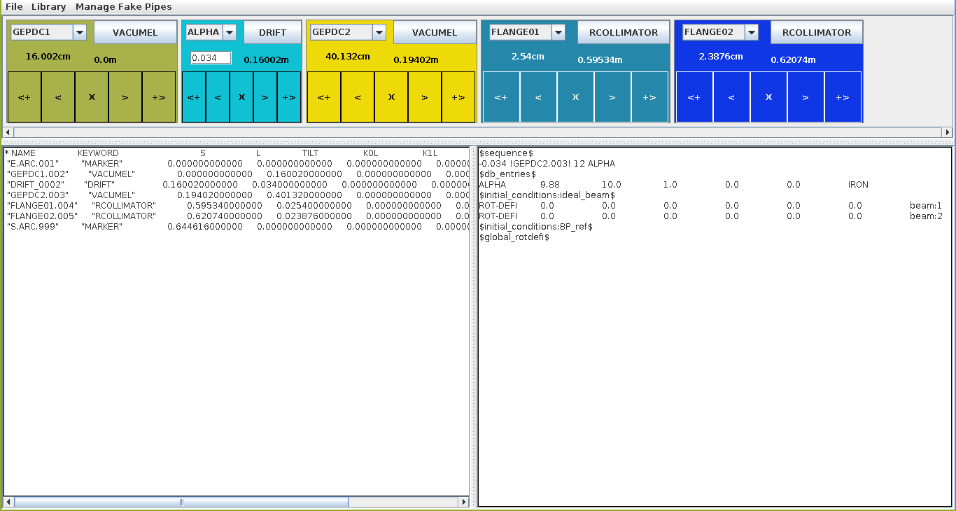
Beamline
Twiss output
Beampipe file for Line Builder
Outline of developed GUI

Slide 14
Managing Multiple Users
Version control to track changes, CERN uses SVN, JLAB uses Git
Users self-manage additions
Text basis of database allows for standard content management software
Suggest branches for work-in-progress elements

Slide 15
Outcome
Reproducible results using interchangeable parts
Individual elements can be inspected for quality
Elements in the database are reproduced exactly
Changes and tweaks to the line can be realized in seconds
Users can share and maintain elements collaboratively.

Slide 16
End
SATIF-13, HZDR
12 October, 2016

