Slide 1
R&D of Photocathodes used for
ELBE SRF Gun II
Jana Schaber
Graduiertenkolleg “AccelencE”, Leimen, 09.10.– 11.10.2023

Slide 2
Outline
Introduction
1.1 SRF Guns
1.2 Requirements on Photocathodes
ELBE SRF Gun II
Photocathodes for SRF Gun II
3.1 Cs₂Te
3.2 p-GaN:Cs
3.3 Mg studies
Summary & Outlook

Slide 3
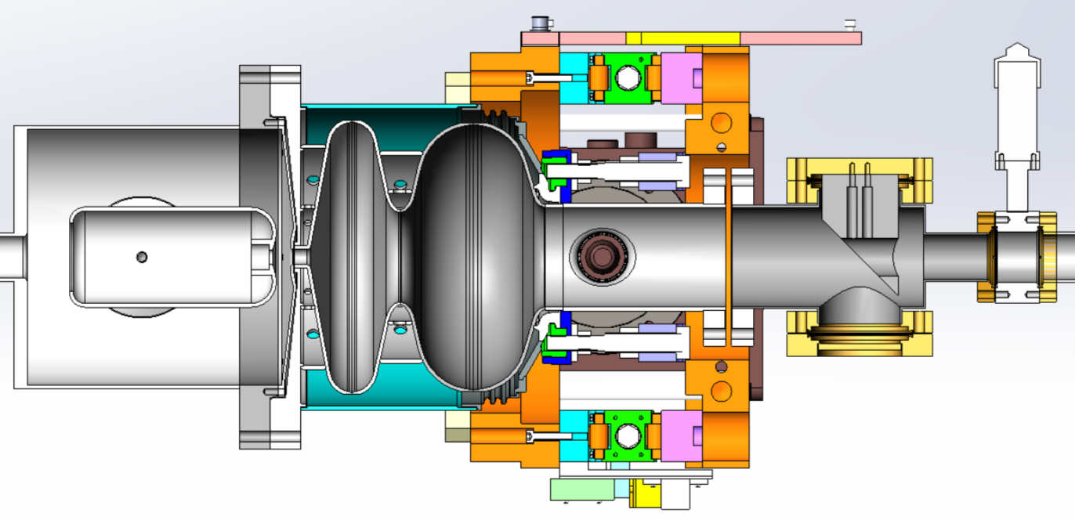
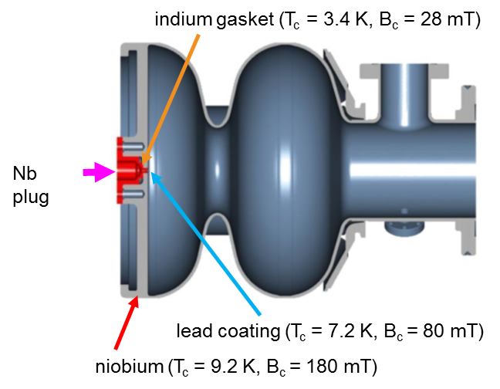
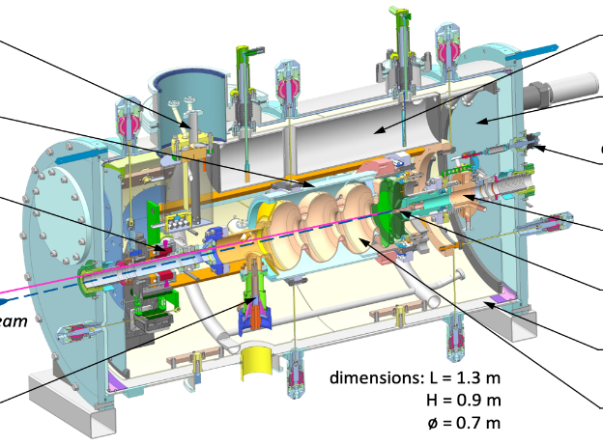
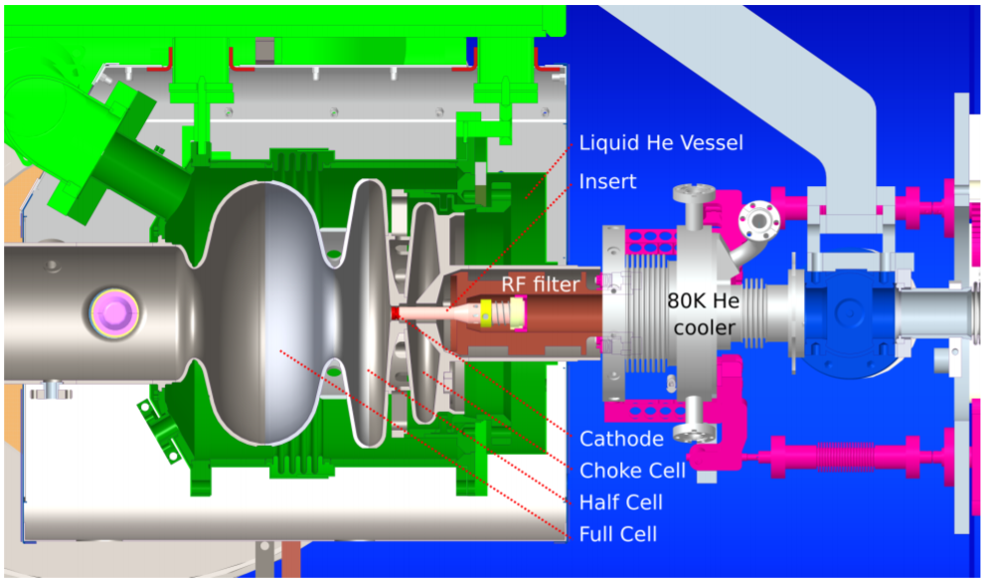
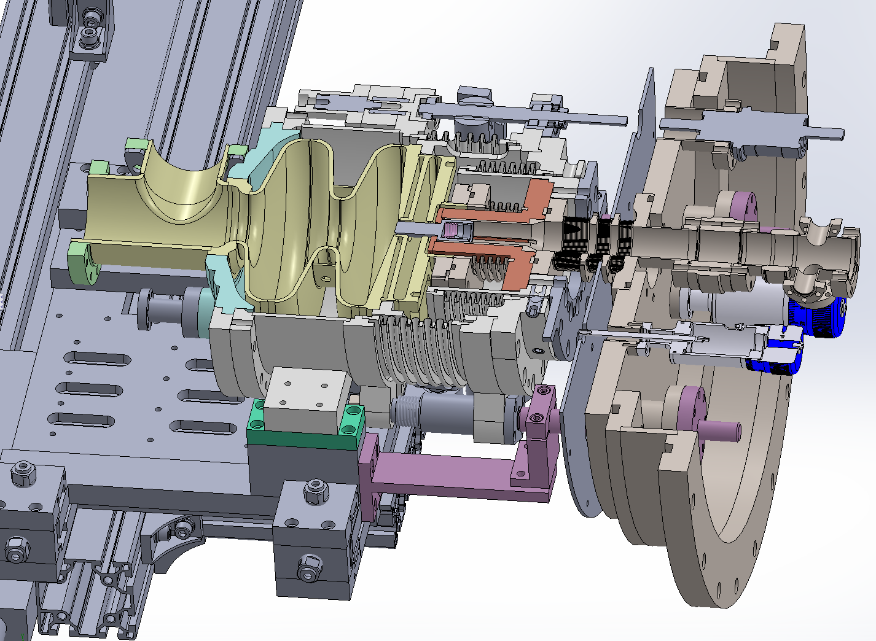
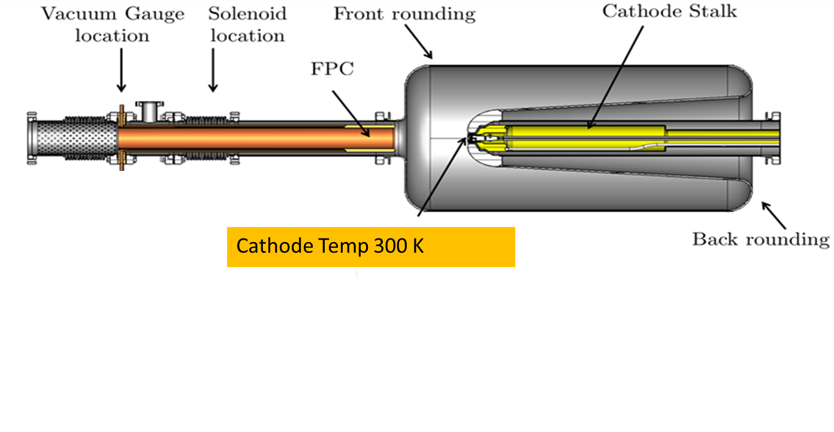
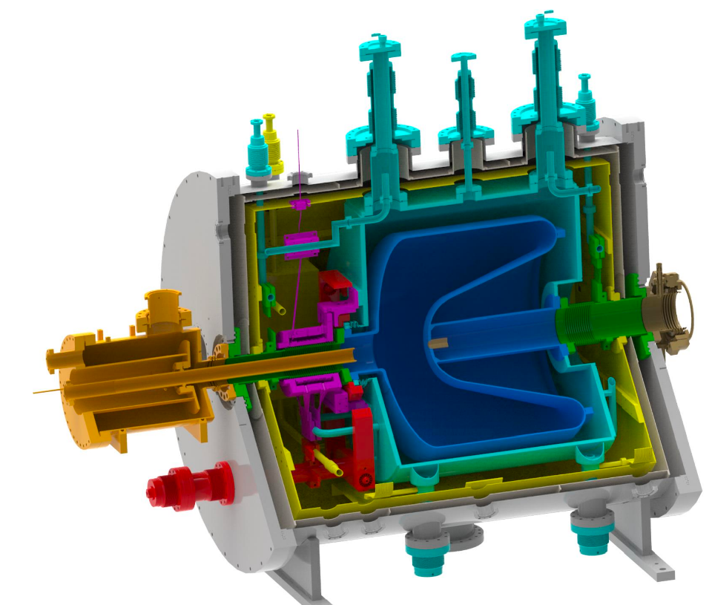
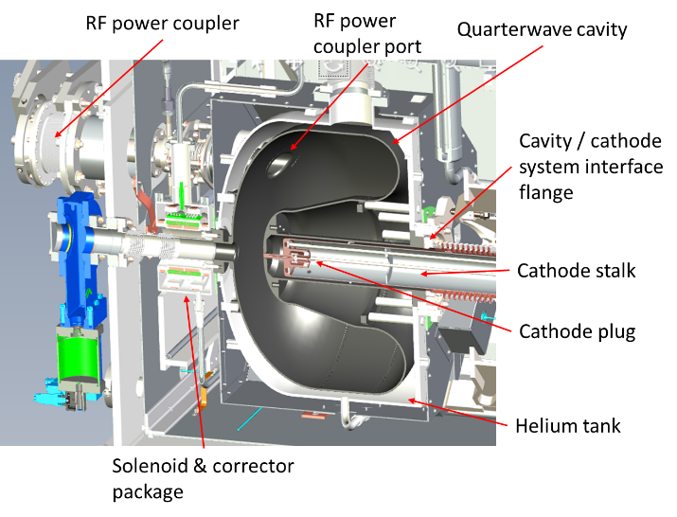
BNL SRF gun
1. Introduction
SRF guns for CW high brightness beam
PKU DC-SRF gun
DESY SRF gun
HZDR SRF gun-II
in user operation
HZB SRF gun
KEK SRF gun
WiFEL gun
LCLS-II HE gun
Notes:
Unterschied in Cavity: oben 1.3 GHz unten nur 120 MHz RF field.

Slide 4
1. Introduction
Requirements for photocathodes in SRF gun
General requirements for photocathode in injectors
high QE, low thermal emittance, fast response time
robust , long lifetime
low dark current
Specially for SRF guns:
clean for SC cavities
properties at cryogenic temperature
thermal conductivity, thermal expansion
(SC cathode) transition temp., critical magnetic field
Multipacting issue: secondary electron yield
heat load: laser heating, RF power deposition

Slide 5
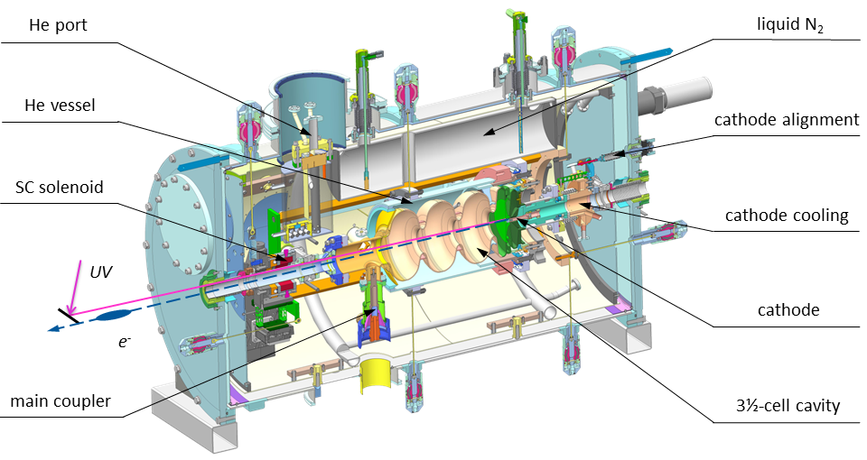
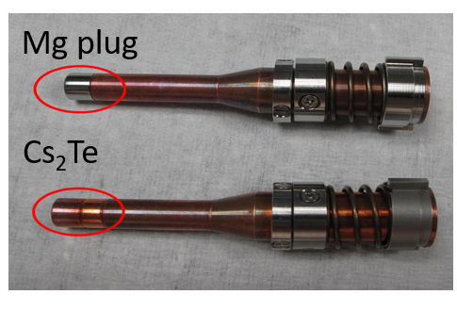
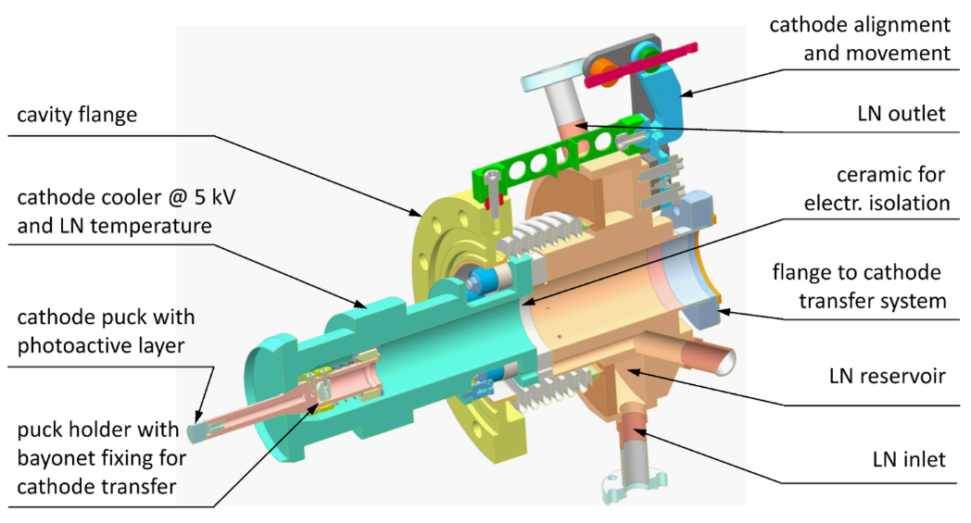
2. Normal conducting photocathodes for SRF guns
2.1 Metal photocathodes in SRF Guns
Cathode Temp ~ 80K
J.Teichert et al. Successful user operation of a superconducting radio-frequency photoelectron gun with Mg cathodes. PRAB 24, 033401 (2021)
Notes:
At HZDR we operate SRF gun II 1.3GHz cavity for CW THz user beam, the bunch charge is 200pC.
In 2014 commissioning with Cu
2016,2017 three time failure with Cs2Te on Mo
Till 2019 succeeded in cleaning and operating Mg. 2019 - 2020 stable operation with Mg ~ 1760 h beam time, ~ 57 C charge

Slide 6
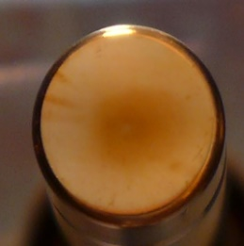
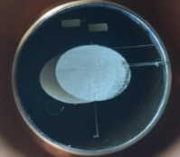
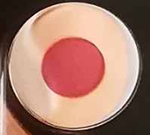
2. Normal conducting photocathodes for SRF guns
2.2 Semiconductor photocathodes in SRF Guns
Cu cathode: gun commissioning
easy to use
little dark current
QE_{258nm}~10⁻⁵ -10⁻⁴
Mg cathode: stable operation
Cs₂Te cathode: most time used
High QE (10⁻¹) after laser cleaning
Long lifetime
No multipacting problem
repeatable
Since 2020 for user operation
Providing ~200 pC, 2.3 ps, 50-100 kHz
2-3 months lifetime with QE 0.5%-1%
Highlight:
2019 - 2020 stable operation for users
200-250 pC, 100 kHz, 1760 hrs, ~ 57 C
? Possible QE drops due to transport, multipacting, CW RF and beam operation
Teichert, J. et al. Successful user operation of the superconducting radio-frequency photo electron gun with Mg cathodes at ELBE. Physical Review Accelerators and Beams 24(33401) (2021), 1–30

Slide 7
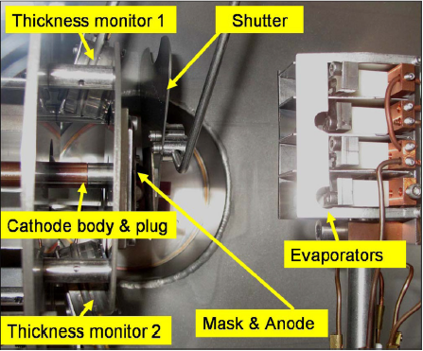
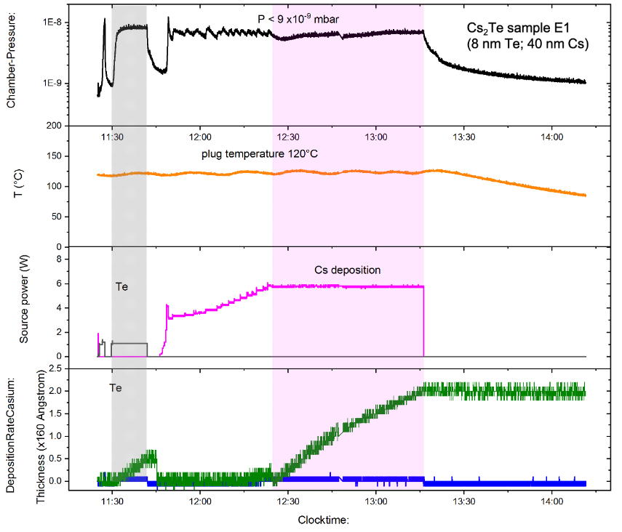
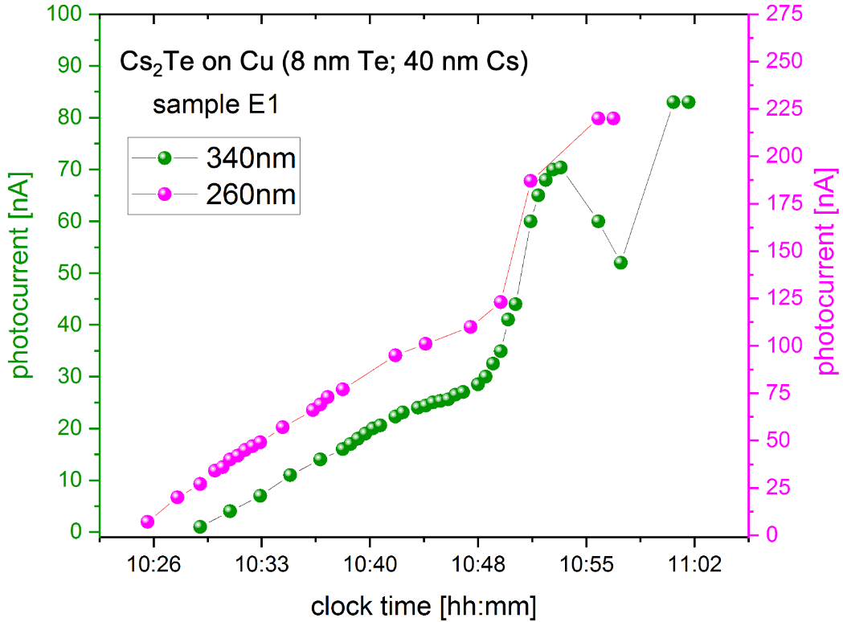
2. Normal conducting photocathodes for SRF guns
2.2 Semiconductor photocathodes in SRF Guns
Cs₂Te for HZDR SRF gun
Cs₂Te deposited on Cu, not on Mo
preparation is quite complex
Deposition of Te (3 - 10 nm), then Cs
till photocurrent reaches a maximum
Cs₂Te used in SRF Gun II with 1% QE
Notes:
At the same time, we have paid effort to solve the problem with overheating of Mo plug. In 2019, we changed to Cu as substrates. Copper is not friendly for Cs2Te coating, lower QE in our preperation, but it works well in the RF field. Since then we use Cs2Te on copper as routine cathodes. Nearly 3 months we will change to a new one. Multipacting is one issue, leading QE dropping but cathode can reach 1% typically. Here I show a cathode not the best, not the latest one, at moment workingin gun. QE dropped down during transport and RF turning on, and the distribution changed during operation, one border shows more robust. The thermal emittance is found strongly coupled to the QE distribution. Higher QE, higher thermal emittance. Film with difference Te thickness from 3nm – 10nm are prepared and installed in the gun, more details about QE evolution will be reported later together with surface chemical analysis.

Slide 8
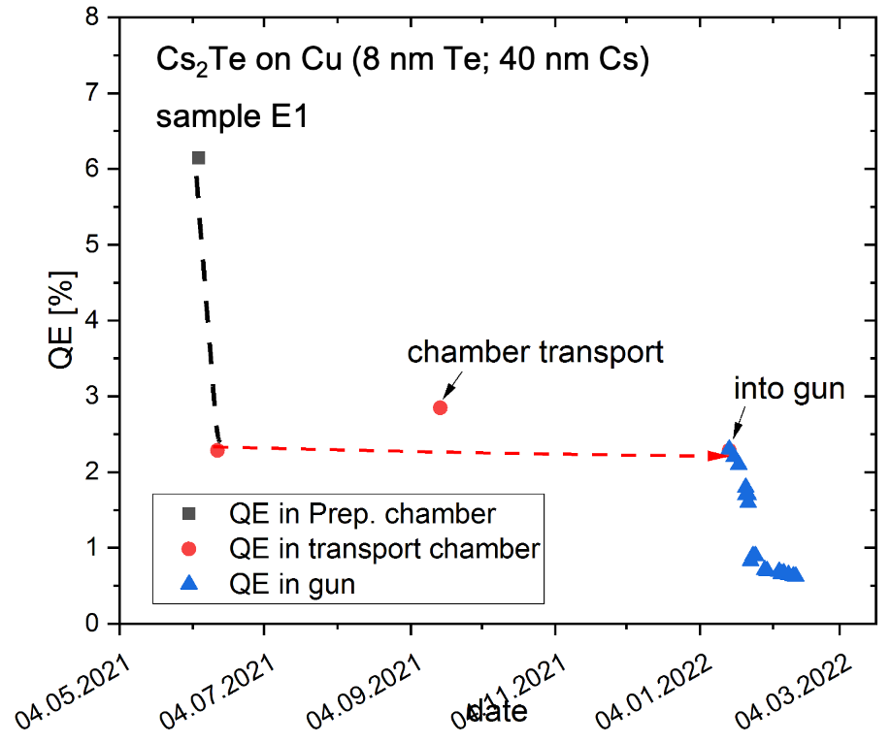
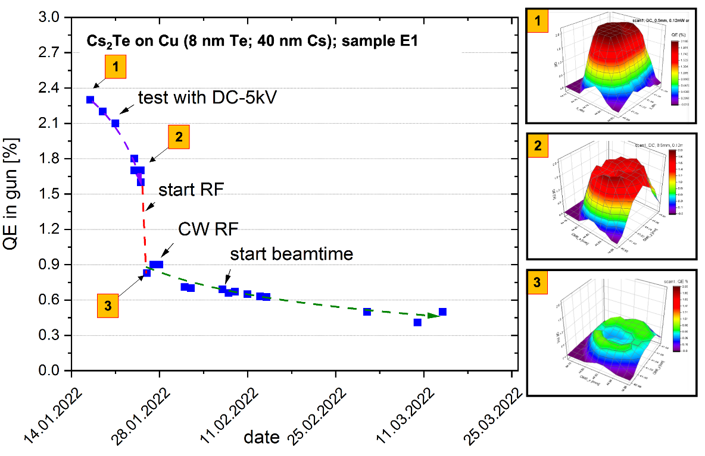
2. Normal conducting photocathodes for SRF guns
2.2 Cs₂Te degradation under RF and QE inhomogenity
QE of 6 % after the preparation
Cs2Te is transportet into transport chamber
And it looses QE during transportation to the SRF Gun II
Shows 1-2 % QE in general in SRF Gun II
RF turning on, and the distribution changed during operation
The thermal emittance is found strongly coupled to the QE distribution.
Higher QE, higher thermal emittance.
Middle of photocathode lost QE more than border region

Slide 9
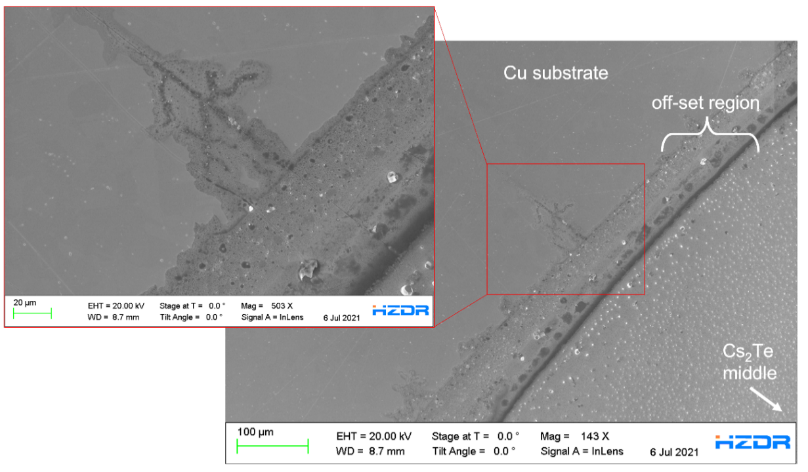
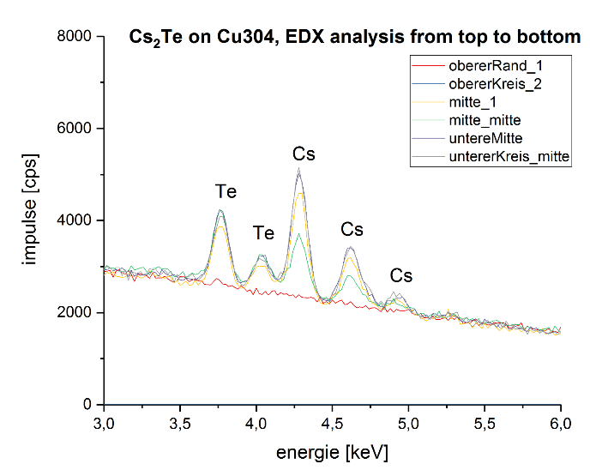
2. Normal conducting photocathodes for SRF guns
2.2 Cs₂Te degradation under RF and QE inhomogenity
Deposition of Te and Cs in the border region not fully overlapped
Border region and the middle are not consitent in Cs:Te ratio
→ Contains less Cs than in the middle

Slide 10
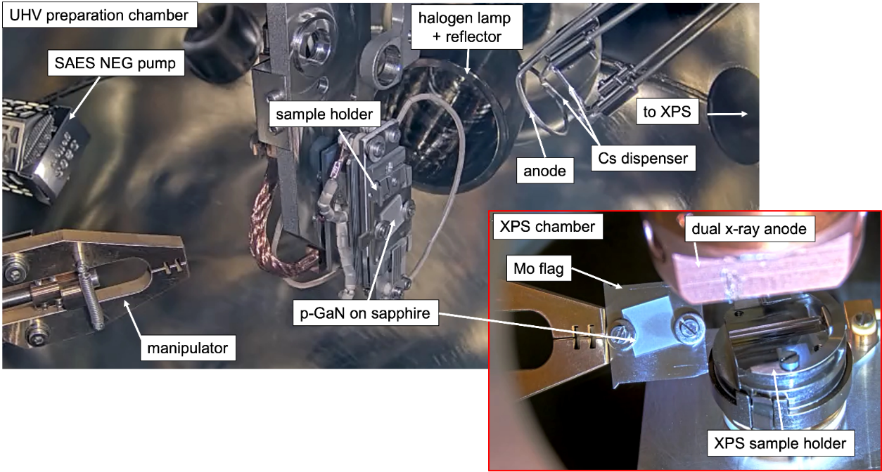
2. Normal conducting photocathodes for SRF guns
p-GaN(Cs) as potential new cathode
UHV preparation chamber (average 3 x 10⁻¹⁰ mbar)
310 nm UV-LED with 50 µW
Black body for thermal cleaning
Backside heating by manipulator
External IR sensor for temperature measurement
XPS chamber (average 5 x 10⁻⁹ mbar)
Schaber, J., Xiang, R. et al. Influence of surface carbon on the performance of cesiated p-GaN photocathodes with high quantum efficiency. Sci Rep 13, 3188 (2023).
Notes:
GaN is interesting because it has high QE at third harmonic of laser and robust as Cs2Te
At HZDR we are studying this cathode with commercial p-GaN on sapphire / Si / SiC, activation only with cesium, QE~ 11.5 % and lifetime~ 5000 h in storage, and we study the degradation process with XPS, the first result shows when QE drops down, there is Ga2O3 appeared.

Slide 11
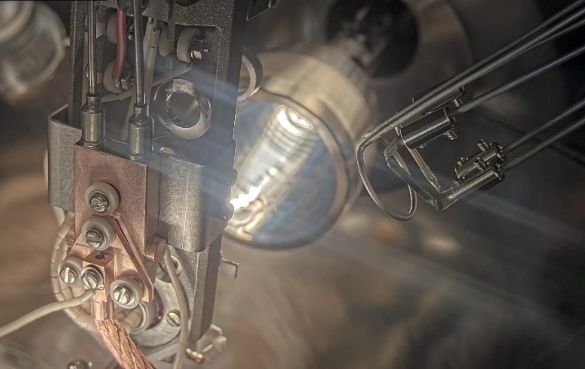
2. Normal conducting photocathodes for SRF guns
p-GaN(Cs) as potential new cathode
Thermal cleaning with black body
use T between 400-500 °C to reduce O and C surface amounts
but low C and O concentrations remained on the p-GaN surface
→ impurities from crystal growths process ?

Slide 12
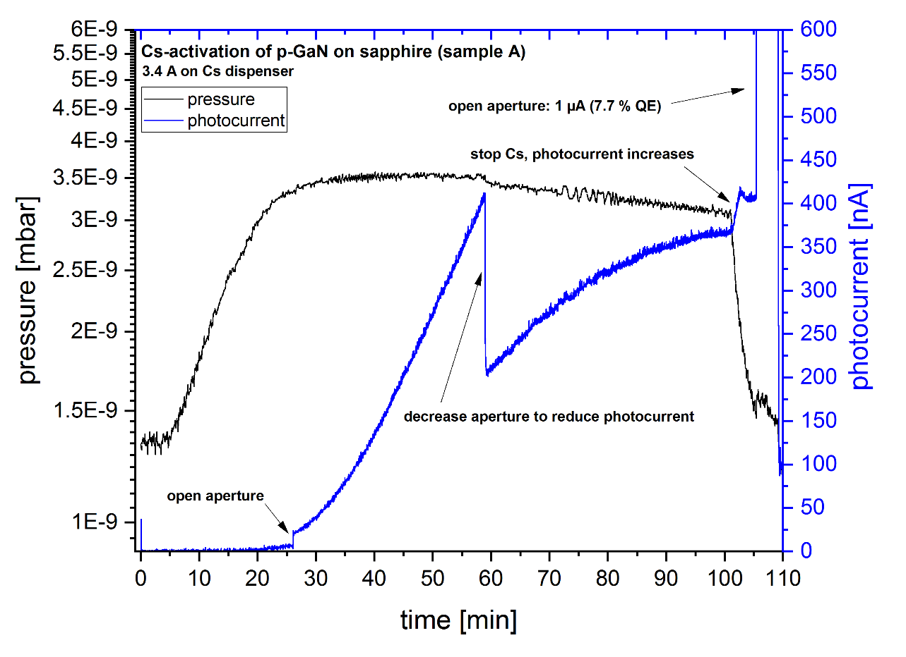
2. Normal conducting photocathodes for SRF guns
p-GaN(Cs) as potential new cathode
Apply 3 – 4 A through Cs dispenser
Constant Cs flux in good E-9 mbar range
Photocurrent starts to increase after 20 min
Aperture in front of LED is used to reduce photocurrent (relief of vacuum)
Photocurrent runs into plateau
Open the aperture to receive the maximum photocurrent
1 µA = 7.7 % QE
pressure/ mbar
time/ min

Slide 13
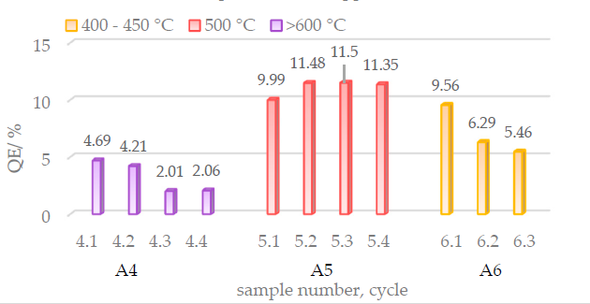
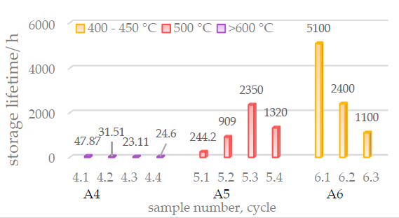
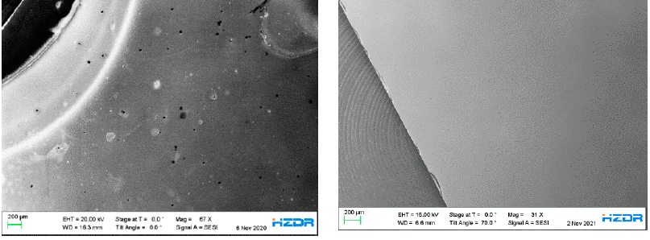
2. Normal conducting photocathodes for SRF guns
p-GaN(Cs) as potential new cathode-spectral response
wet chemically cleaned (H₂O₂:H₂SO₄) & thermal cleaned via halogen lamp
activated with a thin layer of cesium
high QE values ( > 10%) & long lifetimes at suitable temperatures !
Surface morphology of used p-GaN photocathodes
> 600° C
500° C
> 600° C: surface is destroyed → low QE & lifetime
@ 500° C: GaN surface smooth → higher QE & lifetime
Schaber, J.; Xiang, R.; et al. Influence of Surface Cleaning on Quantum Efficiency, Lifetime and Surface Morphology of p-GaN:Cs Photocathodes. Micromachines 2022, 13, 849. https://doi.org/10.3390/mi13060849

Slide 14
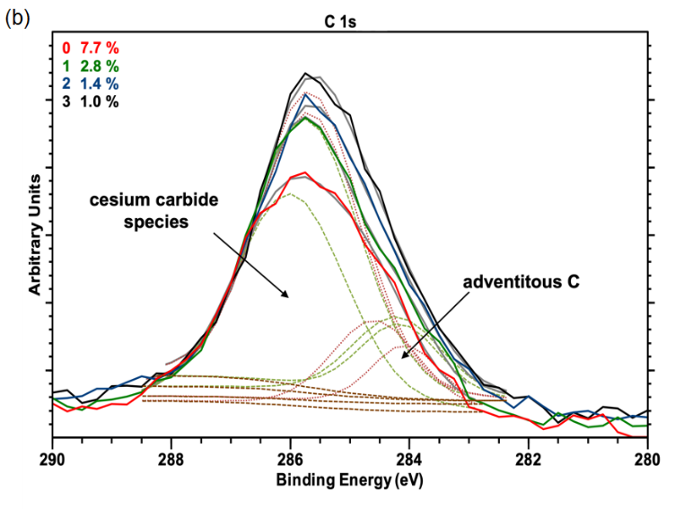
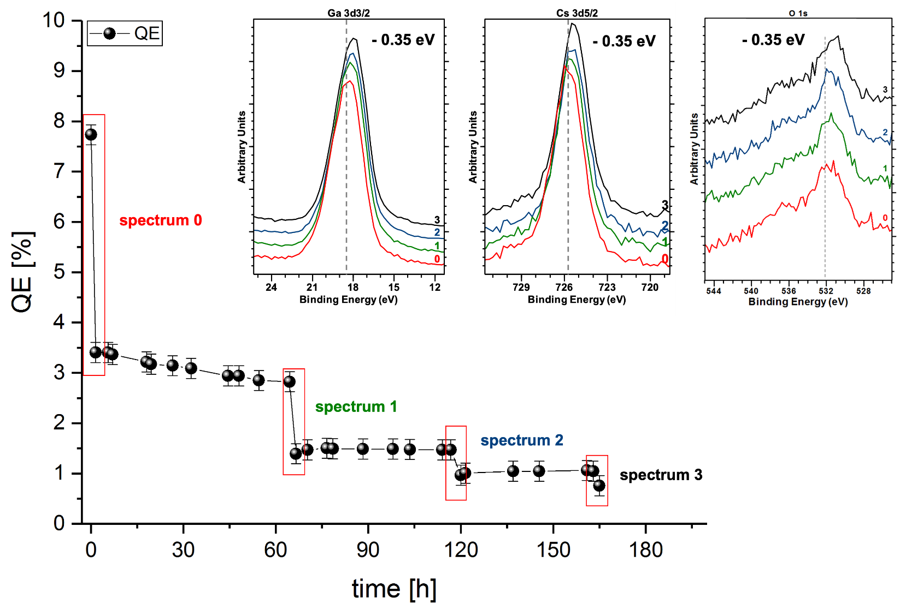


2. Normal conducting photocathodes for SRF guns
p-GaN(Cs) as potential new cathode-degradation
Peaks shift toward lower BE:
Charging effects ?
X-Ray influence ?
Cs_{x}C_{y} intensity increased during decay
→ responsible for the natural lifetime
QE decays in general exponentially
Schaber, J., Xiang, R. et al. Influence of surface carbon on the performance of cesiated p-GaN photocathodes with high quantum efficiency. Sci Rep 13, 3188 (2023).

Slide 15
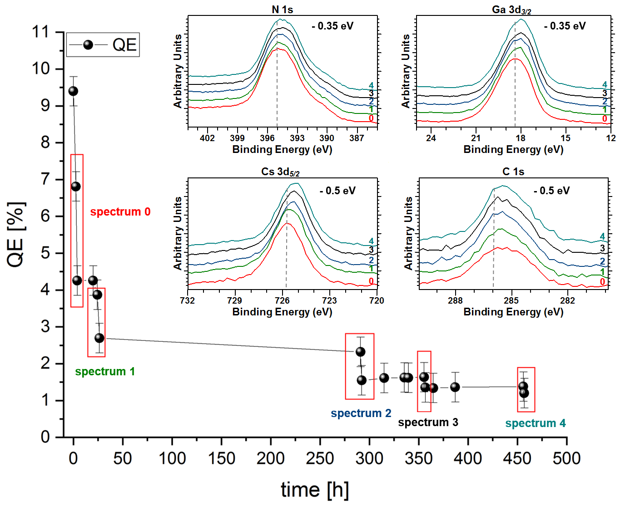
2. Normal conducting photocathodes for SRF guns
p-GaN(Cs) as potential new cathode-degradation
2. Thermal cleaning
3. Cs-activation
4. QE decay
Remaining Cs is beneficial for QE
→ Achieving higher QE after new Cs deposition
QE decays exponentially & longer lifetime
Same effects in the degradation process were observed as before

Slide 16
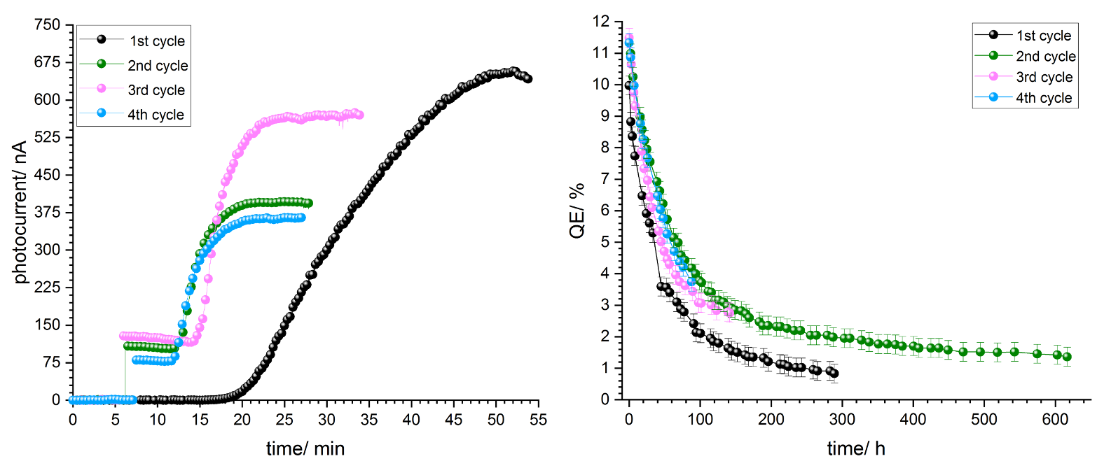
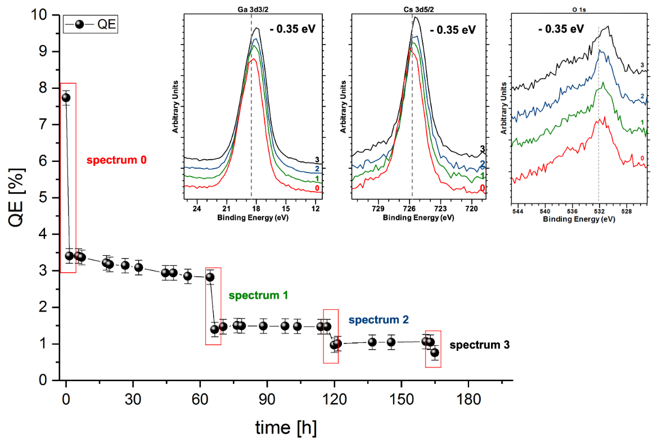
2. Normal conducting photocathodes for SRF guns
p-GaN(Cs) as potential new cathode-degradation
Under static conditions:
With XPS:
QE decays exponentially
XPS accelerates the QE decay
→ thermalization and Cs melting

Slide 17
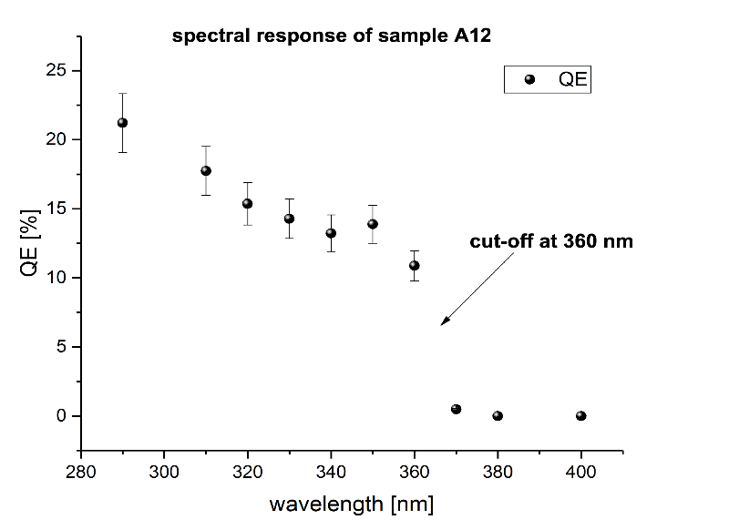
2. Normal conducting photocathodes for SRF guns
p-GaN(Cs) as potential new cathode-spectral response
Using halogenlamp with broad wavelength spectrum plus monochromator
Cut-off wavelength is at 360 nm for p-GaN:Cs photocathodes
P-GaN:Cs reached max. 21 % at 290 nm

Slide 18
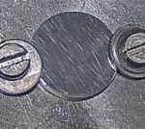
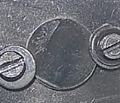
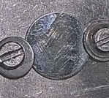
2. Normal conducting photocathodes for SRF guns
2.1 Metal photocathodes in SRF Guns
220 °C, 25.5 h
Mg⁰
2
200 °C, 19.5 h
O^{b}
C-C
MgO-R
1
IPA
CO-R
O^{s}
C=O
MgCO_{x}
0
Surface O is reduced while bulk O shows up
C cannot be fully removed but lowered in ist concentrations
MgCOx at the beginning transforms into MgO-R and MgO
IPA
after 19.5 h
after 25.5 h
0.1 % QE @ 275 nm UV (102 µW)

Slide 19
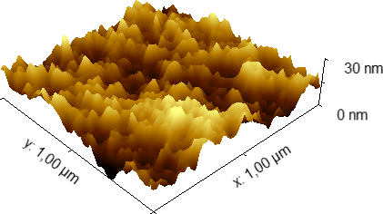
2. Normal conducting photocathodes for SRF guns
2.1 Metal photocathodes in SRF Guns
ex-situ SEM and AFM measurements
→ might not be the „real“ surface as under vacuum
RMS roughness = 5.95 nm for 10 x 10 µm sample surface
Thermal cleaning is not able to remove all C and O
shows a smooth surface

Slide 20
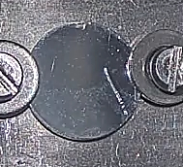
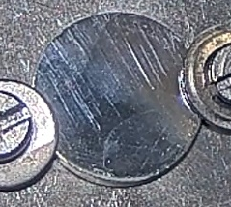
2. Normal conducting photocathodes for SRF guns
2.1 Metal photocathodes in SRF Guns
1.5 keV Ar⁺
(300 s)
1.5 keV Ar⁺
(300 s)
O^{b}
Mg⁰
1.5 keV Ar⁺
(480 s)
IPA
MgO-R
CO-R
O^{s}
C=O
CO_{x}
C-C
MgCO_{x}
Original surface showed a a lot of surface O (O^{s})
A lot of C from air environment and IPA
Mg showed a lot of MgCO_{x}
After 300 s: (O^{s}) peak decreased and O in bulk showed up (O^{b})
Continued sputtering: O almost disappeared
Still MgO-R in spectrum and intensive Mg⁰
Before sputtering
After sputtering
0.35 % QE @ 275 nm UV (102 µW)

Slide 21
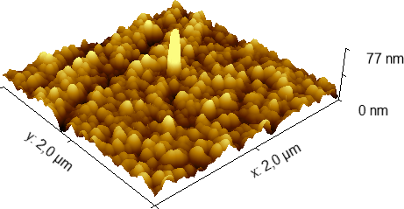
2. Normal conducting photocathodes for SRF guns
2.1 Metal photocathodes in SRF Guns
ex-situ SEM and AFM measurements
→ might not be the „real“ surface as under vacuum
RMS roughness: 8.35 +- 2.1 nm
Sputtering causes a rough surface,
Spikes might be act as field emitter ?
→ More studies are needed

Slide 22
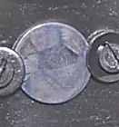
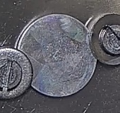
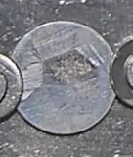
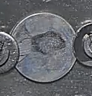
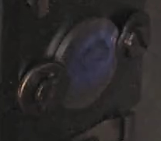
2. Normal conducting photocathodes for SRF guns
2.1 Metal photocathodes in SRF Guns
Ar⁺ 3.0 keV, 40 min
C-C
MgO-R
Ar⁺ 2.5 keV, 20 min
Mg⁰
Citric acid
after 1.5 keV
Ar⁺ 1.5 keV, 10 min
O^{b}
O^{s}
citric acid
after 2.5 keV
after 3.0 keV
CO_{x}
CO-R
C=O
MgCO_{x}
Cleaning with a citric acid solution does not result in a homogenous surface
Different phases of citrate on the Mg plug
Sputtering takes a lot of time → thick citrate layer
Some QE received
→ Cleaning with citric acid and sputtering does not result in the best surface conditions
QE = 0.134 %

Slide 23
4. Summary and outlook
Both metal and semiconductor cathodes can be safe in SRF guns
Cs₂Te
5-6 % QE after preparation on Cu substrate
1-2 % QE in SRF Gun II
loss of QE under RF field and operation
2-3 months used in SRF Gun II
→ Mo substrate ?
P-GaN:Cs shows high potential to be a future electron source
21 % QE @ 260 nm; 11.5 % QE @ 310 nm UV-LED
commercially available p-GaN
only Cs required to form a photocathode
p-GaN quality, especially C, is the limiting factor
→ higher quality of p-GaN ?
Mg photocathode research
surface behaviour can be followed by in-situ XPS
O at surface decreased while O in bulk appeared
cleaning with IPA works best
Ar⁺ works but roughens the surface
→ Softer method (H_{atomic})
→ laser cleaning ?
Notes:
NC photocathodes proved in gun
Waiting for results of SC photocathodes in gun
Important: technical know-how
heat load, thermal contact, suppressing multipacting,
particle free operation, vacuum during transport and operation, …
Theoretical understanding and full characterization:
QE & intrinsic emittance vs. temperature & RF & beam operation

Slide 24


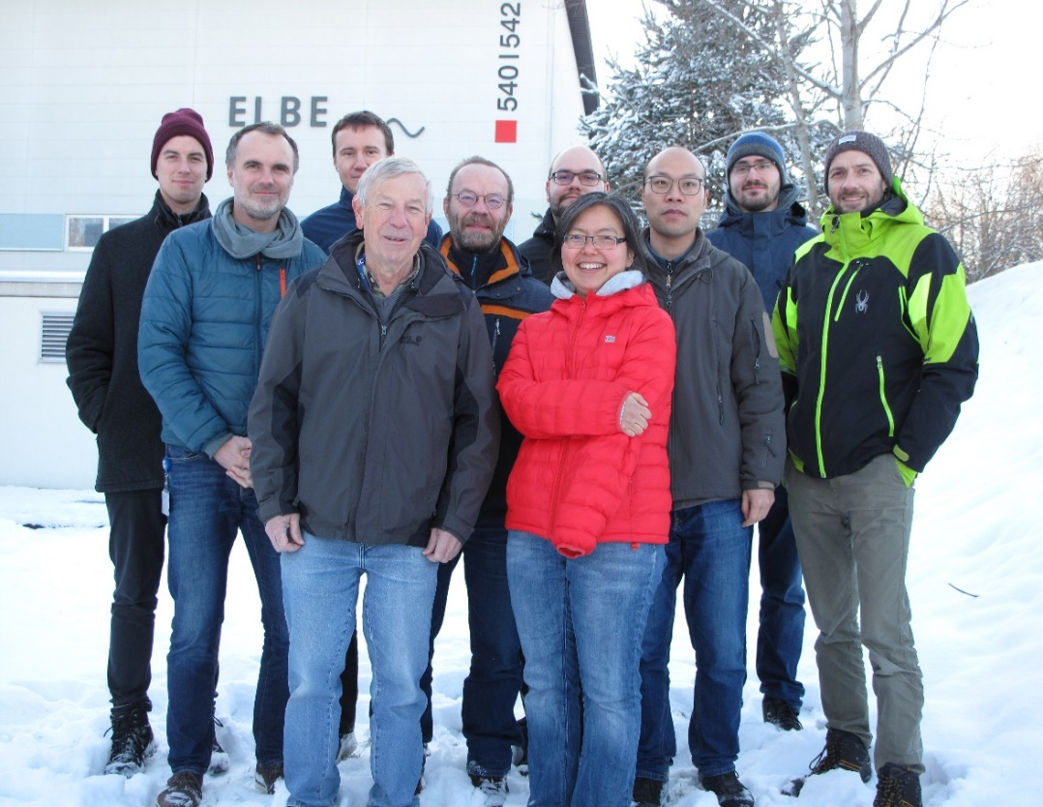



Thank you for your attention!
from the ELBE SRF Group:
A. Arnold, P. Zwartek, S. Ma, P. Murcek, R. Xiang, J. Teichert, A. Ryzhov, A. Hoffmann,
R. Niemcyk, S. Gatzmaga
Thanks to all of our project partners !
Visit us @ EWPAA 2024 !

Slide 25
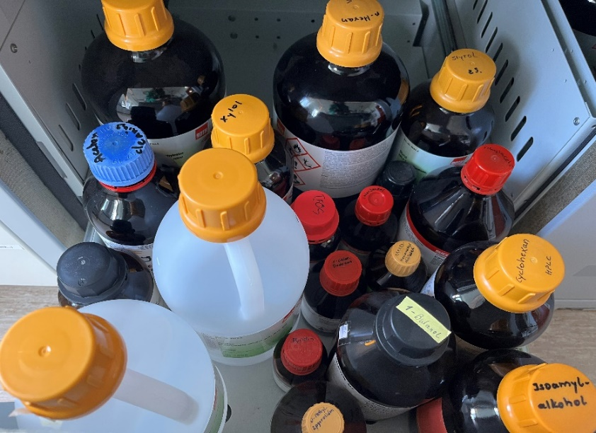
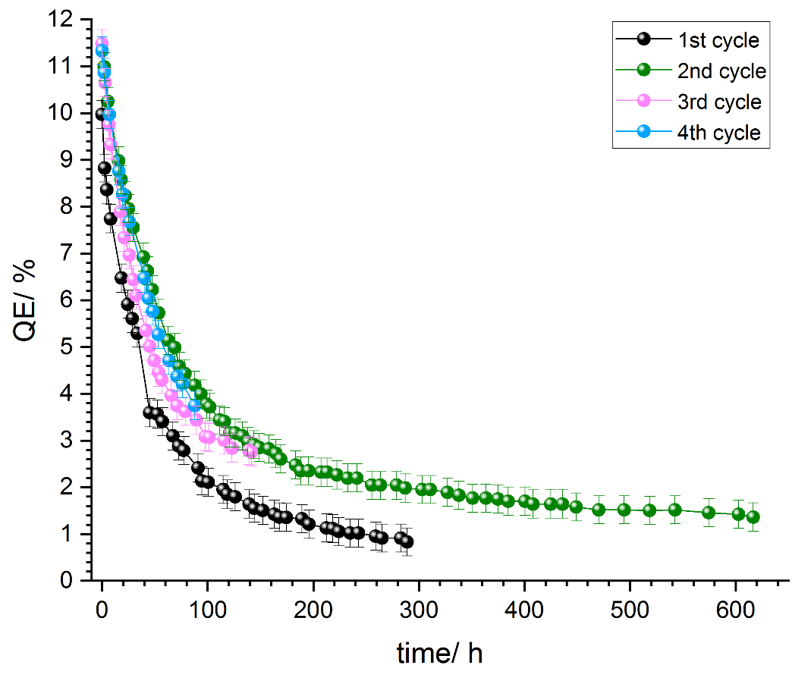

Results
Wet chemical cleaning using simple solvents or acidic solutions to minimize surface contaminations
Thermal cleaning using black body or thermo-coupler to heat the surface and create an atomically clean surface
Cs activation by the deposition of a thin Cs layer on the cleaned surface
Degradation QE decay examination in a certain period; reaching 1 %
Re-activation of the same sample starting again at step 2
Wet chemical cleaning using simple solvents or acidic solutions to minimize surface contaminations
Thermal cleaning using black body or thermo-coupler to heat the surface and create an atomically clean surface
Cs activation by the deposition of a thin Cs layer on the cleaned surface
Degradation QE decay examination in a certain period; reaching 1 %
Re-activation of the same sample starting again at step 2
Wet chemical cleaning using simple solvents or acidic solutions to minimize surface contaminations
Thermal cleaning using black body or thermo-coupler to heat the surface and create an atomically clean surface
Cs activation by the deposition of a thin Cs layer on the cleaned surface
Degradation QE decay examination in a certain period; reaching 1 %
Re-activation of the same sample starting again at step 2
Wet chemical cleaning using simple solvents or acidic solutions to minimize surface contaminations
Thermal cleaning using black body or thermo-coupler to heat the surface and create an atomically clean surface
Cs activation by the deposition of a thin Cs layer on the cleaned surface
Degradation QE decay examination in a certain period; reaching 1 %
Re-activation of the same sample starting again at step 2
Wet chemical cleaning using simple solvents or acidic solutions to minimize surface contaminations
Thermal cleaning using black body or thermo-coupler to heat the surface and create an atomically clean surface
Cs activation by the deposition of a thin Cs layer on the cleaned surface
Degradation QE decay examination in a certain period; reaching 1 %
Re-activation of the same sample starting again at step 2
2. Thermal cleaning
3. Cs-activation
4. QE decay
Thermal cleaning with black body

Slide 26
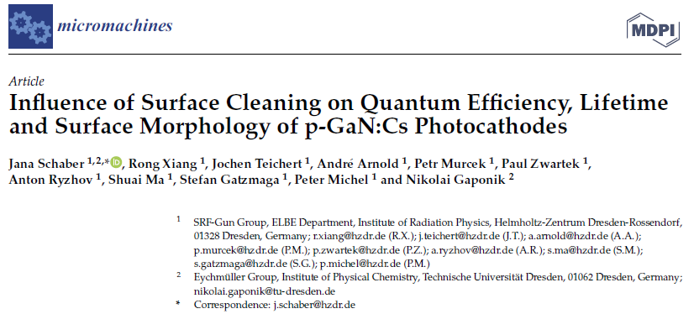
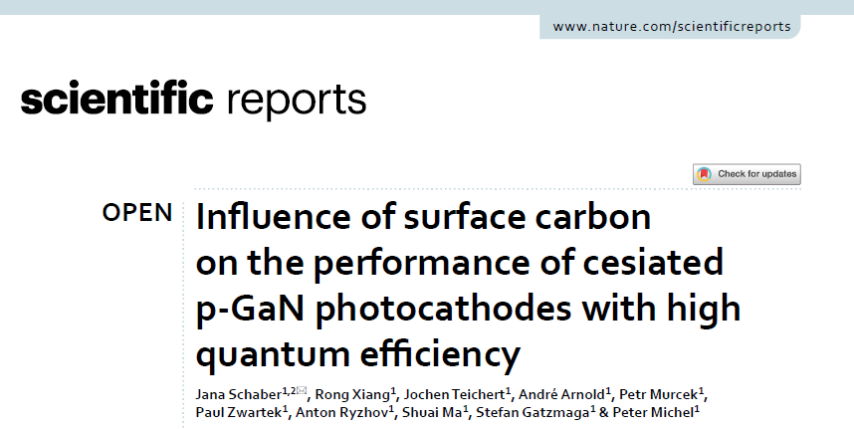


Publications
J. Schaber, R. Xiang, J. Teichert, A. Arnold, P. Murcek, P. Zwartek, A. Ryzhov, S. Ma, S. Gatzmaga, P. Michel, N. Gaponik. „Influence of Surface Cleaning on Quantum Efficiency, Lifetime and Surface Morphology of p-GaN:Cs Photocathodes”. Micromashines, 2022, 13, 849. DOI: 10.3390/mi13060849
R. Xiang and J. Schaber. „Review of Recent Progress on Advanced Photocathodes for Superconducting RF Guns”. Micromachines, 2022, 13, 1241. DOI: 10.3390/mi13081241
S. Ma, A. Arnold, P. Michel, P. Murcek, A. Ryzhov, J. Schaber, R. Steinbrück, P. Evtushenko, J. Teichert, W. Hillert, R. Xiang, J. Zhu. „The application of encoder-decoder neural networks in high accuracy and efficiency slit-scan emittance measurements”. Nuclear Inst. and Methods in Physics Research, A 1050, 2023, 168125. DOI: 10.1016/j.nima.2023.168125
J. Schaber, R. Xiang, N. Gaponik. „Review of photocathodes for electron beam sources in particle accelerators”. J. Mater. Chem. C, 2023,11, 3162-3179. DOI:10.1039/D2TC03729G
J. Schaber, R. Xiang, A. Arnold, A. Ryzhov, J. Teichert, P. Murcek, P. Zwartek, S. Ma, P. Michel. „Impact of various cleaning procedures on p-GaN surfaces”. Surf Interface Anal. 2023;1–8. DOI: 10.1002/sia.7207
J. Schaber, R. Xiang, J. Teichert, A. Arnold, P. Murcek, P. Zwartek, A. Ryzhov, S. Ma, S. Gatzmaga, P. Michel. „Influence of surface carbon on the performance of cesiated p-GaN photocathodes with high quantum efficiency”. Scientific Reports, 2023, 13:3188. DOI: 10.1038/s41598-023-30329-0

Slide 27

2. Normal conducting photocathodes for SRF guns
2.2 Semiconductor photocathodes in SRF Guns
Cathode | Typical wavelength (nm) | QE @ room Temp. | E_{G}+E_{A} (eV) | Expected thermal emittance (µm/mm)
Cs₂Te | 266 | 0.1 | 3.5 | 0.9
Cs₃Sb | 432 | 0.15 | 1.6+0.45 | 0.7
K₃Sb | 400 | 0.07 | 1.1+1.6 | 0.5
Na₃Sb | 330 | 0.02 | 1.1+2.44 | 0.4
Na₂KSb | 330 | 0.1 | 1+1 | 1.1
K₂CsSb | 532 | 0.1 | 1+1.1 | 0.4
GaAs(Cs,O) | 532 | 0.1 | 1.4$±0.1$ | 0.44
GaN(Cs) | 250-360 | 0.2-0.3 | 3.4 -? | -
D.H. Dowell et al., NIMA 622, Pages 685-697 (2010)
Xiaohui Wang et al., J. Mater. Chem. C, 2021, 9, 13013
Notes:
I borrow a semiconductor overview table from Dr. Dowell, here one can see the cathodesfrom UV to green.

Slide 28
1. Introduction
SRF gun - promising source for high brightness and high current beams required by CW FELs and ERL facilities.
high gradients on the cathode surface than DC guns – increasing achievable surface current density and reducing thermal emittance contribution;
high beam energy to mitigate space-charge effects on the way from the gun to the next accelerator cavity;
outstanding vacuum environment for sensitive cathodes;
low RF jitter for excellent e- beam and light source stability.
Notes:
SRF guns have advantages for operating in continuous wave (CW) mode and generating the high-brightness and high-current beams required by CW X-ray free electron laser (XFEL) [1] [2] and energy recovery linac (ERL) facilities [3] [4]. Similar to the normal conducting rf guns, SRF guns are able to provide higher gradients on the cathode surface than DC guns, increasing the achievable surface current density and reducing the thermal emittance contribution for a given bunch charge; higher beam voltages help to mitigate space-charge effects as the beam travels from the gun to the next accelerator cavity. Concurrently, SRF guns have an outstanding vacuum environment for sensitive cathodes and potentially lower RF jitter compared to CW normal-conducting (NC) photoinjectors [5].

Slide 29

2. Normal conducting photocathodes for SRF guns
2.1 Metal photocathodes in SRF Guns
Metal | QE | ɸ (eV) | Tc (K)
Cu | 10⁻⁵ - 10⁻⁴ | 4.6
Mg | 10⁻⁵ - 10⁻³ | 3.6
Nb | 10⁻⁶ – 10⁻⁴ | 4.3 | 9.3
Pb | 10⁻⁶ - 10⁻³ | 4.2 | 7.2
Advantage: robust and „clean“ for SRF guns
Lide, D. R.. Properties of Solids, CRC Handbook of Chemistry and Physic, Internet Version 2005, P. 124;
S. Halas, Materials Science-Poland, Vol. 24, No. 4, 2006
D.H. Dowell et al., NIMA 622, Pages 685-697 (2010)
Notes:
Metals are Robust, easy for treatment and transport, good rf property, little risk for cavity contamination
always good choice for commissioning
In the list several metals mentioned in following slides, here we can see mg has lower work function than the others and possible to get high QE with 260nm UV laser.

