Slide 1
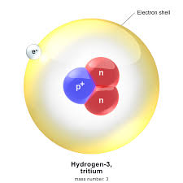
Competitive Reaction in Cyclotrons F-18 Production – Regulatory Implications
Accelerators and Class II Facilities Division
Canadian Nuclear Safety Commission
Angel Licea, MEng
SATIF-13
(October 2016 – Dresden, GE)

Slide 2

Established May 2000 under the Nuclear Safety and Control Act
Replaced the Atomic Energy Control Board, established in 1946 under the Atomic Energy Control Act
Mandate
Regulate the use of nuclear energy and materials to protect the health, safety and security of Canadians and the environment
Implement Canada's international commitments on the peaceful use of nuclear energy
Disseminate objective scientific, technical and regulatory information to the public

Slide 3
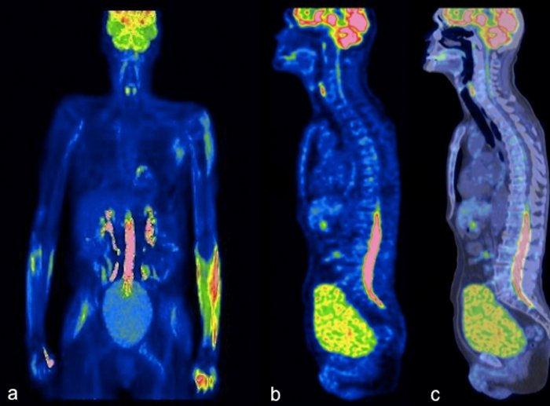
Background -
F-18
In the last forty years, positron emission tomography (PET) has advanced rapidly and is becoming an indispensable imaging modality for the evaluation of cancer patients.
Of the hundreds of positron labelled radiotracers, 2-[¹⁸F]-fluoro-2-deoxy-D-glucose (FDG) is the most successful and widely used imaging agent in PET today

Slide 4
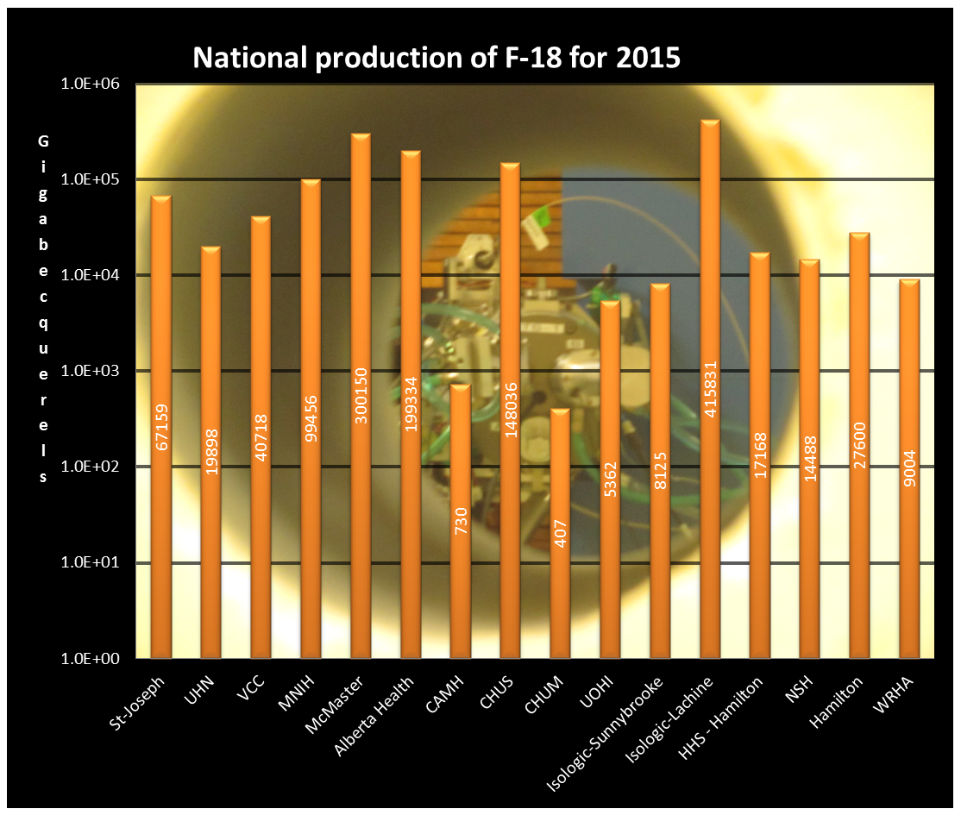
Canada is no exception; last year, a total combined ¹⁸F production of 1.37 PBq at the end of bombardment (EOB) was reported from the cyclotron facilities licenced by the CNSC.

Slide 5
Publications
In 2004 Shileki Ito and al, confirmed the presence of tritium in enriched [¹⁸O]water irradiated with 9.6MeV protons used to produce [¹⁸F] fluoride via ¹⁸O(p, n)¹⁸F , reaction was inferred from the cross sections and threshold energies of the reaction..
¹⁸ O+p->³H + ¹⁶O
Tomiyoshi et al., (1999) also detected tritium in [¹⁵O]water as a by-product of the ¹⁴N(d, t)¹³N when the ¹⁵O was produced by the ¹⁴N(d, n)¹⁵O reaction with 8.6MeV deuterons.

Slide 6
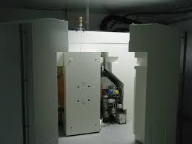
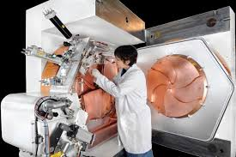
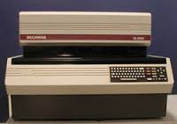
Publications
MiniTrace GE 9.6 MeV protons, 25 µA, 1.38 ml target capacity (self-shielded baby cyclotron)
Beckman LS-6000, scintillation counter

Slide 7
Distribution of tritium in each step from ¹⁸F production to [¹⁸F]FDG purification
(¹⁸F ) 17.4 GBq EOB
93 % of T is recuperated for recycling
T - 46.1 kBq
T - 63.5 kBq
T - 43.3 kBq
T - 0.726 kBq
T - 1.3 kBq
T - N.D.
(¹⁸F ) 8.59 GBq EOS

Slide 8
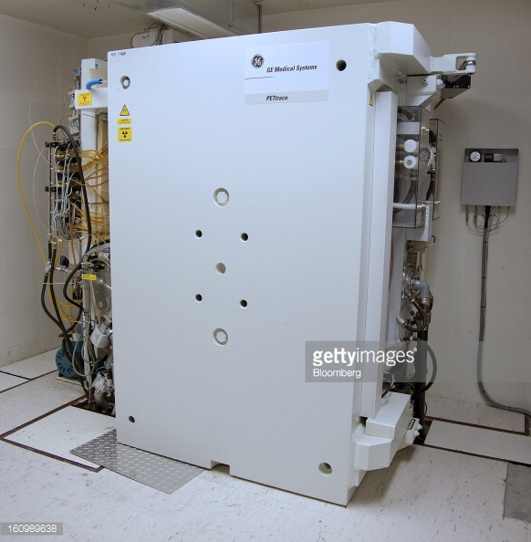
Publication..
In 2011, Romolo Remetti et al .. FLUKA simulation and radiometric characterization of proton irradiated [¹⁸O]H2O for the treatment of the waste streams originated from [¹⁸F]FDG synthesis process
Measured 36 & 33 kBq/ml slightly below than Ito et al.
- 50 kBq/ml simulated with FLUKA,
 | H.L. | A (Bq)
Ni57 | 35.60 h | 188.919
Co58 | 70.86 d | 856.403
Co57 | 271.8 d | 51.88
Mn52 | 5.591 d | 198.997
Mn52 | 5.591 d | 204.346
Mn52 | 5.591 d | 198.58
Co56 | 77.27 d | 430.836
Mn54 | 312.3 d | 5.034
Cr51 | 27.70 d | 807.185
Cd109 | 463.55 d | 246.632
Re183 | 70.02 d | 11.229
PetTrace GE, 16.5 MeV, 37 µA for an hour in two samples, no synthesis of F-18.
Gamma emitters detected in water samples

Slide 9
Publication…
In 2014, C Marshall et al, Quantification of the activity of tritium produced during the routine synthesis of ¹⁸F[FDG] for positron emission tomography
Measured from 71.3 to 91.8 kBq/ml with a mean of 80.6 kBq/ml, very close to Ito’s results.
Tritium activity in unirradiated enriched water varies from 1400 to 0.4 Bq/ml.
Mochizuki et al (2006) reported the presence of tritium in non irradiated H₂¹⁸O used to rinse their target vessel at a much greater concentration of 92 kBq/ml.
Cyclone IBA, 18 MeV, 40 µA for an hour in 24 separated runs.

Slide 10
The reactions..
https://www-nds.iaea.org/

Slide 11



Five Canadian facilities…
Participated for some measurements,
Non-irradiated enriched water
Samples after the EOB
Different cyclotrons
Different conditions
CNSC lab analyzed most of samples*
Vancouver
Thunder Bay
MNIH
* A Tri-Carb (low background level) Liquid Scintillation Counter was used to measure the tritium activity
CAMH & UHN

Slide 12
Sampling results…
Centre | Cyclotron | Energy (MeV) | Current (µA) | Time (min) | Supplier (H₂¹⁸O) | Tritium (kBq/ml)
TBRHSC | TR24 | 18 | 100 | 60 | Rotem | 181.8
 | n/a | n/a | n/a | n/a | Rotem | 0.0004
VCC | TR19 | 19 | 60 | 36 | Huayi | 57.07
 | n/a | n/a | n/a | n/a | Huayi | 5.22
UHN | PETTrace | 16.5 | 48/target | 130/126ª | Rotem | 268.7
 | n/a | n/a | n/a | n/a | Rotem | 0.0009
CAMH | IBA Cyclone | 18 | 40 | 30 | Huayi | 70.57
 | n/a | n/a | n/a | n/a | Huayi | 31.74
 | MC-17 | 17 | 40 | 30 | Huayi | 22.32^{b}
MNIH^{c} | IBA Cyclone | 18 | 40 | 60 | Isoflex | 31.65
a – Two 2.5 ml targets, dual extraction, volumes mixed at the end of the run.
b – Diluted 30%
c – Produced their own analysis of five recovering water samples, no samples of unirradiated water were provided.

Slide 13
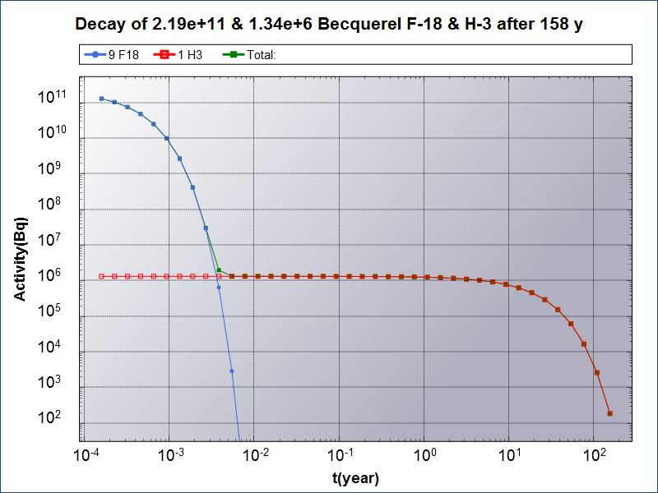
UHN – dual irradiation sample (5 ml) to decay below 200 Bq/g (2.2 days for ¹⁸F and more than 100 years for Tritium)

Slide 14
Regulatory issues..
Licensing
In order to license the tritium concentration produced as a competitive reaction in the production of ¹⁸F, concentration has to exceed 1 MBq/g (Schedule 1), this is not the case in any Canadian cyclotron normal operation (optimal ¹⁸F production is in less than two hours).
Unconditional releases of tritium concentration shall comply with the limits indicated in Schedule 2, which is 200 Bq/g. Then dilution of enriched water wastes is strongly recommended if the licensee choose this option.
Import/Export
tritium concentration in export/import transactions with enriched water shall not exceed the ratio of tritium to hydrogen by atoms 1 part in 1000. This ration is equivalent to 6.023E+19 atoms of tritium per millilitre in enriched water which computes in a tritium activity of 107.2 GBq/ml, again not possible in any Canadian recycling or new stock export/import operation

Slide 15
Conclusion
Tritium is present in unirradiated enriched water, concentrations may vary from 0.6 Bq to < 100 kBq.
During the production of ¹⁸F, tritium is also produced via a competitive reaction and it can be recovered in the enriched water (~ 93%) .
Tritium is not present in the final product FDG.
Some cyclotron licensees recycle the recovered water from the synthesis to the suppliers.
Right now, the enriched water sent for recycling, there is no monitoring for tritium nor when “virgin” enriched water is received by the licensees, more important, there is no indication of tritium concentration in the Certificate of Analysis provided by suppliers of “virgin” stock .
Tritium concentration in ¹⁸F production vary from cyclotron, target and materials (target body, havar window, etc), its concentration does not trigger any regulatory consequences other than the unconditional release.
Procedure in place to monitor tritium concentration in new stock and inventory (annual compliance report), inspection sampling, etc.

Slide 16
Next Steps
Complete the trititum survey of the rest cyclotron production of F-18 (EOB) in Canada.
Work with Heath Canada to include the tritium content in their cGMP Certificate of Analysis.
Implement a procedure to monitor tritium concentration in new stock and operational inventory (annual compliance report).
Share this information to the other international forums.

Slide 17
Thank you
Questions?
For more details
http://nuclearsafety.gc.ca/eng/nuclear-substances/licensing-class-II-nuclear-facilities-and-prescribed-equipment/index.cfm#ClassIINuclearFacilities
Email
Angel.Licea@Canada.Ca

