Slide 1
Annual Dose to Personnel and General Public from Direct Exposure, Skyshine and Airborne Emission at FRIB
Dali Georgobiani for Mikhail Kostin
Facility for Rare Isotope Beams (FRIB)
Michigan State University, East Lansing, MI 48824 USA

Slide 2
Collaboration
Reg Ronningen, FRIB (retired)
Robert Lowrie, FRIB/URS Corporation
Dali Georgobiani, FRIB
Mikhail Kostin, FRIB
Jeremy Northum, FRIB
Brent Blunt, Air Emissions
Igor Remec, ORNL

Slide 3
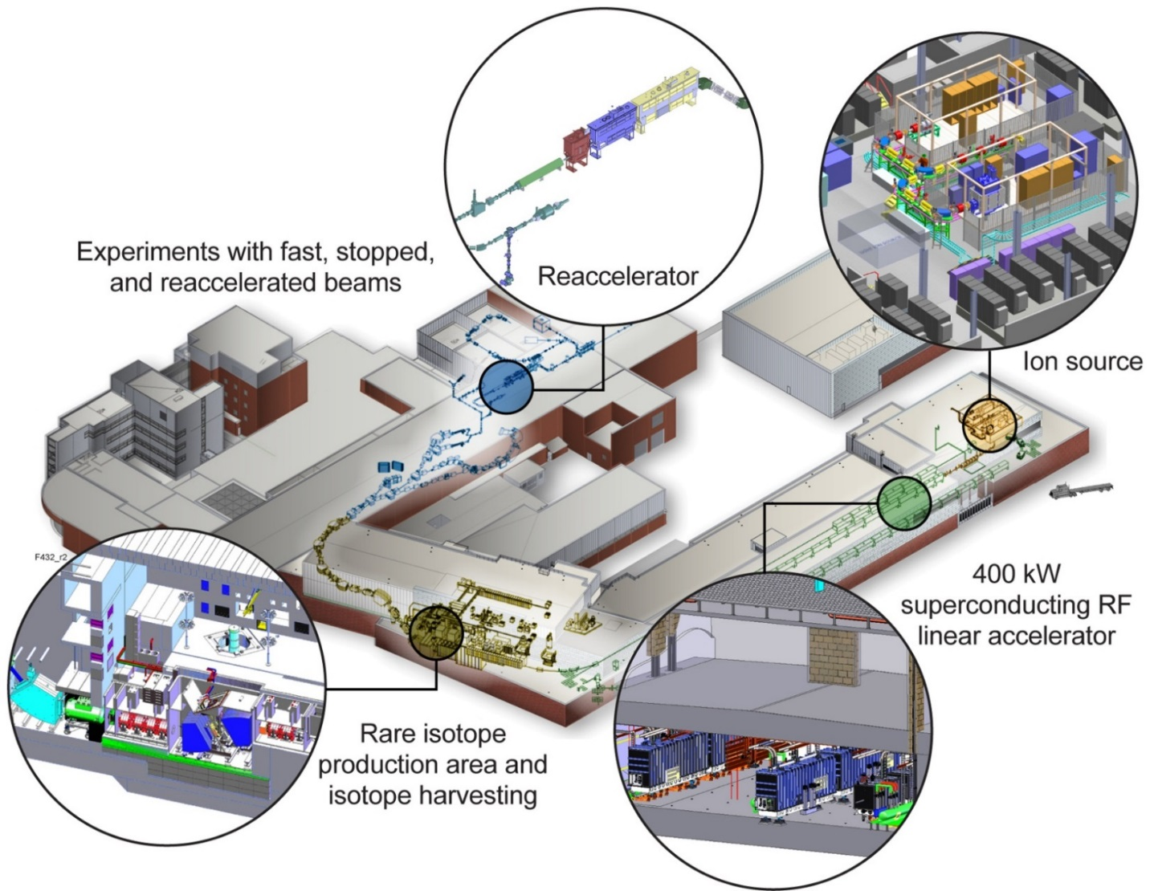
Outline
Facility for Rare Isotope Beams overview
Regulatory requirements and design goals
Receptors
Target area
  Direct exposure
  Skyshine
Linac area
  Direct exposure
  Direct + Skyshine
Activated air release
  Linac
  Target Area
Total annual dose
to receptors

Slide 4
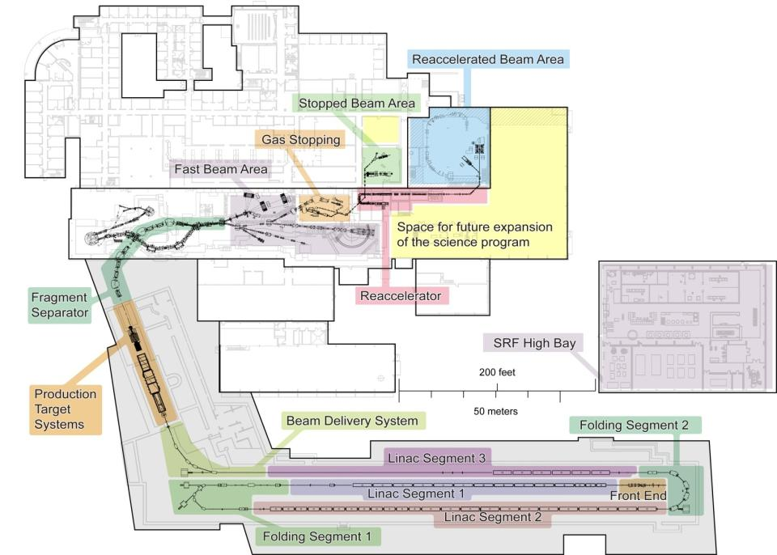
Facility for Rare Isotope Beams (FRIB) Overview
Next generation Rare Isotope Beam Facility
Rare isotope production via in-flight technique with primary beams up
to 400 kW, 200 MeV/u uranium
Fast, stopped and
re-accelerated
beam capability
Possible upgrade options
  Increased energy up to
  400 MeV/u for uranium
  Light ion beams with
  ISOL target station
FRIB user organization
in place
  1350 members
NSCL enables pre-FRIB science
NSCL
FRIB
project

Slide 5
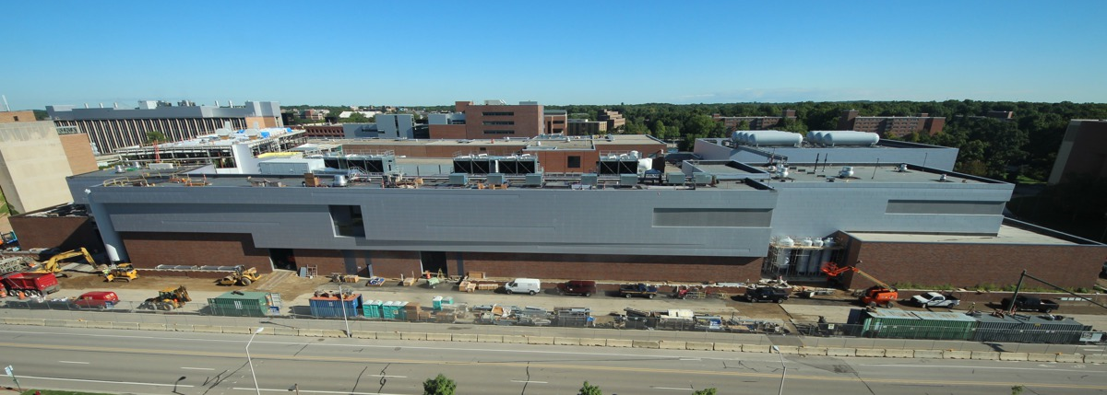
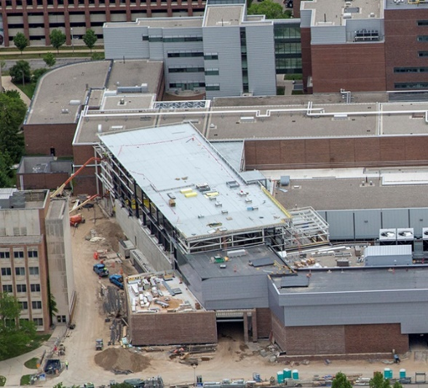
FRIB Overview
Civil construction started 3/2014
Technical construction started 10/2014
CD-4 (project completion) 6/2022
Project managed to early completion in FY2021
22 August 2016

Slide 6
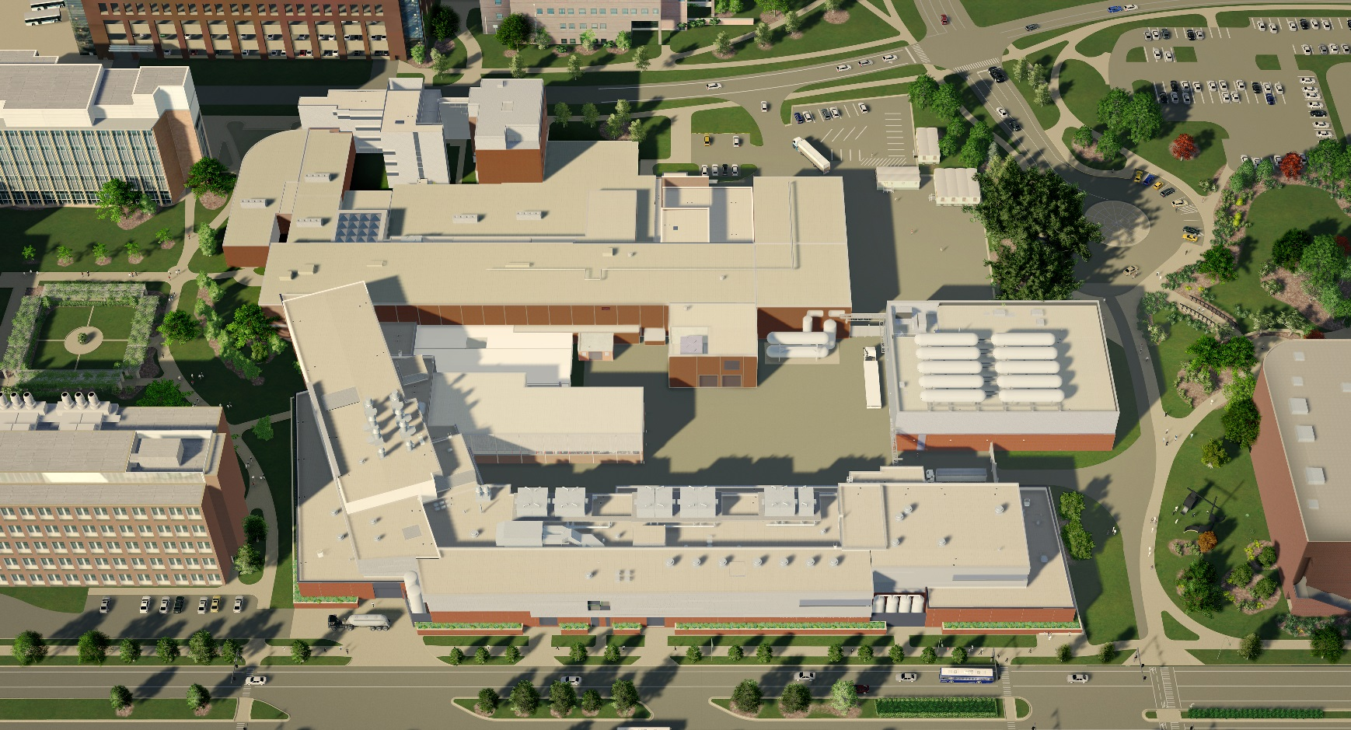
FRIB Overview
Existing NSCL
Target Facility
LINAC Building

Slide 7


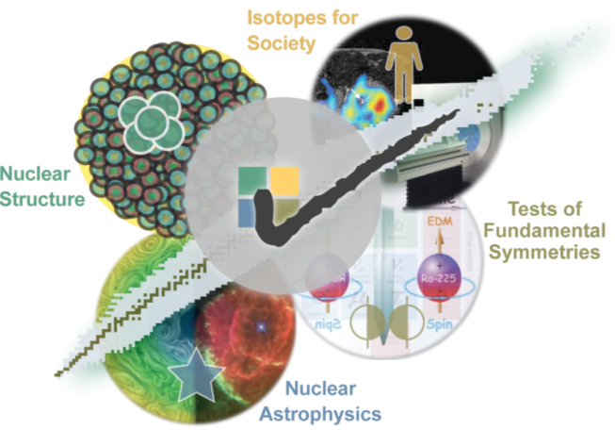


FRIB – Four Science Themes
Properties of nuclei
  Develop a predictive model of nuclei and their interactions
  Many-body quantum problem: intellectual overlap to mesoscopic
  science, quantum dots, atomic clusters, etc.
Astrophysical processes
  Origin of the elements in the cosmos
  Explosive environments: novae,
  supernovae, X-ray bursts …
  Properties of neutron stars
Tests of fundamental symmetries
  Effects of symmetry violations are
  amplified in certain nuclei
Societal applications and benefits
  Bio-medicine, energy, material
  sciences, national security

Slide 8
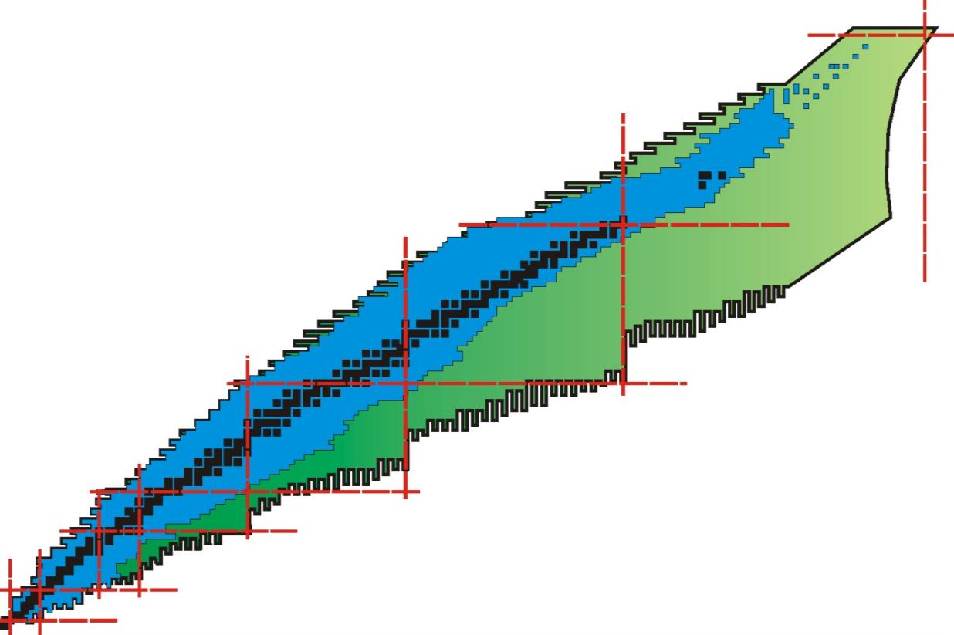
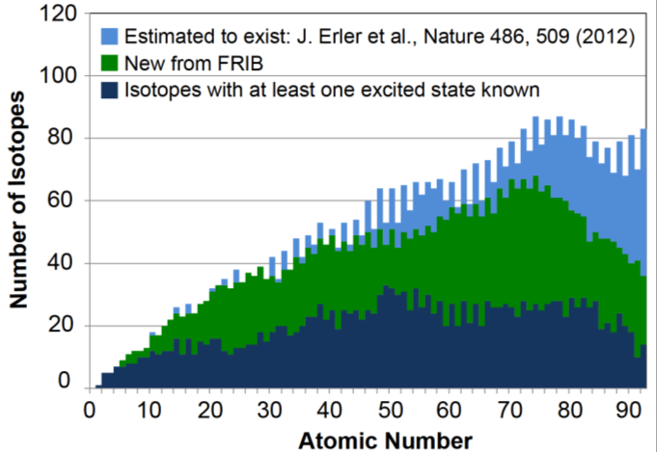
FRIB Beams Will Enable New Discoveries
Available today
New territory to be explored with FRIB
about 3000 known isotopes

Slide 9
Regulatory Requirements and Design Goals
Target Receptor | Limits and Goals
Radiation Dose - Worker | Standard ª: 5000 mrem/yr MSU ALARA Goal: 500 mrem/yr ^{c}
Radiation Dose - Public | Standard ª: 100 mrem/yr and 2 mrem/(any one hour) MSU ALARA Goal ^{c}: 10 mrem/yr and 2 mrem/(any one hour)
Air – maximum exposure to nearest public receptor | Standard ª: 10 mrem/yr^{f}
Soil and Groundwater ^{d} (in situ, no decay reduction factor) | ³H Water Effluent Regulatory Limit ª: 1,000 pCi/ml Design Goal: 20 pCi/ml (drinking water standard ^{b}) | ²²Na Water Effluent Regulatory Limit ª: 6 pCi/ml Design Goal: 0.4 pCi/ml (drinking water standard ^{b})
Waste Water ^{e} | ³H Standard ª: 10,000 pCi/ml | ²²Na Standard ª: 60 pCi/ml
Standard refers to 10 CFR 20 (Nuclear Regulatory Commission) limits. Standard refers to 40 CFR 141 (Environmental Protection Agency) limits for drinking water from community water systems. Some conservative self-imposed goals are used to provide flexibility in the design, commissioning, and operation of FRIB and accommodate future upgrades or changes in mission. The ALARA Goals represent internal action levels for FRIB and the University as a precursor for ES&H to assure that regulatory limits are not exceeded. Activated soil and groundwater is being evaluated using drinking water limits as an FRIB design goal to assure that there are no negative impacts for water that may migrate to the underground aquifer. The point of compliance for groundwater will be established at the closer of a) nearest potential unrestricted access to the location or b) region containing 99.9 percent of the potentially activated soil. The actual point of compliance will be set following CD-3b. Of the activated material in the soil and groundwater, the limiting radionuclides are ³H and ²²Na. Waste Water is being evaluated using limits for release to the sanitary sewer. To implement the ALARA requirements of 20.1101 (b) a constraint on air emissions of radioactive material to the environment shall not cause an individual member of the public to receive a dose of 10 mrem TEDE per year from these emissions. (See 20 CFR 20.1101 (b) for specific requirement. No additional ALARA goals are established for air emissions based on the NRC ALARA requirements.

Slide 10
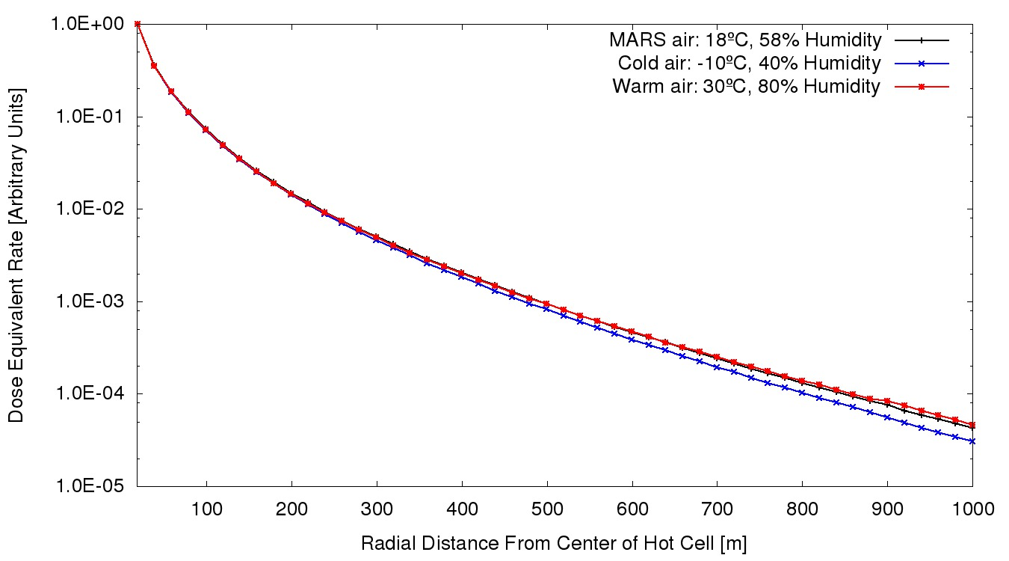
Bounding Air for Skyshine
Compared standard MARS15 air at 18 ºC and relative humidity of 58%
and two extreme cases based on U.S. Standard Atmosphere
(http://ccmc.gsfc.nasa.gov/modelweb/atmos/us_standard.html)
  Cold extreme at
  -10 ºC with relative
  humidity of 40%
  Warm extreme at
  30 ºC with relative
  humidity of 80%
FRIB target building is
source term, ⁴⁸Ca beam
Despite the lower density,
warm moist air has higher
humidity – bounding air
Extending air more than
1 km (all directions) has a
negligible effect on Skyshine
MARS15 air at 18 ºC and 58% relative humidity (ρ=1.20E-03 g/cm³)
Cold air at -10 ºC and 40% relative humidity
(ρ=1.34E-03 g/cm³)
Warm moist air at 30 ºC and 80% relative humidity (ρ=1.14E-03 g/cm³)
Element | Mass Fraction
H | 8.00E-04
N | 7.49E-01
O | 2.37E-01
Ar | 1.29E-02
Element | Mass Fraction
H | 1.26E-04
C | 1.08E-04
N | 7.80E-01
O | 2.11E-01
Ar | 9.33E-03
Element | Mass Fraction
H | 3.62E-03
C | 1.05E-04
N | 7.56E-01
O | 2.32E-01
Ar | 9.04E-03

Slide 11
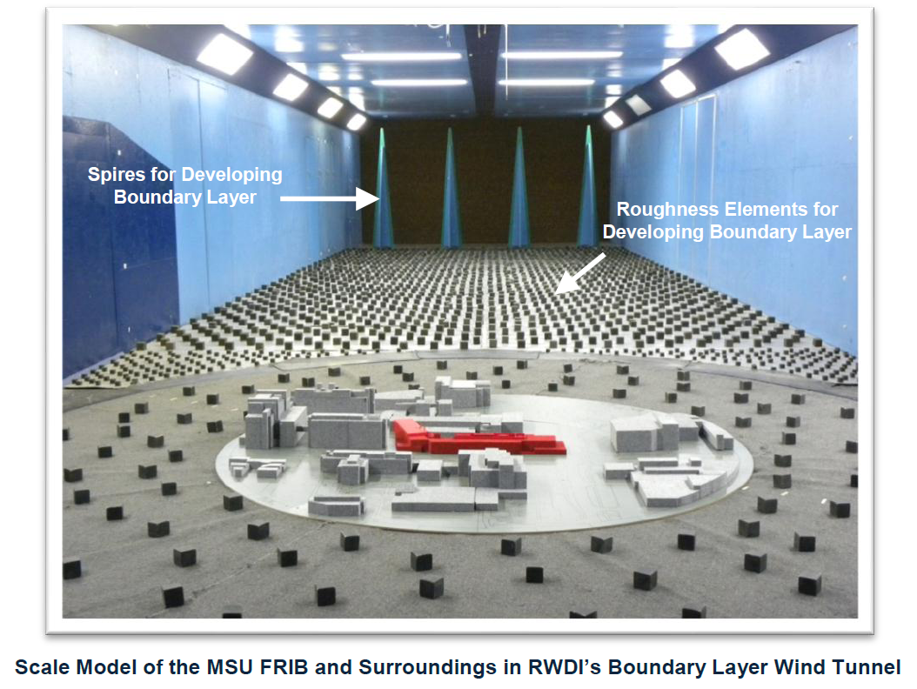
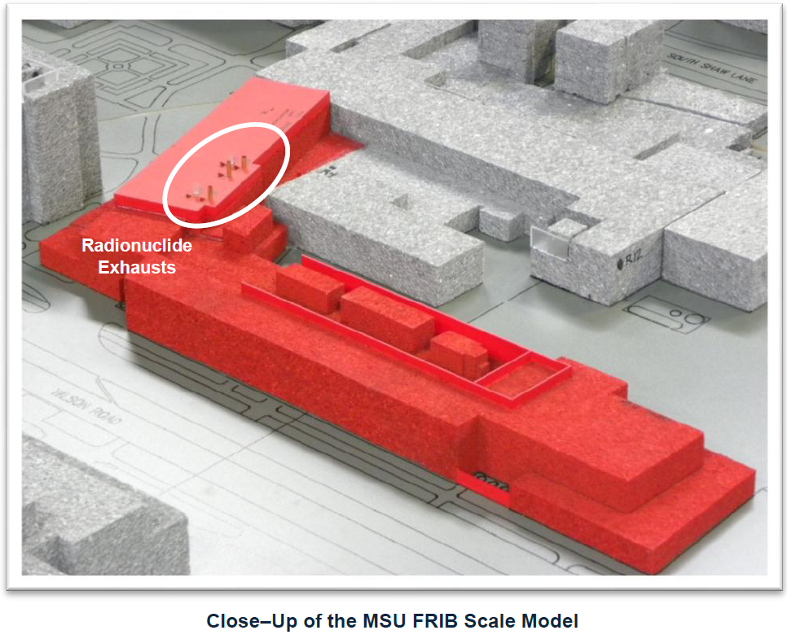
Receptor Locations
Activated air will be emitted through stacks
Receptor locations are based on previous
wind tunnel studies by the RWDI company
using 1:250 scale 3D model of FRIB and
immediate MSU campus
Nowadays we use the AERMOD code
Contribution from direct exposure and
skyshine must be added

Slide 12
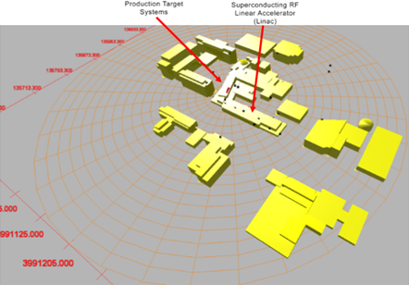
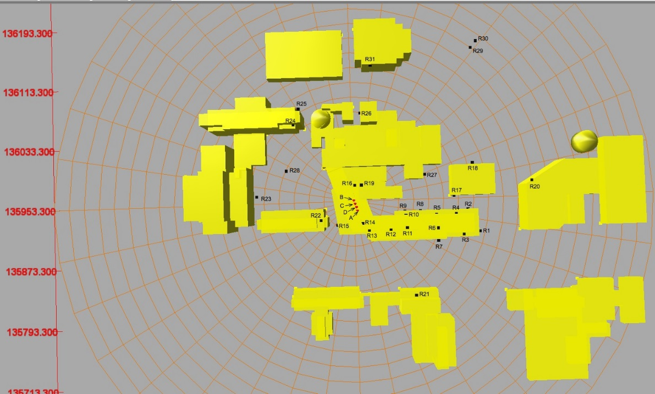
Receptor Locations
Locations of receptors whose annual dose equivalents were assessed using the AERMOD code. The letters A – D depict locations of emission stacks:
A-Linac exhaust,
B-Target Primary exhaust,
C-Target Hot Off-Gas (HOG) exhaust,
D-Service Building Special Mechanical (SMOG) exhaust.

Slide 13
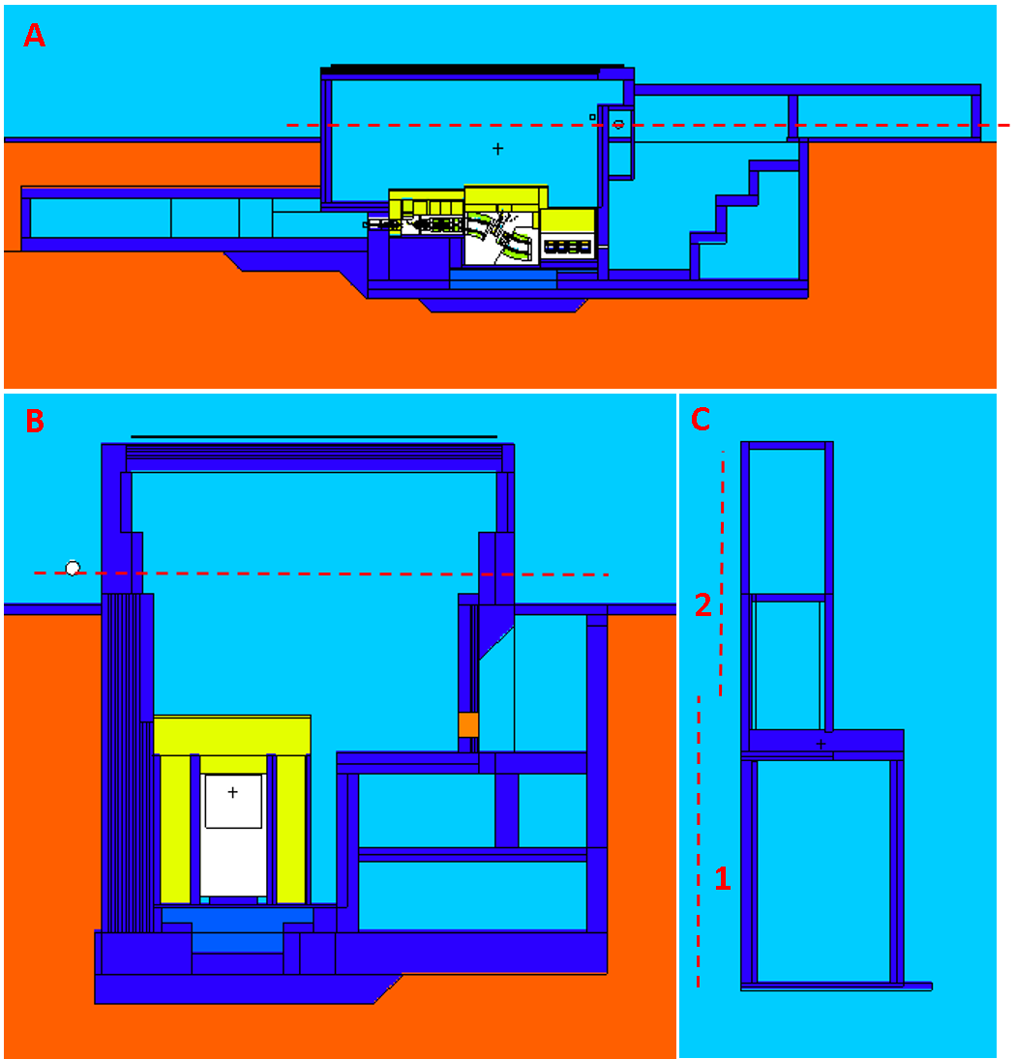
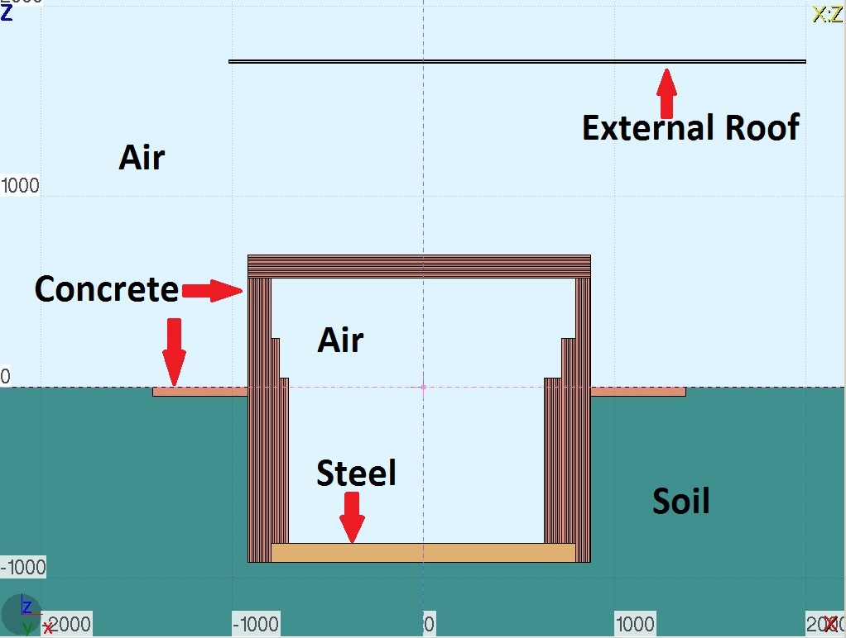
Target Building Model
400 kW of ⁴⁸Ca beam at 261 MeV/u
(21% of operation - conservative)
Operating year 5556 h (2 ×10⁷ sec)
PHITS used for direct dose and to
generate source for skyshine
FLUKA for skyshine
PHITS Model
Elevation View of FLUKA Model

Slide 14
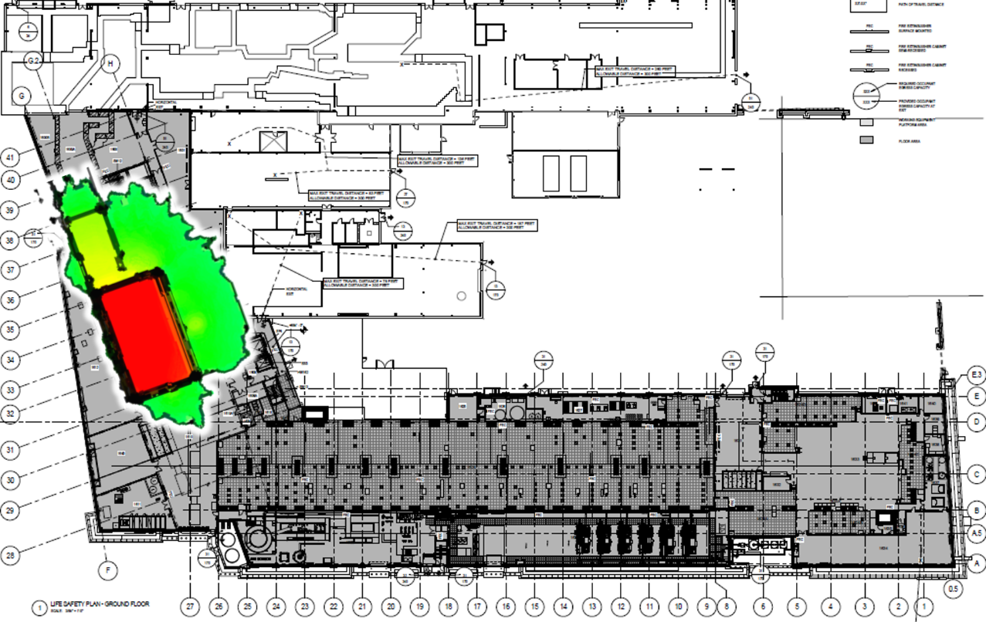
Annual Dose From Direct Radiation From Target Building
Map in “human torso” (24 in to 74.8 in)
NASA Man-Systems Integration Standards
http://msis.jsc.nasa.gov/sections/section03.htm
Green area boundary is 10 mrem/y,
not accessible by public
Receptor | Annual Dose Equivalent Rate from Direct Radiation [mrem] | Relative Error [%]
R1 | 4.8E-02 | 23%
R2 | 6.7E-02 | 17%
R3 | 5.7E-02 | 16%
R4 | 8.3E-02 | 16%
R5 | 1.2E-01 | 10%
R6 | 9.1E-02 | 6%
R7 | 7.2E-02 | 11%
R8 | 2.3E-01 | 8%
R9 | 2.7E-01 | 3%
R10 | 2.2E-01 | 6%
R11 | 1.6E-01 | 8%
R12 | 4.0E-01 | 13%
R13 | 5.4E-01 | 15%
R14 | 8.9E-01 | 12%
R15 | 5.8E-01 | 10%
R16 | 6.5E+00 | 8%
R17 | 7.2E-02 | 12%
R18 | 6.7E-02 | 19%
R19 | 4.9E+00 | 5%
R20 | 3.4E-02 | 12%
R21 | 4.3E-02 | 19%
R22 | 9.4E-02 | 19%
R23 | 7.9E-02 | 3%
R24 | 8.9E-02 | 7%
R25 | 1.0E-01 | 9%
R26 | 2.5E-01 | 9%
R27 | 1.9E-01 | 10%
R28 | 1.3E-01 | 17%
R29 | 2.5E-02 | 6%
R30 | 3.5E-02 | 7%
R31 | 8.7E-02 | 15%
Annual Dose Map at Target Building

Slide 15
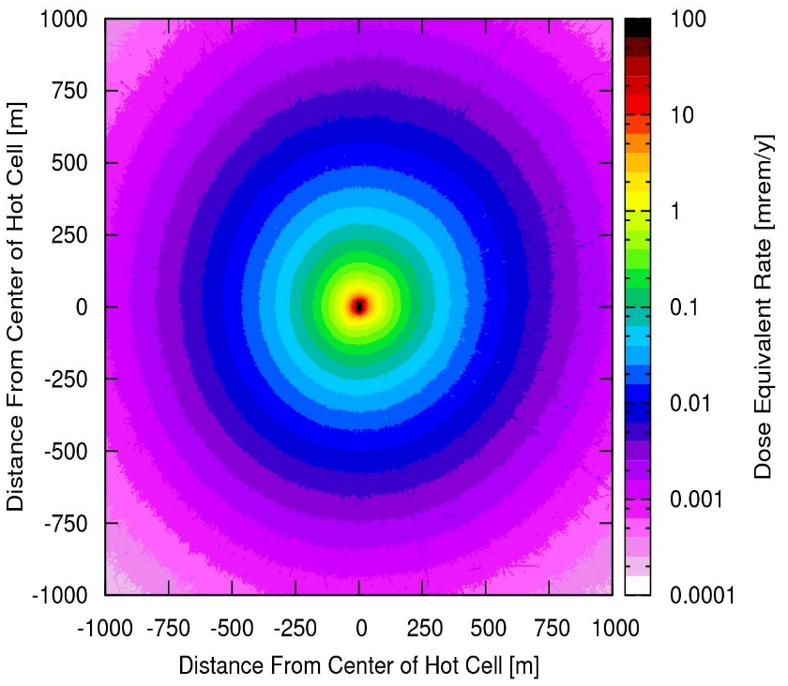
Annual Dose from Target Building Skyshine
Receptor | Annual Dose Equivalent [mrem] | Relative Error [%]
R1 | 1.18E-01 | 3.3
R2 | 1.55E-01 | 3.3
R3 | 1.76E-01 | 5.3
R4 | 2.16E-01 | 4.4
R5 | 2.99E-01 | 3.7
R6 | 3.00E-01 | 7.7
R7 | 2.74E-01 | 4.0
R8 | 4.23E-01 | 4.8
R9 | 7.72E-01 | 4.0
R10 | 7.26E-01 | 4.3
R11 | 6.96E-01 | 5.9
R12 | 1.09E+00 | 1.5
R13 | 1.88E+00 | 2.9
R14 | 4.54E+00 | 2.8
R15 | 2.39E+00 | 1.3
R16 | 2.58E+01 | 1.5
R17 | 2.25E-01 | 17.0
R18 | 2.67E-01 | 21.4
R19 | 1.22E+01 | 2.7
R20 | 9.21E-02 | 3.9
R21 | 1.77E-01 | 2.8
R22 | 6.69E+00 | 2.0
R23 | 2.68E-01 | 2.8
R24 | 5.19E-01 | 6.6
R25 | 2.91E-01 | 2.4
R26 | 4.32E-01 | 3.2
R27 | 4.42E-01 | 4.9
R28 | 4.94E-01 | 4.9
R29 | 7.68E-02 | 9.8
R30 | 8.63E-02 | 6.0
R31 | 2.25E-01 | 9.3
Map in 0-50 cm above ground dose rate
>10 mrem/y in R16 and R19
(not accessible by public)
Dose rate in all public receptors
<10 mrem/y (MSU ALARA)

Slide 16
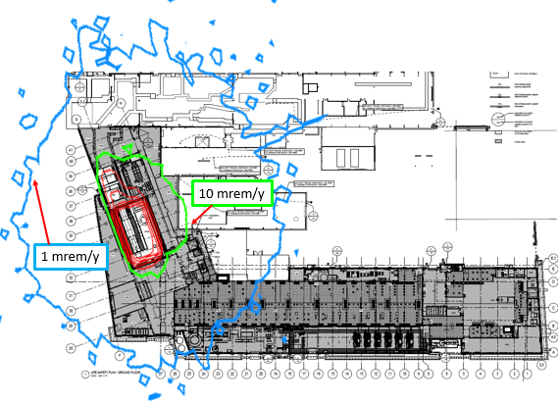
Annual Dose from Target Building
Annual Dose from Target Building
(Direct + Skyshine)

Slide 17
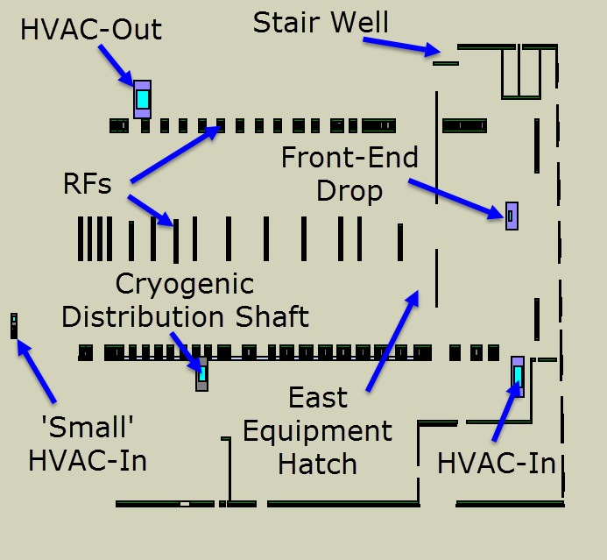
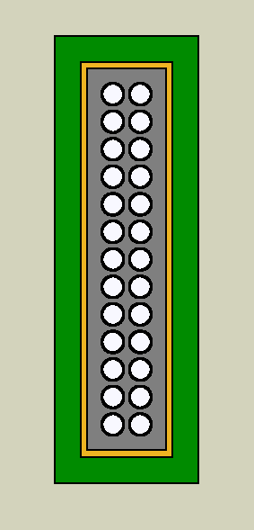
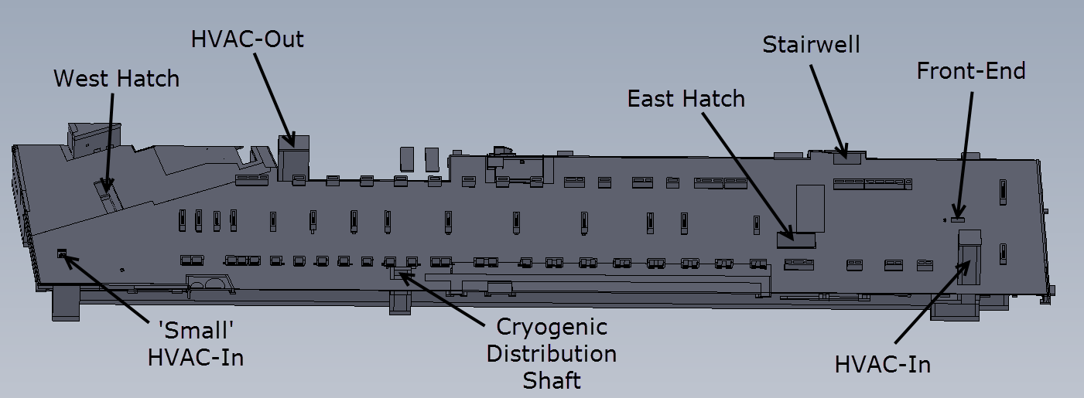
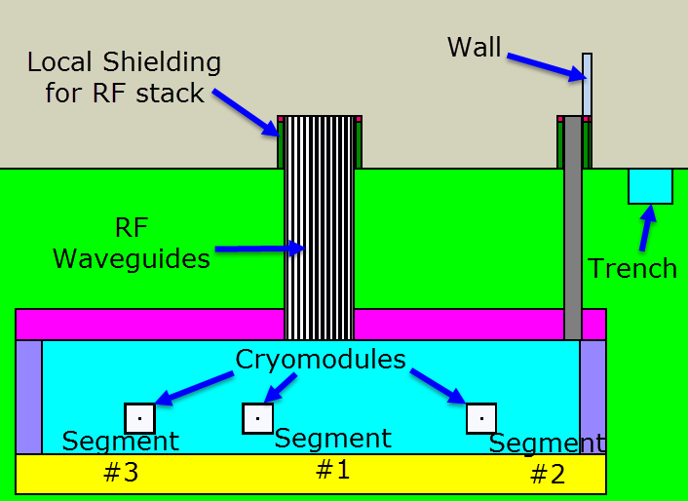
Linac Model
Includes linac walls, shielding penetrations (major and utility conduits), pits and trenches in the service building, local shielding for RFs and penetrations, walls of the service building
The same model for both the direct
exposure and skyshine
1 W/m normal beam losses condition
⁴⁸Ca at 193.6 MeV/u in linac segment
#2 and 261 MeV/u in linac segment #3
First segment was not used due to
very low beam energy of 20 MeV/u
Penetrations Above Ground
RF Stack

Slide 18
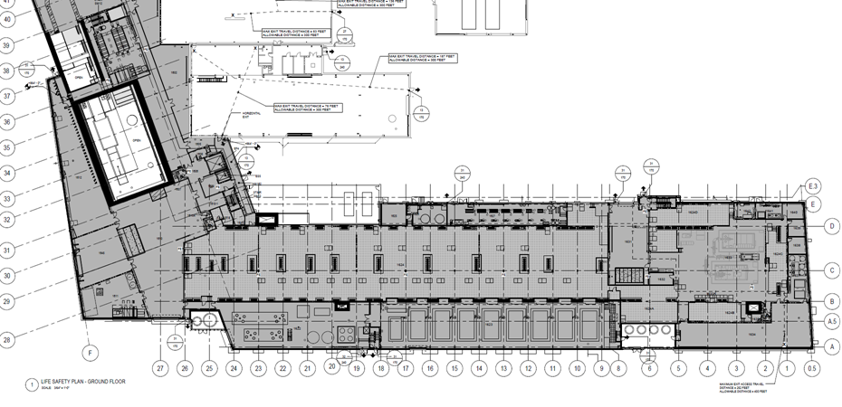
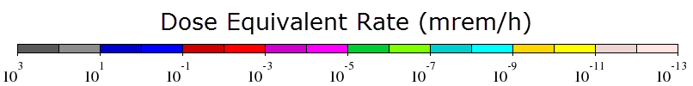
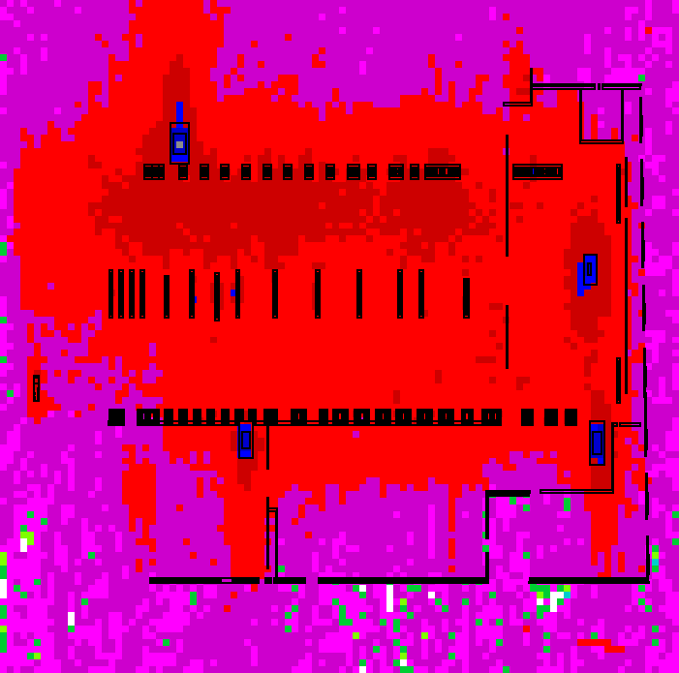
Direct Dose to Public and Workers From Linac
Direct dose to public and workers from 1 W/m beam losses in linac
  Upgraded facility: 611 MeV protons in segment 2, 1 GeV protons in segment 3
  Even for protons, the dose rate to public is <0.001 mrem/h (5.6 mrem/y) and
  <0.1 mrem/h (200 mrem/y) for workers (except fenced out areas at penetrations)
  The dose rate will be 4.8 times smaller for ¹⁸O and ≈20 times smaller for ⁴⁸Ca
Public Area
Controlled Area
Controlled Area
Public Area

Slide 19
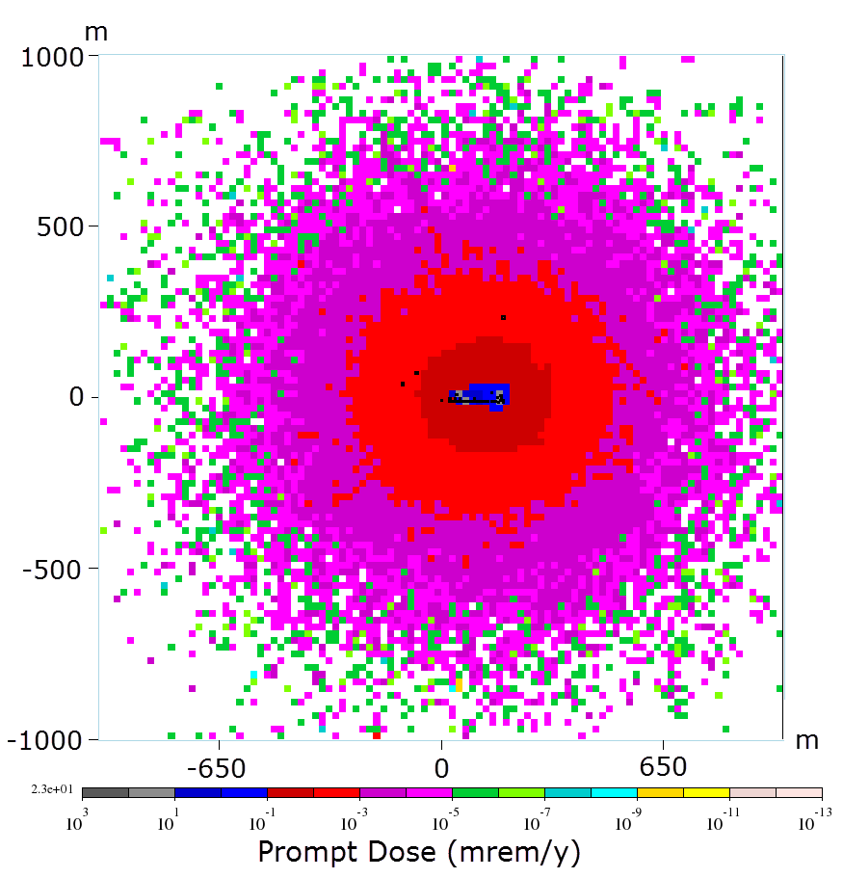
Skyshine+Direct Dose from Linac
Map in “human torso” (24 in to 74.8 in) -
NASA Man-Systems Integration Standards
http://msis.jsc.nasa.gov/sections/section03.htm
Receptor | LS2 Dose Equivalent Rate [mrem/y] | LS3 Dose Equivalent Rate [mrem/y] | Total Dose equivalent Rate [mrem/y] | Error [%]
R1 | 1.9E-01 | 9.9E-03 | 2.0E-01 | 13
R2 | 2.1E-01 | 1.7E-02 | 2.3E-01 | 13
R3 | 8.4E-01 | 2.3E-02 | 8.7E-01 | 8
R4 | 9.0E-01 | 3.8E-02 | 9.4E-01 | 7
R5 | 1.8E-01 | 2.7E-01 | 4.5E-01 | 11
R6 | 1.5E-01 | 1.4E-01 | 2.9E-01 | 10
R7 | 1.3E-01 | 7.4E-02 | 2.0E-01 | 15
R8 | 7.4E-02 | 1.1E-01 | 1.8E-01 | 12
R9 | 2.1E-02 | 1.4E-01 | 1.6E-01 | 12
R10 | 5.9E-02 | 2.2E-01 | 2.8E-01 | 10
R11 | 9.3E-02 | 1.4E-01 | 2.4E-01 | 13
R12 | 1.3E-01 | 1.2E-01 | 2.5E-01 | 14
R13 | 4.6E-02 | 7.9E-02 | 1.2E-01 | 19
R14 | 3.1E-02 | 2.2E-01 | 2.6E-01 | 13
R15 | 9.9E-03 | 3.6E-02 | 4.6E-02 | 11
R16 | 1.6E-02 | 2.3E-02 | 3.9E-02 | 12
R17 | 1.1E-01 | 2.9E-02 | 1.4E-01 | 8
R18 | 3.3E-02 | 1.4E-02 | 4.8E-02 | 12
R19 | 1.8E-02 | 2.5E-02 | 4.3E-02 | 12
R20 | 3.8E-02 | 7.5E-03 | 4.5E-02 | 9
R21 | 2.0E-02 | 1.2E-02 | 3.2E-02 | 9
R22 | 1.1E-02 | 2.0E-02 | 3.1E-02 | 10
R23 | 3.8E-03 | 2.3E-03 | 6.0E-03 | 23
R24 | 3.2E-03 | 5.1E-03 | 8.3E-03 | 18
R25 | 2.7E-03 | 4.7E-03 | 7.4E-03 | 18
R26 | 6.0E-03 | 6.8E-03 | 1.3E-02 | 15
R27 | 3.8E-02 | 3.0E-02 | 6.9E-02 | 11
R28 | 3.5E-03 | 4.5E-03 | 8.0E-03 | 19
R29 | 3.4E-03 | 2.4E-03 | 5.8E-03 | 18
R30 | 3.5E-03 | 2.3E-03 | 5.9E-03 | 18
R31 | 4.5E-03 | 3.0E-03 | 7.5E-03 | 16

Slide 20
Annual Dose Equivalents from Facility Emissions
Wind Rose Obtained from Michigan State Department of Environmental Quality
Four source terms
  Service building Special Mechanical
  Off-Gas exhaust (SMOG)
  Target Hot Off-Gas (HOG)
  Target primary exhaust
  Linac exhaust
Based on radionuclide inventories
calculated for all systems
AERMOD code used for nuclide
propagation through air
Uncertainties
  Operation (inventories)
  Meteorological (wind direction, speed)
Results are favorably compared
to wind tunnel results

Slide 21
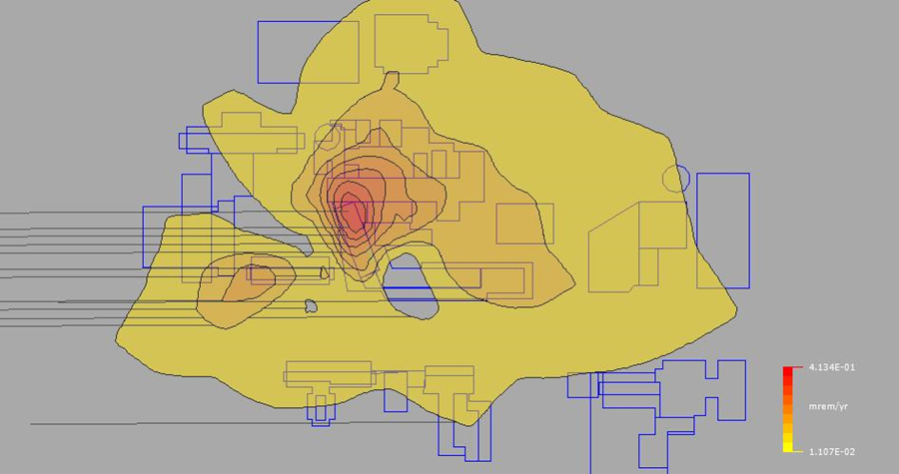
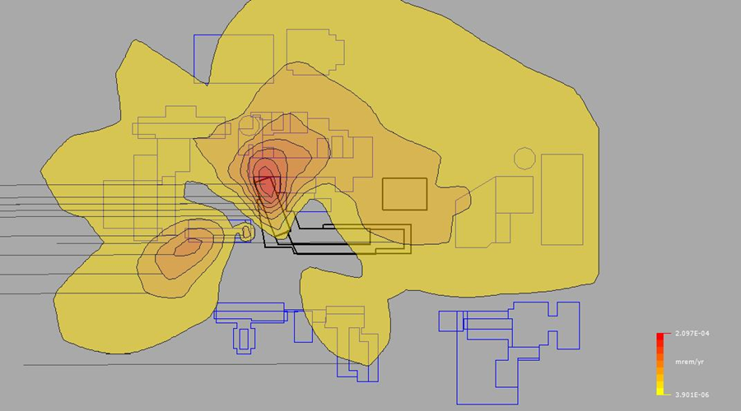
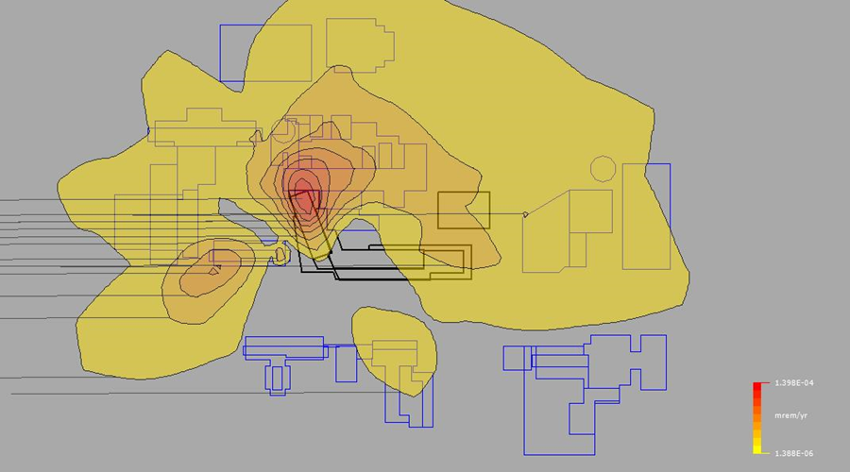
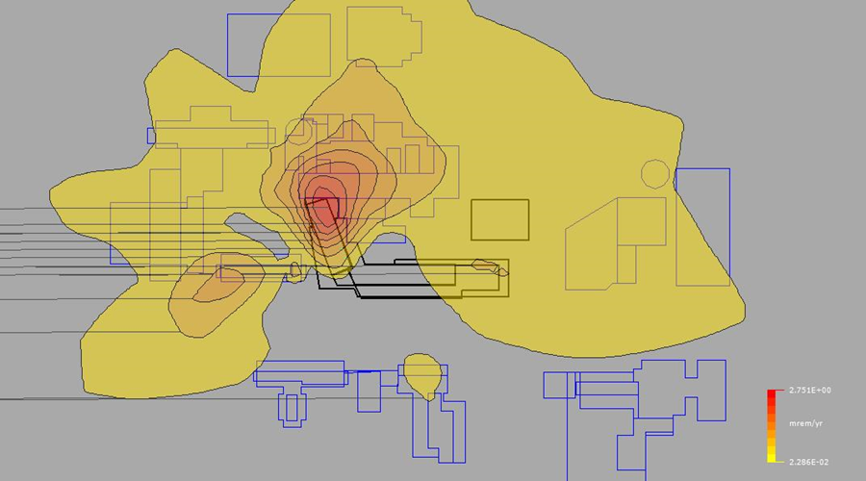
Annual Dose Equivalents from Facility Emissions
Annual Dose Equivalent Isopleths from Linac Exhaust
Annual Dose Equivalent Isopleths from
Target Primary Exhaust
Annual Dose Equivalent Isopleths from
Target Hot Off-Gas (HOG) Exhaust
Annual Dose Equivalent Isopleths from Service
Building Special Mechanical (SMOG) Exhaust

Slide 22
Annual Dose Equivalents from Facility Emissions
Annual Dose Equivalents from FRIB Air Emission Sources
Annual doses from facility
emissions are relatively
small
Worst doses
  2.57 mrem/y for R16
  1.94 mrem/y for R19
R16 and R19 cannot be
accessed by public
Nearest public receptor R22
  1.67 mrem/y
Receptor | Annual Dose Equivalent from FRIB Facility Air Emission Sources [mrem]
 | A | B | C | D | Sum
R1 | 1.3E-01 | 5.2E-05 | 3.4E-05 | 6.6E-01 | 0.79
R2 | 1.3E-01 | 6.5E-05 | 4.0E-05 | 7.1E-01 | 0.84
R3 | 1.3E-01 | 4.9E-05 | 3.2E-05 | 6.3E-01 | 0.76
R4 | 1.5E-01 | 6.6E-05 | 4.2E-05 | 7.4E-01 | 0.89
R5 | 1.4E-01 | 5.6E-05 | 3.6E-05 | 6.3E-01 | 0.77
R6 | 1.4E-01 | 4.4E-05 | 3.0E-05 | 5.6E-01 | 0.70
R7 | 9.5E-02 | 3.0E-05 | 1.9E-05 | 3.6E-01 | 0.45
R8 | 1.3E-01 | 4.7E-05 | 3.0E-05 | 4.9E-01 | 0.62
R9 | 9.3E-02 | 2.8E-05 | 1.7E-05 | 2.7E-01 | 0.36
R10 | 9.2E-02 | 2.7E-05 | 1.6E-05 | 2.7E-01 | 0.36
R11 | 6.5E-02 | 1.9E-05 | 1.1E-05 | 1.8E-01 | 0.24
R12 | 2.4E-02 | 1.4E-05 | 6.1E-06 | 7.0E-02 | 0.09
R13 | 5.3E-02 | 2.4E-05 | 1.1E-05 | 1.5E-01 | 0.20
R14 | 7.5E-02 | 2.3E-05 | 1.2E-05 | 2.6E-01 | 0.33
R15 | 8.2E-02 | 3.9E-06 | 1.5E-06 | 1.8E-01 | 0.26
R16 | 3.5E-01 | 1.4E-04 | 9.5E-05 | 2.2E+00 | 2.57
R17 | 1.3E-01 | 6.3E-05 | 3.7E-05 | 6.4E-01 | 0.77
R18 | 1.2E-01 | 6.4E-05 | 3.9E-05 | 6.7E-01 | 0.79
R19 | 2.6E-01 | 1.0E-04 | 6.9E-05 | 1.7E+00 | 1.94
R20 | 1.1E-01 | 6.5E-05 | 3.8E-05 | 6.7E-01 | 0.78
R21 | 1.0E-01 | 4.7E-05 | 2.9E-05 | 5.1E-01 | 0.61
R22 | 1.7E-01 | 1.3E-04 | 8.3E-05 | 1.5E+00 | 1.67
R23 | 6.6E-02 | 3.2E-05 | 2.2E-05 | 4.5E-01 | 0.52
R24 | 1.0E-01 | 6.5E-05 | 3.9E-05 | 7.4E-01 | 0.84
R25 | 9.8E-02 | 6.1E-05 | 3.6E-05 | 6.9E-01 | 0.79
R26 | 1.9E-01 | 1.1E-04 | 6.5E-05 | 1.3E+00 | 1.52
R27 | 1.4E-01 | 6.3E-05 | 4.0E-05 | 6.4E-01 | 0.78
R28 | 7.4E-02 | 3.8E-05 | 2.3E-05 | 4.6E-01 | 0.53
R29 | 5.5E-02 | 3.7E-05 | 2.2E-05 | 3.8E-01 | 0.43
R30 | 6.8E-02 | 4.7E-05 | 2.7E-05 | 4.8E-01 | 0.55
R31 | 1.2E-01 | 7.3E-05 | 4.3E-05 | 8.5E-01 | 0.97

Slide 23
Total Annual Dose Equivalent to Receptors
Receptor |  | Annual Dose Equivalent [mrem]
 | Target Building Skyshine | Target Building Direct Radiation | Facility Emissions | Tunnel Skyshine + Direct Radiation | Sum | Relative Error Assuming 0 % Uncertainty in Emission Doses [%] | Relative Error Assuming 50 % Uncertainty in Emission Doses [%] | Relative Error Assuming 100 % Uncertainty in Emission Doses [%]
R1 | 0.1 | 4.8E-02 | 0.8 | 0.2 | 1.2 | 2 | 34 | 71
R2 | 0.2 | 6.7E-02 | 0.8 | 0.2 | 1.3 | 2 | 33 | 65
R3 | 0.2 | 5.7E-02 | 0.8 | 0.9 | 1.9 | 4 | 21 | 42
R4 | 0.2 | 8.3E-02 | 0.9 | 0.9 | 2.1 | 3 | 21 | 44
R5 | 0.3 | 1.2E-01 | 0.8 | 0.4 | 1.6 | 4 | 24 | 43
R6 | 0.3 | 9.1E-02 | 0.7 | 0.3 | 1.4 | 3 | 25 | 54
R7 | 0.3 | 7.2E-02 | 0.5 | 0.2 | 1.0 | 4 | 23 | 49
R8 | 0.4 | 2.3E-01 | 0.6 | 0.2 | 1.5 | 5 | 21 | 45
R9 | 0.8 | 2.7E-01 | 0.4 | 0.2 | 1.6 | 3 | 12 | 26
R10 | 0.7 | 2.2E-01 | 0.4 | 0.3 | 1.6 | 3 | 12 | 25
R11 | 0.7 | 1.6E-01 | 0.2 | 0.2 | 1.3 | 4 | 10 | 20
R12 | 1.1 | 4.0E-01 | 0.1 | 0.2 | 1.8 | 5 | 3 | 7
R13 | 1.9 | 5.4E-01 | 0.2 | 0.1 | 2.7 | 2 | 4 | 9
R14 | 4.5 | 8.9E-01 | 0.3 | 0.3 | 6.0 | 7 | 4 | 9
R15 | 2.4 | 5.8E-01 | 0.3 | 0.05 | 3.3 | 5 | 4 | 9
R16 | 25.8 | 6.5E+00 | 2.6 | 0.04 | 35.0 | 4 | 4 | 8
R17 | 0.2 | 7.2E-02 | 0.8 | 0.14 | 1.2 | 4 | 32 | 65
R18 | 0.3 | 6.7E-02 | 0.8 | 0.05 | 1.2 | 5 | 34 | 64
R19 | 12.2 | 4.9E+00 | 1.9 | 0.04 | 19.1 | 6 | 5 | 12
R20 | 0.1 | 3.4E-02 | 0.8 | 0.05 | 1.0 | 1 | 41 | 83
R21 | 0.2 | 4.3E-02 | 0.6 | 0.03 | 0.9 | 1 | 35 | 74
R22 | 6.7 | 9.4E-02 | 1.7 | 0.03 | 8.5 | 2 | 10 | 19
R23 | 0.3 | 7.9E-02 | 0.5 | 0.01 | 0.9 | 7 | 30 | 52
R24 | 0.5 | 8.9E-02 | 0.8 | 0.01 | 1.5 | 9 | 29 | 36
R25 | 0.3 | 1.0E-01 | 0.8 | 0.01 | 1.2 | 2 | 33 | 36
R26 | 0.4 | 2.5E-01 | 1.5 | 0.01 | 2.2 | 1 | 34 | 77
R27 | 0.4 | 1.9E-01 | 0.8 | 0.1 | 1.5 | 6 | 26 | 49
R28 | 0.5 | 1.3E-01 | 0.5 | 0.01 | 1.2 | 3 | 23 | 50
R29 | 0.1 | 2.5E-02 | 0.4 | 0.01 | 0.5 | 1 | 40 | 82
R30 | 0.1 | 3.5E-02 | 0.5 | 0.01 | 0.7 | 6 | 41 | 70
R31 | 0.2 | 8.7E-02 | 1.0 | 0.01 | 1.3 | 2 | 38 | 72
MSU ALARA of
10 mrem/y is
exceeded for
R16 and R19
(but not accessible
to public)
Dose at closest
public receptor
(R22) from all
sources is
8.5 mrem/y

Slide 24
Conclusions
Considered contribution from air emissions, target (skyshine and direct) and linac (skyshine and direct)
Conservative assumptions
  ⁴⁸Ca beam (only used 21% of operation)
  Worst type of air (warm and moist)
Annual dose equivalents from FRIB facility air emissions are below 10 mrem
The regulatory limit of 10 mrem annually from air emissions to the nearest public receptor (R22) is met
In sum, the annual dose equivalents to public receptors is below the MSU ALARA goal of 10 mrem
Annual occupational location dose equivalents are below about 40 mrem, which is small compared to the MSU ALARA goal of 500 mrem. This provides a reasonable operational margin for FRIB workers.

Slide 25
Backup Slides

Slide 26
Receptor Locations (Backup)
Receptor Label | Location | Description | Receptor Type¹
R1-R7 | East End of FRIB, Ground Floor to High Roof (7’6” – 39’ elevation above grade) | Air intakes to Potentially Occupied Spaces | Primarily Non-Public²
R8-R13 | Center of FRIB, Ground Floor to High Roof (4’6” – 38’6” elevation above grade) | Air intakes to Potentially Occupied Spaces
R14-R16 | West End of FRIB, Ground Floor to High Roof (10’6” – 39’ elevation above grade) | Air intakes to Potentially Occupied Spaces
R17 | West façade of SRF Highbay Building (15’6” elevation above grade) | Air intakes to Potentially Occupied Spaces
R18 | North façade of SRF Highbay Building (21’3” – 29’3” elevation above grade) | Air intakes to Potentially Occupied Spaces
R19 | Roof of NSCL Building, West End | Existing Outdoor Air Intake
R20 | West Façade of Wharton Center, Penthouse Level | Existing Outdoor Air Intake Louver | Public
R21 | North Façade of Plant Sciences Addition, Penthouse Level | Existing Outdoor Air Intake Louver
R22 | East End of Biochemistry Building, Roof Level | Existing Outdoor Air Intake
R23 | East End of Biomedical Physical Sciences Building, Grade Level | Existing Outdoor Air Intake Louver
R24 | West Façade of Chemistry Building, 5th Level | Representative Existing Operable Window
R25 | North Façade of Chemistry Building, 4th Level | Existing Outdoor Air Intake Louver
R26 Existing Outdoor Air Intake Louver Primarily Penthouse Level Non-Public | West Façade of NSCL Phase 3 Building, | Existing Outdoor Air Intake Louver | Primarily Non-Public²
R27 | East Façade of NSCL Building, 2nd Level | Existing Outdoor Air Intake Louver
R28 | Courtyard adjacent to Chemistry Building | Representative Existing Pedestrian Location | Public
R29-R30 | Traffic Circle on Bogue Street, various elevations | Locations representative of buildings further afield
R31 | West Façade of College of Law, Penthouse Level | Existing Outdoor Air Intake Louver
¹ Receptors R1, R2, R7, R8, R9, R15, R17, R18 and R27 represent locations that could also be considered as public, given that pedestrians could be traveling near these locations. However, several of these locations are able to be controlled from public access.
² Receptors are either designated as publicly accessible locations (i.e., uncontrolled) or non-public (i.e. controlled) locations.

Slide 27
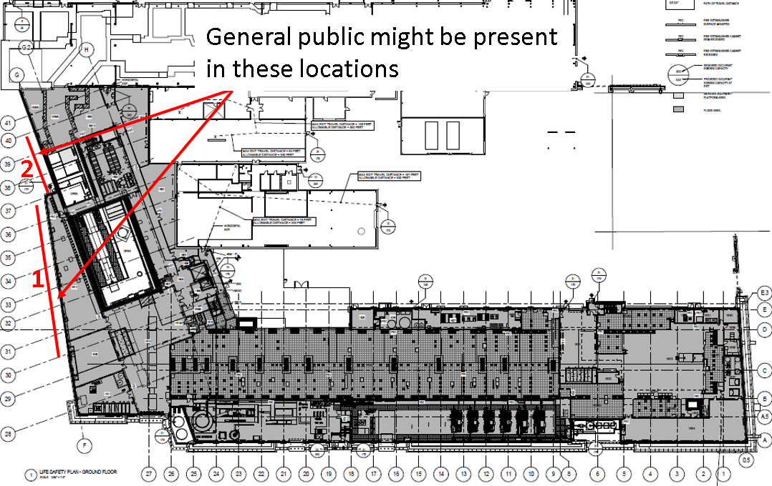
Direct Dose From Target Building
(indicate workers area, public area)

Slide 28
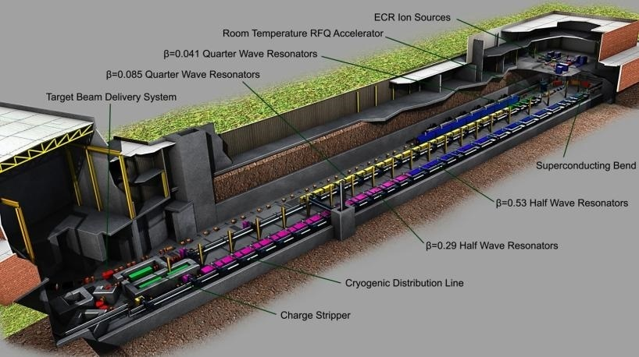
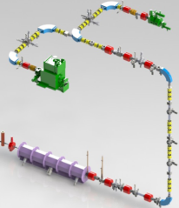
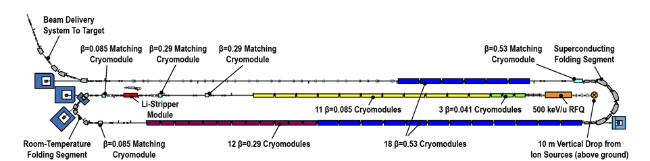
Superconducting RF Driver Linac Overview
Accelerate ion species up to ²³⁸U with energies of no less than 200 MeV/u
Provide beam power up to 400 kW
Energy upgrade to 400 MeV/u for uranium by filling vacant slots with 12 SRF cryomodules

Slide 29
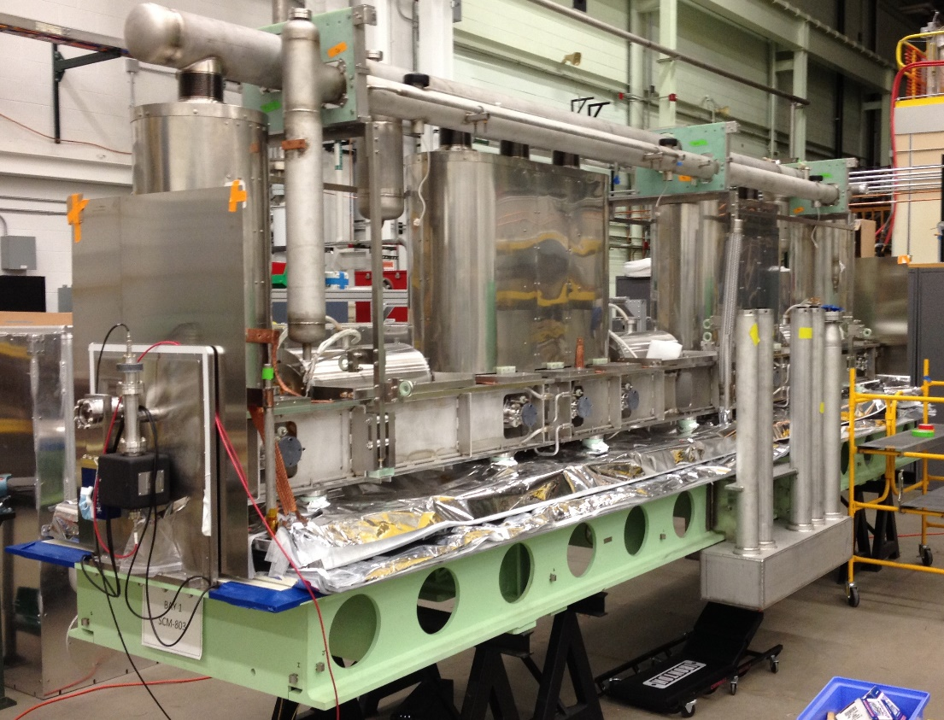
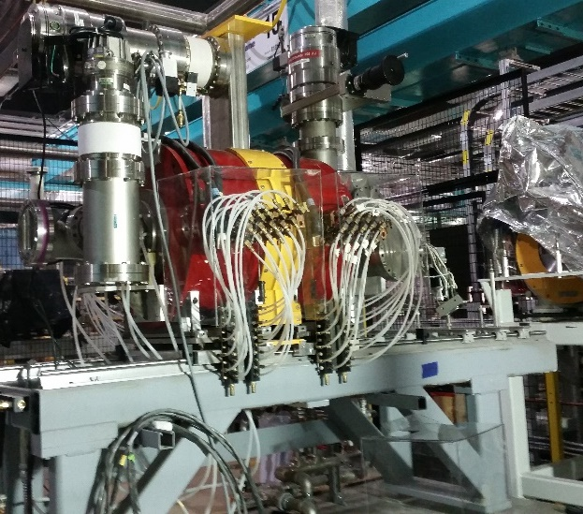
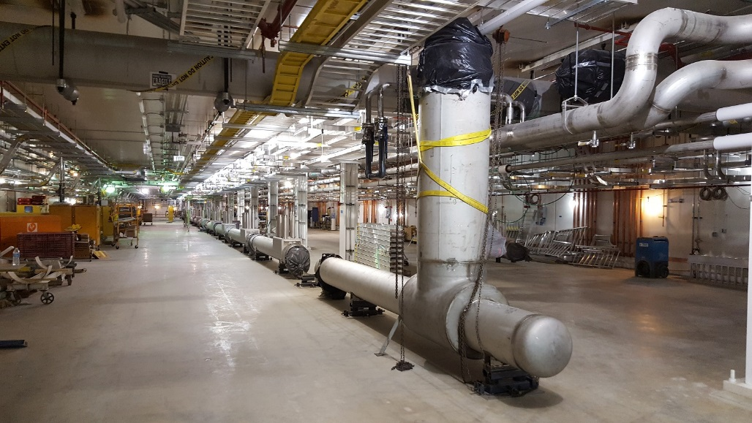

Accelerator Progress
Technical construction on track
Commissioning of linac front end to
start in Jan/Feb 2017
ARTEMIS 14 GHz ECR ion source on HV platform
Assembly of
β=0.085 cryomodule
Linac Segment 1 transfer line sections being installed in tunnel

Slide 30
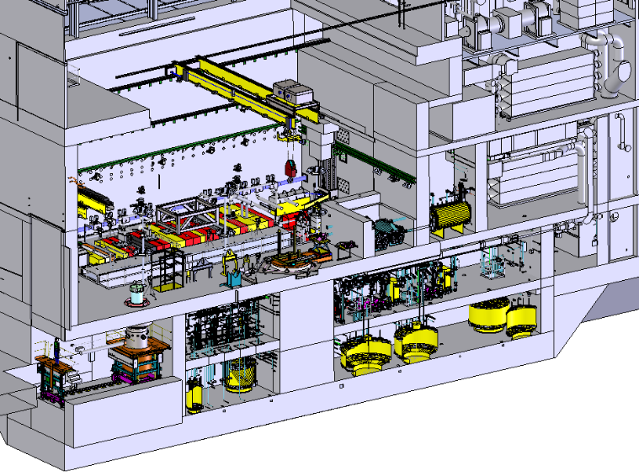
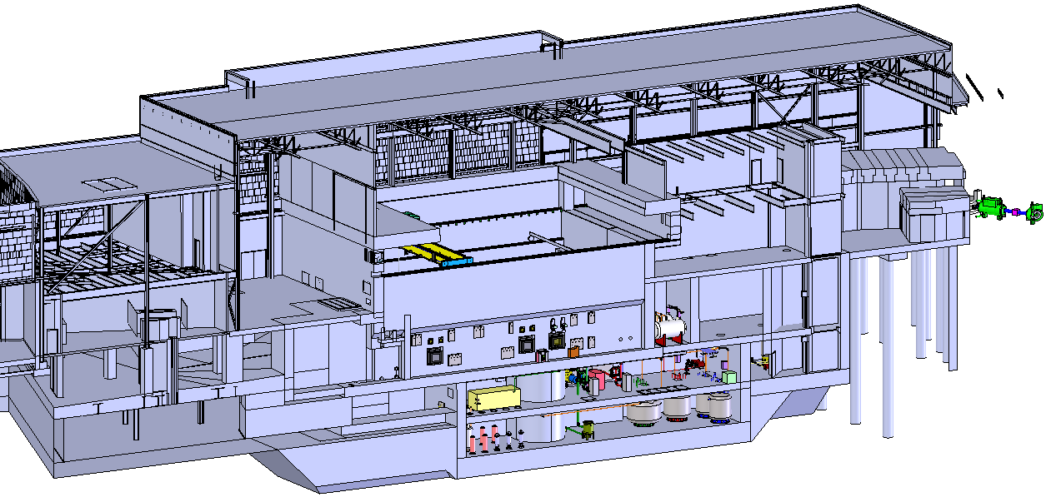
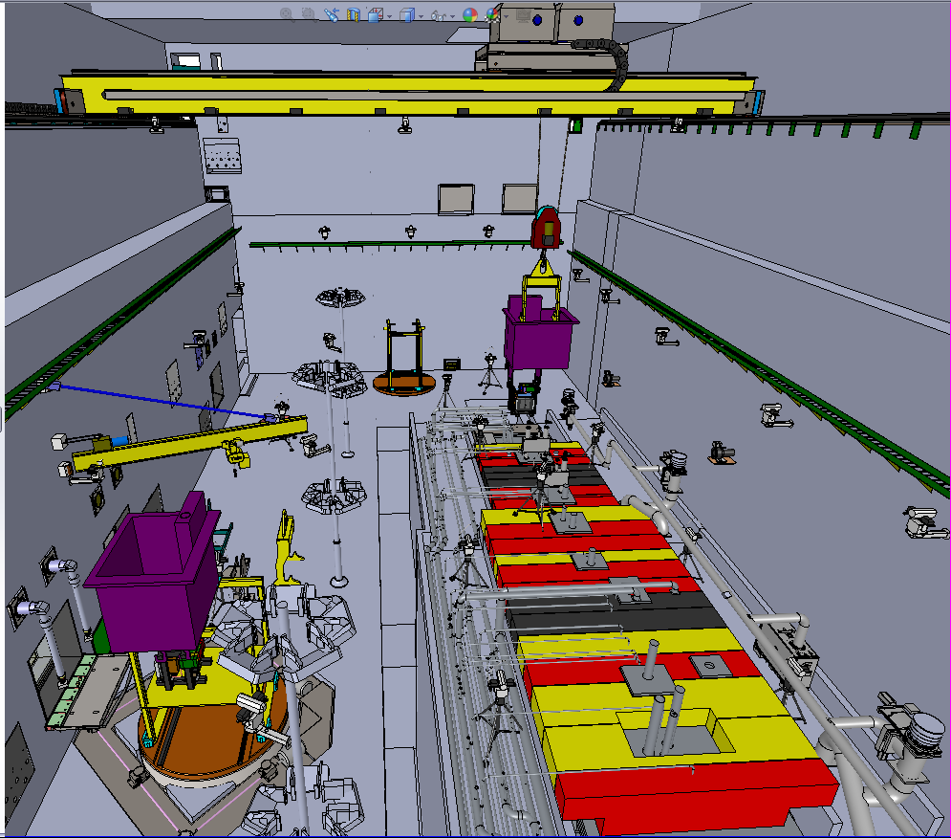

FRIB Rare Isotope Production Facilities
Accommodates first part of fragment separator with target and beam dump
Remote-handling of activated components (target change within 24 h)
Non-conventional utilities

Slide 31
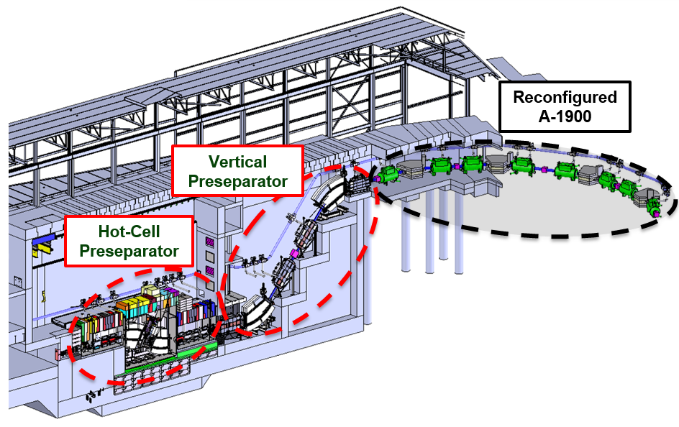
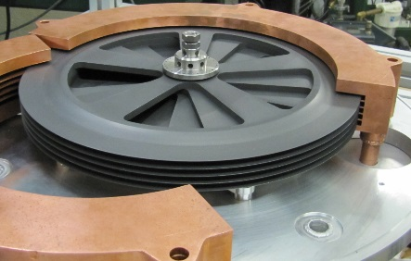
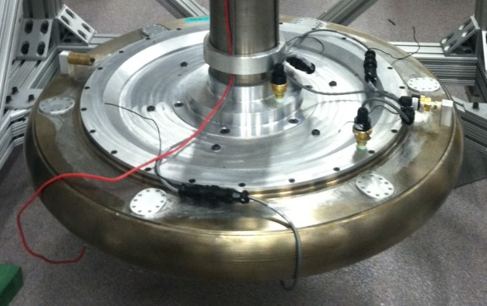
FRIB Rare Isotope Production Facilities
Fragment Separator
Three stage magnetic fragment separator
  High acceptance, high resolution to maximize science
400 kW beam power beam capability
  Rotating multi-slice target
  Rotating water-filled beam dump
Multi-slice rotating graphite target
Water-filled rotating beam dump

Slide 32
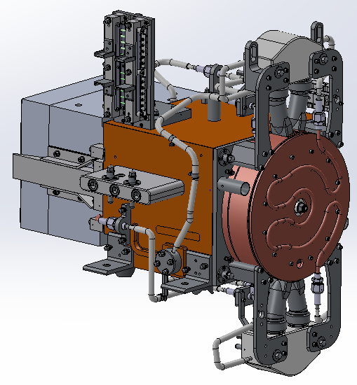
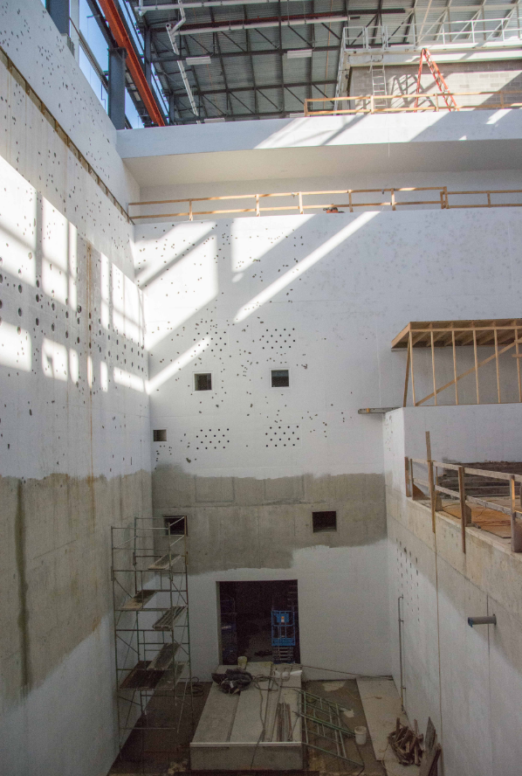
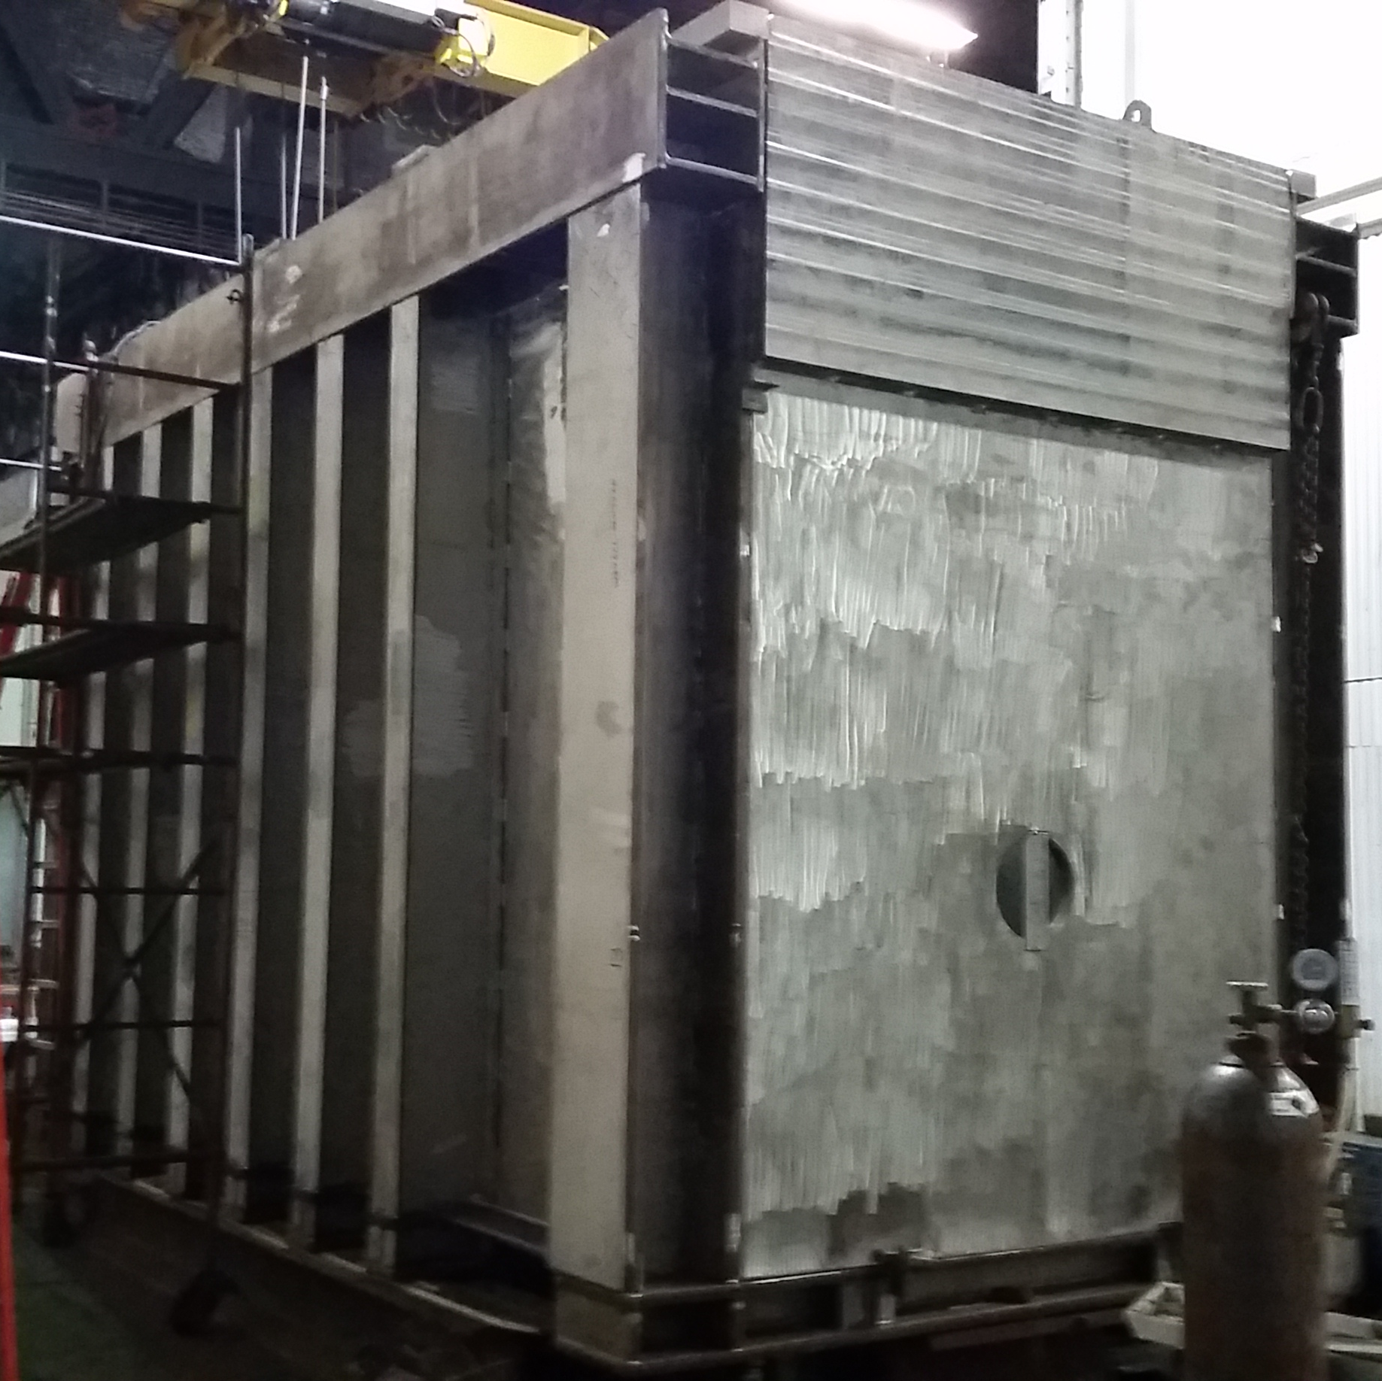
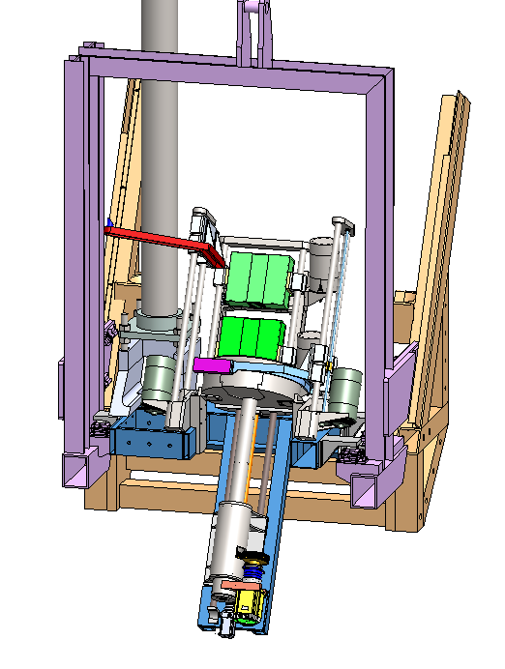
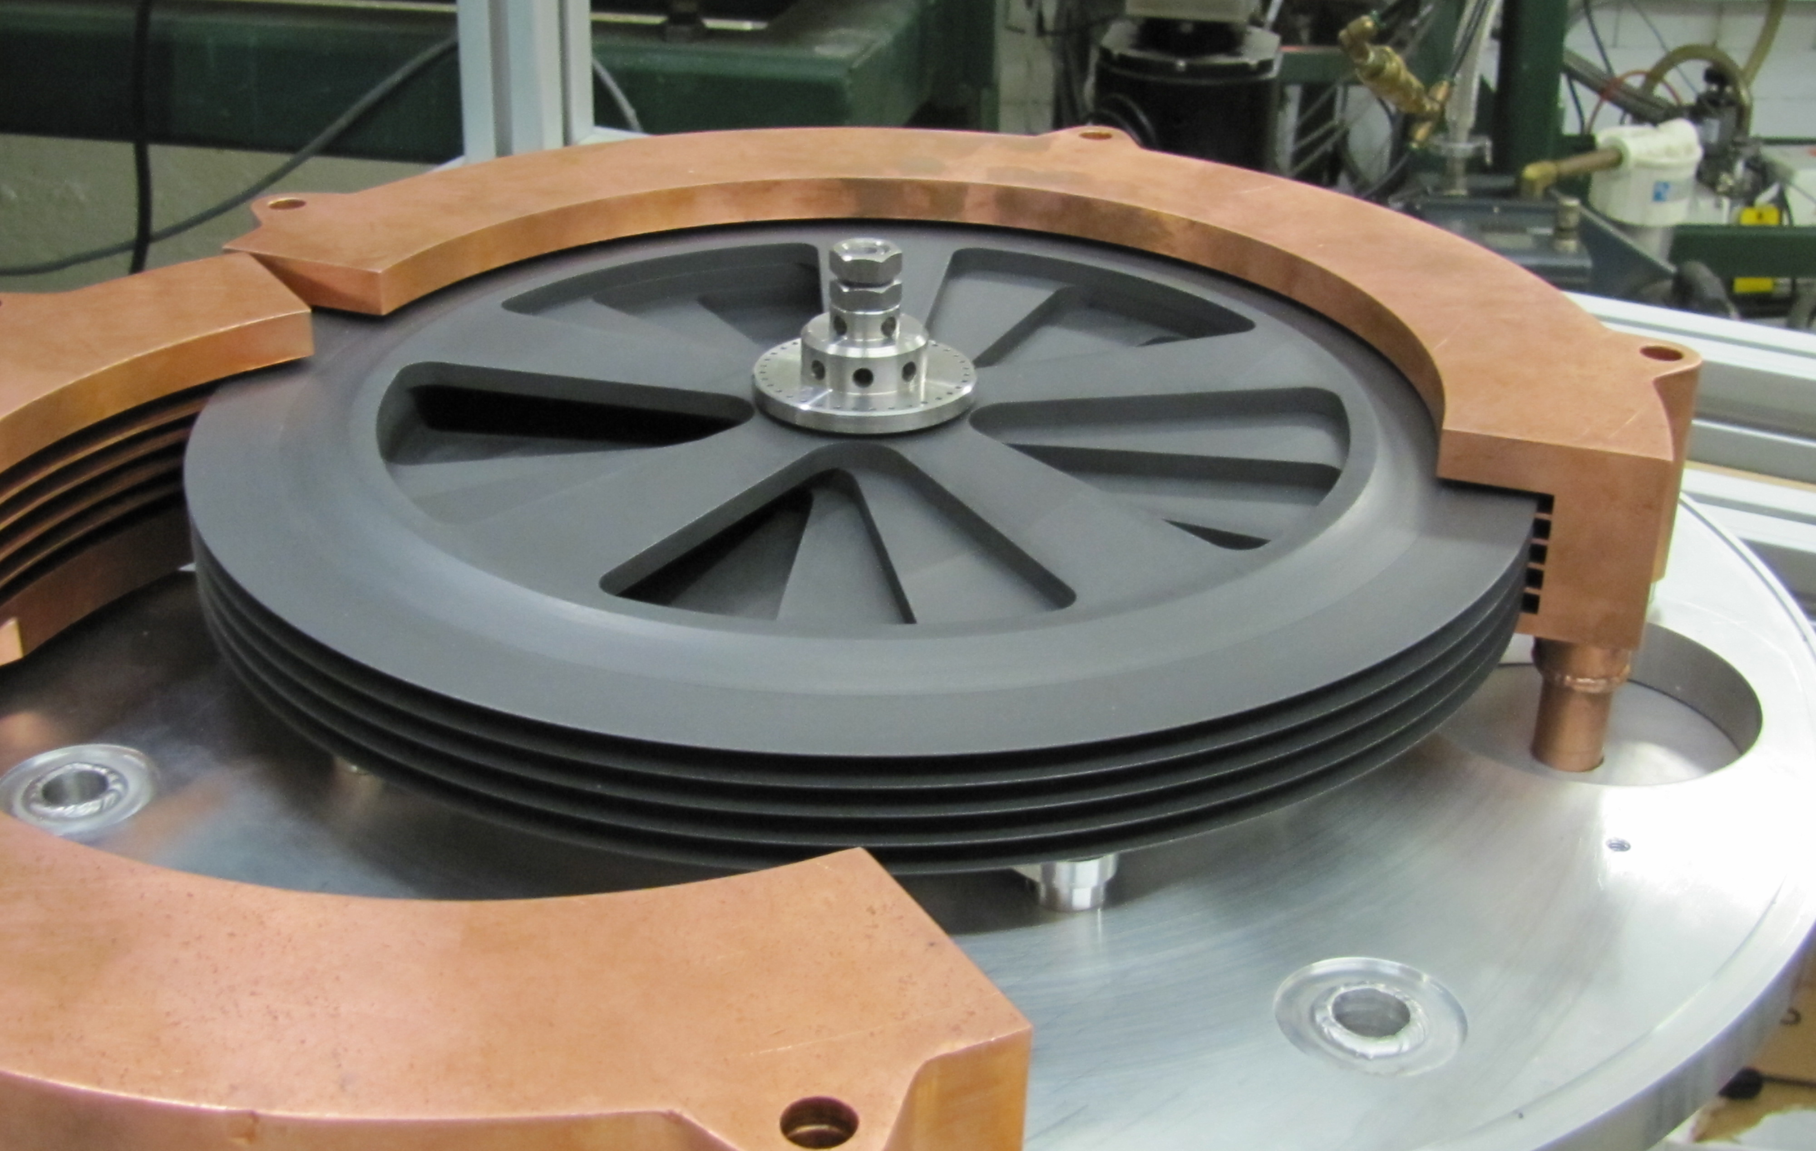
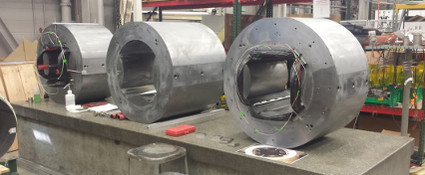
Fragment Separator Progress
Preseparator vacuum vessels
Target module
Beam dump assembly
Target prototype
Magnet fabrication
Full scale prototype drum
Target facility hotcell

