Slide 1
SATIF13 Poster session
(ultrashort summary)

Slide 2
21 Poster
Source Terms and related topics 1
Induced Activity 3
Radiation Shielding and dosimetry 3
Benchmark and Intercomparison 2
Laser-particle interaction and acceleration 4
Presentation of facilities 7

Slide 3
Nr. | Title | Presenter
1 | Radiological and environmental impacts of the activated air inside the tunnel of ESS accelerator | Daniela Ene
2 | Methodology study for the reduction of air activation in KOMAC | Yi-Sub Min
3 | Introduction of the general activity to maintain the radiation safety of KOMAC | Sungkyun Park
4 | A study on the establishment of residual dose estimation procedure for accumulated radioactive ions in RAON ISOL beam separator devices | Do-Hyun Kim
5 | FLUKA shielding calculations for the low-background underground accelerator laboratory Felsenkeller/Dresden | Marcel Grieger
6 | Source term and shielding calculations for the installation of a new cyclotron for medical applications at HZDR | Joerg Konheiser
7 | The γ ELBE facility at HZDR | Ronald Schwengner
8 | The nELBE time-of-flight facility at HZDR | Roland Beyer
9 | Experiments with positrons: the pELBE facility | Thu Trang Trinh
10 | Discussion on the concept of standard concrete for radiation shield | Kenichi Kimura
11 | Measurement of neutron energy spectra in different licensed facilities using the nested neutron spectrometer | Angel Licea
12 | The CNAO synchrotron: design and operation | Michele Ferrarini
13 | Benchmarking Geant4 for spallation neutron source shielding calculations | Douglas Di Julio
14 | Residual activity evaluation: benchmark and intercomparison between ANITA, FISPACT, FLUKA and PHITS codes | Anna Ferrari
15 | Radiation safety systems for high power laser systems at SPring-8 SR – SACLA XFEL experimental inter-availability facility | Yoshihiro Asano
16 | The ELI-Beamlines facility: design and radiation sources | ELI-Beamlines
17 | An activation database for materials used at high-intensity laser-acceleration facilities | Nikhil Shetty
18 | Development of a novel active technique for bremsstrahlung source term determination in laser-plasma experiments | Maria Molodtsova
19 | Laser-particle accelerators for radiotherapy | Liselotte Obst
20 | Generation of high charge electron beams by ionization injection | Arie Irman
21 | Radiation protection considerations at the design stage for the ELI-NP facility | Lewis McFarlane

Slide 4
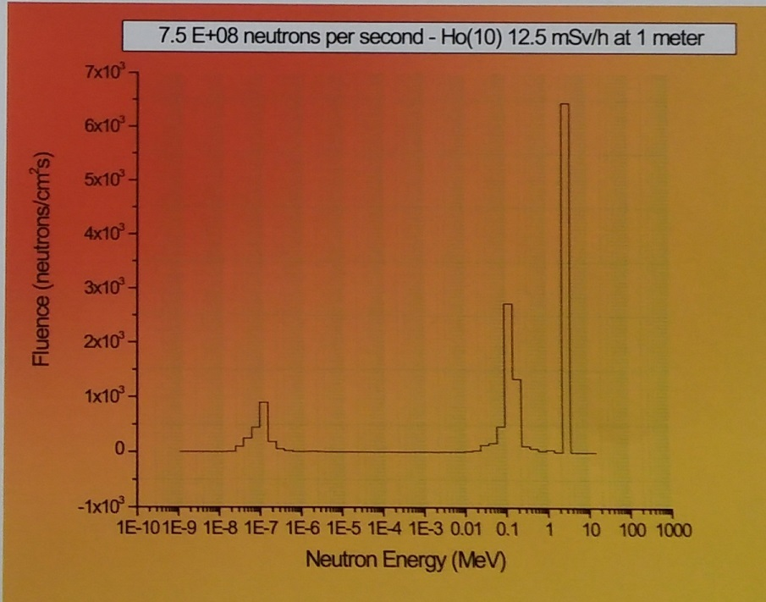
Poster 11
Presenter: Angel Licea

Slide 5
Poster 5
Presenter: Marcel Grieger
It will be the deepest underground
y-counting Lab in Germany
A 5MV Pelletron accelerator will be placed
in some tunnels early 2017
and will provide ion species (¹H⁺, ⁴He⁺)
Measurement of neutron background without beam have beam done
Natural neutron background from (alpha,n),
(µ, n) reactioins in the rock

Slide 6
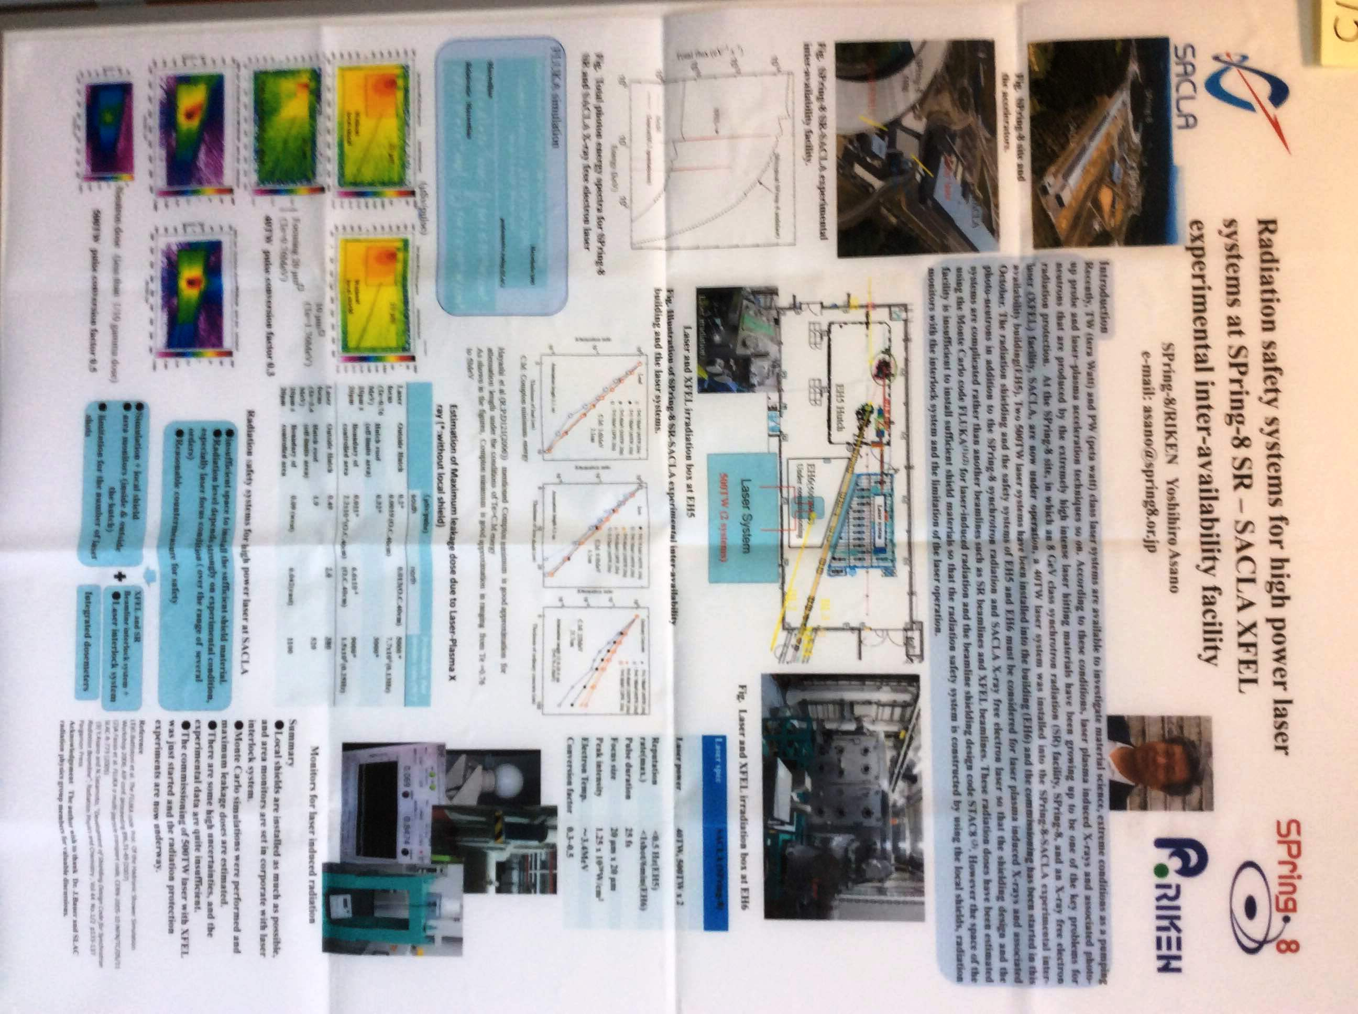
Poster 15
Presenter: Yoshihiro Asano
Two 500 TW laser have been
Installed and commissioning started
- Photoneutron production is
important at these laser
intensities
Simulations (FLUKA) showed
the need of additional shielding
Importance of determination of source terms

