Slide 1
Benchmark calculation of the PHITS code for neutron attenuation in iron and concrete on shielding experiments at proton accelerator facilities
SATIF-13, Helmholtz-Zentrum Dresden-Rossendorf
( Dresden, Germany, 10-12 October, 2016 )
Norihiro Matsuda¹, Yosuke Iwamoto¹, Tatsuhiko Sato¹, Shintaro Hashimoto¹, Tatsuhiko Ogawa¹, Takuya Furuta¹, Shinichiro Abe¹, Takeshi Kai¹,
Ryuji Hosoyamada², Hiroshi Iwase³, Hiroshi Nakashima¹, and Koji Niita²
¹ JAEA, Japan Atomic Energy Agency
² RIST, Research Organization for Information Science and Technology
³ KEK, High Energy Accelerator Research Organization

Slide 2
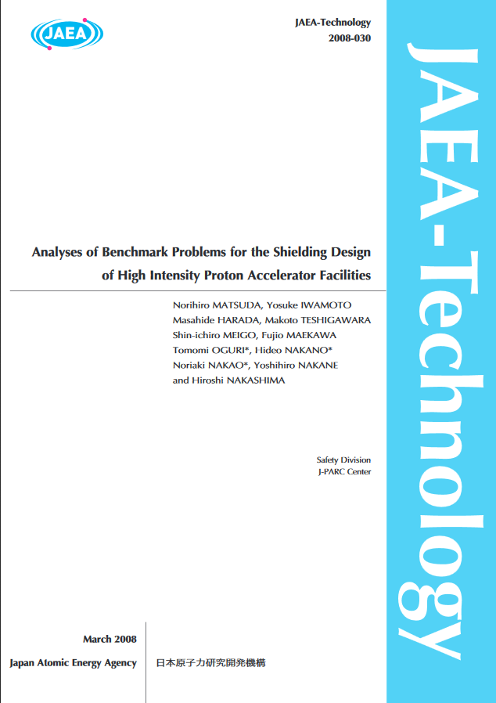
Introduction -1
For shielding designs and safety analyses of the J-PARC (Japan Proton Accelerator Research Complex), accuracy of PHITS (Particle and Heavy Ion Transport code System) were validated through benchmark calculations based on shielding experiments about 10 years ago.
The PHITS has been upgraded especially in the past five years.
Therefore, another round of benchmark calculations are required for the latest version of the PHITS.

Slide 3
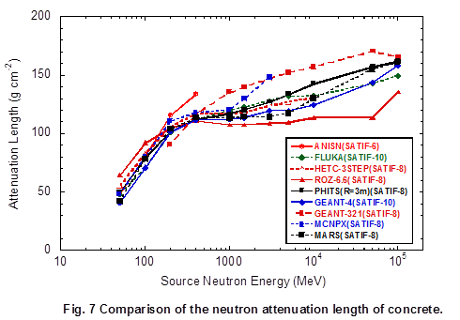
Introduction -2
Dr. HIRAYAMA has studied neutron attenuation through the inter-comparison in SATIF. Neutron attenuation length is very important for shielding calculations involving high-energy accelerators.
However, comparable experimental data is not exist.
CONCRETE
H. Hirayama, Inter-comparison of medium-energy neutron attenuation in iron and concrete (8), SATIF-10

Slide 4
PURPOSE
In this study, benchmark calculations for shielding experiments at several proton accelerator facilities (TIARA, RCNP, AGS) are carried out with the latest version of the PHITS (ver. 2.82).
Moreover, we try to evaluate neutron attenuation length for these shielding experiments with the help of the PHITS.
TIARA: Takasaki Ion Accelerators for Advanced Radiation Application, JAEA
RCNP: Research Center for Nuclear Physics, Osaka Univ.
AGS: Alternating Gradient Synchrotron, BNL

Slide 5
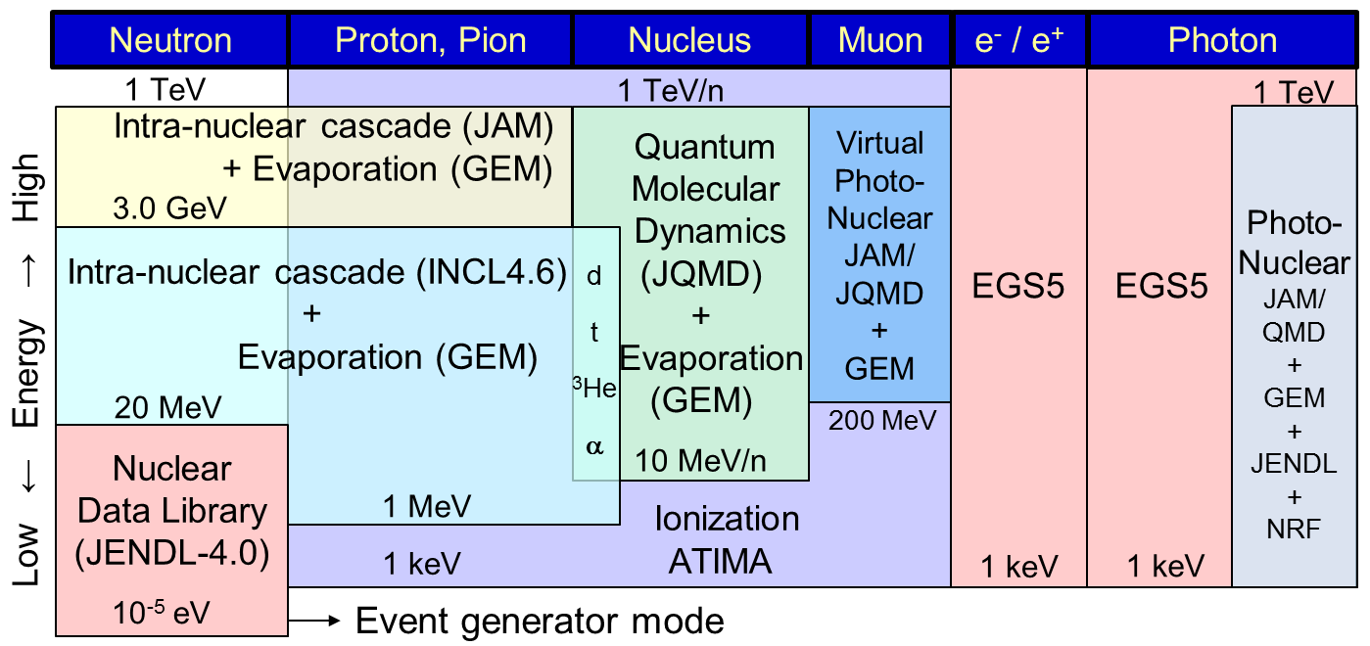
Models (default) in PHITS 2.82
INCL4.6 was introduced into PHITS version 2.52 (Dec., 2012) as substitute for Bertini model.

Slide 6
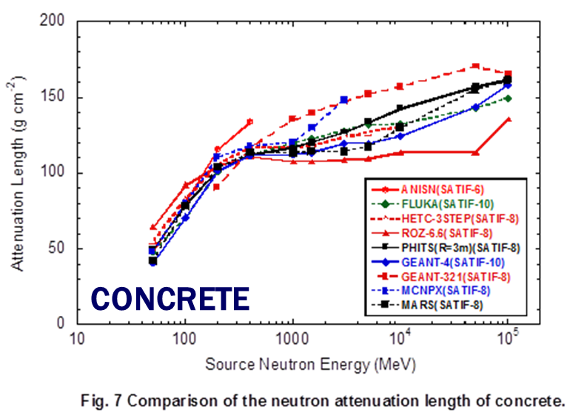
Difference of neutron attenuations
For concrete, differences of neutron attenuations are observed for energies from 1 to 3 GeV.
PHITS ver. 2.82
Max.(@ 3 GeV): ~10 g cm⁻²
← Bertini
H. Hirayama, Inter-comparison of medium-energy neutron attenuation in iron and concrete (8), SATIF-10

Slide 7
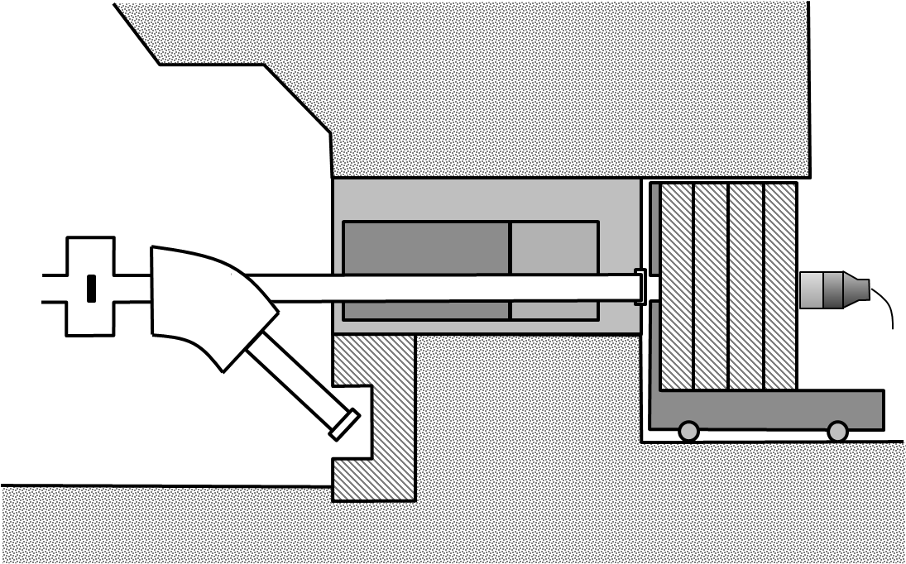
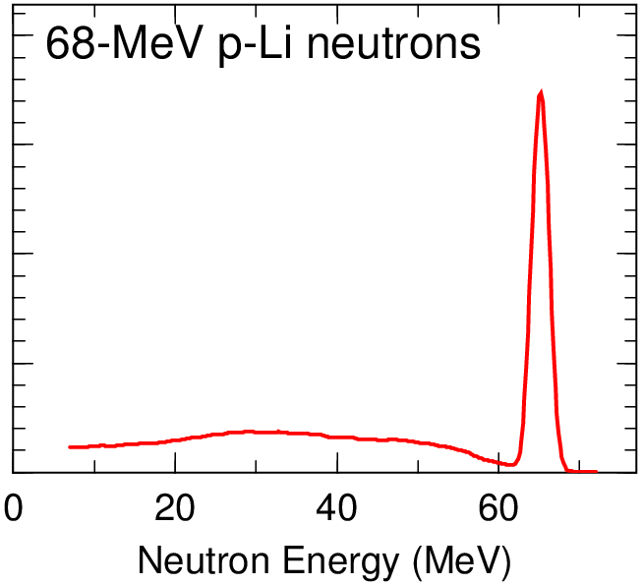
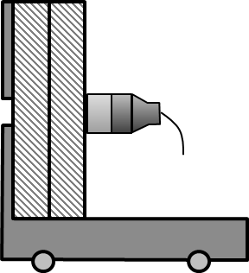
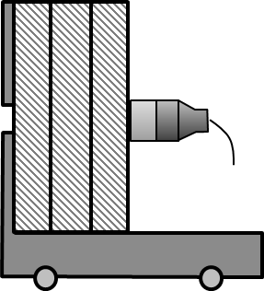
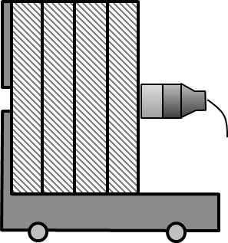
Tiara experiment
Experimental geometry & the source spectrum
Quasi-mono energetic collimated neutrons are a produced this experimental facility.
99% enriched ⁷Li
68-MeV protons
2.0×10⁹
1.5×10⁹
1.0×10⁹
～10 times
Ex.) Concrete shield
100-cm thick 150-cm thick 200-cm thick
5.0×10⁸
Peak region: 60-70 MeV

Slide 8
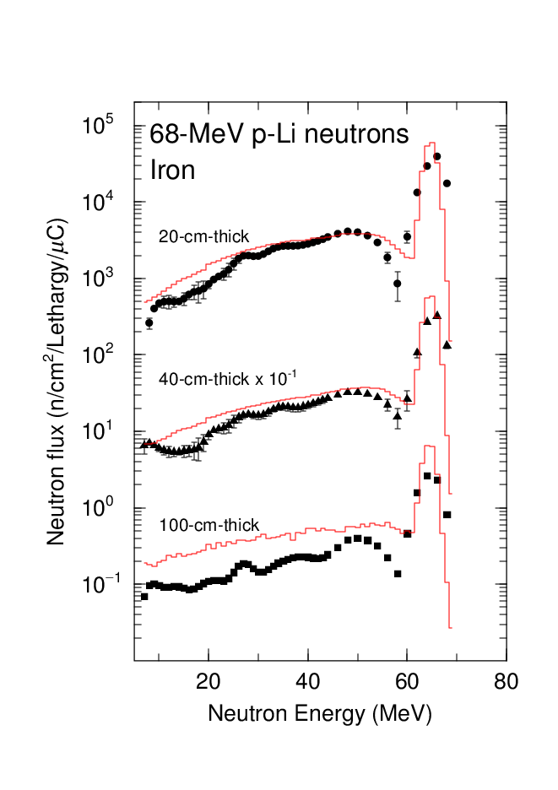
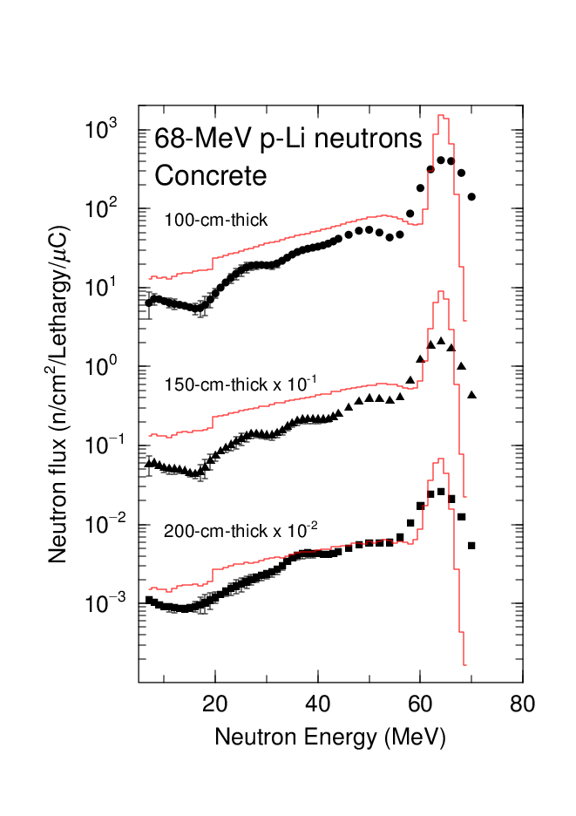
Calculation results (TIARA)
TIARA (IRON)
TIARA (CONCRETE)
Expt.
Calc.
Overestimations are observed in the results at 100-cm-thick iron, and at 100- and 150-cm-thick concrete.

Slide 9
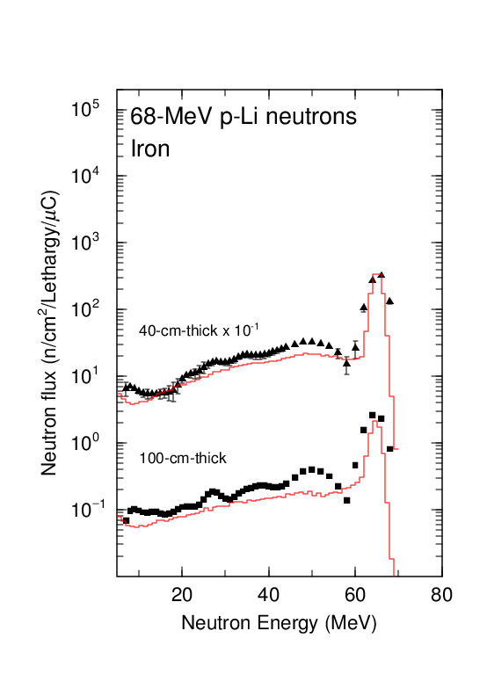
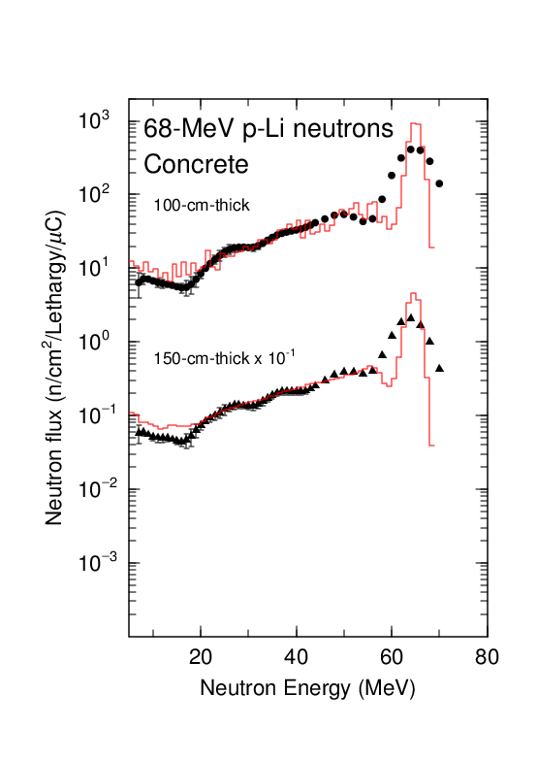
Calculation results with JENDL-4.0/HE
TIARA (IRON)
TIARA (CONCRETE)
Expt.
Calc.
(JENDL-4.0/HE)
C. Konno, JENDL-4.0/HE benchmark test with concrete and iron shielding experiments at JAEA/TIARA, ICRS-13
Overestimation was improved by using extended version of JENDL-4.0 (neutrons up to 200 MeV), JENDL-4.0/HE.

Slide 10
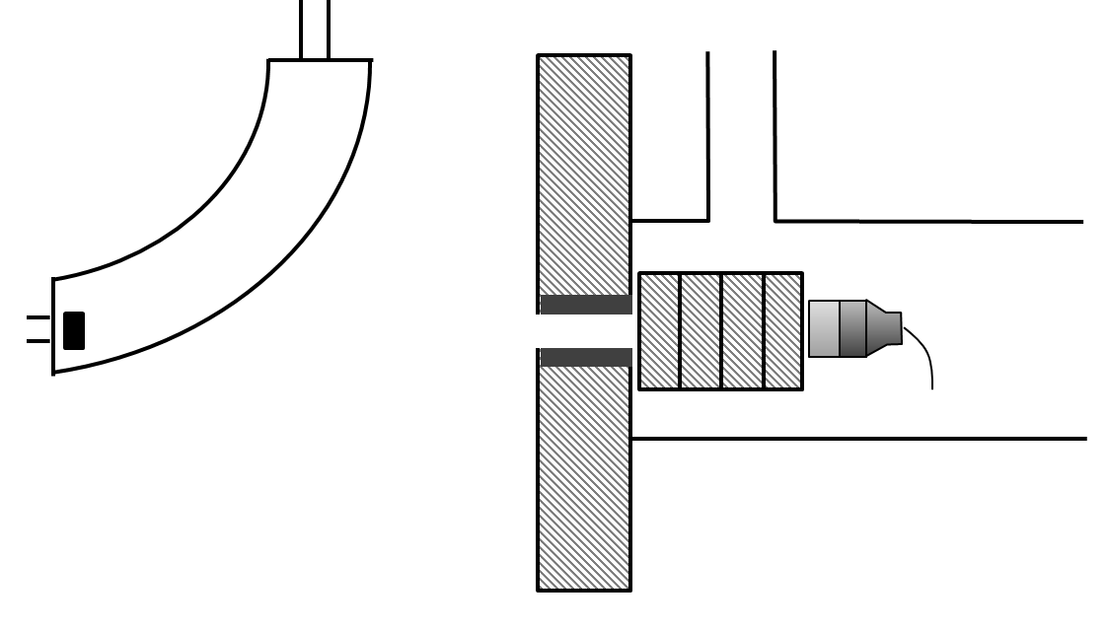
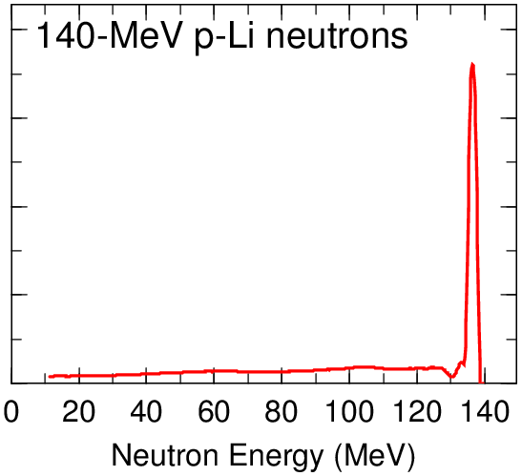
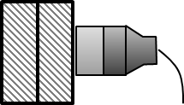
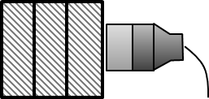
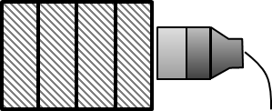
RCNP experiment
Experimental geometry & the source spectrum
Quasi-mono energetic collimated neutrons are a produced this experimental facility.
enriched ⁷Li
140-MeV protons
4.0×10⁹
3.0×10⁹
2.0×10⁹
～10 times
Ex.) Concrete shield
100-cm thick 150-cm thick 200-cm thick
1.0×10⁸
Peak region: 130-140 MeV
Geometry of RCNP is about the same as that of TIARA.

Slide 11
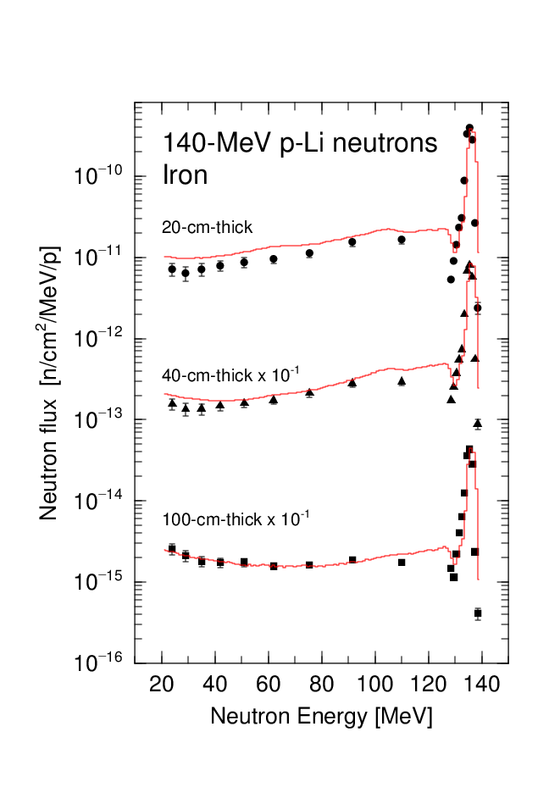
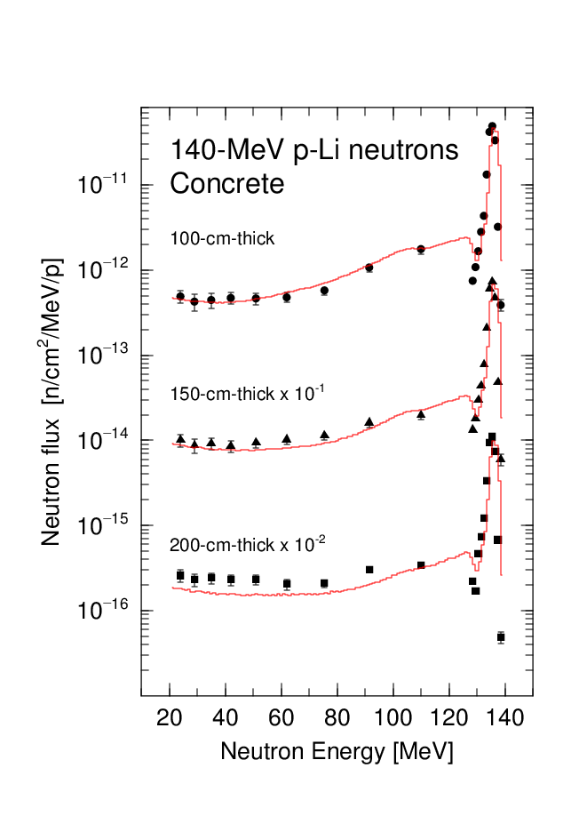
Calculation results (RCNP)
RCNP (IRON)
RCNP (CONCRETE)
Expt.
Calc.
Calculated results both in iron and concrete are in good agreement with the experimental data on the whole.

Slide 12
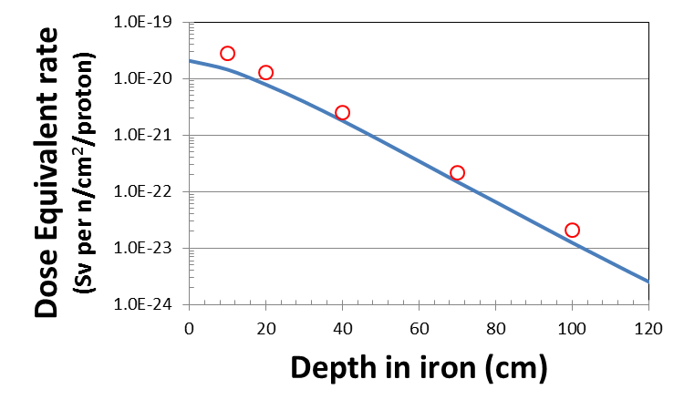
Attenuations of DOSE (TIARA & RCNP)
We try to evaluate neutron attenuation length based on the measured data at TIARA & RCNP.
(Dose equivalent rate is calculated from neutron spectrum with flux-to-dose conversion coefficient in inter-comparison.)
Ex.)
RCNP experiment (IRON)
100 g cm⁻²
Expt.
Calc.

Slide 13
Attenuation length (TIARA & RCNP)
Neutron attenuation length are summarized for the shielding experiments at TIARA and RCNP.
If we want to put the obtained values of attenuation length on the figure, we must determine the incident neutron energy (horizontal axis in the figure) for the experiments.
<= for TIARA, 60-70 MeV (peak energy ???)
for RCNP, 130-140 MeV (peak energy ???)
Att. Length (g cm⁻²) | TIARA | RCNP
IRON | 73 (70- to 130-cm) | 100 (70- to 100-cm)
CONCRETE | 61 (150- to 200-cm) | 70 (150- to 200-cm)

Slide 14
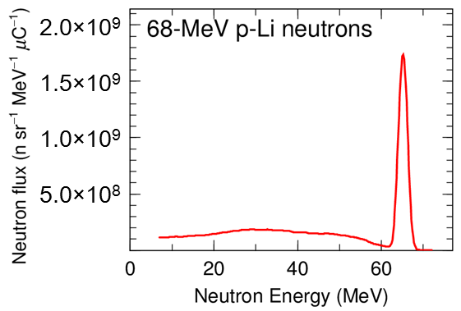
Peak and continuum spectrum
Continuum spectrum is unnecessary components to determine the incident energy in the experiment.
Hence, we analyzed contributions for dose equivalent rate from the peak and continuum spectrum separately.
peak
continuum

Slide 15
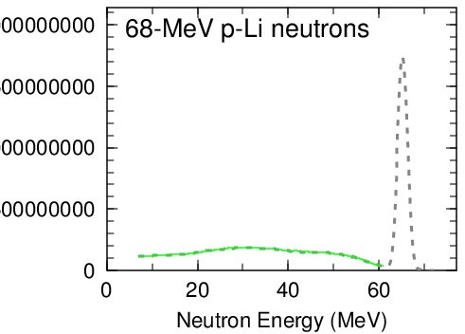
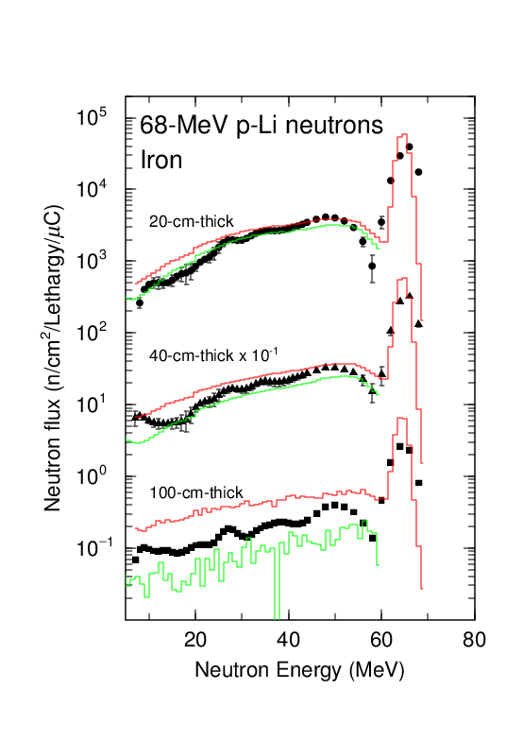
Calculation results (TIARA)
2.0×10⁹
1.5×10⁹
TIARA (IRON)
1.0×10⁹
5.0×10⁸
continuum
Expt.
Calc.
Calc.
(continuum)
The continuum spectrum decreases with the thickness (depth).
However, the contribution for the dose equivalent rate from the continuum spectrum still remain about 7% at 100-cm thick.
RCNP expt.: 63~77%

Slide 16
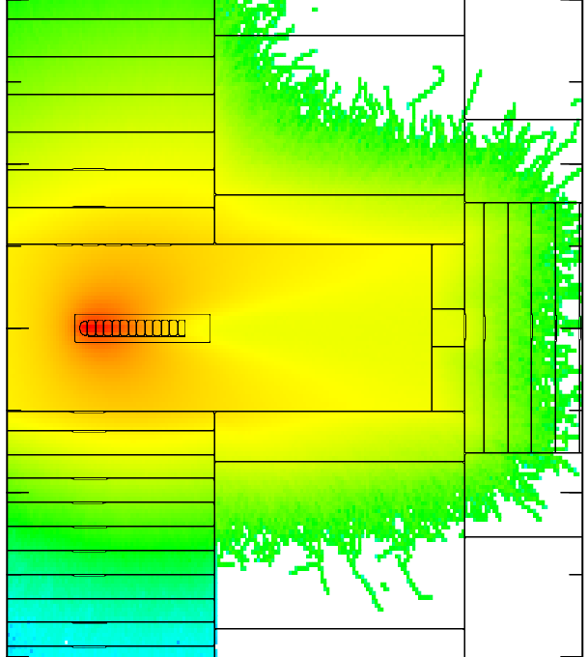
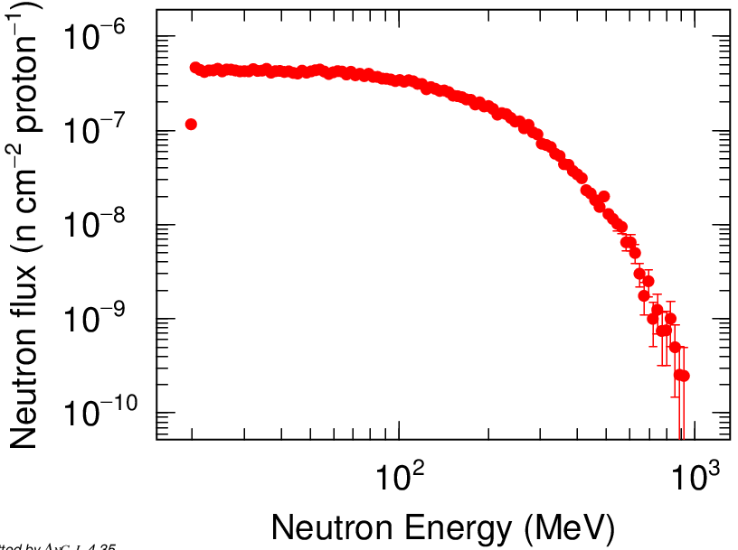
AGS experiment
Experimental geometry & neutron spectrum
Concrete
Iron
2.83-GeV protons
Mercury target
lateral
calculated by PHITS
Iron
spallation neutrons
Activation detectors were installed in iron and concrete shield.

Slide 17
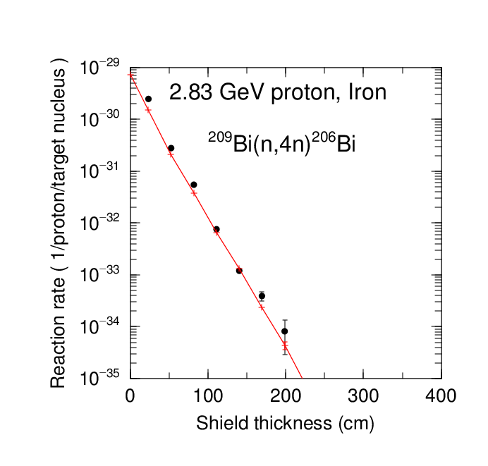
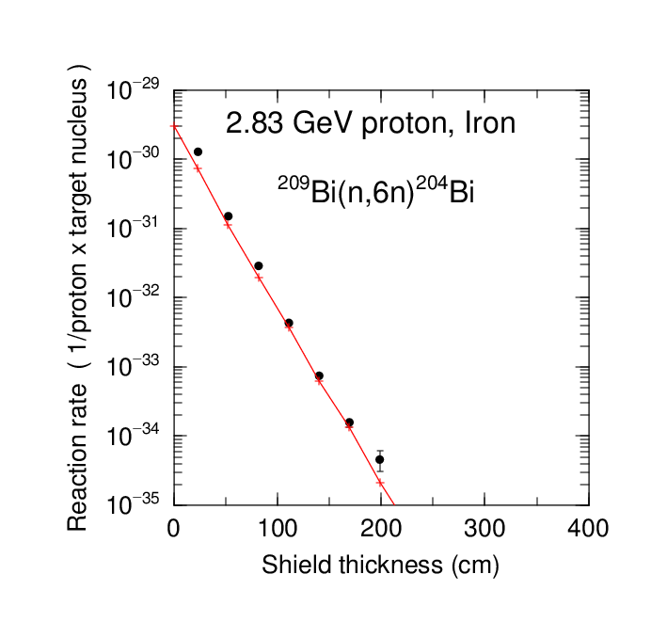
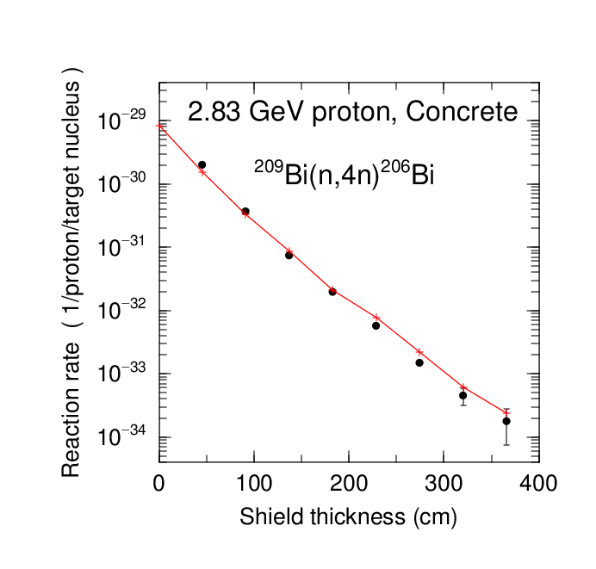
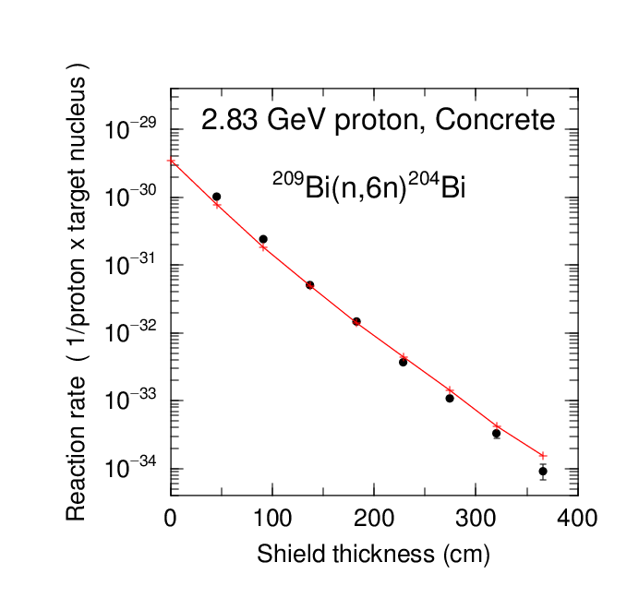
Calculation results (AGS)
AGS (IRON)
The calculated results are in good agreement with the experimental data.
149 g cm⁻²
149 g cm⁻²
Expt.
Calc.
AGS (CONCRETE)
We evaluated the neutron attenuation length from these data.
88 g cm⁻²
93 g cm⁻²

Slide 18
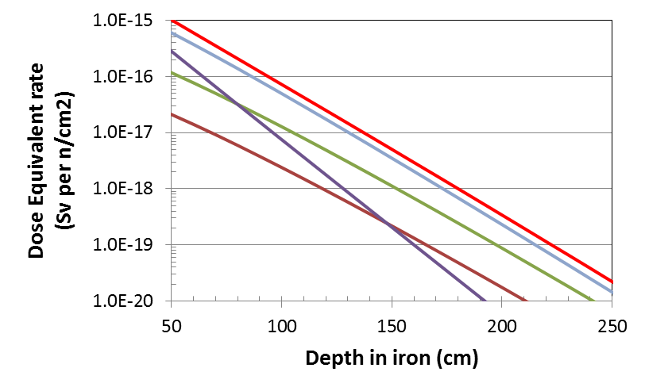
Attenuation LENGTH (AGS)
Neutron attenuation length is summarized for AGS experiment.
Att. Length (g cm⁻²) | ²⁰⁹Bi(n, 4n)²⁰⁶Bi | ²⁰⁹Bi(n, 6n)²⁰⁴Bi
IRON | 149 (111- to 199-cm) | 149 (111- to 199-cm)
CONCRETE | 88 (229- to 320-cm) | 93 (229- to 320-cm)
AGS (IRON)
We divide the spallation spectrum into some energy region.
The Total dose attenuations from 100 to 200 cm depth depend on the attenuations by 100-300 MeV neutrons.
Total
100-300 MeV
500-1,000 MeV
300-500 MeV
20-100 MeV

Slide 19
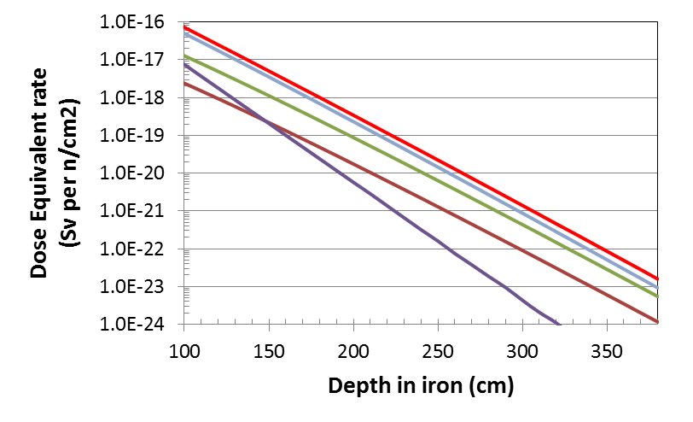
Attenuations of DOSE (AGS)
AGS (IRON)
Total
100-300 MeV
300-500 MeV
500-1,000 MeV
20-100 MeV
Neutron attenuations (slope) in AGS experiments are gradually changed with the depth by the flux and energy of the spallation spectrum.
We may obtain some attenuation length at different depth.

Slide 20
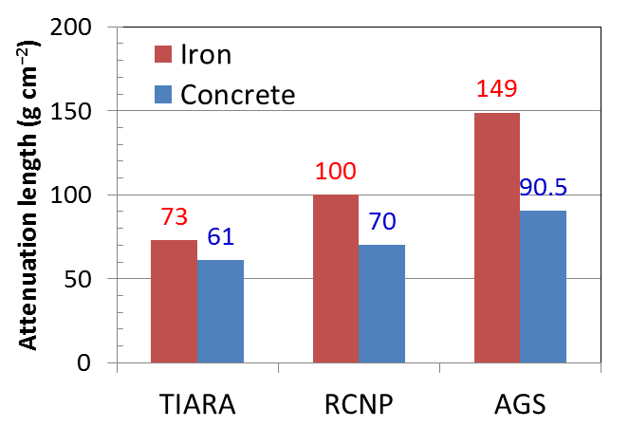
Attenuation length
Attenuation length based on the measurements are summarized.

Slide 21
Conclusion
In order to validate the accuracy of the latest version of PHITS (ver. 2.82), benchmark calculations were carried out for the shielding experiments at TIARA, RCNP, and AGS.
The calculated results by the PHITS (INCL4.6) were in good agreement with the measured ones on the whole, except for TIARA experiments.
Neutron attenuation length was summarized for each shielding experiment.
It is possible to obtain neutron attenuation length experimentally. However, we need more and more shield.

Slide 22
Thank you for your attention.
E-mail: matsuda.norihiro@jaea.go.jp

Slide 23
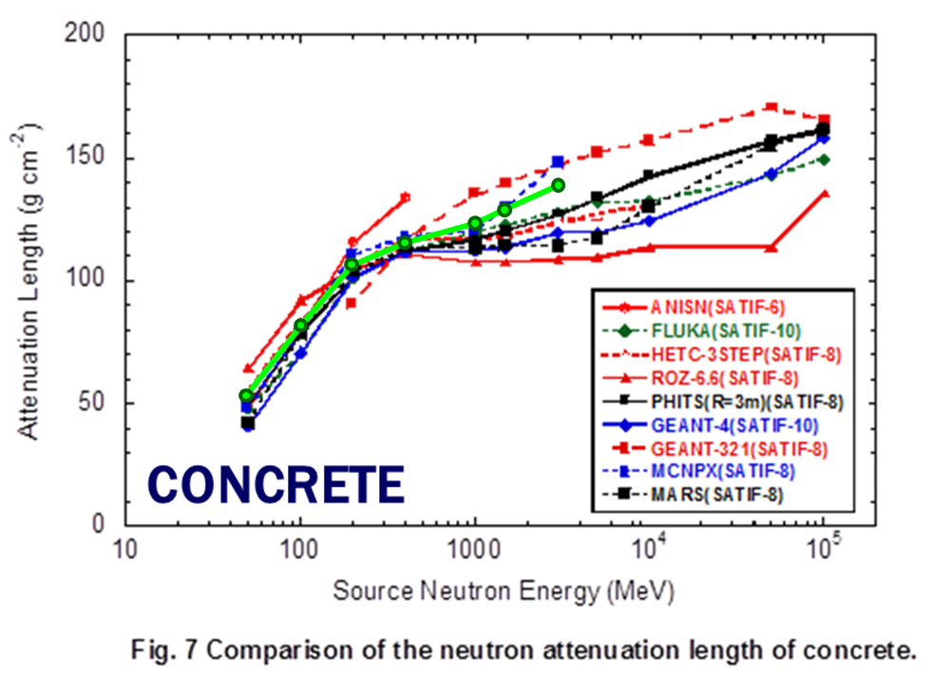
Attenuation length (CONCRETE)
PHITS ver. 2.82
Attenuation length (g/cm⁻²)
AGS
TIARA
RCNP
Source neutron energy (MeV)

Slide 24
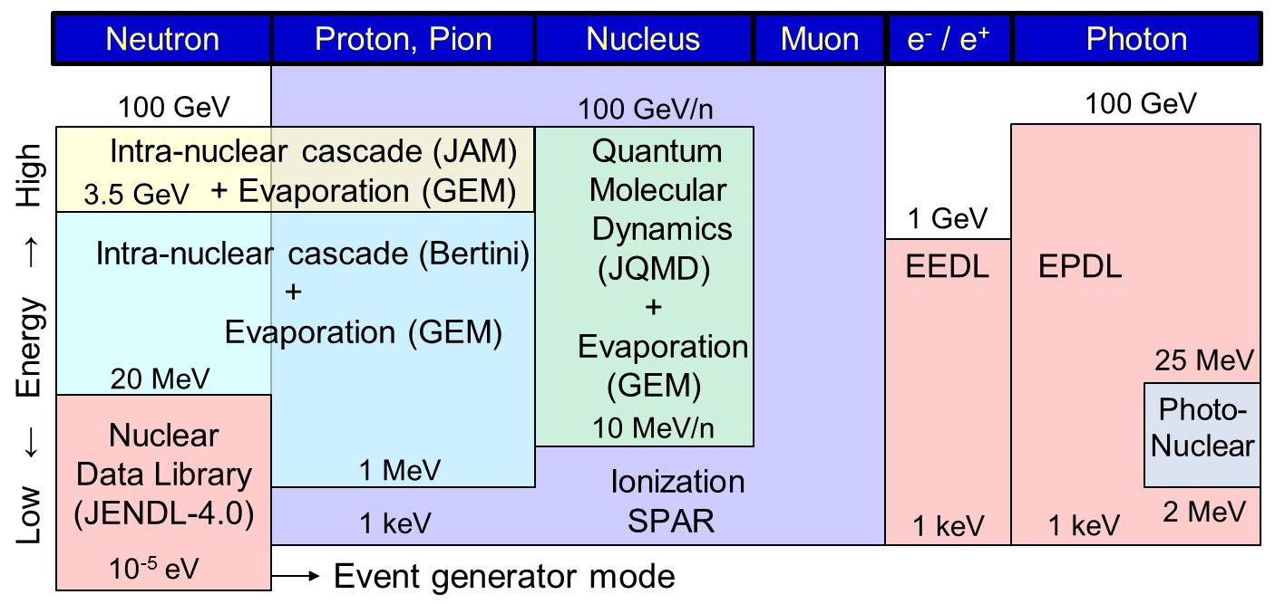
Models recommended to use in PHITS 2.24

Slide 25
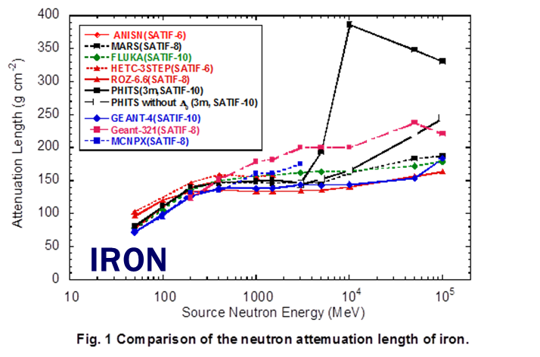
Difference of neutron attenuations
Neutron attenuations for iron make a slight change from 1 to 3 GeV.
← Bertini
PHITS ver. 2.82
H. Hirayama, Inter-comparison of medium-energy neutron attenuation in iron and concrete (8), SATIF-10

Slide 26
Attenuation length (iron)
Attenuation length (g/cm⁻²)
AGS
RCNP
TIARA
PHITS ver. 2.82
Source neutron energy (MeV)

Slide 27
Background
A Japanese Evaluated Nuclear Data Library (JENDL) special purpose file, JENDL-4.0 High Energy File (JENDL-4.0/HE), is an extended version of JENDL-4.0 for incident neutrons up to 200 MeV for 130 nuclei, and a nuclear data library for incident protons up to 200 MeV for 133 nuclei, which are relevant to high-energy applications. It was released in November, 2015.
More than 20 years ago shielding experiments at the Takasaki Ion Accelerators for Advanced Radiation Application (TIARA) in Japan Atomic Energy Agency (JAEA) were carried out for concrete and iron with quasi-mono energetic 40 or 65 MeV neutrons.

Slide 28
Differences from the experiments
Calculation conditions of the inter-comparison are different from those of the shielding experiments.
 | Inter-comparison | TIARA expt. | RCNP expt. | AGS expt.
Neutron source | Mono-energy | Quasi-mono energy | Quasi-mono energy | Spallation spectrum
Shielding | Iron, Concrete | Iron, Concrete | Iron, Concrete* | Iron, Concrete
Thickness (cm) | Iron: 0-600 Conc.: 0-1200 | Iron: 0-130 Conc.: 0-200 | Iron: 0-100 Conc. : 0-200 | Iron: 0-330 Conc.: 0-500
Detector type (Geometry) | Surface cross (infinite) | Counter (finite) | Counter (finite) | Activation (≃infinite)
*: Low-activationized concrete (Ca-rich)
At least two data is needed to evaluate neutron attenuation length for the shielding experiments. For the measurements, we need to determine the energy of attenuation length.

Slide 29
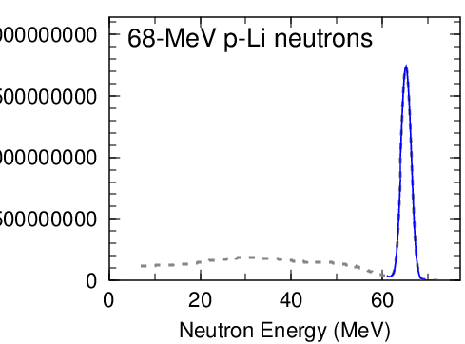
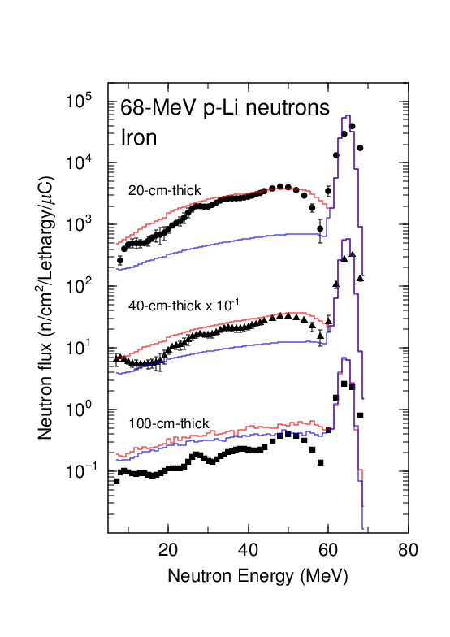
Calculation results (TIARA)
2.0×10⁹
1.5×10⁹
peak
TIARA (IRON)
1.0×10⁹
Expt.
Calc.
Calc.
5.0×10⁸
(peak)
The peak spectrum decreases with the thickness (depth).
And, the peak spectrum also make continuum spectrum.

Slide 30
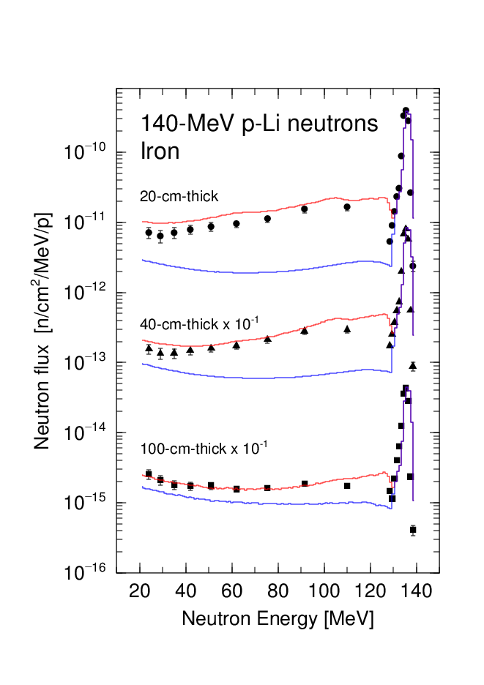
Calculation results (TIARA & RCNP)
For iron shield (20-, 40-, and 100-cm-thick)
TIARA expt.
RCNP expt.
Expt.
Calc.
Calc.
(peak)
Calculated results (100-cm-thick) were approximately made by the peak spectrum.

Slide 31
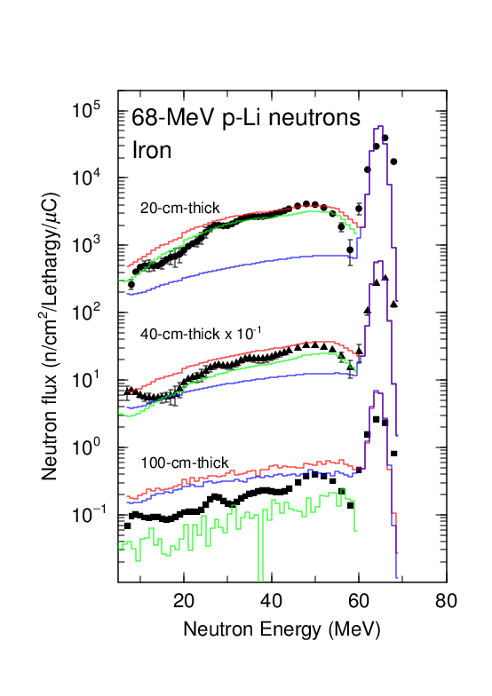
Calculation results (TIARA)
2.0×10⁹
2.0×10⁹
1.5×10⁹
1.5×10⁹
peak
1.0×10⁹
1.0×10⁹
5.0×10⁸
continuum
TIARA (IRON)
5.0×10⁸
Expt.
Calc.
Calc.
(peak)
Results around 100-cm depth is reliable.
10～35%@ 100 cm
(Dose: ~7%)

Slide 32
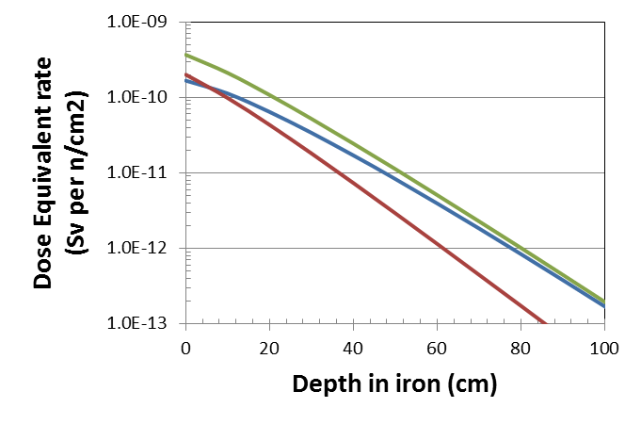
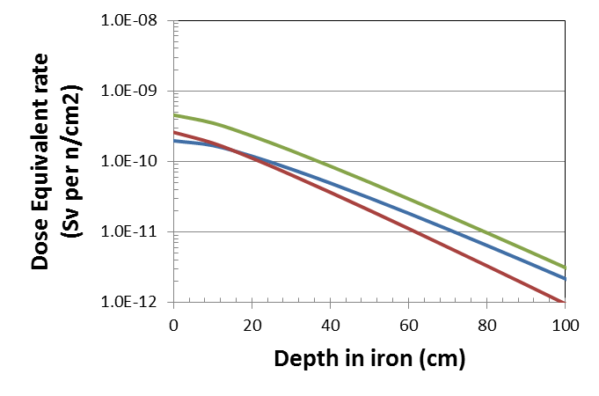
Attenuation of DOSE (TIARA & RCNP)
Attenuation of DOSE in iron and concrete was calculated with the models of the inter-comparison.
TIARA expt.
RCNP expt.
Total
Peak
Continuum
Dose equivalent rate
(Sv per n/cm²)
Peak (slow)
Dose equivalent rate
(Sv per n/cm²)
Peak (slow)
Continuum
(fast)
Continuum
(fast)
Depth in iron (cm)
Depth in iron (cm)
In a finite geometry (thickness), attenuation length using the neutron source in the experiments (Total) don’t reach the maximum one (peak energy).

Slide 33
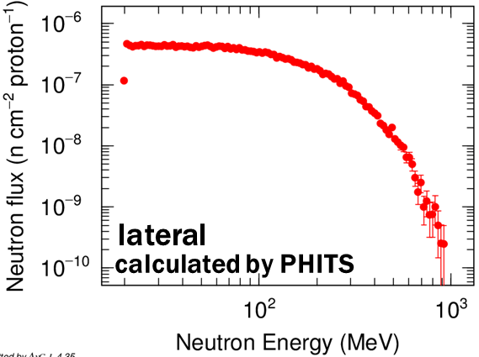
Neutron spectrum (AGS)
100-300 MeV
300-500 MeV
20-100 MeV
500-1,000 MeV

Slide 34
Attenuation of DOSE (AGS)
Neutron attenuation length is summarized for AGS experiment.
Att. Length (g cm⁻²) | ²⁰⁹Bi(n, 4n)²⁰⁶Bi | ²⁰⁹Bi(n, 6n)²⁰⁴Bi
IRON | 149 (111- to 199-cm) | 149 (111- to 199-cm)
CONCRETE | 88 (229- to 320-cm) | 93 (229- to 320-cm)
AGS (IRON)
The dose attenuation from 100 to 200 cm depth depends on the decreasing by 100-300 MeV neutrons.
⇒ Any attenuations up to 1,000 MeV may be obtained by the depth.
Total
100-300 MeV
500-1,000 MeV
300-500 MeV
20-100 MeV

Slide 35
Material composition
CONCRETE
Nuclide | TIARA (wt%) | RCNP (wt%) | AGS (wt%) | Inter-comparison (wt%)
H | 1.1 | 1.1 | 0.9 | 1.0
C | --- | 7.5 | 1.3 | 0.1
O | 48.2 | 49.6 | 48.3 | 53.9
Na | 2.0 | 0.3 | --- | ---
Mg | 1.1 | 0.6 | --- | 0.2
Al | 6.1 | 1.5 | 3.3 | 3.4
Si | 23.2 | 9.1 | 26.3 | 34.2
K | 1.1 | 0.1 | --- | 1.3
Ca | 12.4 | 32.5 | 14.2 | 4.4
Cr | --- | --- | 0.3 | ---
Fe | 6.0 | 0.8 | 2.0 | 1.4
← Silica stone
← Lime stone

Slide 36
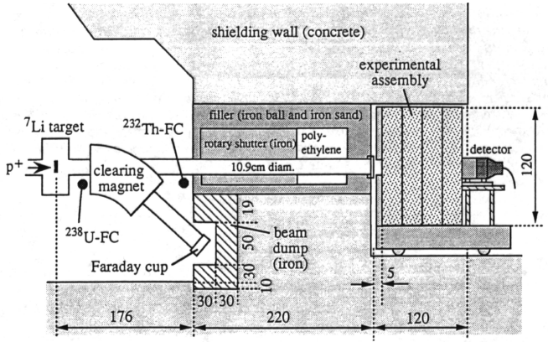

Slide 37
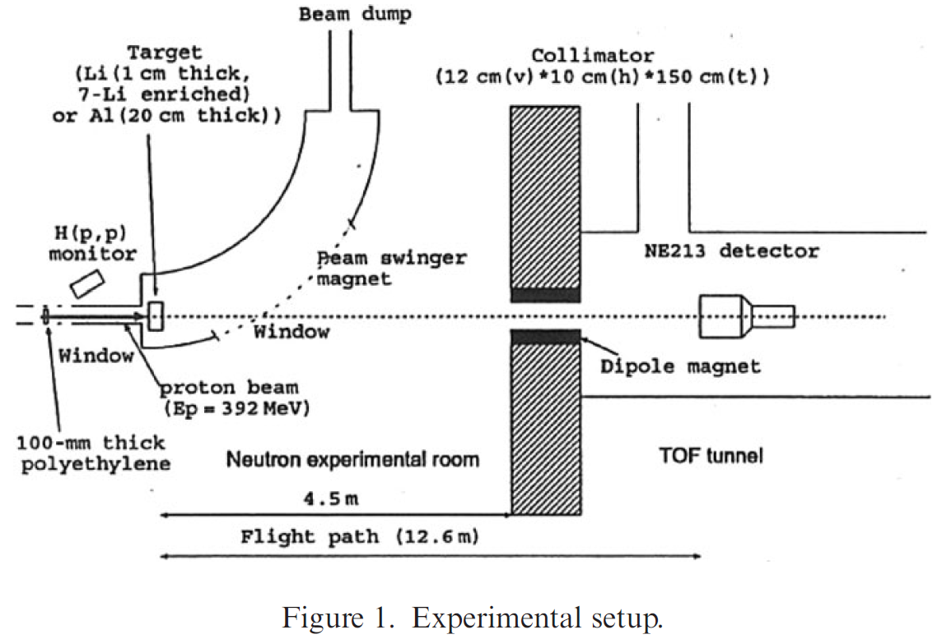

Slide 38
台車＆検出器

